Slide 1

Slide 1
Data Analyst Professional Practical Exam Presentation

Slide 2
Slide 2
Project Overview and Deliverables
An update on sales approaches for the new product line:
Different specs of the customers in each cohort
Different specs of the methods regarding revenue and profitability
Introducing metrics to monitor the sales status
1

Slide 3
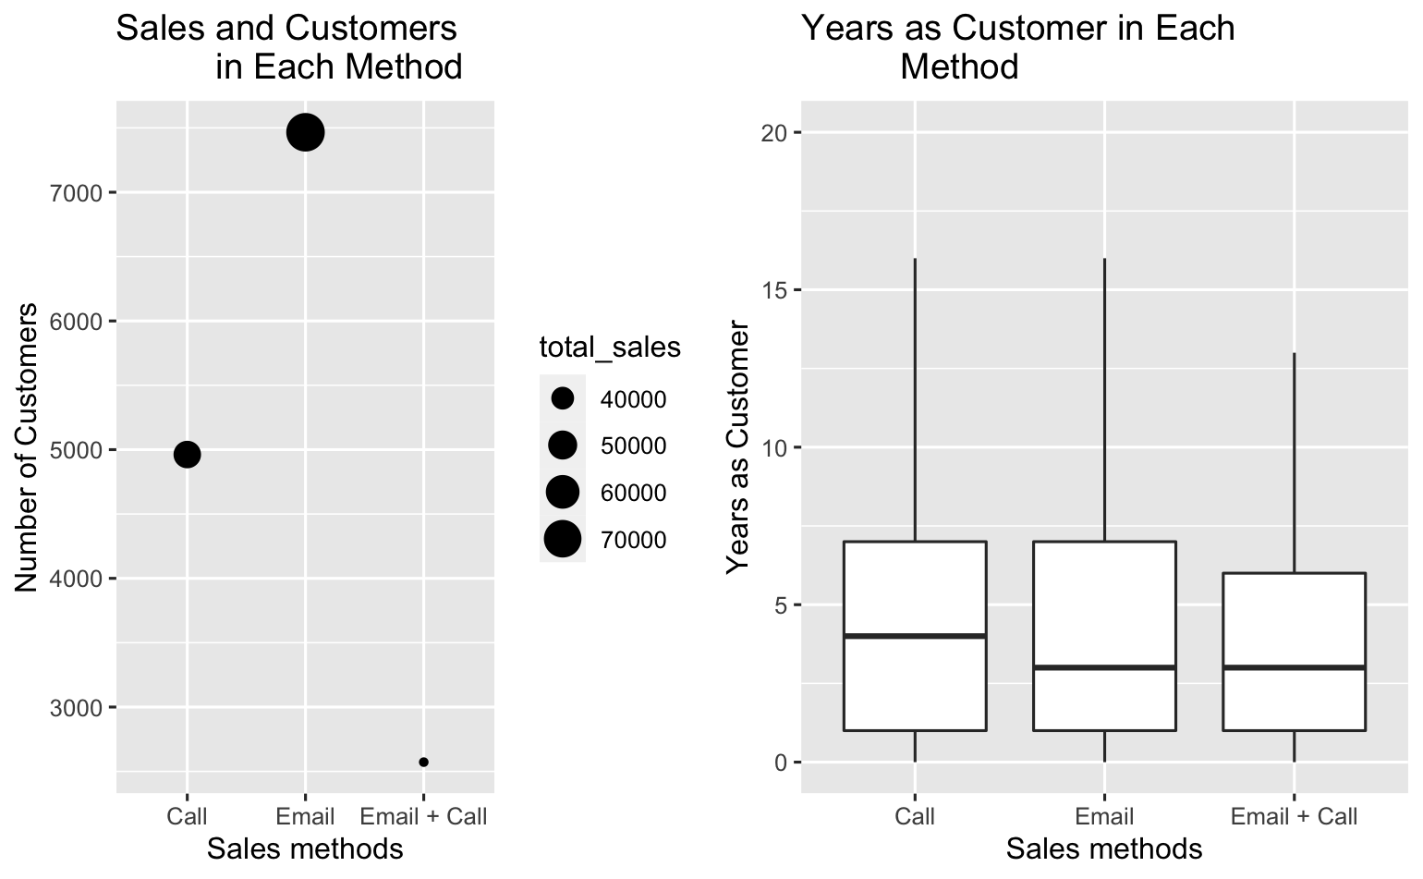
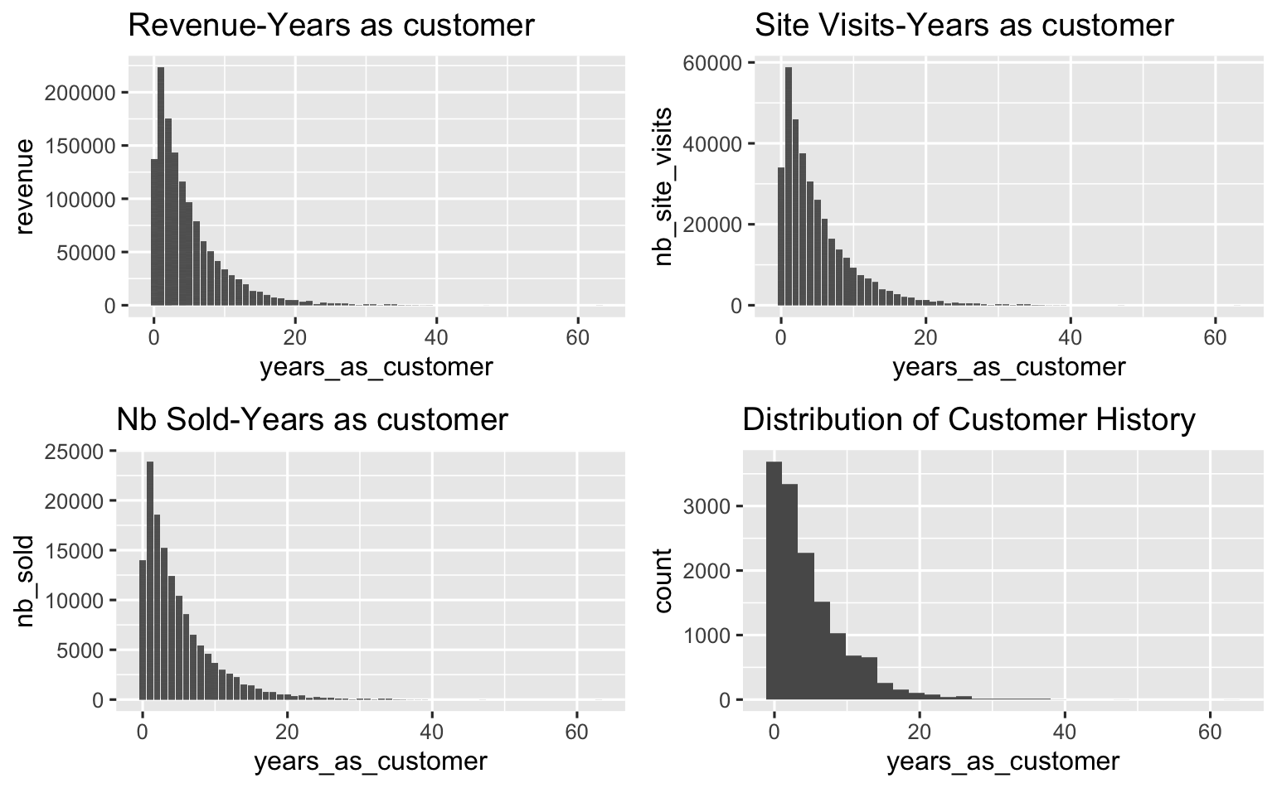
Slide 2
Findings-Customer Specs
2

Slide 4
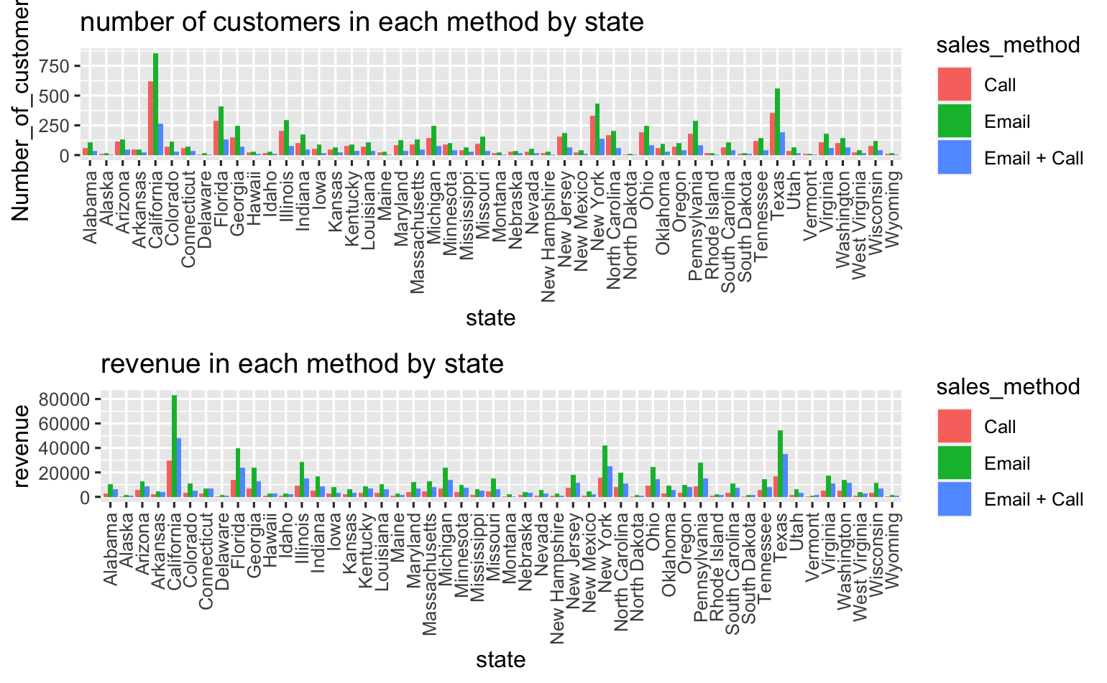
Slide 2
Findings-Customer Specs
3

Slide 5
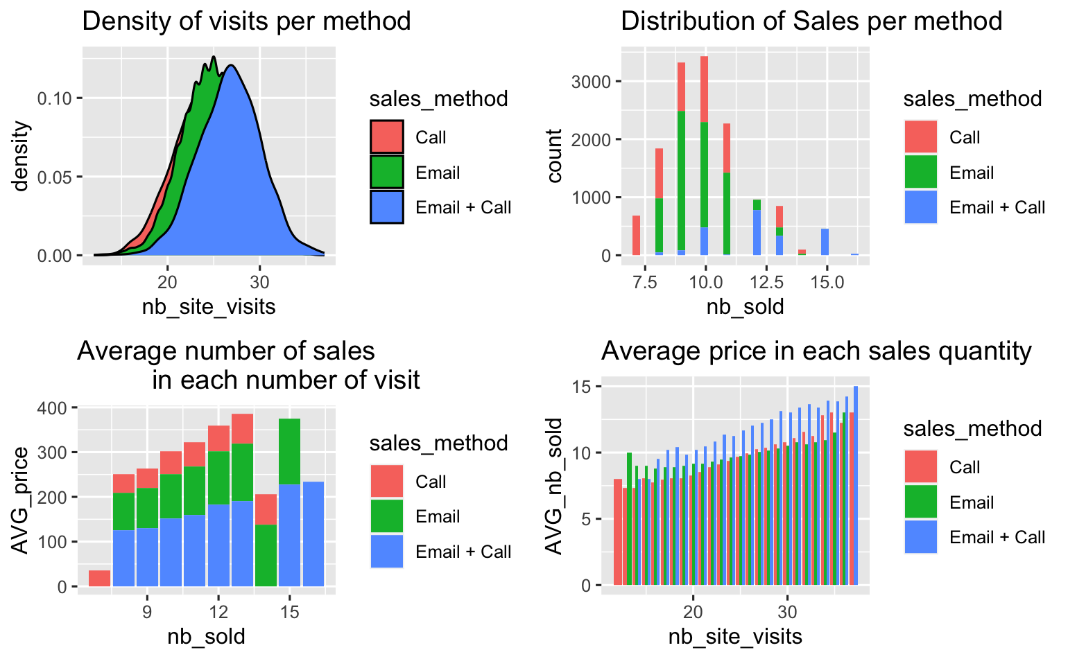
Slide 2
Findings-Revenue&Sales
4

Slide 6
Slide 2
Findings-Revenue&Sales
Method | Visit/Customer | Sold/Visit | Revenue/Sold | Revenue/Customer
Call | 24.42 | 0.38 | 5.00 | 47.59
Email | 24.73 | 0.39 | 9.98 | 97.12
Email + Call | 26.73 | 0.45 | 15.06 | 183.65
Considering the fact that call center agent is paid 18.5 $/Hr; in canada for example, Check Indeed Please, and regarding the fact that we have spent 10 minutes in each consumer we can certainly conclude that the revenue gained per customer, 183.6, outweighs the cost we have spent. So, this method is certainly worth investing more on.
5

Slide 7
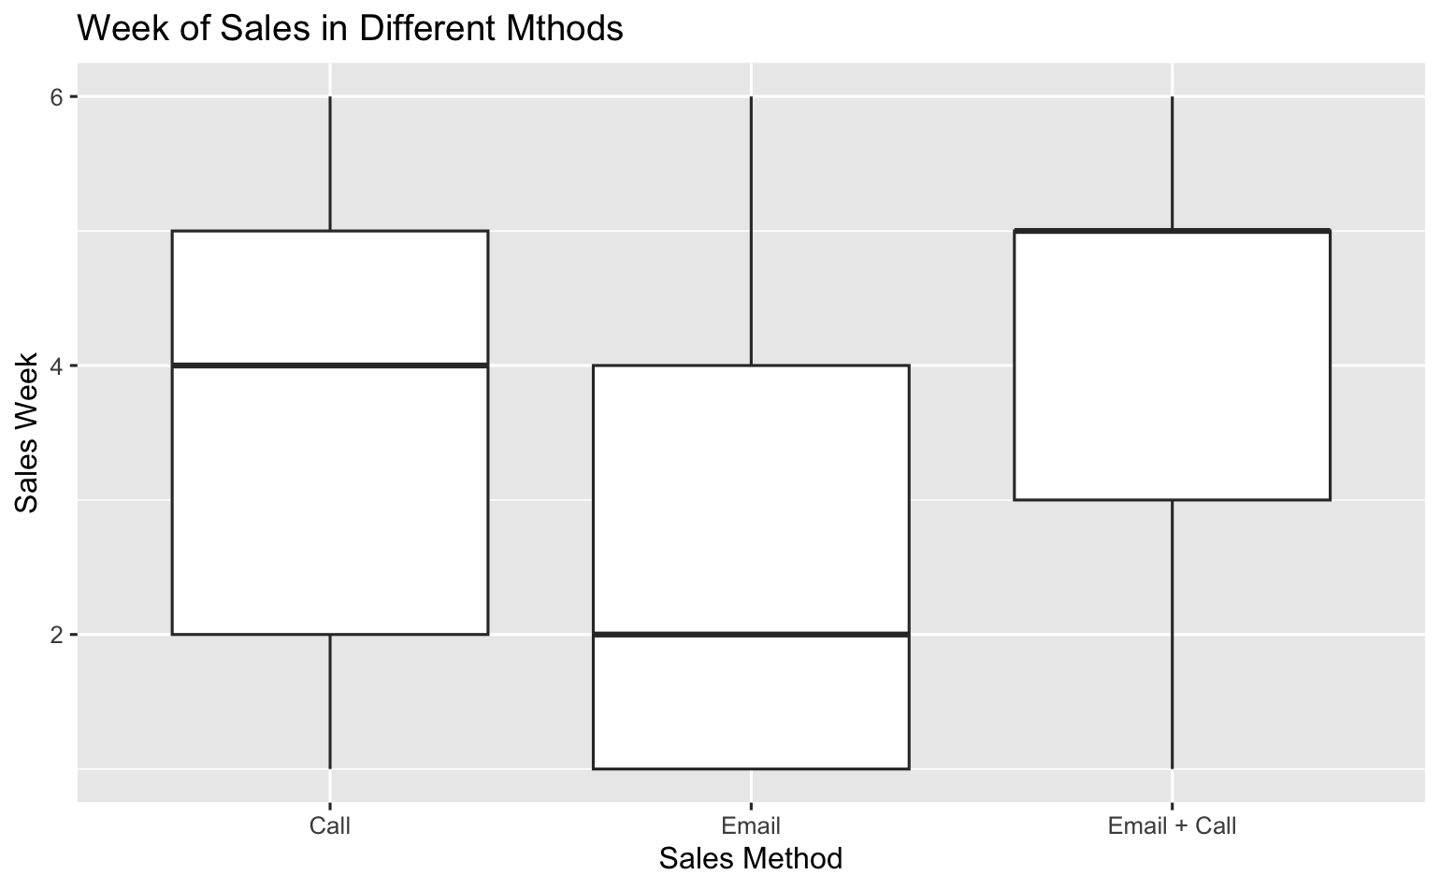
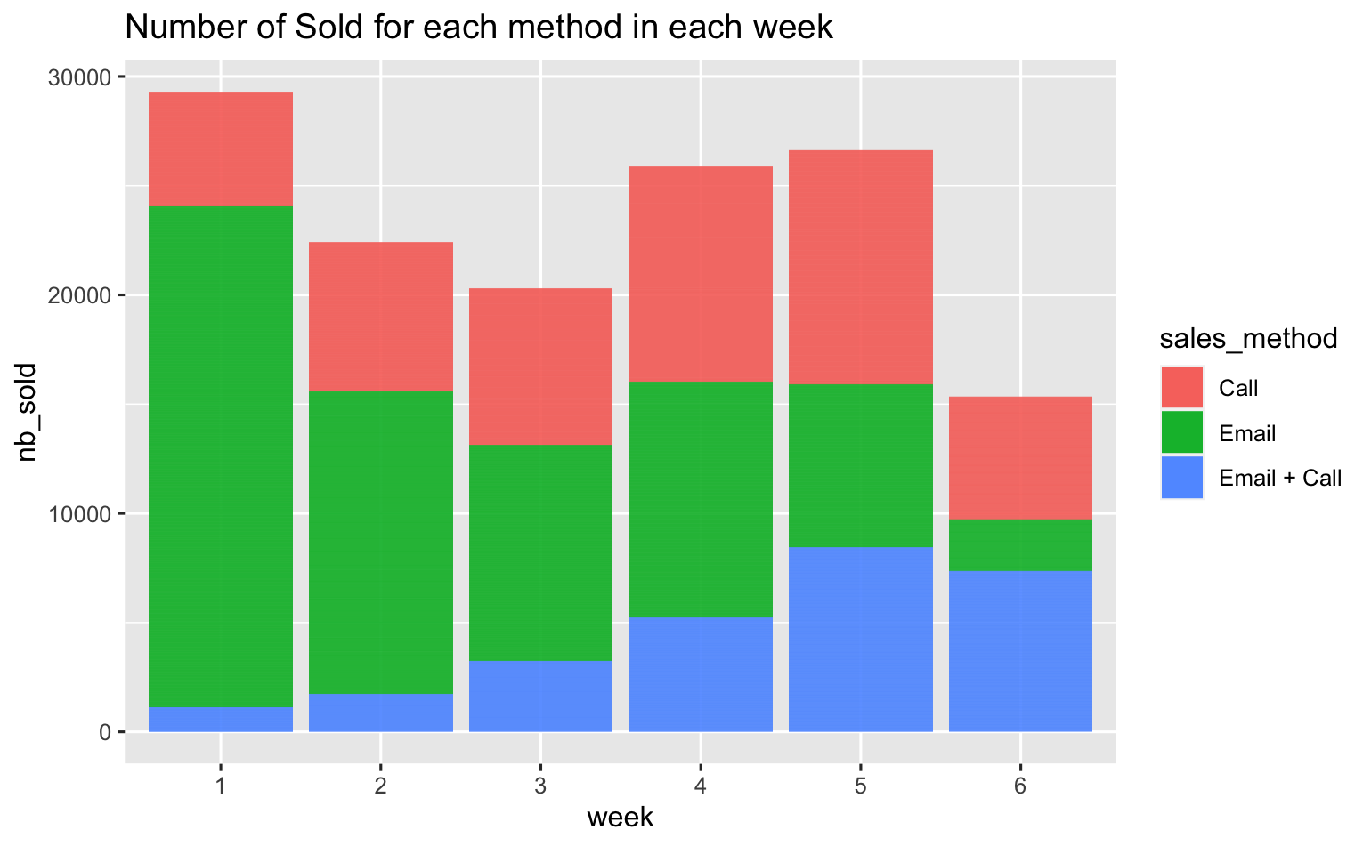
Slide 2
Findings-Revenue&Sales
6

Slide 8
Slide 2
Recommendations
Assuming that the demographic population in each method was sampled randomly and size of each population wasn't selected equally since some methods require more time for the following weeks, I would recommend we can focus on the following steps:
Using key metrics to monitor whether there is a change in each methods effectiveness and efficiency.
To implement the campaign more profitable, we could rule out "Call" method and invest more on "Call + Email":
we can do this in Texas and California before rolling out for every state.
We can focus on customers with less history with the firm (less than 10 years)
Stay on "Email" method as we are since it is the most efficient sales_method.
Data Collection for in-depth analysis
Improve data quality - Test on equal size of population in each cohort
7

