Slide 1
A Polynomial Time Algorithm for Finding Minimal Conflicting Sets
Overview

Slide 2
Contents
Definitions
Problem statement
Approach
Algorithms
References

Slide 3
Definitions

Slide 4
Consecutive Ones Property (COP)
A 0/1 matrix is said to have COP for rows, if there exists a permutation of columns which leaves consecutive ones in each row of the matrix.
Example:
1 0 0 1 1 0 0 1 1 1
0 0 1 1 0 0 1 1 0 0
0 1 1 1 0 1 1 1 0 0
1 0 1 1 1 0 1 1 1 1

Slide 5
Vertex-colored bipartite graph from binary matrix
Given a binary matrix M of size m x n, the corresponding vertex-colored bipartite graph G(M) = ( R, C, E) can be constructed as follows:
  For every row of M, there is a black vertex in R
  For every column of M, there is a white vertex in C
  There is an edge between a black vertex v_{i} and a white vertex v_{j} if and only if M[i,j]=1.
Thus, M is the half adjacency matrix of G(M).

Slide 6
Asteroidal triple
In a graph G=(V,E), three vertices form an asteroidal triple only when there exists a path between any two of them which does not include the third vertex and its neighborhood.

Slide 7
Characterization of COP matrix and AT free graphs
Matrices with COP can be characterized by a set of forbidden submatrices, S
  A 0/1 matrix has COP iff it does not contain a matrix from this set S as its submatrix.
Due to Tucker’s characterization (1972) of asteroidal triple free bipartite graphs by forbidden subgraphs
    Forbidden submatrices are the half adjacency matrices of forbidden subgraphs

Slide 8
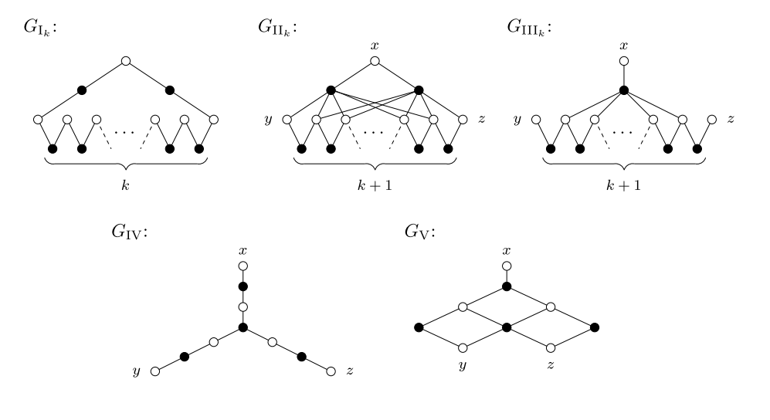
Forbidden subgraphs

Slide 9
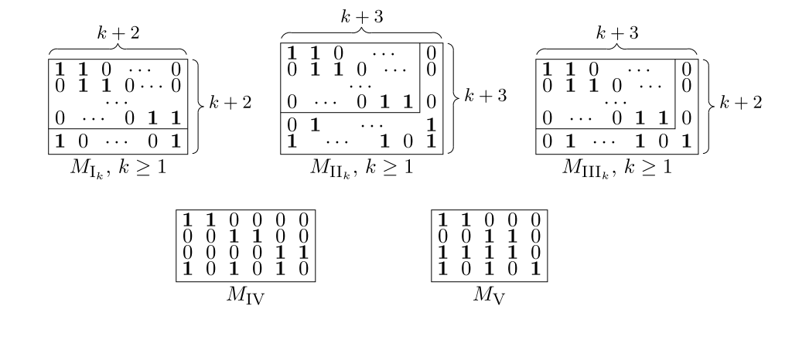
Forbidden submatrices for the COP
(Tucker, Theorem 9) A matrix M has COP iff it contains none of the matrices M_{Ik}, M_{IIk} , M_{IIIk}(with k >= 1), M_{IV}, M_{V} as shown below.

Slide 10
Minimal Conflicting Sets (MCS)
MCSR – Minimal Conflicting Sets of Rows, is a set of rows R of a matrix that does not have COP, such that any proper subset of R has COP.
MCSC – Minimal Conflicting Sets of Columns (analogous)

Slide 11
Problem statement

Slide 12
Problem statement
Finding MCSR involving a given row
Given a m x n binary matrix M, for any row r of M, decide whether there exists an MCSR involving row r

Slide 13
approach

Slide 14
Basic approach
For any MCSR R_{T} of M, G(M)[R_{T} \cup C] contains at least one Tucker subgraph T= (R_{T},C_{T},E_{T})
  i.e. for any R’ ⊂ R_{T,} G(M)[R’ \cup C] does not contain a Tucker subgraph.
Polynomial time algorithms for finding a minimal Tucker configuration of a given type T ∈ T’= { M_{Ik}, M_{IIIk} , M_{IIk}, M_{IV}, M_{V} }(in this particular order) responsible for an MCSR involving a given row (if it exists)

Slide 15
Graph Pruning – clean & anticlean
clean(v):
  If v ∈ R (respectively v ∈ C), results in a graph where any neighbor of v has been deleted.
  If v ∈ R, resultant graph will be G(M)[R U(C\N(v)) ]
anticlean(v):
  If v ∈ R (respectively v ∈ C), results in a graph where all the vertices are deleted except only the neighbors of v.
  If v ∈ R, resultant graph will be, G(M)[ R U(C\{ u: u ∉ N(v)}) ]
Input vertices of algorithms are not pruned

Slide 16
Algorithms

Slide 17
Finding G(M_{Ik})
Checking for subgraph G(R_{T}, C_{T}, E_{T}) = G(M_{I1} ) or G(M_{I2} ) done by brute force
  In latter case, additional condition: s.t. R_{T’} \subsetof R_{T} does not result in G(M_{III1})
  O(m³n³) and O(m⁴n⁴) resp.
G(M_{Ik}), k > 2 is found by graph pruning – Algorithm 1
  Called for every tuple of input. Smallest of all results is the MCSR
  O(m³n³) for all tuples
Overall O(m⁴n⁴)

Slide 18
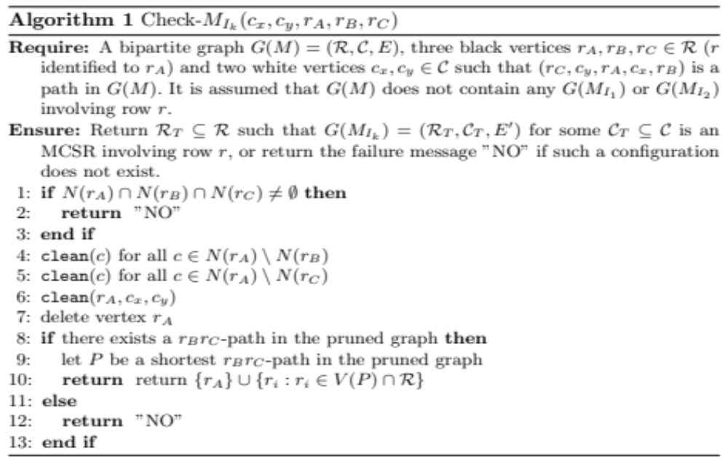
Finding G(M_{Ik}), k > 2

Slide 19
Finding G(M_{Ik}), k > 2
c_{i} \in C (column, white), r_{i} \in R (row, black)
Input
  path (r_{C}, c_{Y}, r_{A}, c_{X}, r_{B})
  w.l.o.g r = r_{A} due to the symmetry of cycle
Output
  R_{T} \in R s.t. for some C_{T} \in C, G[R_{T} \cup C_{T}] = G(M_{Ik}), k > 2

Slide 20
Lemma 7 (correctness)
Pruning operations in Algo 1 are safe
If R_{T} is MCSR s.t. G[R_{T} \cup C_{T}] = G[M_{Ik}], this is not destroyed by pruning by algo 1
Let this G[R_{T} \cup C_{T}] = G[M_{Ik}] be T
  T is a chordless cycle
  k > 2, hence, |R_{T}| >= 5

Slide 21
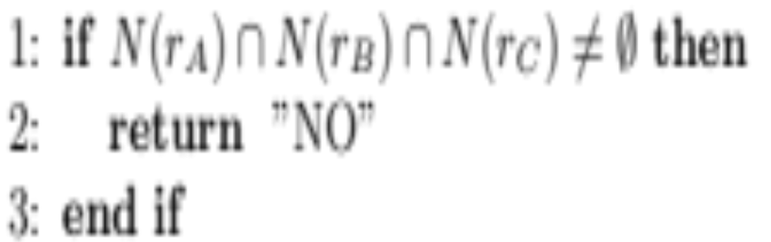
Lemma 7, Claim 1 this condition is correct
Let c_{s} be adjacent to r_{A}, r_{B}, r_{C}
Let r_{D} \in R_{T}. Thus c_{s} is connected to r_{D}
We can get a chordless cycle = G(M_{Ik’}) avoiding r_{A} that is smaller than T contradiction
If c_{s} is adjacent to all r_{i} \in R_{T}, we get G(M_{III1})
  because|R_{T}| >= 5
  G(M_{III1}) is a smaller conflicting set contradiction

Slide 22
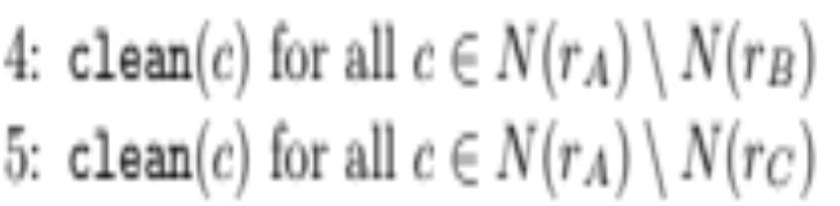
Lemma 7, Claim 2 & 3 these clean operations are safe
Unsafe if c is adjacent to some r_{i} \in R_{T} i.e. on T
r_{i} \notin {r_{A}, r_{B}, r_{C}}
We can get a chordless cycle = G(M_{Ik’}) avoiding r_{C} and r_{B} (claim 2&3 resp.) that is smaller than T- contradiction
N(r_{A} ), N(c_{x} ), N(c_{y} ) that are in C_{T} or R_{T} are all input vertices thus unaffected by clean

Slide 23
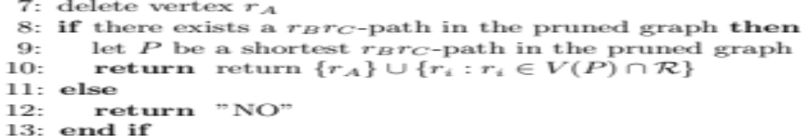
Lemma 8
Algo 1 finds MCSR of type G(M_{Ik}) k > 2 with r
Consider
  c outside C_{T} adjacent to some row vertices R_{T} (c \in C\C_{T} and N(c) \cap R_{T} != \0)
  Let P be the shortest path r_{B}r_{C} without r_{A}
Case 1: c \notin N(r_{A}) \cup N(r_{B}) \cup N(r_{C})
  c is adjacent to some other black vertex in P
  c has degree 1 or adjacent to 2 consecutive black vertices in P else it is part of a shorter r_{B}r_{C} path (contradiction)
Case 2: c \in N(r_{A}) \cup N(r_{B}) \cup N(r_{C})
  c is adj to atmost two of {r_{A}, r_{B}, r_{C}} due to Claim 1
  Several cases - c is clone of c_{X} or c_{Y} or c_{Z}

Slide 24
Finding G(M_{IIIk})
G(M_{Ik} ) is not responsible for an MCSR in G(M)
G(M_{III1} ) found by brute force
  ₋ O(m³n⁴)
G(M_{IIIk}), k > 1 is found by graph pruning – Algorithm 2 & 3
  Called for every tuple of inputs. Smallest of all results is the MCSR
  O(m⁵n⁵(m+n)²log(m+n))
Overall complexity O(m⁵n⁵(m+n)²log(m+n))

Slide 25
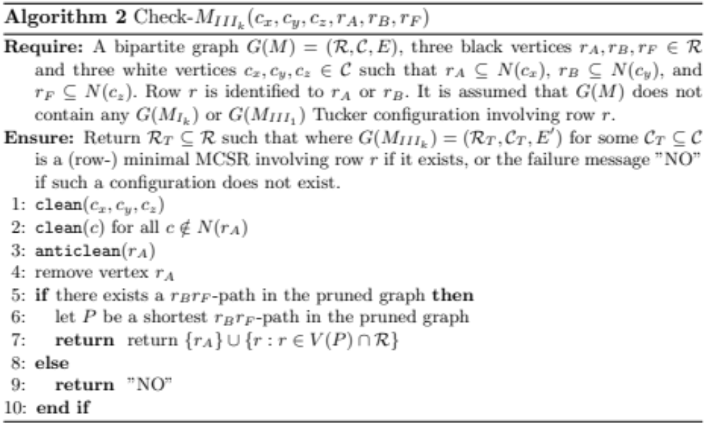
Finding G(M_{IIIk}), k > 1
Algo 2

Slide 26
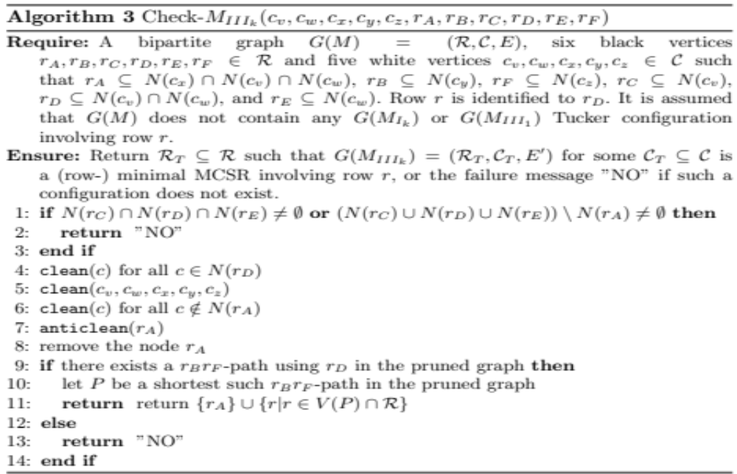
Finding G(M_{IIIk}), k > 1
Algo 3

Slide 27
Finding G(M_{IIk})
G(M_{Ik} ), G(M_{IIIk} ) are not responsible for an MCSR in G(M)
G(M_{II1} ) found by brute force
  ₋ O(m⁴n⁴)
G(M_{IIk}), k > 1 is found by graph pruning – Algorithm 4 & 5
  Called for every tuple of inputs. Smallest of all results is the MCSR
  O(m⁶n⁵(m+n)²log(m+n))
Overall complexity O(m⁶n⁵(m+n)²log(m+n))

Slide 28
Finding G(M_{IV}) & G(M_{V})
Constant size subgraphs
Use brute force
  ₋ O(m³n⁶) & O(m³n⁵) resp.
Proof for the fact that there is no smaller MCSR

Slide 29
References
Guillaume Blin, Romeo Rizzi, and St´ephane Vialette, A Polynomial-Time algorithm for finding Minimal Conflicting Sets.
Michael Dom, Recognition, Generation and Application of Binary matrices with the Consecutive Ones Property, 2010.

