Slide 1

Eid Takbeer
“Allah is the greatest,
Allah is the greatest,
There is no god but Allah,
And Allah is the greatest,
Allah is the greatest,
And to Allah belongs
all praise.”
اللَّهُ أَكْبَرُ اللَّهُ أَكْبَرُ
لَا إلَهَ إلَّا اللَّهُ
وَاَللَّهُ أَكْبَرُ اللَّهُ أَكْبَرُ
وَلِلَّهِ الْحَمْدُ

Slide 2
Eid Jama’ah Times
Time | Imām
7:30 AM
8:30 AM
9:30 AM
10:30 AM
11:30 AM

Slide 3
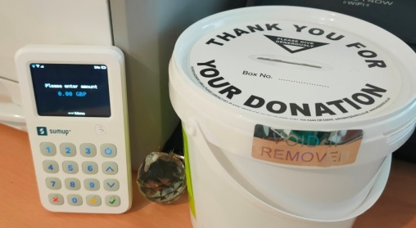
Friday Collection
Alḥamdulillāh
Cash:
Card & Online:
Total:
£830
£652
£1,482
JazakAllahu Khairan
Your contribution will help us to maintain services we offer. Prophet Muhammad ﷺ said: “Spend, O son of Adam, and I shall spend on you.”

Slide 4
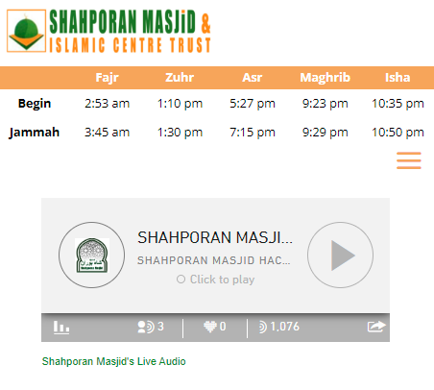

Official Website
Donate
Daily Prayer Times
Live Radio
www.shahporanmasjid.uk
www icon: freepik.com

Slide 5
Amazon Alexa
Wake word:
What is Alexa?
Alexa is a voice activated device or app
“Alexa”
“Start Hackney Road Mosque”

Slide 6
Important Notice
Please refrain from discussing worldly affairs inside the prayer halls.
Be respectful to our Imams, staff, volunteers and fellow muṣallees at all times.
Use the suggestions box near the hall entrance for any feedback and suggestions.
জরুরী ঘোষণা
১. মসজিদের ভিতরে ছুনিয়াবী বিষয় নিয়ে আলোচনা করা থেকে দয়া করে বিরত থাকুন।
২. মসজিদের ইমাম, মুয়াজ্জিন এবং সমস্ত মুসল্লিদের প্রতি সন্বদা সুন্দর ব্যবহার কাম্য।
৩. আপনার মন্তব্য এবং পরামর্শের জন্য মসজিদের দরজার পাশে রাখা বক্স ব্যবহার করুন।

Slide 7
COVID Notice
Recommended to wear a face mask. (optional)
Wash your hands regularly.
Stay home if you are sick or are experiencing COVID symptoms.
Recommended to bring your own prayer mat and shoe bags. (optional)

Slide 8
Notice for brothers praying in the 1st/2nd Floor
Maybe add picture example here?
For all Jamāʿāt (except Friday Jumu’ah) remember to start one line back
This is because the Imām is leading Salah one line behind the expected position.

Slide 9

Free Weekly Events
Monday
Tuesday
Wednesday
Thursday
Friday
Qur’an Class
By Imam Abu Yahya
Location:
Main Hall
Time:
After Fajr Jama’ah
Qur’an Class
By Imam Abu Yahya
Location:
Main Hall
Time:
After Fajr Jama’ah
Bangla Tafsir
By Imam Abu Yahya
Location:
Main Hall
Time:
After Maghrib Jama’ah
English Tafsir
By Imam Abu Yahya
Location:
Main Hall
Time:
After Maghrib Jama’ah
Holding onto Hot Coals
16+ Youth Programme
Location:
1st Floor of the New Building
Time:
After Maghrib Jama’ah
Friday (continued)
Qur’an Class
By Imam Abu Yahya
Location:
Main Hall
Time:
After Fajr Jama’ah
WhatsApp Group
Bangla Tafsir
By Sheikh Abu Sa’eed
Location:
Main Hall
Time:
After Maghrib Jama’ah?

Slide 10
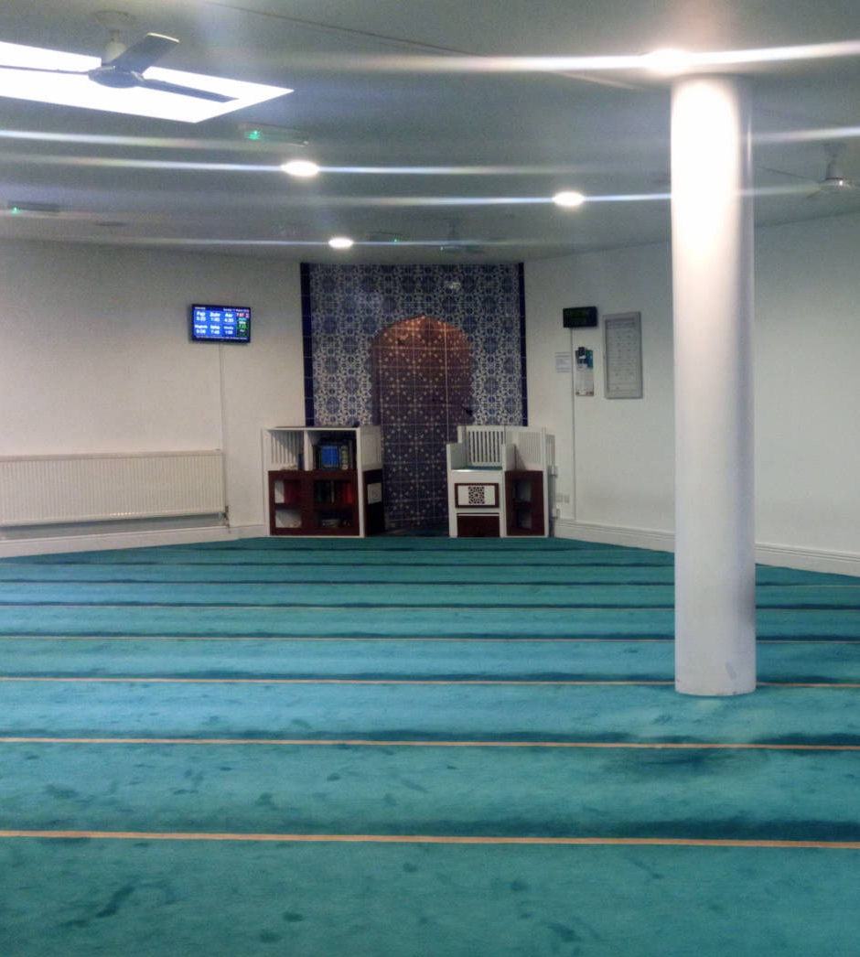
Free Weekly Events (continued)
Saturday
Sunday
Childrens’ Programme
By Imam Abu Yahya
Location:
Main Hall
Time:
After Dhuhr Jama’ah
Hadith Session
By Imam Abu Yahya
Location:
Main Hall
Time:
After ‘Asr Jama’ah

Slide 11
Hifdh & Maktab Classes
Monday - Friday
Boys’ Hifdh Madrasah | 5-8 PM
Teachers: Imam Abu Yahya, Hafidh Abdus Salam
Boys’ Maktab Islamic Classes | 5-7 PM
Teachers: Imam Shofiqul Islam, Ekhlasur Rahman
Weekends
Girls’ Maktab
Taught by Female Teacher

Slide 12
Du’a when leaving the Masjid
بِسْمِ اللّهِ وَالصَّلاَةُ وَالسَّلاَمُ عَلَى رَسُولِ اللّهِ،
اَللَّهُـمَّ إِنِّي أَسْأَلُكَ مِنْ فَضْـلِكَ
Bismillahi waṣ-ṣālatu was-salāmu ‘alā
Rasūlillāh, Allāhumma innī as-aluka min fadlik
“In the name of Allāh, peace and blessings be upon
The Messenger ﷺ. O Allāh, I ask You from Your bounty.”

Slide 13
Du’a when entering the Masjid
اَللَّهُـمَّ افْتَـحْ لِي أَبْوَابَ رَحْمَتـِكَ
Allāhumma-f-taḥ lī abwāba raḥmatik
“O Allah, Open for me the gates of Your Mercy”

Slide 14
Du’a after the Adhān
اللَّهُمَّ رَبَّ هَذِهِ الدَّعْوَةِ التَّامَّةِ وَالصَّلاَةِ
الْقَائِمَةِ آتِ مُحَمَّدَانِ الْوَسِيلَةَ وَالْفَضِيلَةَ
وَابْعَثْهُ مَقَامًا مَحْمُودَانِ الَّذِي وَعَدْتَهُ

