Slide 1
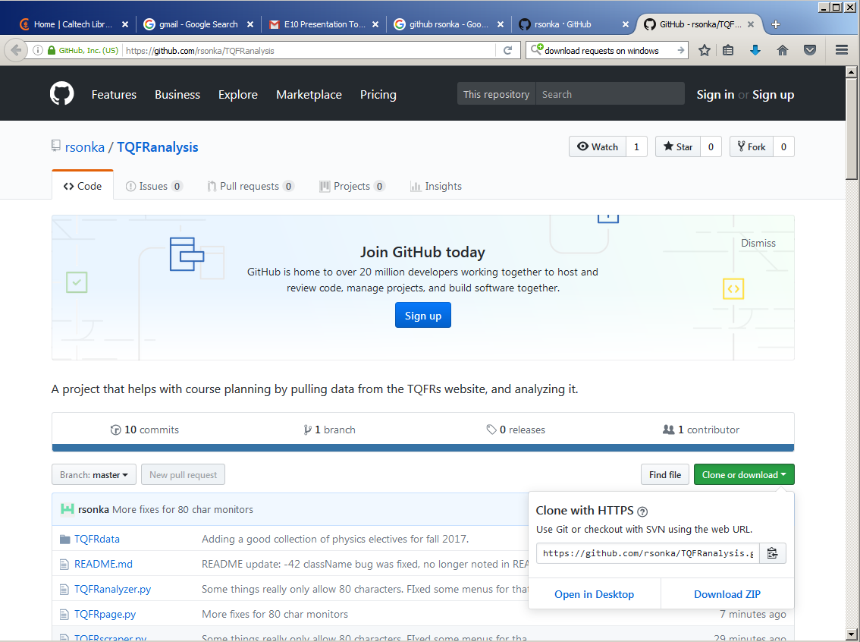
1. Enter:
2. Click:
3. Click:

Slide 2
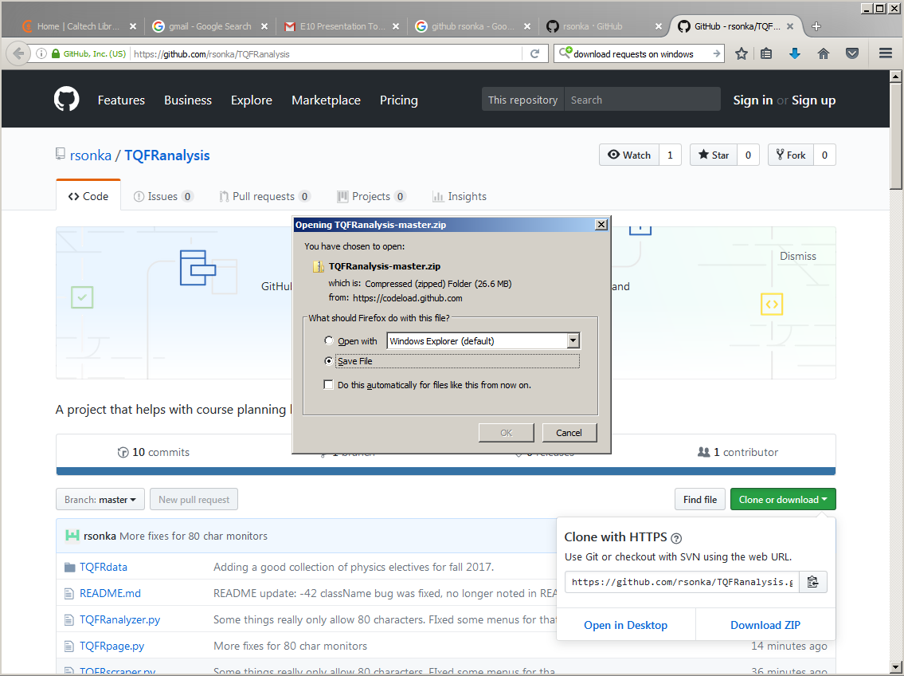
1. Enter:
4. Save the file
2. Click:
3. Click:

Slide 3
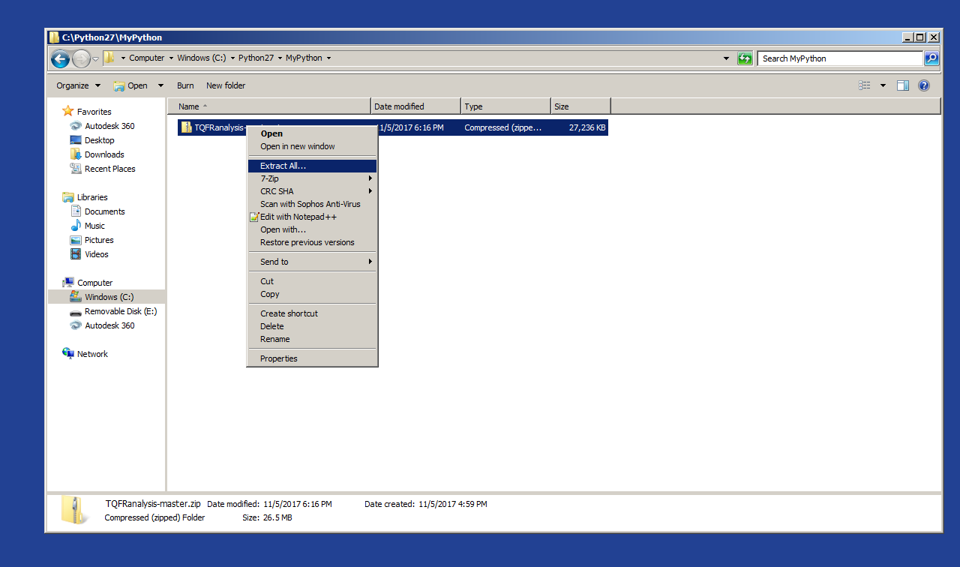
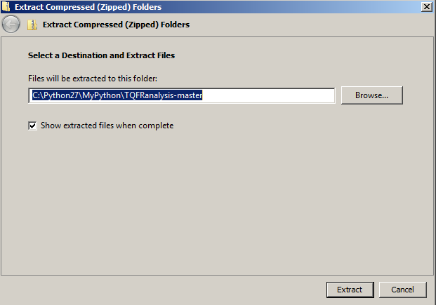
5. I suggest creating the MyPython directory and saving to C:\Python27\MyPython.
6. Right-click zip file. Extract All.
This window will appear:
7. Extract!

Slide 4
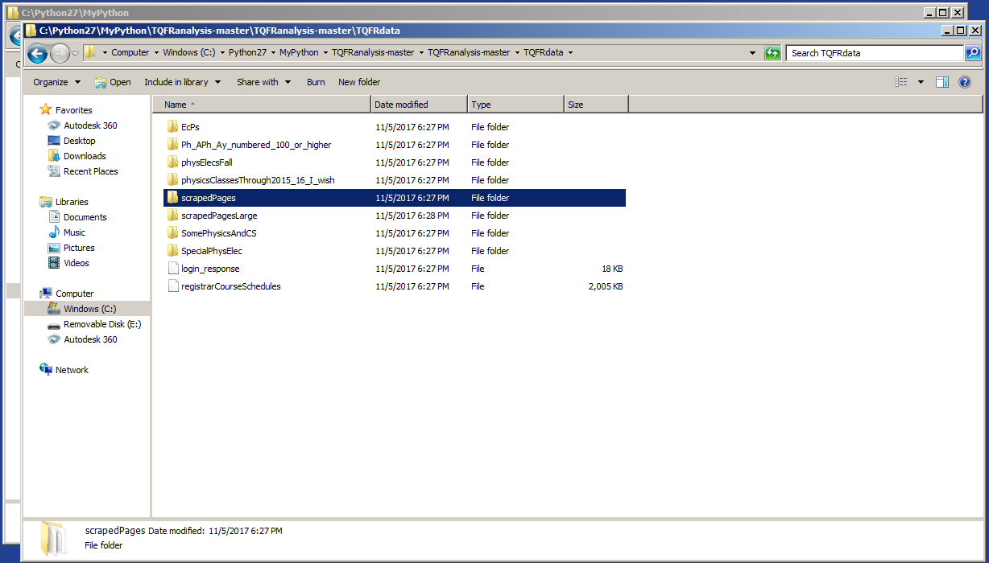
8. This directory
houses scrapedPages, the container of class files to analyze, and other folders of example classfiles.
You may want to remove the current contents of scrapedPages.

Slide 5
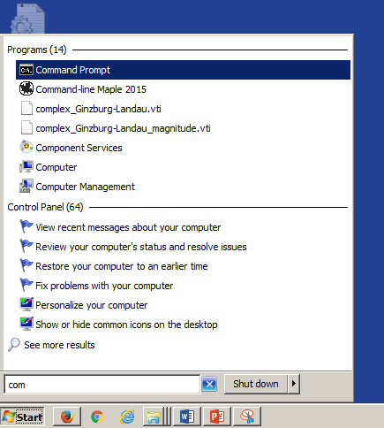
9. Windows Start menu -> type “Command Prompt”
-> Click :

Slide 6
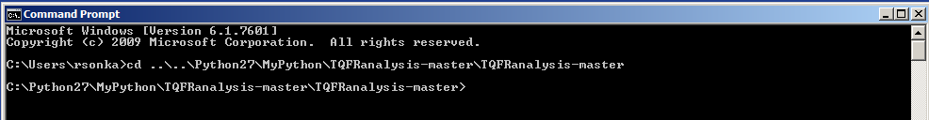
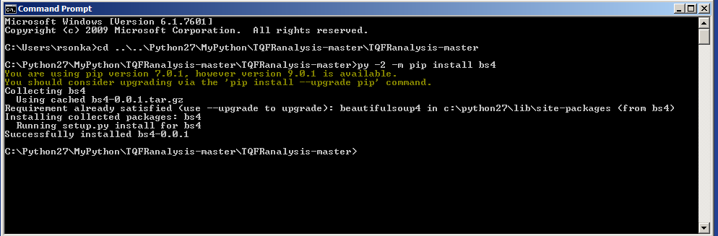
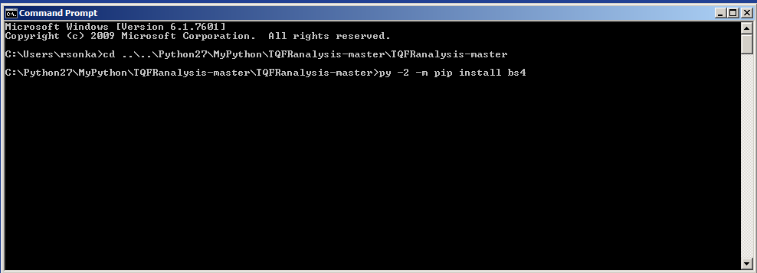
10. Navigate to location of our files by entering
cd ..\..\Python27\MyPython\TQFRanalysis-master\TQFRanalysis-master
11. Install needed python package ‘bs4’ by entering
py -2 -m pip install bs4
12. Then install needed python packages ‘requests’ and ‘numpy’ by entering
py -2 -m pip install requests
And then
py -2 -m pip install numpy
Your installation is now complete! I was able to log out and back in and it was still there, so you should only have to do this once.

Slide 7
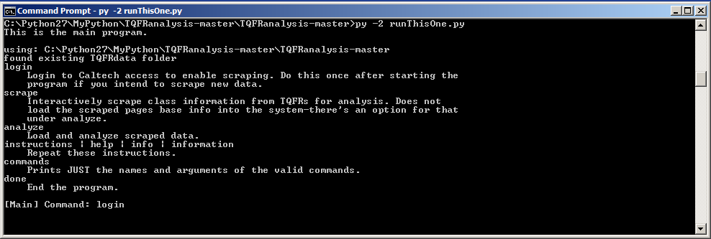
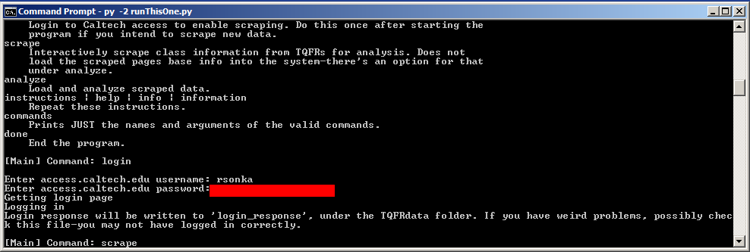
1. Now we can run our program. Enter
py -2 runThisOne.py
2. We have to login to Caltech Access to scrape new pages.
3. Let’s go scrape some data!

Slide 8
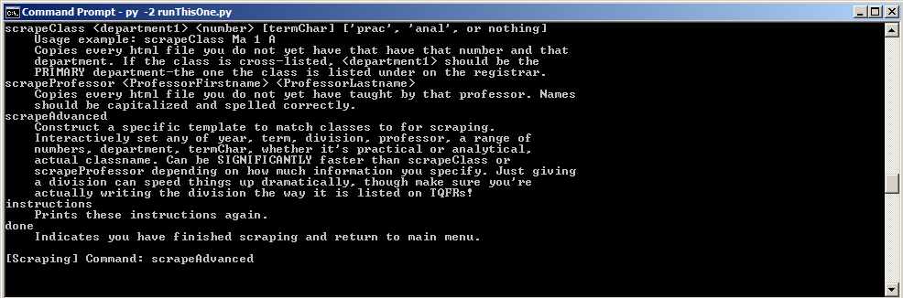
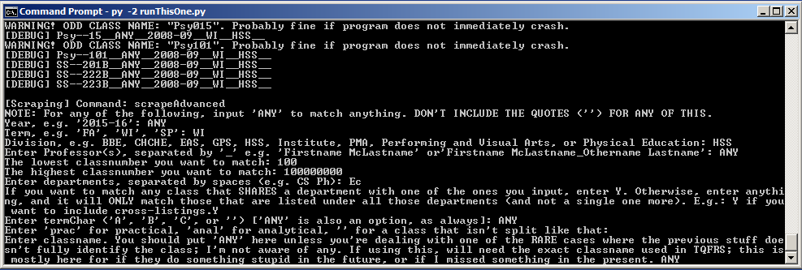
(You might want to actually scroll up and read this menu. I’m going to skip to doing stuff because this is a 10 minute presentation.)
4. I’m going to pick out the best Winter-term economics classes to fulfill my Advanced Social Science requirement with.
The program then downloads TQFR reports for every winter Economics class #100 or above.

Slide 9
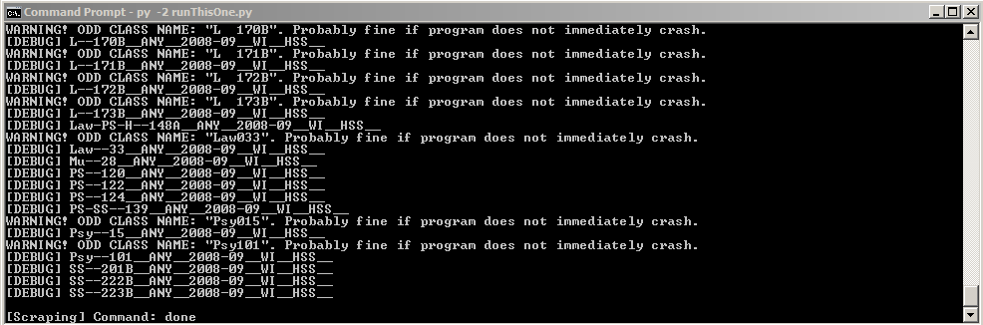
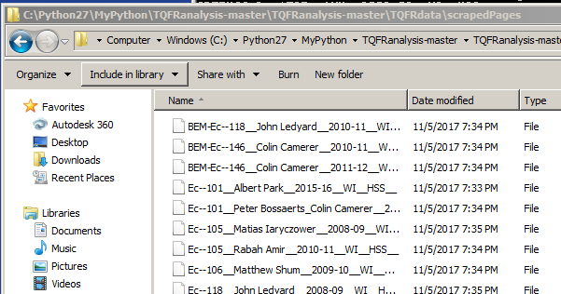
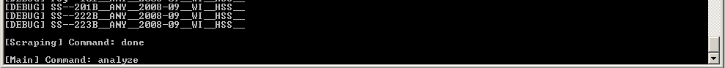
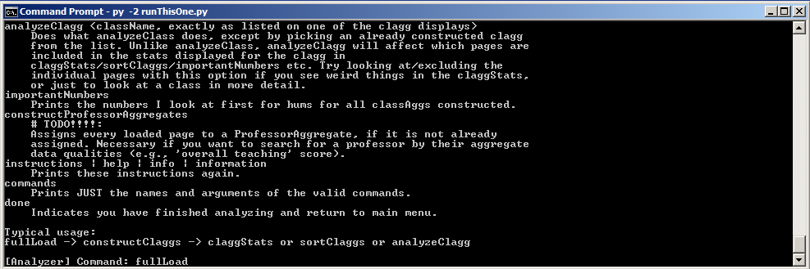
Our scrapedPages directory is now full of data!
5. Time to examine our options.
(Again, you might want to actually scroll up and read this menu. )

Slide 10
Our scrapedPages directory is now full of data!
5. Time to examine our options.
(Again, you might want to actually scroll up and read this menu. )

Slide 11
Our scrapedPages directory is now full of data!
5. Time to examine our options.
(Again, you might want to actually scroll up and read this menu. )
6. A couple setup commands to load our data and calculate the stats for the classes.

Slide 12
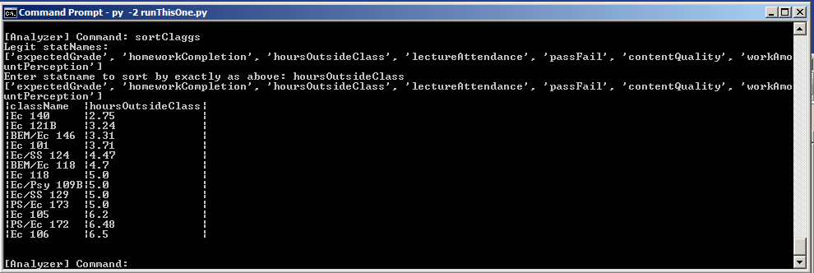
7. If you’re like me, you probably don’t really care about economics. Thus, your first instinct is to ask “which class is the least work?”
This list takes about 1.5 numbingly boring hours to compile by hand due to how TQFR report is laid out. I guarantee you can install TQFRscraper on an SFL computer and get this list in way less than 1.5 hours.
Cross-reference with registrar list of classes available next term (http://schedules.caltech.edu/WI2017-18.html) … 121B, 124, and 172 are offered next term, plus the completely-new or never-surveyed classes 101, 149, and 181.
So Ec 121B is our top contender, followed by Ec/SS 124. We don’t really want to take the underunited PS/Ec 172.

Slide 13
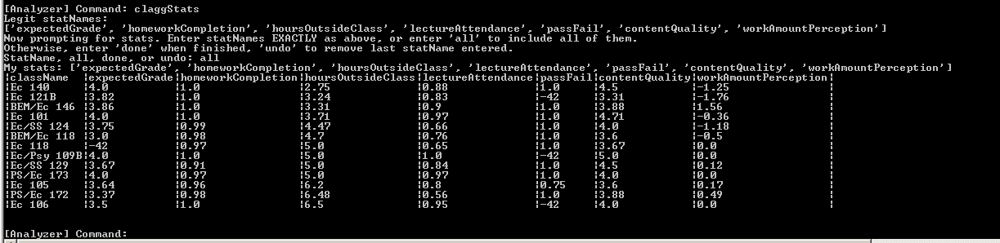
8. Let’s quickly check overall class stats to make sure we’re not missing anything nasty, like an arbitrary grading scheme or horrific content quality.
9. Hmm, Ec/SS 124 gets a much higher contentQuality rating. Is it enough to justify the extra hour of work per week? Let’s look at the class’s consolidated TQFRdata in depth.

Slide 14
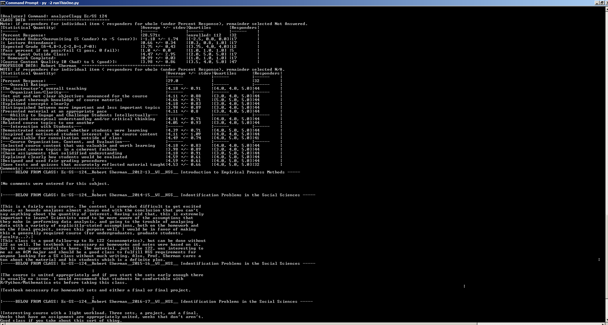
8. Let’s quickly check overall class stats to make sure we’re not missing anything nasty, like an arbitrary grading scheme or horrific content quality.

Slide 15
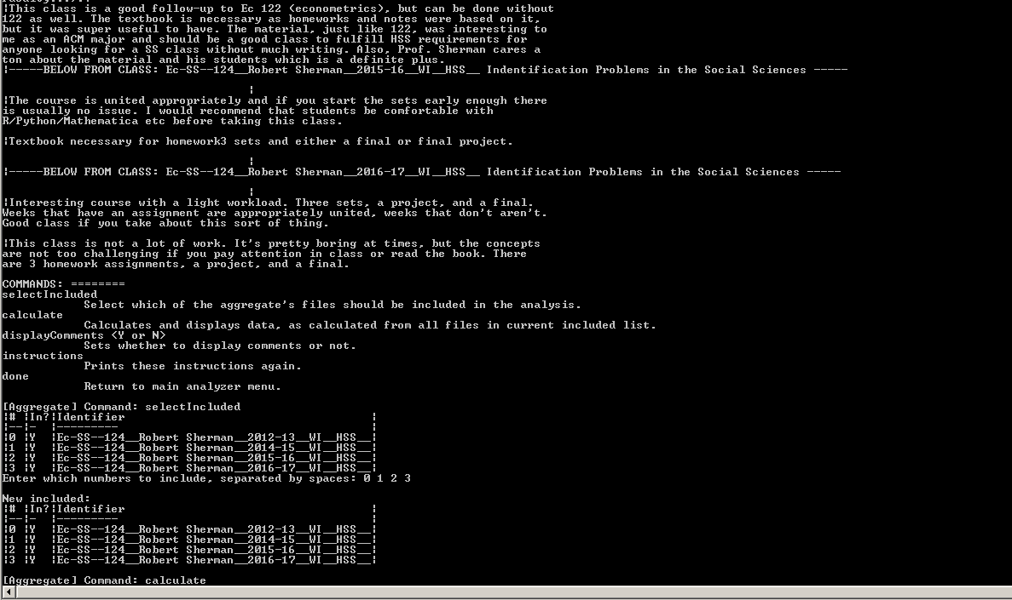
8. Let’s quickly check overall class stats to make sure we’re not missing anything nasty, like an arbitrary grading scheme or horrific content quality.
8. Let’s quickly check overall class stats to make sure we’re not missing anything nasty, like an arbitrary grading scheme or horrific content quality.

Slide 16
8. Let’s quickly check overall class stats to make sure we’re not missing anything nasty, like an arbitrary grading scheme or horrific content quality.
8. Let’s quickly check overall class stats to make sure we’re not missing anything nasty, like an arbitrary grading scheme or horrific content quality.

Slide 17
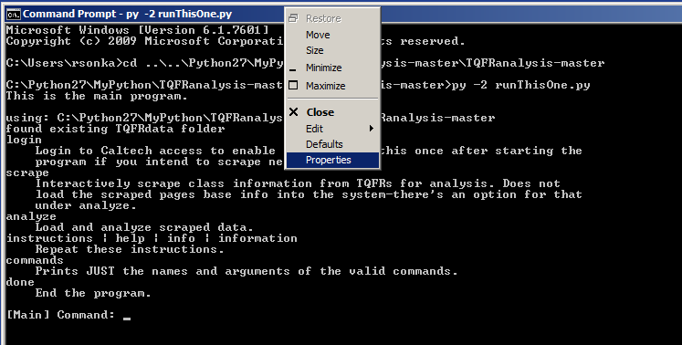
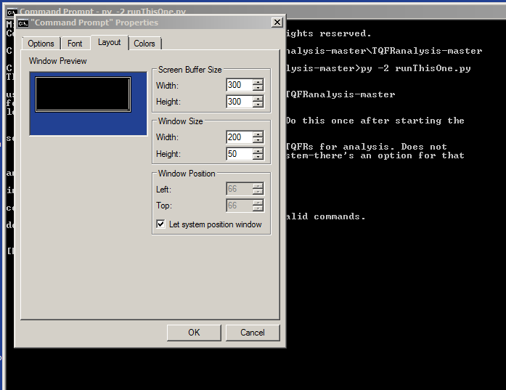
8. Let’s quickly check overall class stats to make sure we’re not missing anything nasty, like an arbitrary grading scheme or horrific content quality.
8. Let’s quickly check overall class stats to make sure we’re not missing anything nasty, like an arbitrary grading scheme or horrific content quality.
One last trick: right-click the Command Prompt bar and open Properties.
Then you can resize the Command Prompt Window and buffer to actually view everything on one screen.

