Slide 1
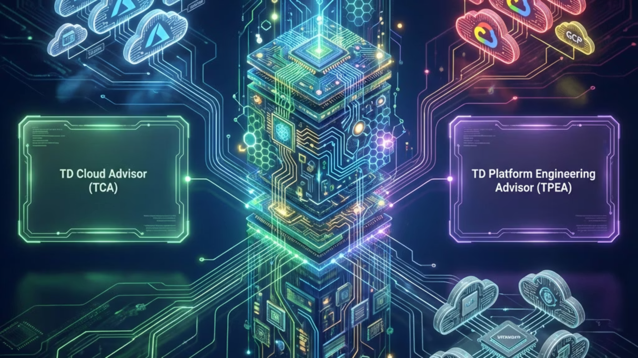
TD Delivery eXecution Platform (TDX)
Intelligent Guidance for Cloud Adoption, Infrastructure Modernization & Engineering Excellence
Scott Tully — Platform Engineering

Slide 2

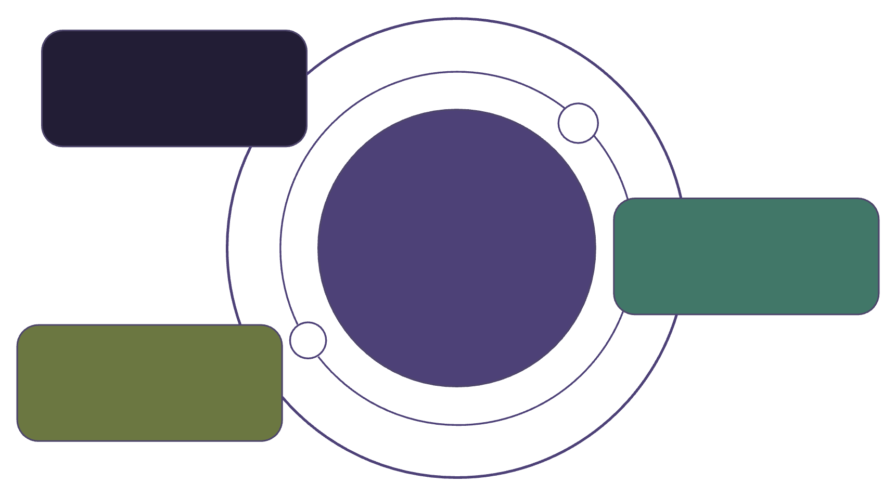
TD Delivery eXecution Platform (TDX) Vision
TDX is TD's unified intelligence layer that turns cloud and platform decisions into fast, accurate, and repeatable actions.
TD Cloud Advisor (TCA)
Purpose-built for Lines of Business
Remove Ambiguity
Delivers clear, validated cloud architecture guidance
Clarify cloud and platform choices
Shortens onboarding and discovery cycles
Ensures designs align with TD-certified patterns and compliance expectations
TDX Unified Intelligence
Reduce Friction
Turns decisions into fast, accurate actions
Simplify workflows and approvals
TD Platform Engineering Advisor (TPEA)
Purpose-built for internal platform teams
Provide Guidance
Actionable, repeatable recommendations
Modernizes Terraform, pipelines, and legacy configurations
Reduces drift, rework, and support escalations
Improves consistency and predictability of platform operations

Slide 3
The Enterprise Problem Space
Why TD needs TDX now
Cloud adoption is slow and inconsistent
Platform teams cannot plan or scale
App teams don’t know how to translate on-prem systems into cloud-native architectures
Architecture requests arrive without clarity
Platform teams cannot forecast service demand
LOBs depend heavily on platform SMEs for basic planning
Roadmaps are reactive instead of predictive
Repeated "architecture discovery cycles" stall onboarding
Security & compliance friction
High cost of inconsistency
Teams learn about policy blockers late, near deployment
Each team reinvents architecture
Exceptions take weeks and slow releases
Every platform (network, IAM, cloud, VMC, Kubernetes) has drift
STIGs are interpreted inconsistently across teams
Terraform varies wildly by team, pattern, and era

Slide 4

The Engineering Problem Space
What slows engineering output today
Reinventing architecture & standards
No consistent testing or assurance
Terraform fragmentation
Inconsistent structure. Hard to onboard. Hard to validate. Hard to scale.
Every service team builds patterns differently → constant drift.
Functional, security, and compliance testing vary by team.
Manual security interpretation
High friction between LOBs & platform
STIGs, policy-as-code rules, and config restrictions require SME knowledge.
LOBs don’t know what platform can provide; Platform doesn’t know what LOBs actually need.

Slide 5
TDX Architecture Overview
TDX Platform: Unified Guidance
TDX delivers consistent cloud and platform decision guidance across the enterprise.
Advisor Layer
TCA (Cloud Advisor): Cloud-specific guidance & best practices.
TPEA (Platform Engineering Advisor): Platform engineering expertise & architectural standards.
Platform Intelligence
The core reasoning engine, using LLMs and intelligent reasoning for contextual guidance.
Agent Layer: Six Core Capabilities
Compatibility & Alignment: Enterprise standards adherence.
Blueprinting & Planning: Generates architectural plans and deployment specs.
Modernization & Transformation: Guides legacy system transitions & cloud transformation.
Assurance & Quality: Validates compliance, security, & quality.
Governance & Compliance: Enforces policies, STIGs, & regulatory requirements.
Provisioning & Orchestration: Consumes deployment specs to coordinate with external execution systems.
Everything-as-Code Foundation
Foundational layer: Terraform, policy-as-code, automated workflows, STIGs, documentation, CMDB integration – powering all TDX capabilities.

Slide 6
The Six Agent Capabilities
Autonomous engines that power both Advisors (TCA + TPEA)
1. Blueprinting & Planning Agent (TCA primary)
2. Compatibility & Alignment Agent (TCA primary)
3. Modernization & Transformation Agent (TPEA primary)
Generates cloud deployment architectures based on LOB intent
Detects missing features, unsupported services, and policy blockers
Refactors ad-hoc Terraform into standardized enterprise patterns
Produces multiple viable patterns (A/B/C) with clear tradeoffs
Maps requirements to TD-approved services, controls, and data classifications
Eliminates drift, anti-patterns, and legacy structure
Produces consistent IaC that is ready for reuse and automation
Outputs a TDX deployment spec that downstream agents and tools can consume
Surfaces early risk, exception, and compliance insights for architects
4. Assurance & QA Agent (TPEA primary)
5. Governance & Compliance Agent (Shared)
6. Provisioning & Orchestration Agent (TPEA primary)
Generates functional and non-functional test plans for new patterns
Reads IaC and policies to find conflicts and gaps early
Consumes TDX deployment specs from the Advisors and agents
Produces STIG interpretations, SIEM use cases, and detection logic
Suggests remediations aligned with TD Security Standards and regulatory needs
Translates them into orchestrator-ready plans (AAP jobs, TF workspaces, CI pipelines)
Automates validation workflows (what to test, how to test, and expected outcomes)
Assists with exception workflows and evidence collection
Coordinates with external execution systems to track status and feed results back into TDX

Slide 7
How TDX Works
Advisors are interactive. Agents and execution are autonomous.
1. Users interact with Advisors
LOB teams use TCA for cloud adoption and migration guidance
Platform teams use TPEA for Terraform modernization and engineering support
Advisors interpret intent, ask follow-up questions, and shape the problem into a TDX deployment spec
2. Platform Intelligence Layer
Shared reasoning engine that understands the spec, policies, and enterprise constraints
Performs retrieval over "Everything-as-Code" to ground answers in TD reality
Decides which agents to invoke and how to combine their outputs into a coherent recommendation
3. Autonomous Agent & Provisioning Layer
Agents continuously ingest and normalize Terraform, STIGs, policies, and reference designs
Blueprinting, Compatibility, Modernization, Assurance, and Governance agents generate plans, diffs, refactors, test suites, policy findings, and recommended baselines
The Provisioning & Orchestration Agent turns advisor outputs into executable plans (AAP jobs, Terraform Cloud runs, CI/CD workflows) and coordinates with external tools
Execution happens in existing enterprise platforms; TDX focuses on intelligence, not raw infra control
4. Everything-as-Code Foundation
Standardized corpus: Terraform modules, CI workflows, STIG breakdowns, policies-as-code, SIEM use cases, network/IAM standards, and reference architectures
Continuously updated from repos, platforms, and CMDB so agents reason over current reality
Becomes the authoritative knowledge base that keeps TDX's guidance consistent, explainable, and auditable across TD

Slide 8
TCA (TD Cloud Advisor)
Strategic Guidance for Lines of Business
TCA is a pivotal strategic tool, empowering application teams to navigate cloud adoption with unparalleled clarity and efficiency. It provides prescriptive guidance, reducing time-to-market and ensuring alignment with enterprise standards from the outset. TCA de-risks cloud initiatives and accelerates adoption by automating detailed, compliant, and optimized cloud blueprints. This frees up valuable developer time, fosters agility, and ensures secure, strategic cloud deployments.
How to deploy their application into cloud environments securely and efficiently
Which cloud services they should leverage (and a comprehensive rationale why)
Potential architectural and operational risks inherent in their proposed designs
Specific enterprise controls and regulatory requirements that might impede their progress
Whether formal policy exceptions are required, and the justification for them
Which validated architecture patterns best fit their application's strategic needs
TCA automatically produces critical deliverables:
Deployment Blueprint: Tailored IaC templates and configurations for immediate implementation.
Policy Blockers + Rationale: Identification and explanation of governance policies that could impede deployment.
Migration Guidance: Phased strategies for existing application migrations.
Tradeoff Explanations: Transparent analysis of compromises (performance, cost, security).
Compatibility & Alignment Analysis: Report assessing designs against TD's standards.
Recommendations for Alternative TD Services: Suggestions for more suitable, compliant, or cost-effective cloud services.
Use Cases: Validating new deployments, optimizing existing cloud footprints, facilitating complex migrations, and ensuring continuous compliance.

Slide 9
TPEA (TD Platform Engineering Advisor)
Strategic Enabler for Internal Platform Teams
TPEA is a foundational strategic tool designed to elevate TD's internal platform capabilities, ensuring they are robust, scalable, and compliant. It empowers platform engineering teams to accelerate modernization and streamline operations.
TPEA automates critical platform engineering functions:
TPEA strategically reduces:
Manual rework
Standardizing Terraform into organization-wide patterns.
Automating compliant IaC and test plans.
Detecting configuration drift from approved baselines.
Architecture drift
STIG interpretation and compliance assistance.
Continuous validation against enterprise patterns.
Generating SIEM use cases for new services.
Generating test plans for new patterns, IaC modules, or cloud features.
Dependency on SMEs
Codifying expert knowledge into automated processes.
Creating consistent “known good” baselines across services.
Roadmap ambiguity
Clear paths for compliance and insights into blockers.

Slide 10
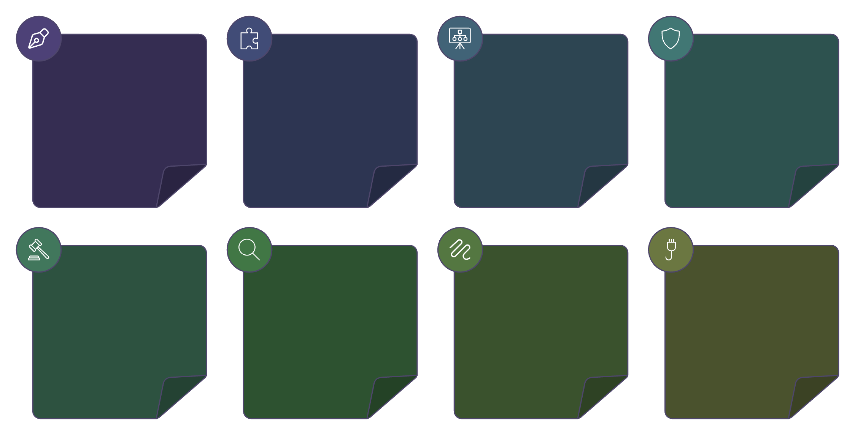

Everything-as-Code
The foundation that makes intelligence possible
Terraform Configs
Module Contracts
Platform Reference
STIG Breakdowns
Everything-as-Code represents the unified, structured repository of machine-readable enterprise knowledge critical for TD. This standardized code foundation is the indispensable bedrock that enables TDX's intelligence layer and agents to deliver accurate, consistent, and actionable guidance across the platform. Without this precise and unified representation, intelligent advisory functions would be severely limited.
Reusable infrastructure code
Interface and version rules
Architectural blueprints
Security technical guidance
Policy-as-Code
SIEM Use Cases
Paved Paths
Network & IAM
Automated compliance rules
Detection and response logic
Provision and Orchestrate Infra
Configuration and access standards
This corpus is continuously transformed into consistent formats so TDX’s agents can reason over it with precision.

Slide 11
Expected Outcomes (Conservative Estimates)
Quantitative Outcomes (Low-risk, defensible ranges)
20-40%
30-50%
40-60%
20-35%
reduction
reduction
reduction
fewer
in LOB onboarding time
in Terraform inconsistencies
in architecture “discovery cycles”
platform support escalations
1.5-2x
improvement
in platform roadmap predictability
Qualitative Outcomes
Earlier clarity for application teams
Predictable cloud adoption pathways
Far less friction and rework
Reduced reliance on SMEs
Stronger alignment between LOBs & platform
Faster delivery without increased staffing

Slide 12
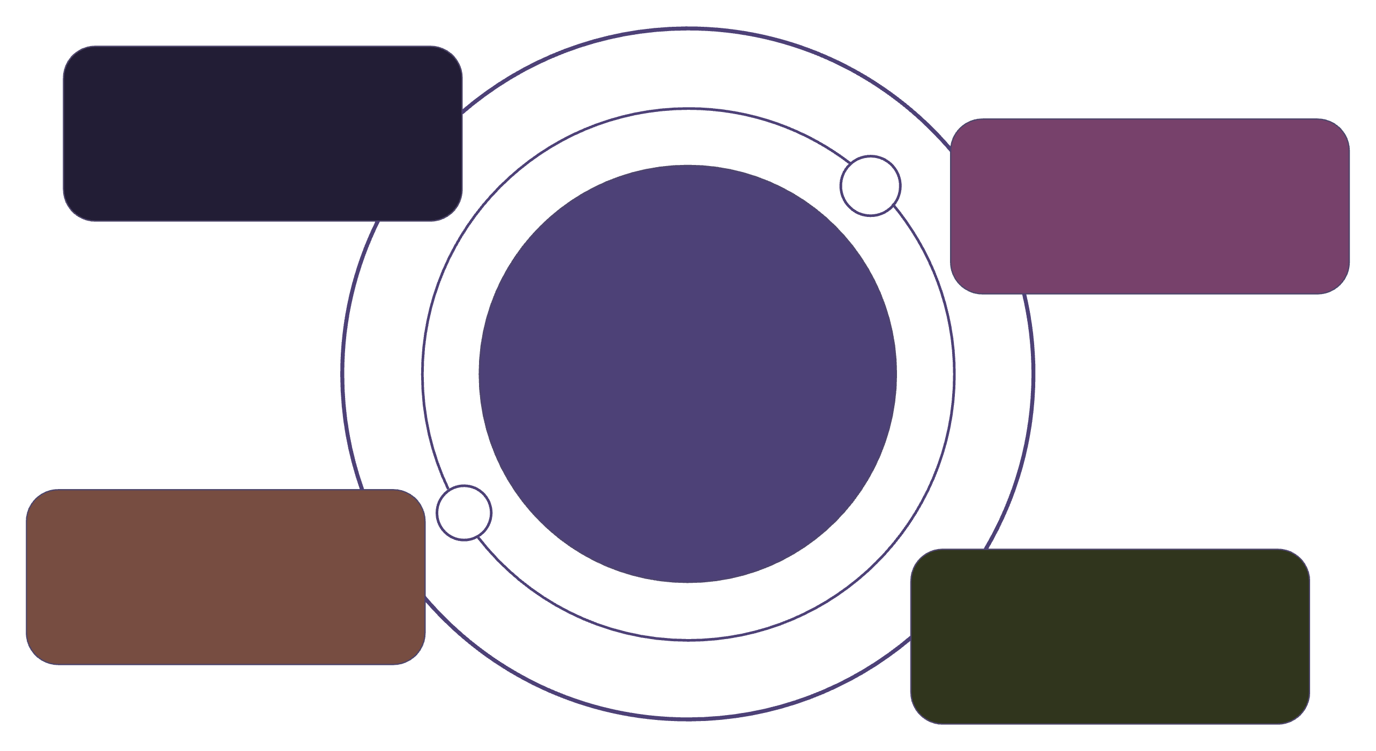
TDX Alignment to GTS Strategic Capabilities
How TDX strengthens TD’s enterprise technology strategy
Modern Technology
Automates IaC, eliminates drift
Fast Trusted Data
Secure cloud data services
TDX Platform
High-leverage platform strengthening GTS scorecard
Artificial Intelligence
AI-driven engineering decisions
Digital Enablement
Increases delivery speed
TDX is a high-leverage platform program with measurable impact across the GTS scorecard.

Slide 13
Firebase Enablement — Near-Term AI-Supported Work
What TDX (TPEA side) can accelerate during the 5-month SoW window
Architecture & Design Acceleration
Security Hardening & STIG Development
Summarize Firebase requirements and produce preliminary Architecture Design (AD).
Assist SLG team in creating and rating Firebase-specific STIGs.
Use AI to accelerate control interpretation, STIG summaries, and evidence collection.
Use AI (Copilot) to draft, refine, and validate design documentation.
Align Firebase usage with TD reference patterns and platform constraints.
Identify which STIGs can be automated via Policy-as-Code (CaC).
Compliance-as-Code (Critical STIG Automation)
Risk & Security Assessments
Draft Wiz policies for all STIGs marked “Critical”.
Support TARA completion using AI for data extraction + document synthesis.
Use AI to generate skeleton CaC rules, descriptions, and test cases.
Assist with Threat Model reviews, summarization, and gaps documentation.
Support iterative testing & refinement with TD CaC team.
Create preliminary IAM/Network control gap analysis.
Terraform & Deployment Enablement
Evidence & Documentation Streamlining
Develop Firebase Terraform module(s) for EngLab + Prod deployment.
Threat modeling feedback
Use AI to draft module documentation, variable definitions, and examples.
Control Gap Risk Assessment content
Validate deployment workflows and surface configuration drift or inconsistencies.
Cloud Quality Assurance test evidence
CPTD/CPTT/CPTO challenge documentation

Slide 14
Enterprise Transformation Enabled by TDX
Long-term modernization powered by Platform Intelligence + Autonomous Agents
Standardized Everything-as-Code
Terraform Modernization & Migration
Normalize Terraform, YAML, and JSON for consistent formats.
Migrate ad-hoc Terraform to GitHub/Terraform Cloud.
Agent-driven refactoring ensures module design and governance.
Convert to reusable enterprise modules with auto-generated documentation.
Network & Firewall Automation
Cloud Architecture Consistency
Automate F5, firewall rules, and load balancers using TDX agents.
Enforce consistent patterns across Azure, GCP, AWS, and on-prem.
Standardize network patterns across all environments with AI validation.
Standardize IAM, networking, and posture management with recommended baselines.
ServiceNow / CMDB Integration
Platform Intelligence Layer
Sync Terraform data into CMDB via TDX agents.
Deploy core intelligence for RAG, code understanding, and policy interpretation.
Automate CI entries, dependencies, and lifecycle events.
Enables orchestration planning for all autonomous agents.
Autonomous Agent Ecosystem
Enterprise Knowledge Graph
Agents trigger continuous analysis across code, infra, and posture.
Build a unified representation of Terraform modules, policies, and architecture patterns.
Bi-directional knowledge flow drives action and future extensibility.
Maps services and their dependencies for comprehensive oversight.

Slide 15
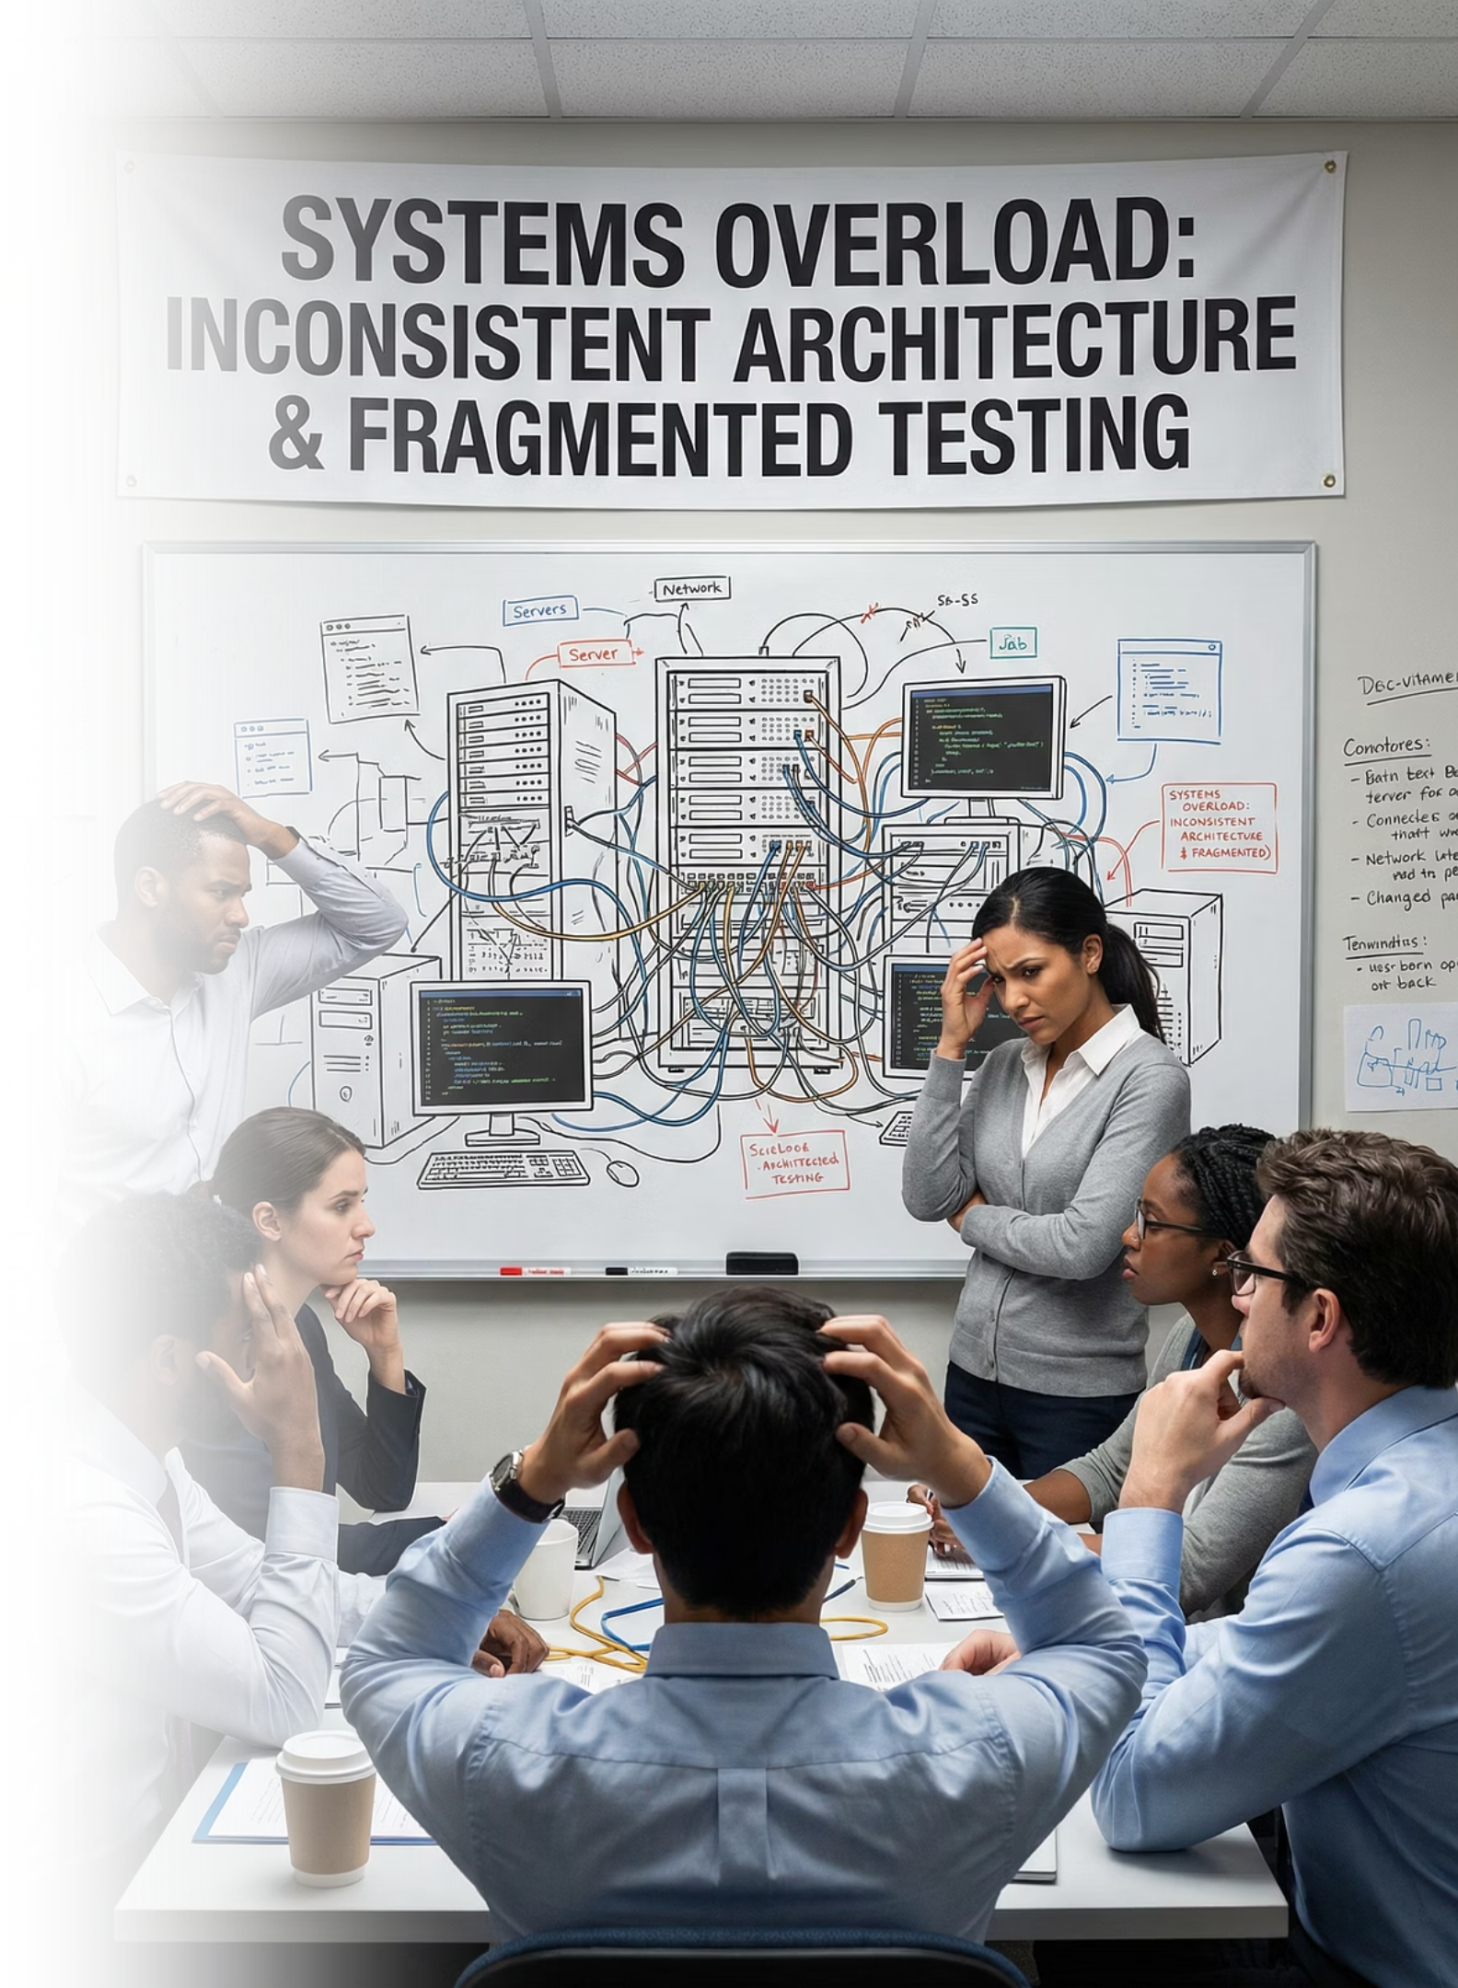
Closing
TDX sets the foundation for a unified, intelligent TD engineering ecosystem
By aligning Everything-as-Code with intelligent advisors and specialized agents, TDX gives TD a scalable system that:
Guides LOBs to cloud safely and predictably
Modernizes platform engineering at scale
Reduces friction, waste, and drift
Protects consistency and compliance
Frees SMEs from repetitive work
Enables faster cloud adoption with higher confidence
TDX isn’t a tool. It’s the next evolution of how TD engineers build, deploy, secure, and understand their systems.

Slide 16

TDX Platform Intelligence — High-Level Architecture
The intelligence engine powering both Advisors
Core Responsibilities
Understand user intent from TCA and TPEA.
Retrieve relevant information from “everything-as-code.”
Orchestrate multi-step reasoning and agentic workflows.
Produce structured outputs: plans, refactors, tests, and compliance artifacts.
Major Components
LLM Layer
Retrieval Layer (RAG)
Agent Layer
Everything-as-Code Foundation
Central reasoning engine for Terraform, STIG, architectures, and planning.
Vector search over Terraform code, STIGs, policies, architecture docs, service catalogs.
Specialized agent families for modernization, planning, compliance, and more.
Terraform, documents, policies, workflows; continuously indexed for intelligence.
Integration Points
TCA and TPEA Advisors call into this shared Platform Intelligence stack, ensuring consistent and informed guidance.
Outputs flow back into repos, pipelines, PRs, portals, or ServiceNow.

Slide 17
Platform Intelligence — GCP Implementation Overview
Core services required to deploy the intelligence layer
AI & Model Services
Intelligence & Agents
Vertex AI Gemini (LLM) for reasoning, planning, and refactoring.
Cloud Run or GKE service as the central “brain” for Advisors.
Vertex AI Embeddings & Vector Search for retrieval across IaC and STIGs.
Cloud Workflows for long-running agentic flows (e.g., Terraform modernization).
Cloud Tasks / Pub/Sub for async work queues.
Knowledge Storage & Indexing
Cloud Storage for raw artifacts (Terraform, STIGs, docs, pipelines).
Security & Operations
AlloyDB or Firestore for metadata (asset types, owners, versions).
IAM + Service Accounts with least privilege.
Pub/Sub pipelines for ingestion triggers from repos, ServiceNow, CMDB.
Private Service Connect for Vertex AI isolation.
Cloud Logging + BigQuery for observability and ROI analytics.
Ingestion & Enrichment Services
Cloud Run microservices to:
Parse Terraform, YAML/JSON, architecture docs, and STIG controls.
Chunk + embed data into vector store.
Maintain continuous background synchronization.

