Slide 1

Terraform Foundations
Establishing the Technical Foundation for Consistent Infrastructure, Governance, and AI Reasoning
Scott Tully (Principal Engineer)
January 21, 2026

Slide 2


FOUNDATION FIRST
Why This Matters: Context, Not Hype
This initiative is not an AI project, but a **Terraform Foundations program**. We are establishing enterprise-grade infrastructure to build a robust, scalable, and secure technical environment. This foundational work ensures reliability and predictability, underpinning all future advancements, including AI.
AI becomes effective only after the foundation is consistent, structured, and reliable.
Here are the key reasons why this foundational work is crucial:
Reduces operational risk Automated deployments reduce failures, human error, and costly outages, ensuring consistent service.
Improves delivery velocity Standardized environments and faster provisioning lead to quicker, more predictable feature releases and application deployments.
Standardizes infrastructure enablement Consistent patterns foster shared understanding, simplify onboarding, and reduce configuration drift and technical debt across teams.
Creates machine-readable truth Codified infrastructure creates a single source of truth, vital for AI systems to analyze, monitor, and automate tasks.

Slide 3

CRITICAL ISSUE
Current State: Terraform as an Enterprise Bottleneck
Based on comprehensive incident data and operational analysis conducted across platform and line-of-business teams, a clear pattern of systemic failure has emerged.
89
$800K
$2.5M+
Terraform Incidents Analyzed
Minimum Annual Cost
Maximum Annual Cost
Comprehensive review of failures
Conservative estimate of impact
Full enterprise impact model
Repeated Failure Categories
State management corruption requiring manual recovery
Module quality inconsistencies across teams
Pipeline instability causing deployment delays
Provider and version drift creating compatibility issues
The cumulative effect creates a high support burden across platform engineering and LOB infrastructure teams, draining resources that could be applied to strategic initiatives.

Slide 4
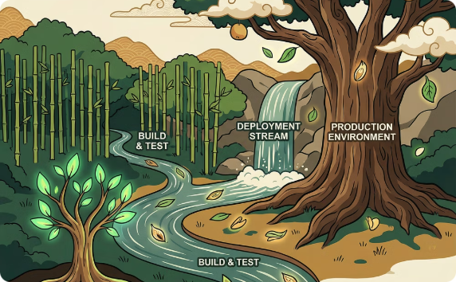
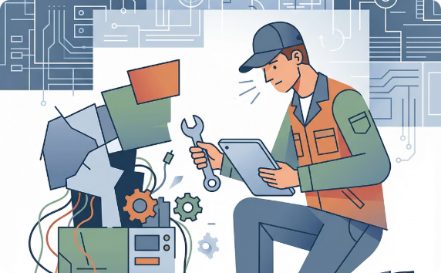


The Core Problem: Technical Deficiencies in Terraform Adoption
What's Missing
What This Creates
Consistent Lifecycle ModelNo standardized approach for module evolution, versioning, or deprecation. Leads to outdated and unmaintainable infrastructure.
Enforced Module StandardsQuality varies due to lack of centralized guidelines, automated linting, or security scanning. Allows vulnerable modules and extensive manual review.
Predictable Repo StructuresInconsistent repository organization impedes onboarding and resource discovery. Slows development and obstructs shared tooling.
Fragile Pipelines
Manual Recovery
Deployments fail unpredictably due to configuration discrepancies. Leads to prolonged recovery and constant manual intervention.
Failures demand engineers spend days analyzing logs and fixing corrupted infrastructure. Creates high operational overhead and extends downtime.
Validated Inputs/OutputsModule interface contracts are often undefined. Lack of schema validation causes silent failures and breaking changes.
Machine-Readable MetadataCritical infrastructure info is siloed in tribal knowledge. Prevents automated governance, auditing, and cost attribution.
Dependency AwarenessLack of automated dependency visualization leads to accidental breaking changes and prolonged outage investigations.
Version Impact VisibilityUnknown consequences from version changes. Teams delay updates, causing significant version drift and higher outage risk.
Tribal Knowledge
Slow Service Enablement
Critical expertise is confined to a few individuals. Creates single points of failure and hinders knowledge transfer.
Provisioning new environments takes weeks due to inconsistent practices and manual bottlenecks. Impacts product launch cycles.

Slide 5

SOLUTION ARCHITECTURE
Terraform Foundations: What We Are Building
We are developing a comprehensive Terraform Lifecycle Management (TFLM) foundation to address critical technical deficiencies in Terraform adoption. TFLM is an enterprise-wide framework establishing standards and processes for how infrastructure-as-code is created, validated, versioned, and evolved. This foundation aims to transform ad-hoc Terraform usage into a robust, scalable, and secure operational model.
How Terraform modules are built
How they are validated
How they evolve safely
Standardized structure and composition patterns ensure every module adheres to consistent conventions, promoting reuse and simplifying onboarding.
Automated quality gates ensure every module meets predefined security, compliance, and operational standards before deployment. All results are auditable.
Controlled versioning with impact analysis allows teams to manage module changes confidently, reducing fear of upgrading and minimizing breaking changes.
How dependencies are tracked
How standards are enforced
Explicit relationship mapping creates a machine-readable understanding of how infrastructure components interconnect, preventing accidental modifications.
Policy-as-code with automated compliance ensures all infrastructure deployments adhere to organizational governance, security, and cost policies.
This becomes the system of record for infrastructure enablement across the entire enterprise.

Slide 6






CORE PILLARS
Terraform Foundations – Core Pillars
Six interconnected pillars form the architectural foundation, each reducing operational risk while simultaneously increasing the system's ability to support advanced reasoning capabilities.
Standardized Module Architecture
Consistent Repo Archetypes
Consistent structure and interfaces
Predictable organization patterns
AI-Ready Artifacts
Schema-Driven Validation
Foundation for intelligent systems
Automated quality enforcement
Machine-Readable Metadata
Automated Governance
Structured, queryable information
Policy enforcement without friction

Slide 7


PILLAR 1
Standardized Terraform Module Architecture
All Terraform services across the enterprise are built as well-defined modules following a consistent architectural pattern that ensures predictability, maintainability, and safe composition.
Required Components
Defined inputs and outputs
Explicit interface contracts with type validation
Required version pinning
Terraform and provider versions explicitly specified
Provider constraints
Compatible provider versions documented and enforced
Explicit dependencies
All module relationships clearly declared
Documented behavior
Human-readable docs + machine-readable metadata
Modules are composed by root configurations — never ad hoc or directly modified.

Slide 8
PILLAR 2
Repo Archetypes (Enforced)
Every repository in the enterprise declares its archetype, establishing a contract that determines structure, validation requirements, and expected behaviors.
Terraform Module Reusable infrastructure components with defined inputs, outputs, and dependencies
Terraform Root / Composition Orchestration layer that combines modules into complete environments
Terraform Metadata / Catalog Service registry and metadata repository for discovery and reasoning
Future: Config, Application, Policy Extensible model ready for additional artifact types
What Archetypes Enable
Required files: Standard structure enforced automatically
Allowed behaviors: Guard rails prevent misuse
Validation rules: Quality gates specific to archetype
CI expectations: Automated pipeline configuration
This architectural pattern enables consistent automation and systematic reasoning across all infrastructure artifacts.

Slide 9

PILLAR 3
Validation as a First-Class Capability
Every piece of Terraform code passes through a comprehensive, automated validation pipeline that produces objective evidence of quality and compliance.
Terraform Native Validation: Syntax, type checking, and internal consistency using terraform validate
Static Analysis (IaC Scanning): Security vulnerabilities, misconfigurations, and policy violations
Schema Checks: Interface contracts, metadata completeness, and archetype compliance
Dependency Checks: Version compatibility, breaking changes, and transitive dependencies
Version Compatibility Checks: Provider version ranges, Terraform version requirements, and upgrade paths
Validation produces evidence, not opinions. Results are structured, versioned, and queryable for audit and compliance purposes.

Slide 10
PILLAR 4 & 5
Metadata: The Missing Layer
Every Terraform artifact—modules, compositions, and configurations—produces rich, structured metadata that answers critical operational questions previously locked in tribal knowledge or scattered documentation.
Key Questions Answered
Metadata Properties
What does this module do?Purpose, capabilities, and intended use cases
Structured
What services does it expose?APIs, endpoints, and integration points
JSON/YAML schemas with validation
What dependencies exist?Required modules, providers, and external services
Queryable
Search, filter, and analyze at scale
What versions are compatible?Supported Terraform and provider version ranges
Versioned
What environments are supported?Development, staging, production readiness
Historical tracking of changes over time
Machine-Consumable
Direct integration with automation and AI

Slide 11
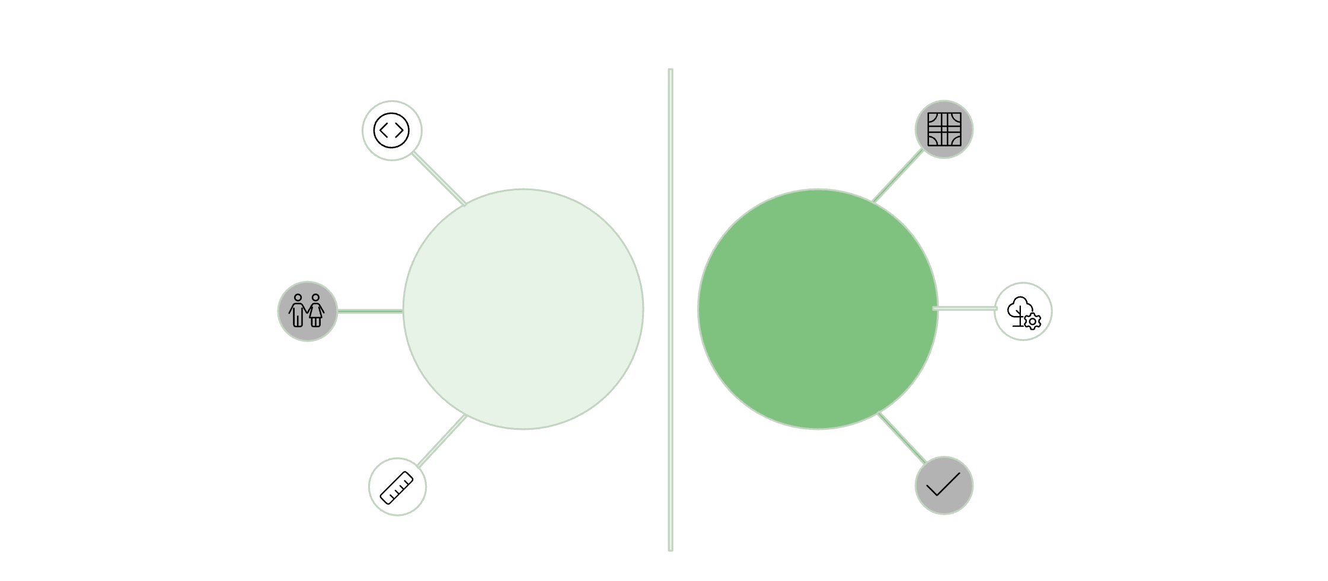
AI CAPABILITIES
AI needs structure to be useful
With Terraform Foundations, AI transforms chaos into clarity, enabling powerful new capabilities.
What AI Can Now Do:
Automated infrastructure reasoning
Inconsistent code
Predictable patterns
Accurate impact analysis
Intelligent design suggestions
Tribal knowledge
Chaos
Order
Structured metadata
And Also:
Proactive drift detection
Guided best practice recommendations
No standards
Validated truth
Predictive failure insights

Slide 12

SUPPORTING CAPABILITY
Sandbox (Supporting Capability, Not the Core)
Sandbox environments serve as controlled observation and experimentation spaces that feed intelligence back into the Terraform Foundations, but they are a supporting capability, not the primary initiative.
Sandbox Purpose
Observe real service usage Capture actual consumption patterns in safe environments
Capture configuration patterns Understand how teams compose and configure services
Compare functional vs security requirements Identify gaps between what works and what's compliant
Generate evidence for module design Validate requirements with real-world usage data
Sandbox informs Terraform Foundations through empirical evidence — it does not replace the need for standardized, governed infrastructure patterns.

Slide 13
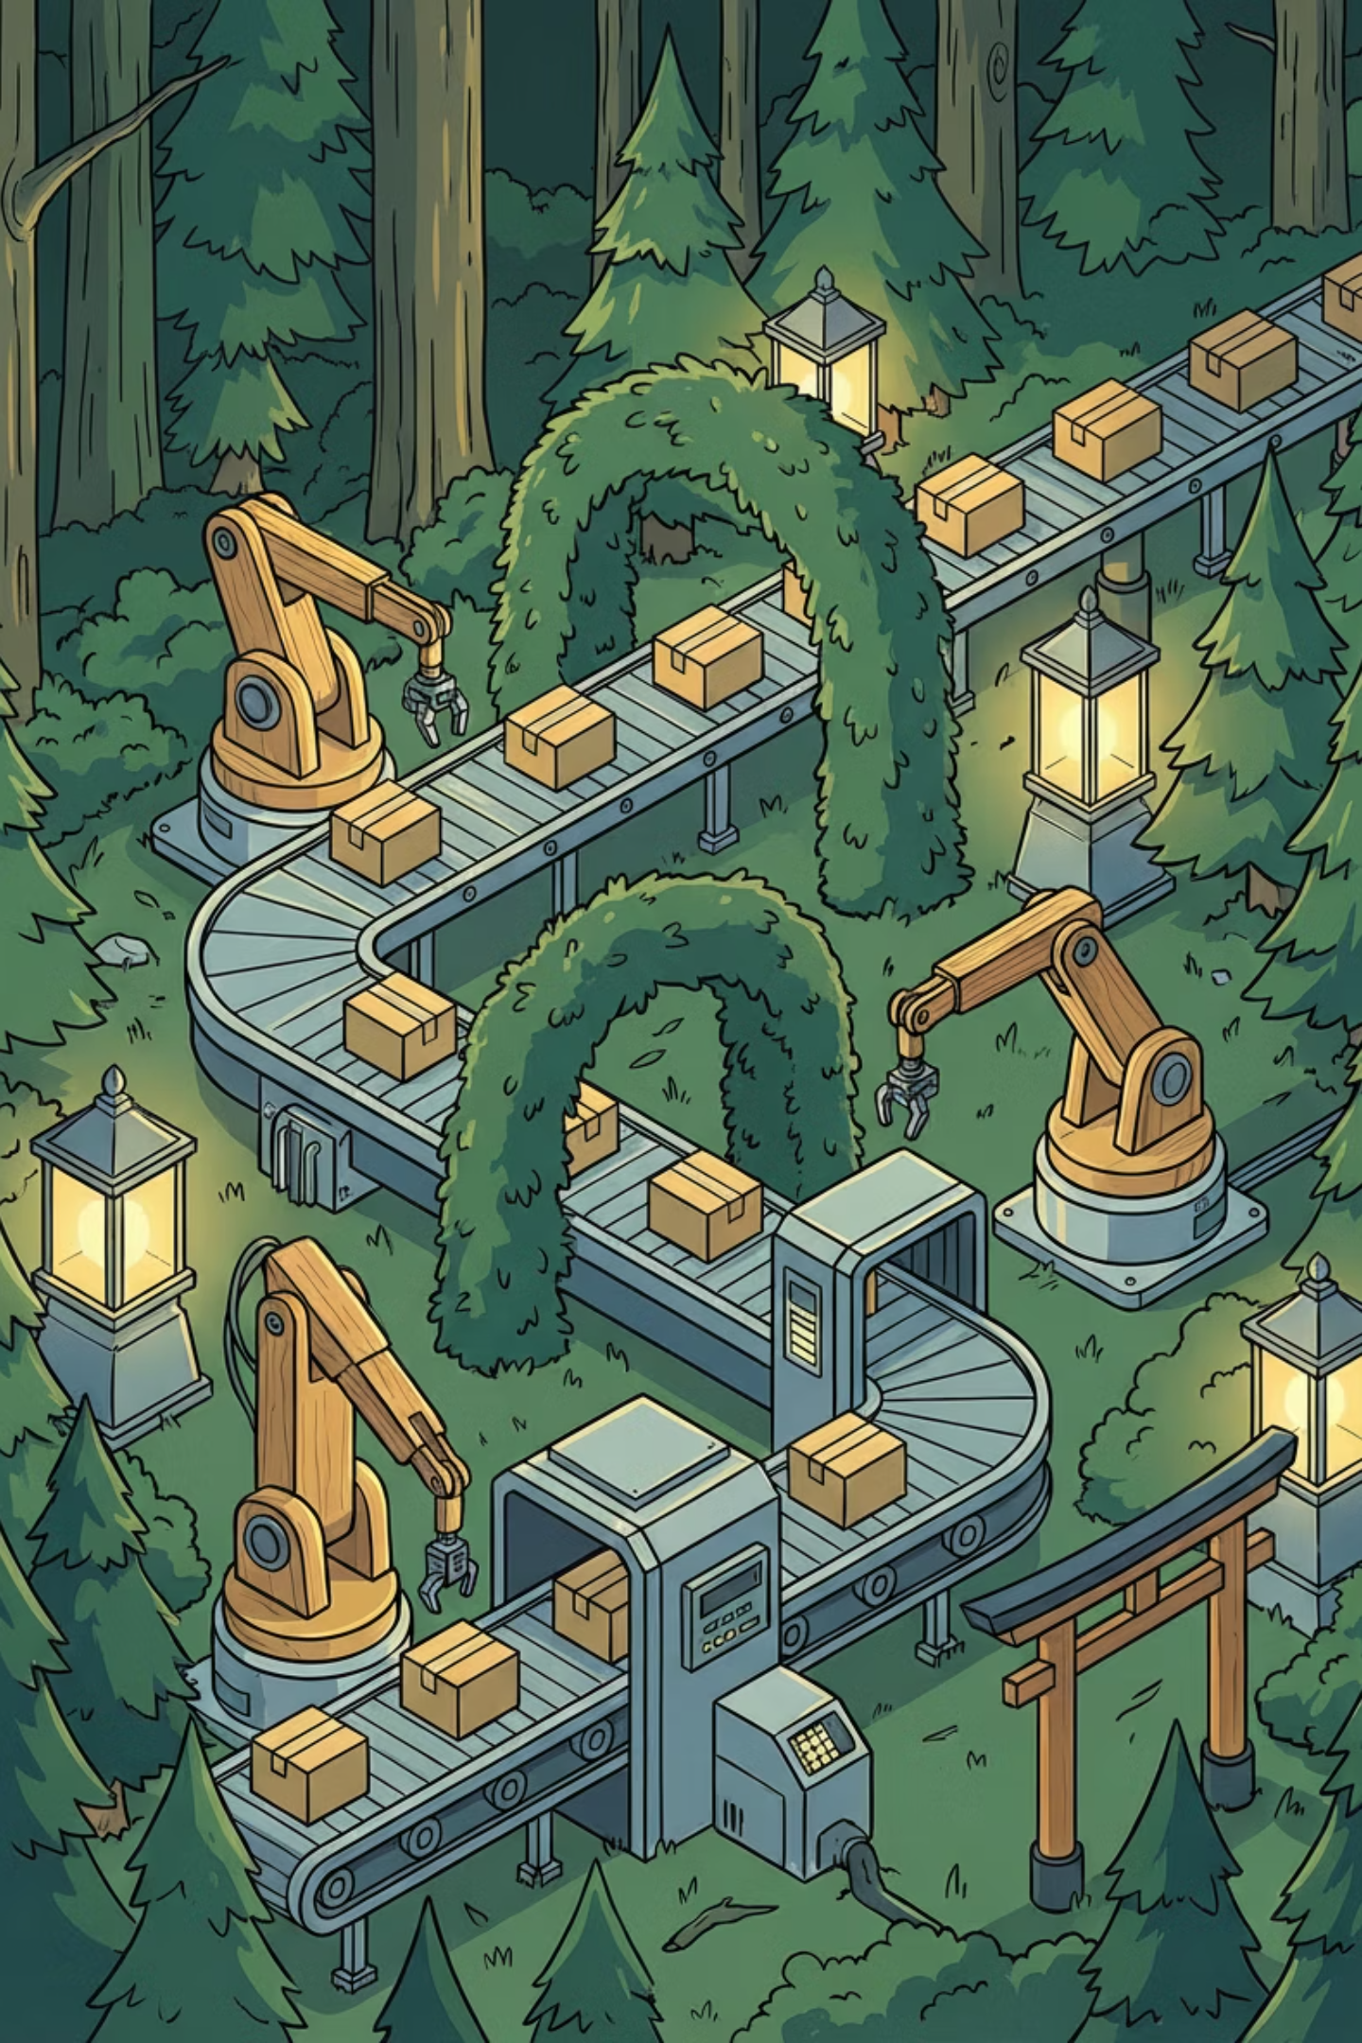

SUPPORTING CAPABILITY
Governance Without Friction
Traditional governance creates bottlenecks through manual reviews, subjective approvals, and endless coordination. Terraform Foundations implements governance as automated, evidence-based enforcement that operates at the speed of code.
Automated Validation
Immutable Standards
Quality gates execute in CI/CD pipelines without human intervention
Policies defined as code and version-controlled alongside infrastructure
Evidence-Based Controls
Versioned Contracts
Objective validation results replace subjective judgment
Module interfaces and dependencies explicitly declared and enforced
Old Model
New Model
Manual review boards
Policy as code executed automatically
Endless coordination meetings
Evidence generation in real-time
Subjective approval processes
Immediate feedback to developers
Weeks of waiting
Governance at velocity
Governance becomes code and policy, not meetings. Compliance is continuous, not a gate.

Slide 14
MEASURED IMPACT
Measured Impact
Impact projections are derived from analysis of 89 documented Terraform incidents, operational support data, and industry benchmarks for infrastructure standardization initiatives.
Incident Reduction Projections
60%
85%
Conservative Estimate
Target Estimate
Minimum incident reduction
Expected with full adoption
Financial Impact
$150K
$310K
$2M+
Direct Annual Savings
Conservative Total Impact
Enterprise-Wide Potential
Platform team efficiency gains
Including reduced incidents
Full LOB productivity impact
Specific Improvements
Additional Impact Details
State corruption events: Nearly eliminated through standardized workflows
Accelerated Deployments: Faster time-to-market for new features.
Pipeline instability: Dramatically reduced via validation gates
Enhanced Security Posture: Automated checks enforce compliance standards.
Module rework: Minimized through upfront standards
LOB inefficiency: Significant reduction in support tickets and escalations
Improved Developer Experience: Reduced friction and clearer guardrails.
Reduced Technical Debt: Consistent patterns prevent future issues.

Slide 15






FUTURE STATE
What This Unlocks Next (Future State)
Terraform Foundations serves as the architectural launchpad for next-generation platform capabilities. Once the foundation is stable, mature, and proven, advanced capabilities become possible.
AI-Assisted Service Design
Intelligent recommendations based on validated patterns and real usage data
Faster GA Enablement
Reduce time-to-production for new services from months to weeks
Predictable Service Patterns
Standardized blueprints that teams can confidently reuse
Reduced Support Burden
Self-service capabilities with automated guidance replace manual tickets
Scalable Platform Growth
Infrastructure that scales with organizational needs without linear cost increases
This becomes the launchpad for next-generation platforms such as TDX, enabling capabilities impossible without a solid foundation.

Slide 16
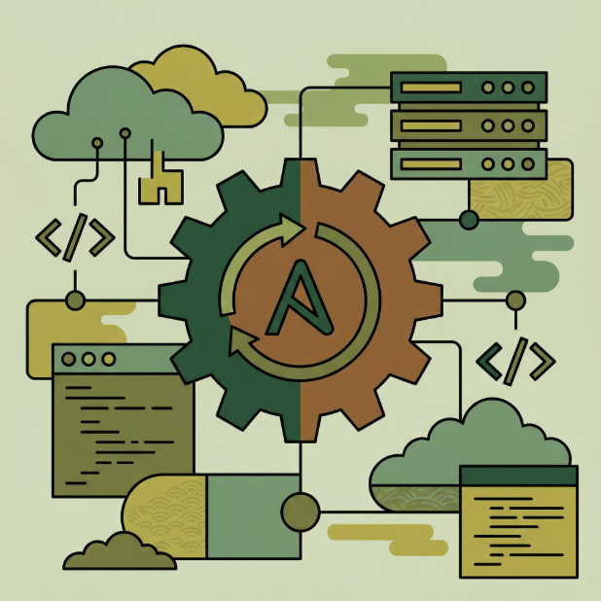

FUTURE EXTENSION
Next Step (Future): Extend Beyond Terraform
After Terraform Foundations are proven stable and delivering measurable value, the same architectural model extends naturally to other infrastructure and configuration management systems.
The Reusable Model
Standards
Consistent patterns and archetypes
Metadata
Machine-readable documentation
Validation
Automated quality enforcement
Future Target: Ansible / AAP
Versioned Contracts
Apply the same foundation model to Ansible Automation Platform:
Explicit interface definitions
Roles: Standardized, validated, cataloged
Playbooks: Consistent structure and metadata
Collections: Versioned with explicit dependencies
Why This Matters
Cross-tooling visibility: Dependencies become visible across infrastructure (Terraform) and configuration (Ansible)
Consistent governance: Same validation and evidence model applies universally
Unified AI reasoning: Systems can reason across the full stack, not just one tool
Key point: This is not "adding Ansible scope" now — it's extending a proven foundation after Terraform success is demonstrated.

Slide 17

Summary
This initiative addresses a critical enterprise need through systematic engineering rather than superficial modernization.
Fixes Terraform at the Root
Reduces Real, Measured Costs
Improves Reliability and Velocity
Addresses systemic problems, not symptoms. Eliminates recurring failure patterns through standardization.
$800K–$2.5M+ annual impact reduction based on documented incident analysis and operational data.
Faster deployments with fewer failures. Teams spend time building, not recovering from incidents.
Enables AI Safely and Responsibly
Creates a Durable Enterprise Foundation
Creates the structured foundation AI requires. No hype, no speculation—just practical capabilities.
Extensible model proven with Terraform, ready to scale to Ansible and beyond.
Key point: This is not "optional modernization" — it is foundational engineering required for sustainable platform growth.

Slide 18
ACTION REQUIRED
Ask / Next Steps
Moving forward requires organizational alignment, appropriate resourcing, and a phased approach that prioritizes foundational work before dependent capabilities.
Align on Terraform Foundations as a Priority Recognize this as critical infrastructure work, not a "nice to have" modernization effort
Fund and Staff the Foundational Work Allocate dedicated engineering resources with infrastructure and automation expertise
Treat AI as a Dependent Capability Sequence initiatives correctly: foundation first, AI capabilities second
Measure Success Through Outcomes Track incident reduction, deployment velocity, and service enablement speed
Plan Extension to Ansible After Terraform Stability Apply the proven model to AAP only after Terraform Foundations deliver results
Build the foundation once. Leverage it everywhere.

