Slide 1
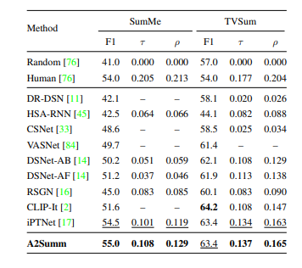
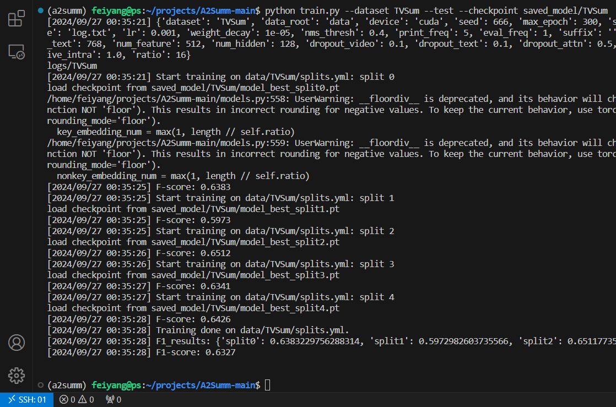
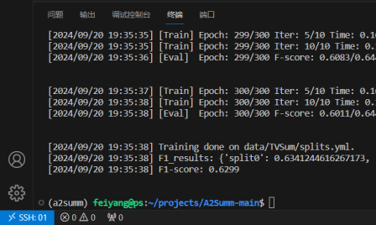
Align and Attend: Multimodal Summarization with Dual Contrastive Losses
TVSum

Slide 2
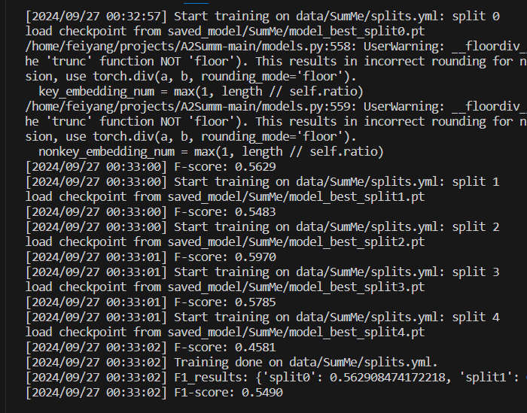
SumMe

Slide 3
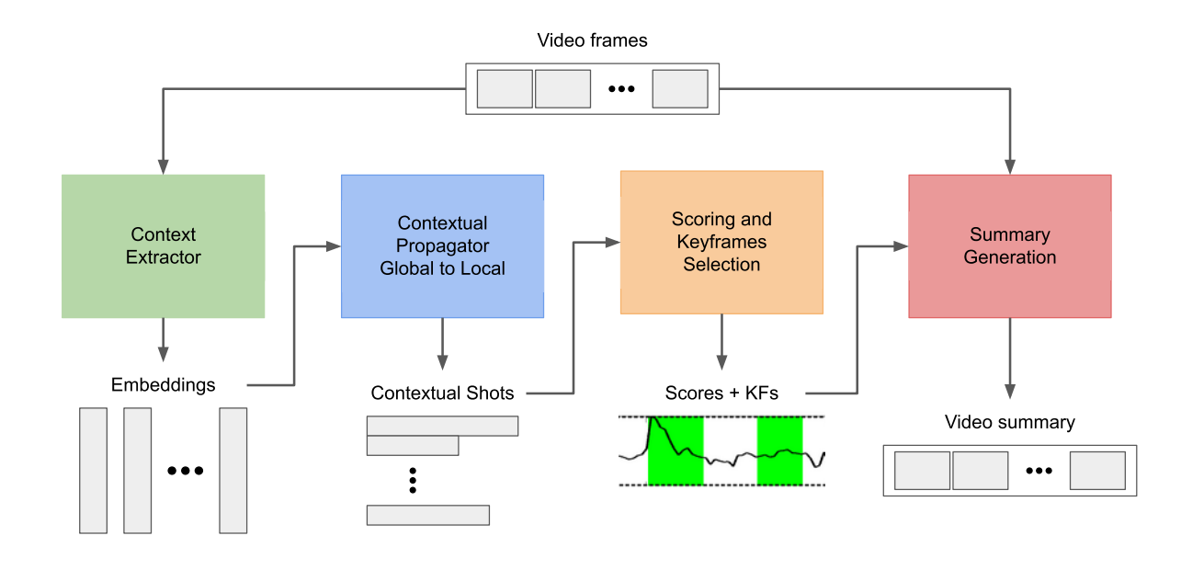
Cluster-based Video Summarization with Temporal Context Awareness
Model

Slide 4
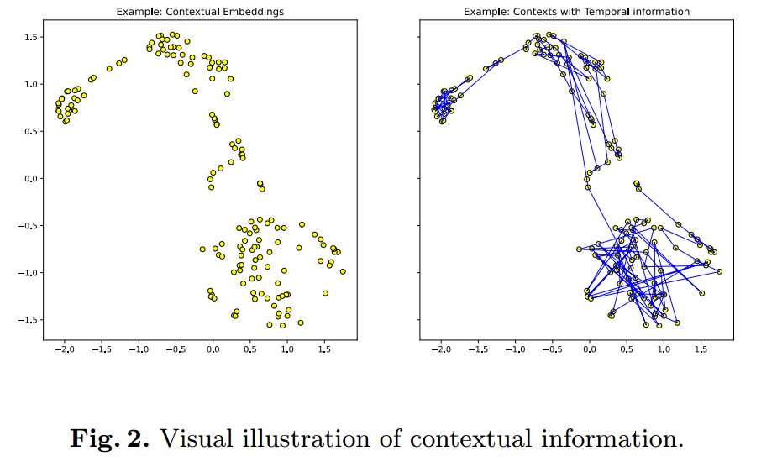


Generating Contextual Embeddings
Sampling
Embedding

Slide 5
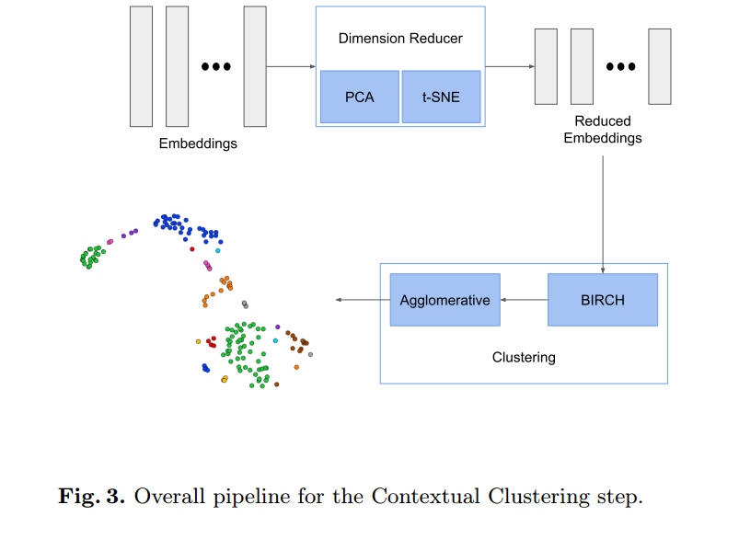


From Global Context to Local Semantics
Contextual Clustering
PCA和t-SNE
BIRCH算法 得到粗聚类标签ˆc
层次聚类算法（hierarchical clustering algorithm)
Semantic Partitioning

Slide 6

Keyframes and Importance Scores
Keyframes Selection
Mean, Middle和Ends
Importance Scores
1. initialize the importance score ˆv to be the length of the section it belongs to
2.a keyframe-biasing method
3. interpolating methods are used to fill the importance scores of samples between key positions.
cosine and linear

Slide 7
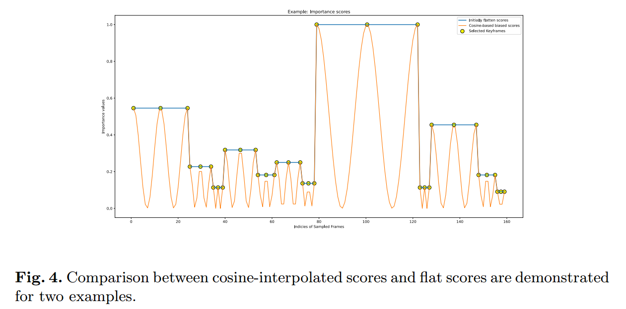

Slide 8
Implementation Details
1.the video is sampled with a target frame rate of R = 4 frames per second
2. DINO and CLIP
3.Semantic Partitioning步骤中，将卷积的窗口大小W设置为5，最小分区长度ϵ 为4。
4.keyframe selection, we employ the setting Middle + End
5.cosine interpolation and set keyframe biasing scheme to Increase the importances of keyframes with B = 0.5.

Slide 9
Evaluation Measures
A widely established metric for this comparison is f-measure

Slide 10
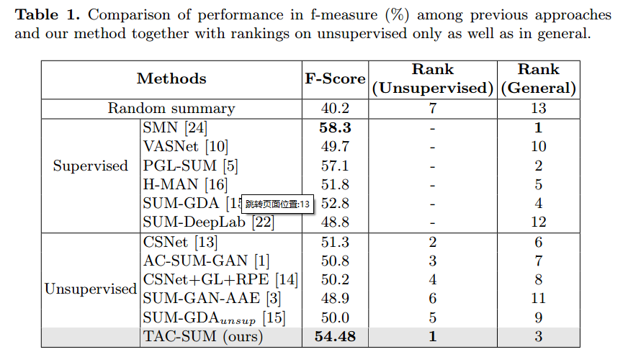

Slide 11
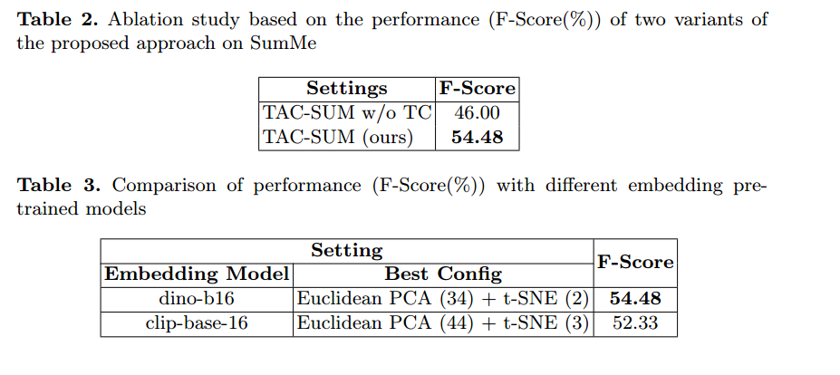
Ablation Study

Slide 12
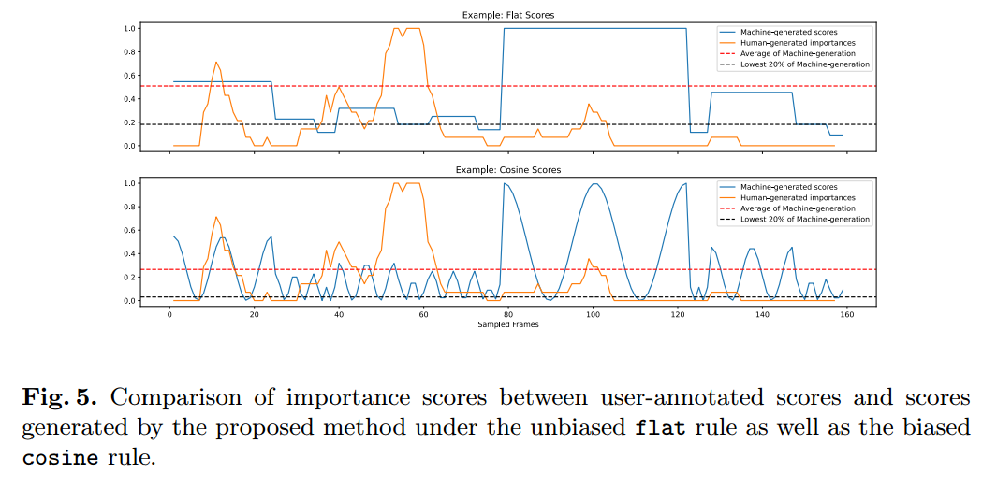

Slide 13
