Slide 1
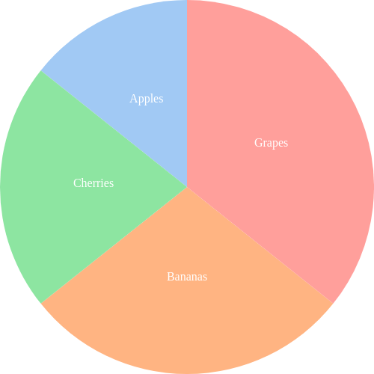
A Custom Chart called Happy chart
<happy data='[ { "label": "Apples", "value": 10 }, { "label": "Bananas", "value": 20 }, { "label": "Cherries", "value": 15 }, { "label": "Grapes", "value": 25 } ]' width=500 height=500 colors='pastel' >

Slide 2
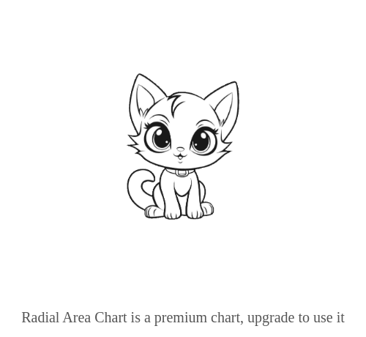
A HORIZONTAL radial_areachart
<radial_areachart data='[ { "group": "North", "label": "Q1", "value": 22 }, { "group": "North", "label": "Q2", "value": 35 }, { "group": "North", "label": "Q3", "value": 40 }, { "group": "North", "label": "Q4", "value": 28 }, { "group": "South", "label": "Q1", "value": 18 }, { "group": "South", "label": "Q2", "value": 30 }, { "group": "South", "label": "Q3", "value": 26 }, { "group": "South", "label": "Q4", "value": 32 }, { "group": "East", "label": "Q1", "value": 25 }, { "group": "East", "label": "Q2", "value": 28 }, { "group": "East", "label": "Q3", "value": 33 }, { "group": "East", "label": "Q4", "value": 29 }, { "group": "West", "label": "Q1", "value": 20 }, { "group": "West", "label": "Q2", "value": 24 }, { "group": "West", "label": "Q3", "value": 32 }, { "group": "West", "label": "Q4", "value": 27 } ]' width=500 height=400 colors='deep' x_label_angle=90 show_legend='true' horizontal='true' >

Slide 3
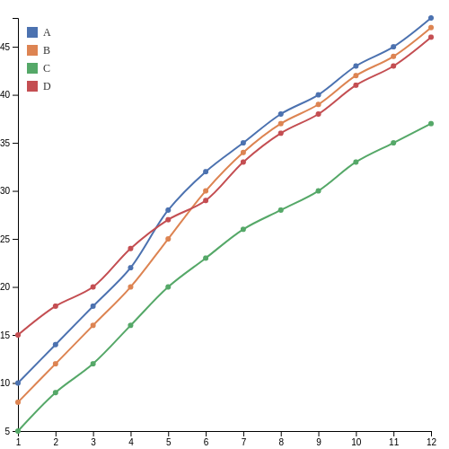
A multi_linechart
<multi_linechart data='[ { "label": "A", "x": 1, "y": 10 }, { "label": "A", "x": 2, "y": 14 }, { "label": "A", "x": 3, "y": 18 }, { "label": "A", "x": 4, "y": 22 }, { "label": "A", "x": 5, "y": 28 }, { "label": "A", "x": 6, "y": 32 }, { "label": "A", "x": 7, "y": 35 }, { "label": "A", "x": 8, "y": 38 }, { "label": "A", "x": 9, "y": 40 }, { "label": "A", "x": 10, "y": 43 }, { "label": "A", "x": 11, "y": 45 }, { "label": "A", "x": 12, "y": 48 }, { "label": "B", "x": 1, "y": 8 }, { "label": "B", "x": 2, "y": 12 }, { "label": "B", "x": 3, "y": 16 }, { "label": "B", "x": 4, "y": 20 }, { "label": "B", "x": 5, "y": 25 }, { "label": "B", "x": 6, "y": 30 }, { "label": "B", "x": 7, "y": 34 }, { "label": "B", "x": 8, "y": 37 }, { "label": "B", "x": 9, "y": 39 }, { "label": "B", "x": 10, "y": 42 }, { "label": "B", "x": 11, "y": 44 }, { "label": "B", "x": 12, "y": 47 }, { "label": "C", "x": 1, "y": 5 }, { "label": "C", "x": 2, "y": 9 }, { "label": "C", "x": 3, "y": 12 }, { "label": "C", "x": 4, "y": 16 }, { "label": "C", "x": 5, "y": 20 }, { "label": "C", "x": 6, "y": 23 }, { "label": "C", "x": 7, "y": 26 }, { "label": "C", "x": 8, "y": 28 }, { "label": "C", "x": 9, "y": 30 }, { "label": "C", "x": 10, "y": 33 }, { "label": "C", "x": 11, "y": 35 }, { "label": "C", "x": 12, "y": 37 }, { "label": "D", "x": 1, "y": 15 }, { "label": "D", "x": 2, "y": 18 }, { "label": "D", "x": 3, "y": 20 }, { "label": "D", "x": 4, "y": 24 }, { "label": "D", "x": 5, "y": 27 }, { "label": "D", "x": 6, "y": 29 }, { "label": "D", "x": 7, "y": 33 }, { "label": "D", "x": 8, "y": 36 }, { "label": "D", "x": 9, "y": 38 }, { "label": "D", "x": 10, "y": 41 }, { "label": "D", "x": 11, "y": 43 }, { "label": "D", "x": 12, "y": 46 } ]' width=500 height=500 colors='deep' curved='true' show_legend='true' >

Slide 4
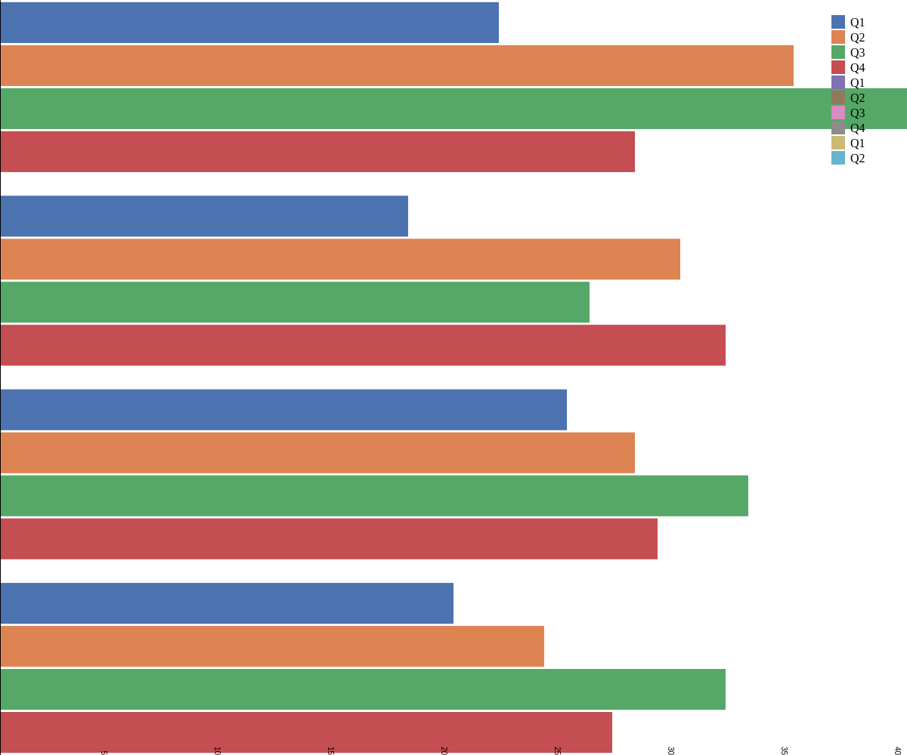
A HORIZONTAL grouped_barchart
<grouped_barchart data='[ { "group": "North", "label": "Q1", "value": 22 }, { "group": "North", "label": "Q2", "value": 35 }, { "group": "North", "label": "Q3", "value": 40 }, { "group": "North", "label": "Q4", "value": 28 }, { "group": "South", "label": "Q1", "value": 18 }, { "group": "South", "label": "Q2", "value": 30 }, { "group": "South", "label": "Q3", "value": 26 }, { "group": "South", "label": "Q4", "value": 32 }, { "group": "East", "label": "Q1", "value": 25 }, { "group": "East", "label": "Q2", "value": 28 }, { "group": "East", "label": "Q3", "value": 33 }, { "group": "East", "label": "Q4", "value": 29 }, { "group": "West", "label": "Q1", "value": 20 }, { "group": "West", "label": "Q2", "value": 24 }, { "group": "West", "label": "Q3", "value": 32 }, { "group": "West", "label": "Q4", "value": 27 } ]' width=1200 height=1000 colors='deep' x_label_angle=90 show_legend='true' horizontal='true' >

Slide 5
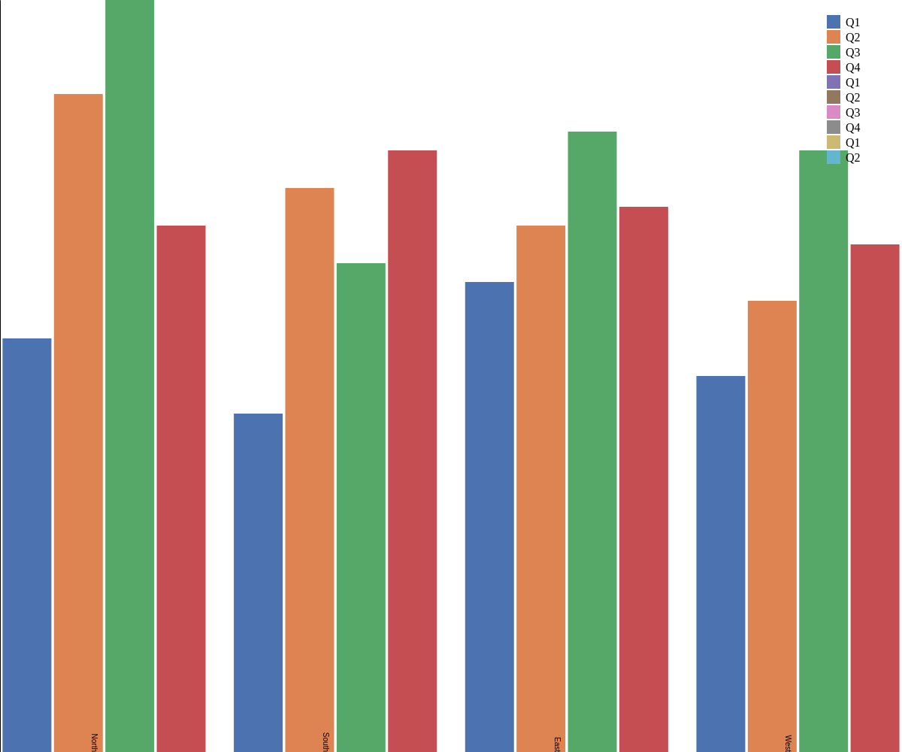
A VERTICAL grouped_barchart
<grouped_barchart data='[ { "group": "North", "label": "Q1", "value": 22 }, { "group": "North", "label": "Q2", "value": 35 }, { "group": "North", "label": "Q3", "value": 40 }, { "group": "North", "label": "Q4", "value": 28 }, { "group": "South", "label": "Q1", "value": 18 }, { "group": "South", "label": "Q2", "value": 30 }, { "group": "South", "label": "Q3", "value": 26 }, { "group": "South", "label": "Q4", "value": 32 }, { "group": "East", "label": "Q1", "value": 25 }, { "group": "East", "label": "Q2", "value": 28 }, { "group": "East", "label": "Q3", "value": 33 }, { "group": "East", "label": "Q4", "value": 29 }, { "group": "West", "label": "Q1", "value": 20 }, { "group": "West", "label": "Q2", "value": 24 }, { "group": "West", "label": "Q3", "value": 32 }, { "group": "West", "label": "Q4", "value": 27 } ]' width=1200 height=1000 colors='deep' x_label_angle=90 show_legend='true' >

Slide 6
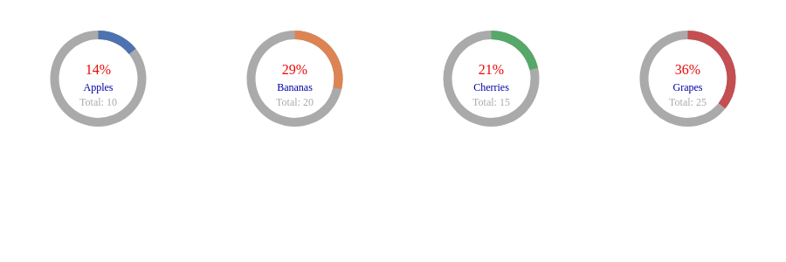
A Pie Grid from data file format
<piegrid path="data/pie.json" width=900 height=300 colors='deep' show_percentages='true' columns=4 bg_arc_color='#aaa' text_color='#0000aa' >

Slide 7
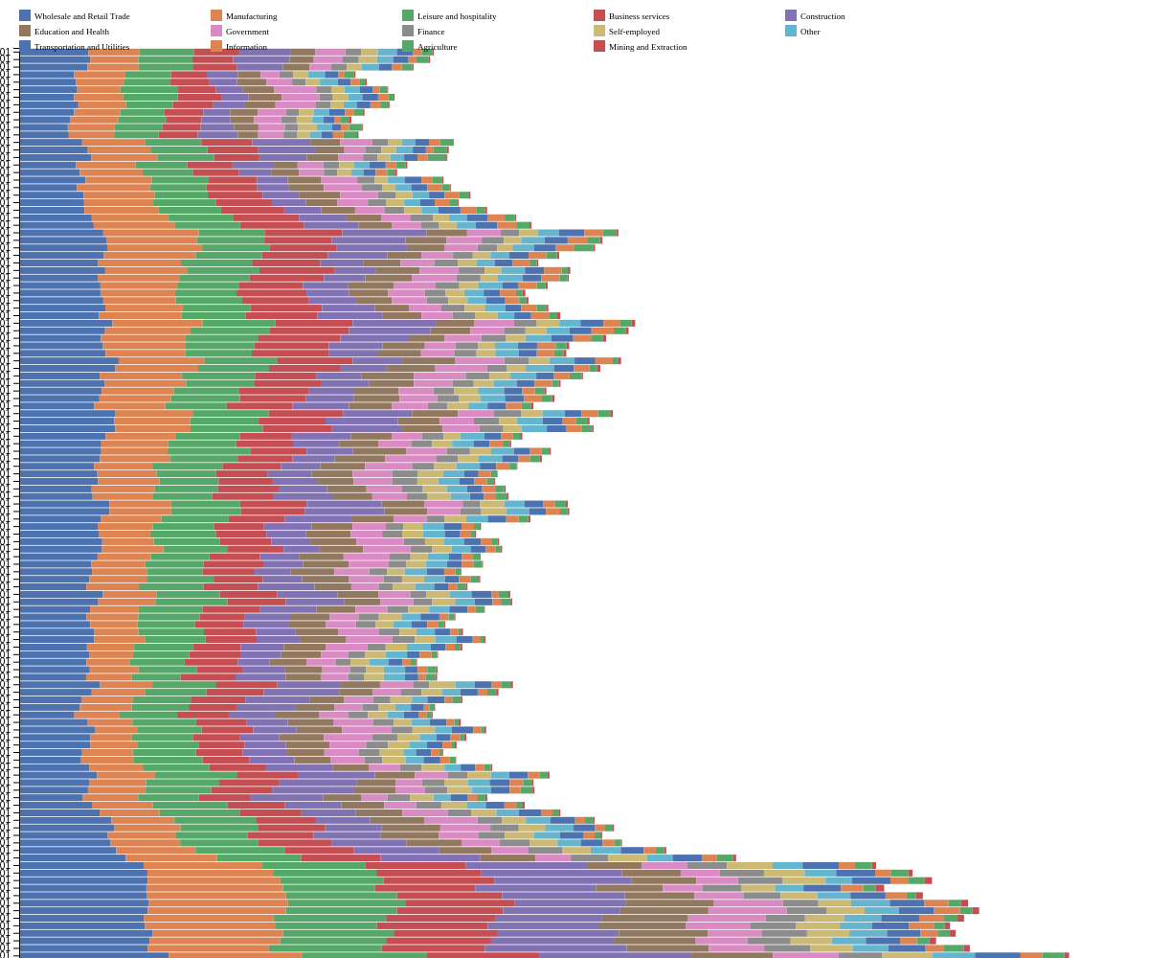
A HORIZONTAL stacked barchart
<stacked_barchart path="data/label_category_value.json" width=1200 height=1000 colors='deep' x_label_angle=90 show_legend='true' horizontal='true' >

Slide 8
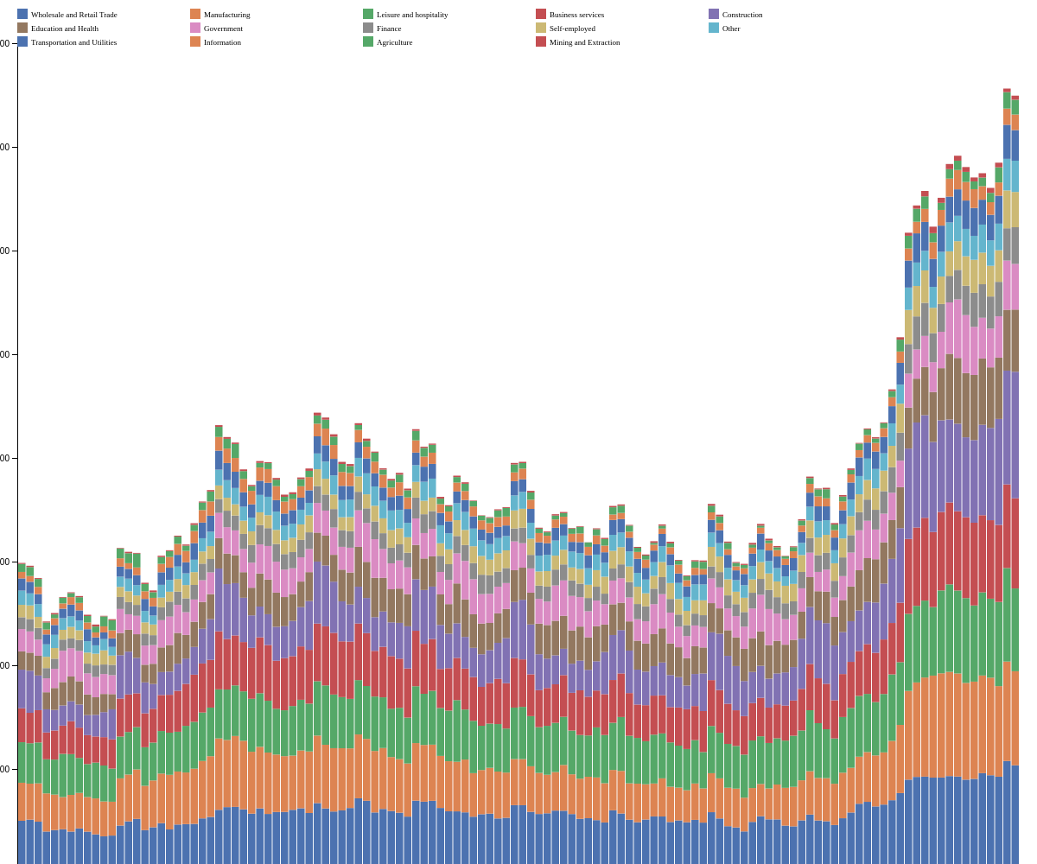
A VERTICAL stacked barchart
<stacked_barchart path="data/label_category_value.json" width=1200 height=1000 colors='deep' x_label_angle=90 show_legend='true' >

Slide 9
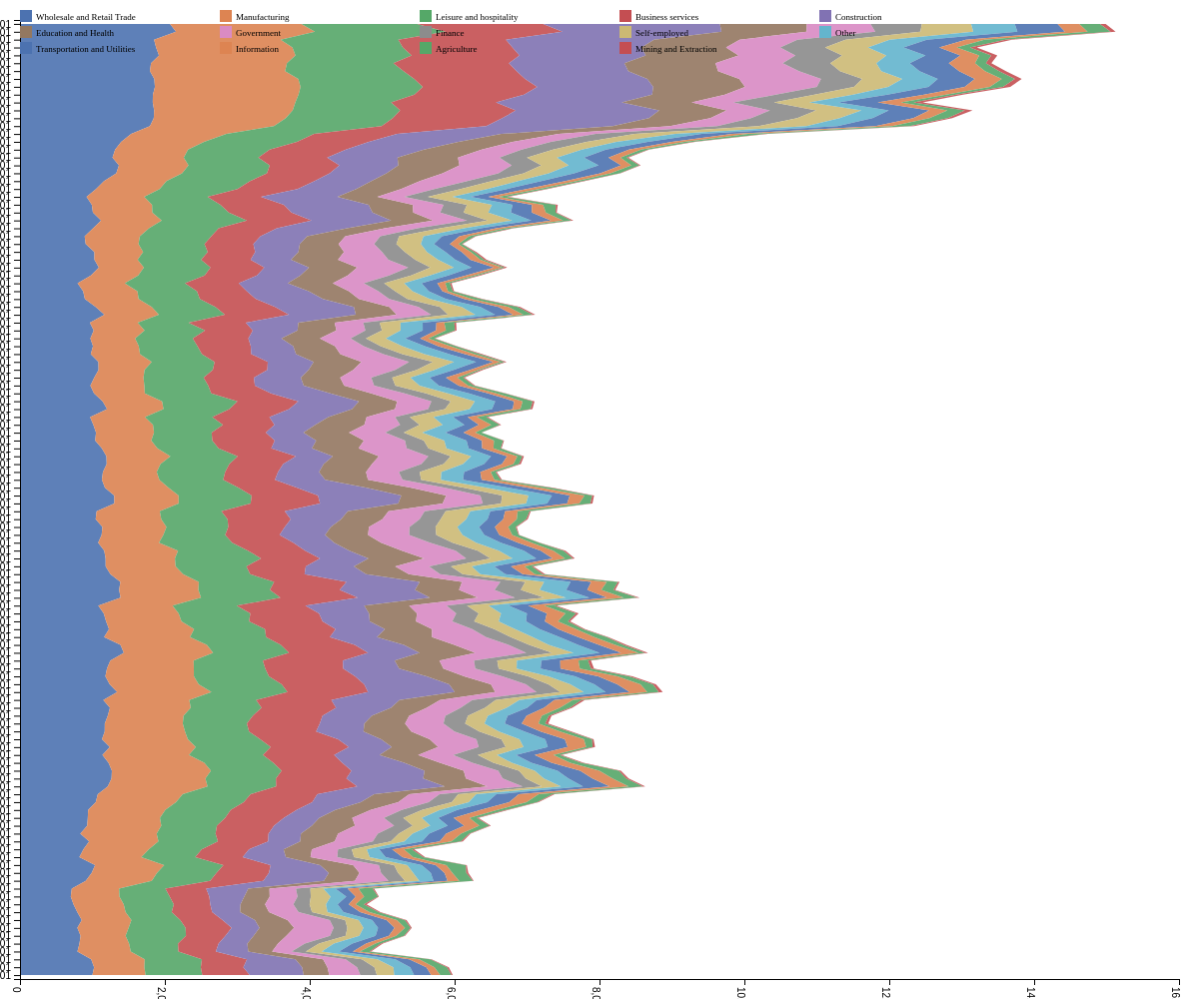
A HORIZONTAL stacked areachart
<stacked_areachart path= "data/label_category_value.json" width=1200 height=1000 colors='deep' x_label_angle=90 show_legend='true' horizontal='true' >

Slide 10
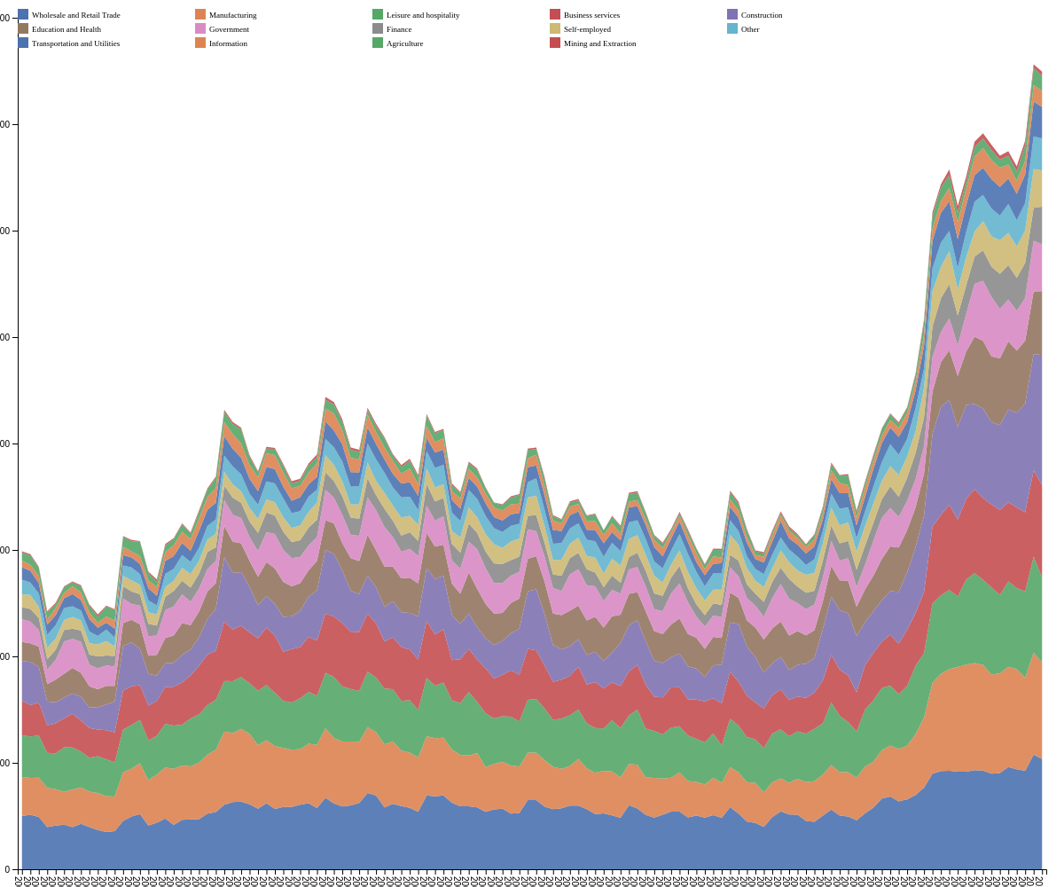
A VERTICAL stacked areachart
<stacked_areachart path= "data/label_category_value.json" width=1200 height=1000 colors='deep' x_label_angle=90 show_legend='true' >

Slide 11
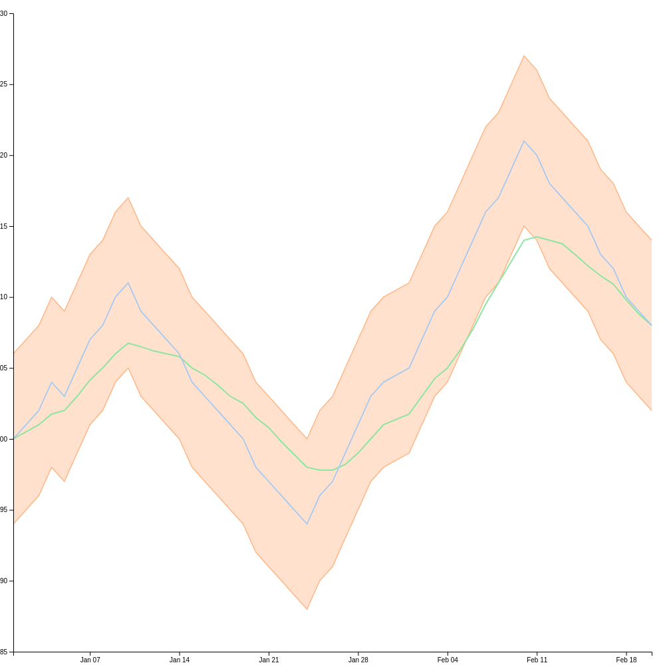
A bollinger band diagram
<bollinger path= "data/bollinger_50.json" size='{"width":1000,"height":1000}' colors='pastel' >

Slide 12
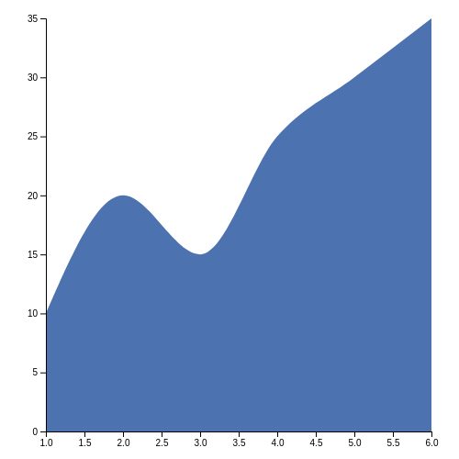
An curved areachart
<areachart data='[ { "x": 1, "y": 10 }, { "x": 2, "y": 20 }, { "x": 3, "y": 15 }, { "x": 4, "y": 25 }, { "x": 5, "y": 30 }, { "x": 6, "y": 35 } ]' width=500 height=500 colors='deep' curved='true' >

Slide 13
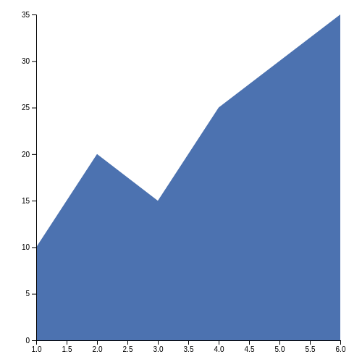
An non-curved areachart
<areachart data='[ { "x": 1, "y": 10 }, { "x": 2, "y": 20 }, { "x": 3, "y": 15 }, { "x": 4, "y": 25 }, { "x": 5, "y": 30 }, { "x": 6, "y": 35 } ]' width=500 height=500 colors='deep' >

Slide 14
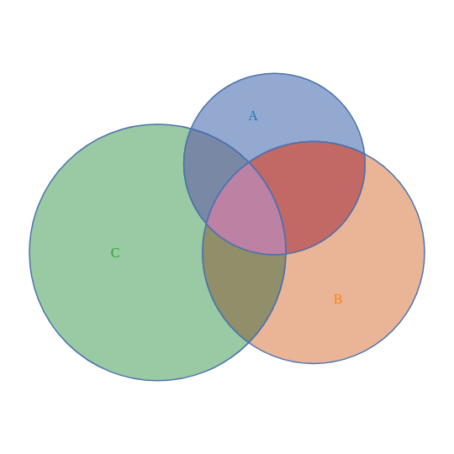
A venn diagram
<vennchart data=' [ {"sets": ["A"], "size": 10}, {"sets": ["B"], "size": 15}, {"sets": ["C"], "size": 20}, {"sets": ["A","B"], "size": 5}, {"sets": ["A","C"], "size": 3}, {"sets": ["B","C"], "size": 4}, {"sets": ["A","B","C"], "size": 2} ] ' size='{"width":500,"height":500}' colors='deep' >

Slide 15
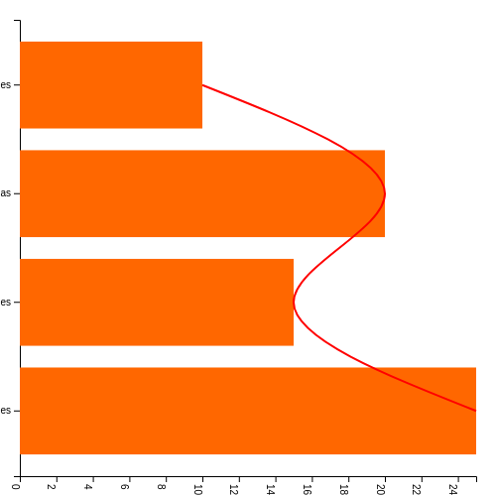
A Vertical Bar chart
<barchart data='[ { "label": "Apples", "value": 10 }, { "label": "Bananas", "value": 20 }, { "label": "Cherries", "value": 15 }, { "label": "Grapes", "value": 25 } ]' width=500 height=500 colors='["#FF6700","#008000"]' horizontal='true' moving_average='true' x_label_angle=90 >

Slide 16
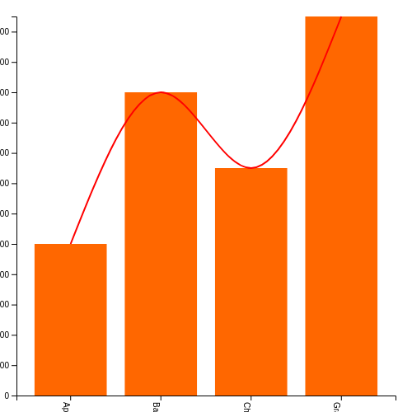
A Horizontal Bar chart
<barchart data='[ { "label": "Apples", "value": 100000000 }, { "label": "Bananas", "value": 200000000 }, { "label": "Cherries", "value": 150000000 }, { "label": "Grapes", "value": 250000000 } ]' width=500 height=500 colors='["#FF6700","#008000"]' horizontal='false' moving_average='true' x_label_angle=90 >

Slide 17
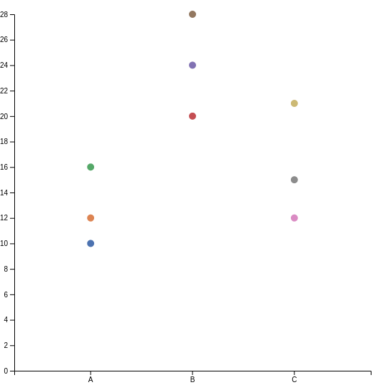
A dotplot chart
<dotplot data='[ { "category": "A", "value": 10 }, { "category": "A", "value": 12 }, { "category": "A", "value": 16 }, { "category": "B", "value": 20 }, { "category": "B", "value": 24 }, { "category": "B", "value": 28 }, { "category": "C", "value": 12 }, { "category": "C", "value": 15 }, { "category": "C", "value": 21 } ]' width=500 height=500 colors='deep' >

Slide 18
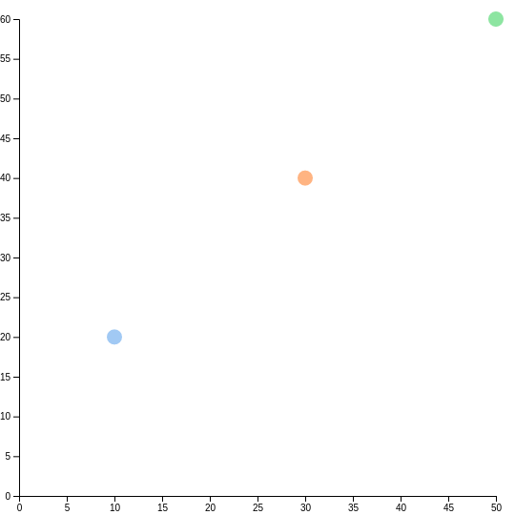
A scatterplot chart
<scatterplot data='[ { "x": 10, "y": 20 }, { "x": 30, "y": 40 }, { "x": 50, "y": 60 } ]' width=500 height=500 dotsize=8 >

Slide 19
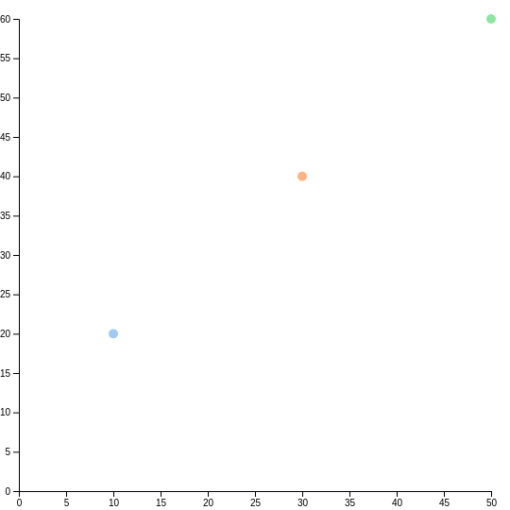
<scatterplot data='[ { "x": 10, "y": 20 }, { "x": 30, "y": 40 }, { "x": 50, "y": 60 } ]' width=500 height=500 >

Slide 20
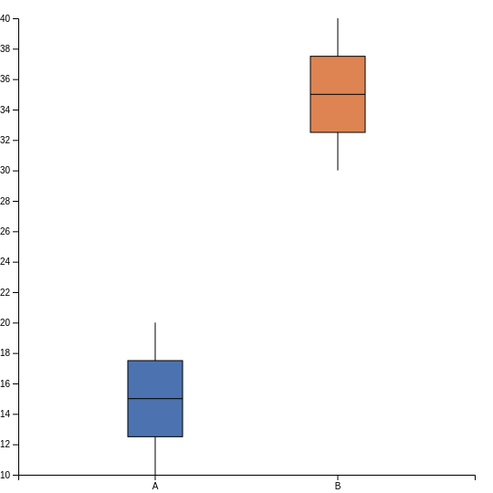
A boxplot chart
<boxplot data='[ { "category": "A", "value": 10 }, { "category": "A", "value": 15 }, { "category": "A", "value": 20 }, { "category": "B", "value": 30 }, { "category": "B", "value": 35 }, { "category": "B", "value": 40 } ]' width=500 height=500 colors='deep' >

Slide 21
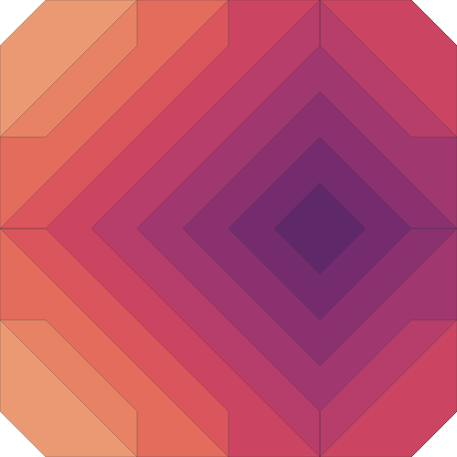
A Contour diagramn
<contour data='[ [0, 10, 20, 30, 20], [10, 20, 30, 40, 30], [20, 30, 40, 50, 40], [10, 20, 30, 40, 30], [0, 10, 20, 30, 20] ]' width=500 height=500 colors='flare' >

Slide 22
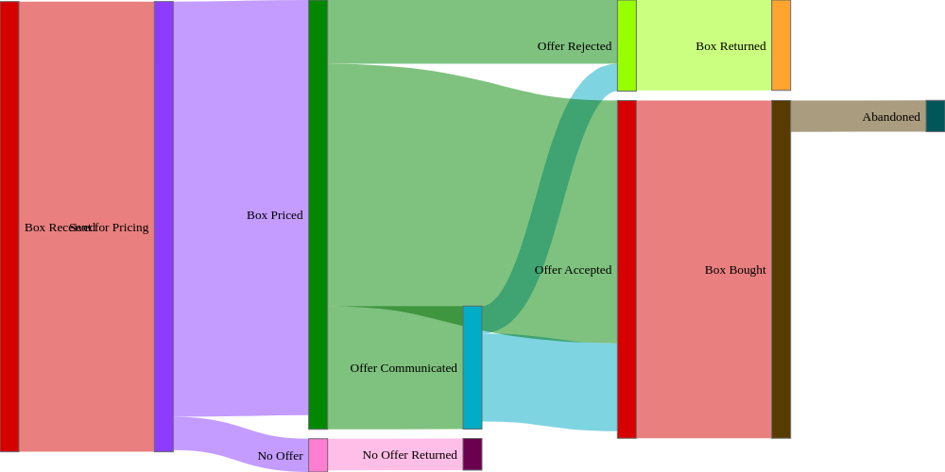
<skey path= "data/std_focus.json" link_color='"target"' colors='cc.glasbey' width=1000 height=500>

Slide 23
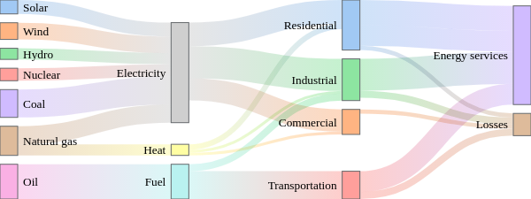
<skey width=600 height=225 path= "data/energy.json" n_colors=10 colors='pastel' link_color='"source-target"' node_align='"right"' >

Slide 24
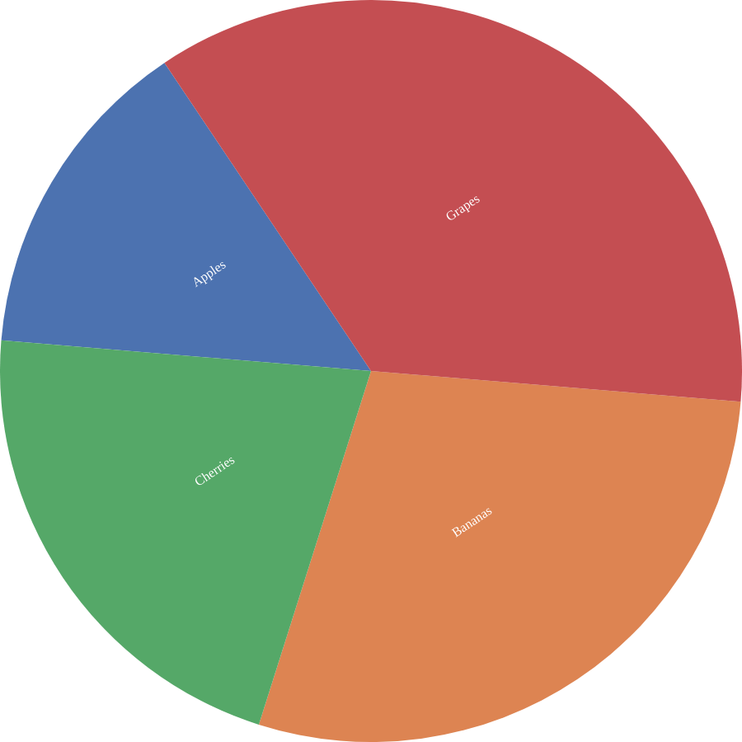
A Pie chart from data file format
<piechart path="data/pie.json" width=900 height=900 colors='deep' >

Slide 25
A Pie chart from data path format
<piechart path="data/pie.json" width="900" height="900" colors='deep' >

Slide 26
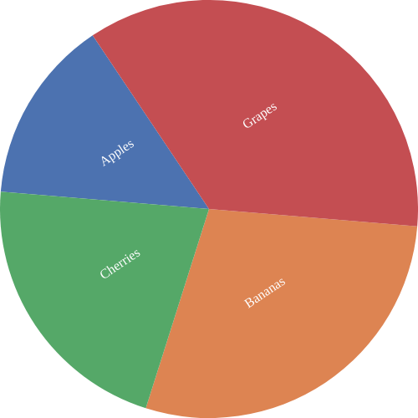
A Pie chart from data path with format
<piechart path="data/pie.json" format="json" width=500 height=500 colors='deep' >

Slide 27
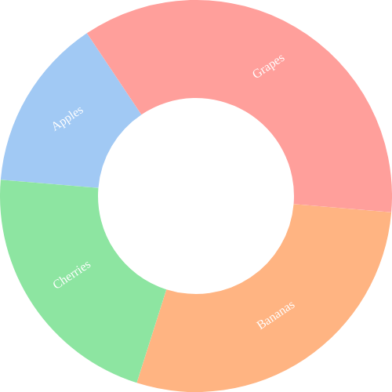
A Donut chart
<piechart data='[ { "label": "Apples", "value": 10 }, { "label": "Bananas", "value": 20 }, { "label": "Cherries", "value": 15 }, { "label": "Grapes", "value": 25 } ]' width=500 height=500 colors='pastel' donut = true >

Slide 28
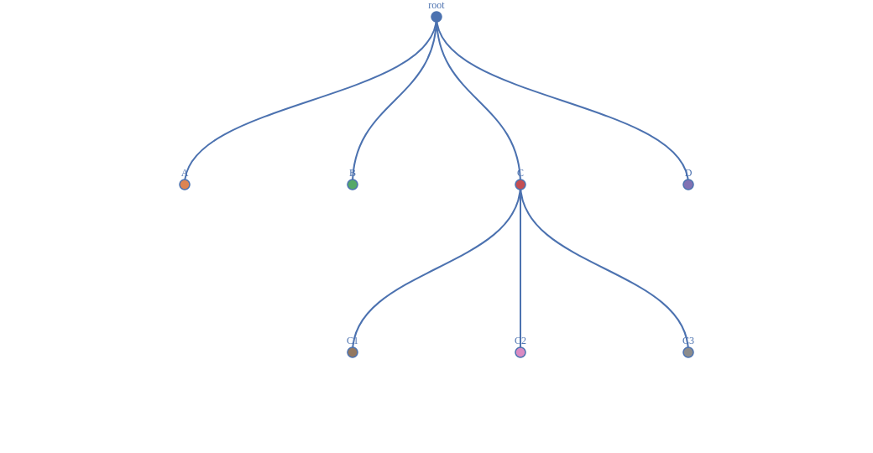
A vertical tree chart
<tree data='{ "name": "root", "children": [ { "name": "A", "value": 10 }, { "name": "B", "value": 20 }, { "name": "C", "children": [ { "name": "C1", "value": 10 }, { "name": "C2", "value": 5 }, { "name": "C3", "value": 15 } ]}, { "name": "D", "value": 40 } ] } ' width=1000 height=500 colors='deep' vertical=True>

Slide 29
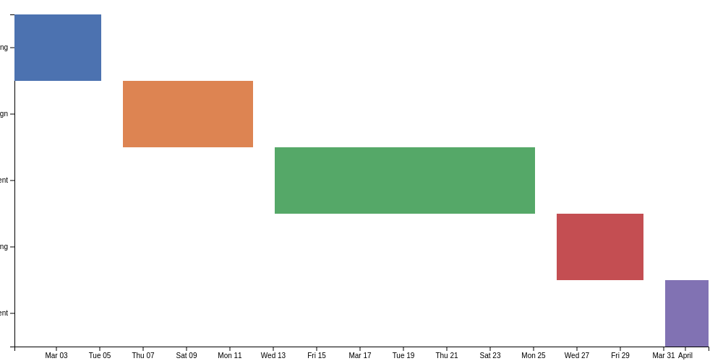
A gantt chart
<gantt data='[ { "task": "Planning", "start": "2024-03-01", "end": "2024-03-05" }, { "task": "Design", "start": "2024-03-06", "end": "2024-03-12" }, { "task": "Development", "start": "2024-03-13", "end": "2024-03-25" }, { "task": "Testing", "start": "2024-03-26", "end": "2024-03-30" }, { "task": "Deployment", "start": "2024-03-31", "end": "2024-04-02" } ]' width=1000 height=500 colors='deep' >

Slide 30
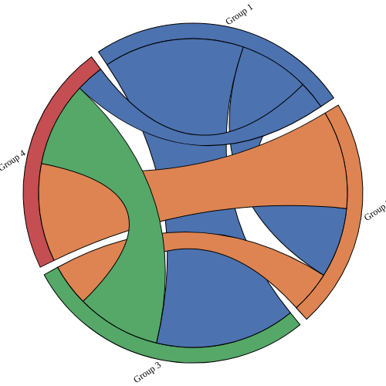
A chord diagram
<chord data='[ [0, 5, 10, 2], [5, 0, 3, 7], [10, 3, 0, 6], [2, 7, 6, 0] ] ' width=500 height=500 colors='deep' >

Slide 31

<bubblechart path="data/flare.json" width=900 height=900 colors='deep' ease_in=1 drag_animations=1 >

