Slide 1
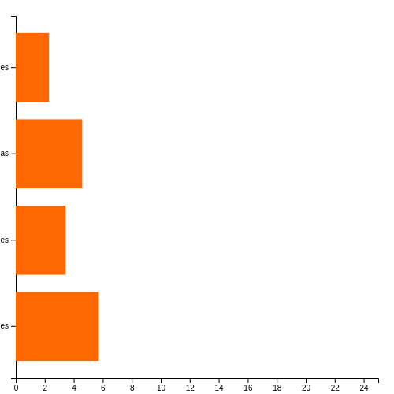
A Vertical Bar chart
<barchart data='[ { "label": "Apples", "value": 10 }, { "label": "Bananas", "value": 20 }, { "label": "Cherries", "value": 15 }, { "label": "Grapes", "value": 25 } ]' size='{"width":500,"height":500}' colors='["#FF6700","#008000"]' horizontal='true' moving_average='true' >

Slide 2
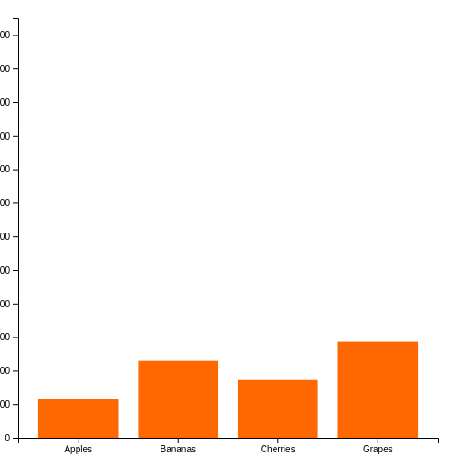
A Horizontal Bar chart
<barchart data='[ { "label": "Apples", "value": 100000000 }, { "label": "Bananas", "value": 200000000 }, { "label": "Cherries", "value": 150000000 }, { "label": "Grapes", "value": 250000000 } ]' size='{"width":500,"height":500}' colors='["#FF6700","#008000"]' horizontal='false' moving_average='true' >

Slide 3
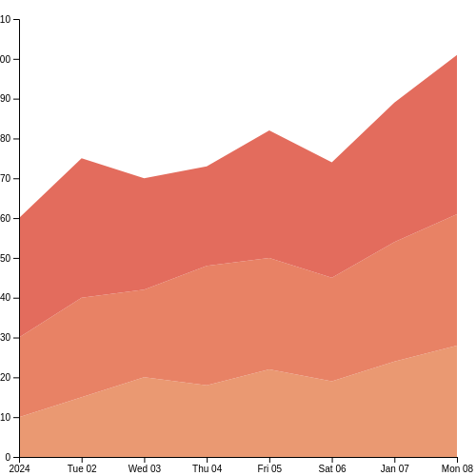
<areachart data='[ { "date": "2024-01-01", "catA": 10, "catB": 20, "catC": 30 }, { "date": "2024-01-02", "catA": 15, "catB": 25, "catC": 35 }, { "date": "2024-01-03", "catA": 20, "catB": 22, "catC": 28 }, { "date": "2024-01-04", "catA": 18, "catB": 30, "catC": 25 }, { "date": "2024-01-05", "catA": 22, "catB": 28, "catC": 32 }, { "date": "2024-01-06", "catA": 19, "catB": 26, "catC": 29 }, { "date": "2024-01-07", "catA": 24, "catB": 30, "catC": 35 }, { "date": "2024-01-08", "catA": 28, "catB": 33, "catC": 40 } ]' size='{"width":500,"height":500}' colors='flare' >

Slide 4
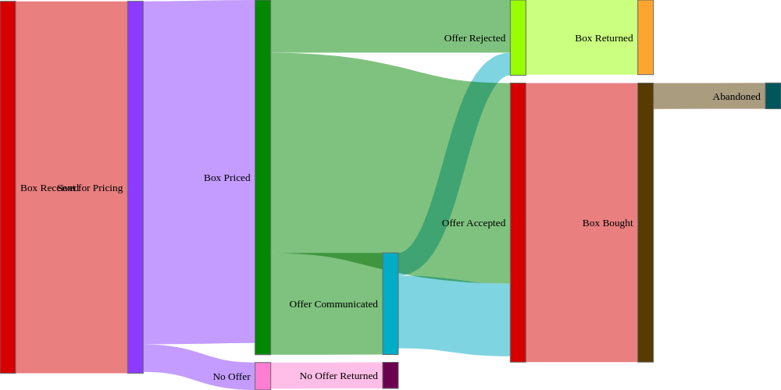
<skey file='{ "path": "std_focus.json", "format": "json" }' link_color='"target"' colors='cc.glasbey' size='{"width":1000,"height":500}'>

Slide 5
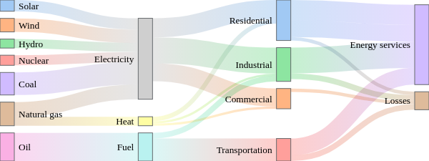
<skey size='{"width":600,"height":225}' file='{"path": "data/energy.json", "format": "json"}' n_colors=10 colors='pastel' link_color='"source-target"' node_align='"right"' >

Slide 6
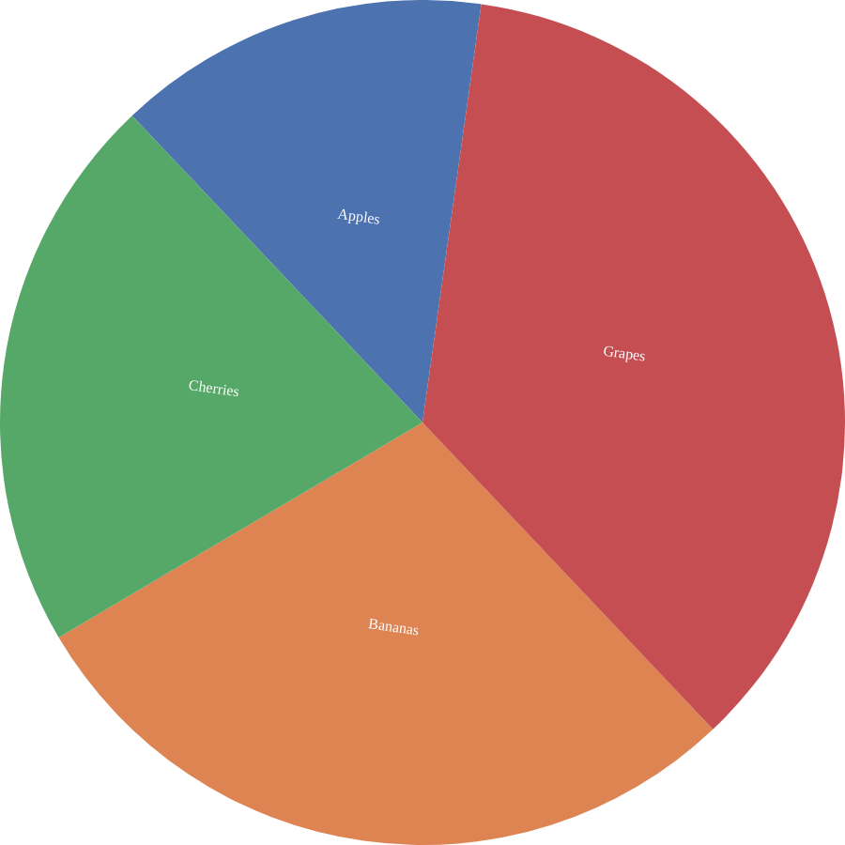
A Pie chart from data file format
<piechart file='{"path":"data/pie.json","format":"json"}' width=900 height=900 colors='deep' >

Slide 7
A Pie chart from data path format
<piechart file='{"path":"data/pie.json","format":"json"}' width="900" height="900" colors='deep' >

Slide 8
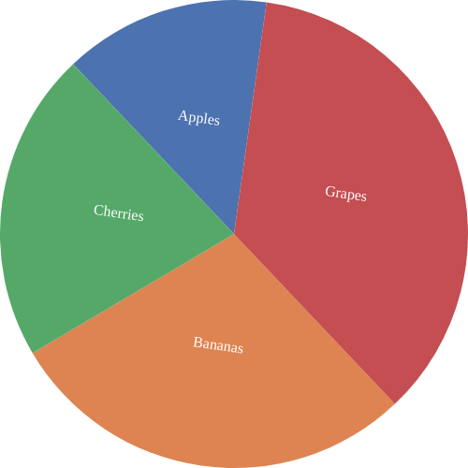
A Pie chart from data path with format
<piechart path="data/pie.json" format="json" size='{"width":500,"height":500}' colors='deep' >

Slide 9
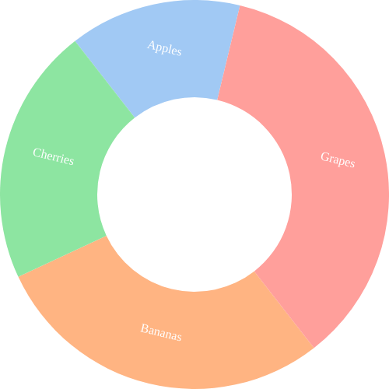
A Donut chart
<piechart data='[ { "label": "Apples", "value": 10 }, { "label": "Bananas", "value": 20 }, { "label": "Cherries", "value": 15 }, { "label": "Grapes", "value": 25 } ]' size='{"width":500,"height":500}' colors='pastel' donut = true >

Slide 10
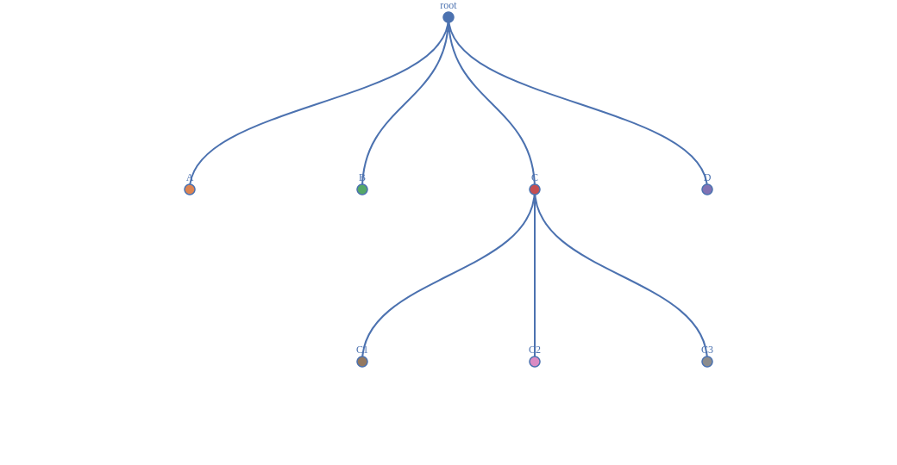
A vertical tree chart
<tree data='{ "name": "root", "children": [ { "name": "A", "value": 10 }, { "name": "B", "value": 20 }, { "name": "C", "children": [ { "name": "C1", "value": 10 }, { "name": "C2", "value": 5 }, { "name": "C3", "value": 15 } ]}, { "name": "D", "value": 40 } ] } ' size='{"width":1000,"height":500}' colors='deep' vertical=True>

Slide 11
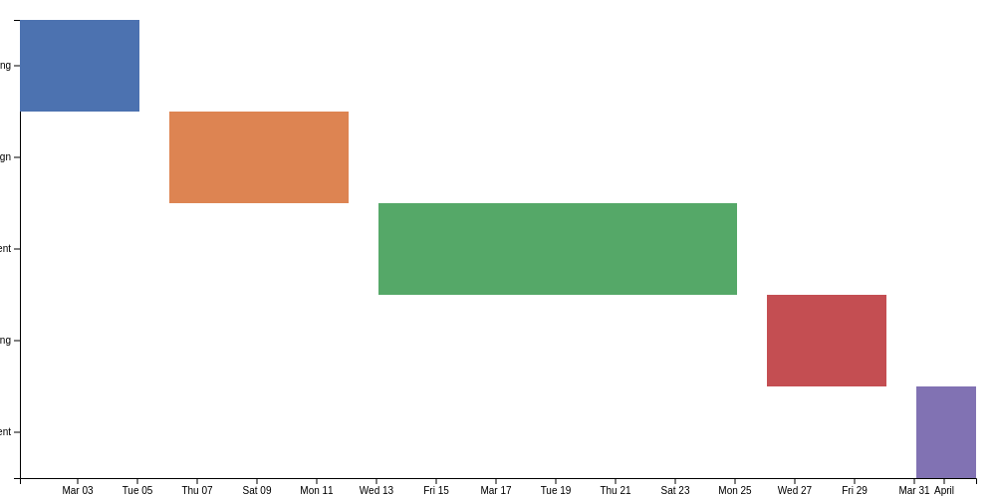
A gantt chart
<gantt data='[ { "task": "Planning", "start": "2024-03-01", "end": "2024-03-05" }, { "task": "Design", "start": "2024-03-06", "end": "2024-03-12" }, { "task": "Development", "start": "2024-03-13", "end": "2024-03-25" }, { "task": "Testing", "start": "2024-03-26", "end": "2024-03-30" }, { "task": "Deployment", "start": "2024-03-31", "end": "2024-04-02" } ]' size='{"width":1000,"height":500}' colors='deep' >

Slide 12
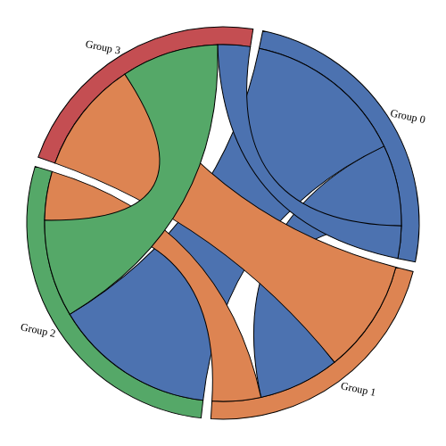
A chord diagram
<chord data='[ [0, 5, 10, 2], [5, 0, 3, 7], [10, 3, 0, 6], [2, 7, 6, 0] ] ' size='{"width":500,"height":500}' colors='deep' >

