Slide 1
Binary Classification of Tumors from MR Images using Deep
Learning
EE491-PROJECT
UTKU ACAR
250206062
Project Advisor: M. Zübeyir Ünlü

Slide 2
INTRODUCTION
AIM : Designing a Deep Learning Model based decision support system for brain tumor classification with highest accuracy as possible to help physicians.

Slide 3
OUTLINE
1. Introduction
  1.1 What is Deep Learning and Why We are Using it?
  1.2 How Binary Classification Works?
  1.3 Difference Between Low- and High-Grade Gliomas
  1.4 What is the General Working Scheme of the Project?
2. Background Information
  2.1 Convolutional Neural Networks
  2.2 Perceptron
  2.3 Convolutional (Filtering) Layer
  2.4 Initialization of Filter Weights
  2.5 Updating of Filter Weights
  2.6 Max Pooling Layer
  2.7 Flattening Layer
  2.8 Dropout Layer
  2.9 Dense Layer (Multilayer Perceptron)
3. Proposed Solution and Design Process
  3.1 Model Creating
  3.2 Training a Model
  3.3 Optimization and Early Stopping Algorithms
4. Conclusion
5.References

Slide 4
1. INTRODUCTION
1.1 What is Deep Learning and Why we are using it?
  Deep learning is a subfield of machine learning which focuses on mimicking neuron activities such as deciding, learning, recognizing in our brains[1].
  Deep learning models are used to find complex relationships between variables even if they looks like independent.
  In Machine Learning Features are given by us.
  In Deep Learning Features are Learned by model.

Slide 5
1. INTRODUCTION
1.2 How Binary Classification Works?
  Binary Classification is a labelling method consists of only 2 different classes. Used in;
    Medical industry to determine patient has specific disease or not.
    Control industry to check if the corresponding product satisfies specifications or not.
  Despite we have only 2 outputs (0,1) we have 4 cases due to output accuracy
    False Negative
    False Positive
    True Negative
    True Positive

Slide 6
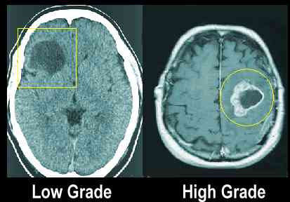
1. INTRODUCTION
1.3 Difference Between Low- and High-Grade Gliomas
  There are 2 grades of Gliomas. These grades based on differentiation of cells, levels of aggression, etc.
  Low-Grade Gliomas (LGG)→ Less aggressive , slower growth
  High-Grade Gliomas (HGG)→More aggressive, rapid growth
Figure 1: HGG vs LGG Example [2]

Slide 7
1. INTRODUCTION
1.4 What is the General Working Scheme of the Project?
  General Scheme of this project has been given below:
    1. Input ( Brain MR Images)
    2. Zero Padding (Kernel Fitting)
    3. Convolution Filtering (Getting Features)
    4. Max-Pool (Removing Unnecessary Features)
    5. Convolution Filtering (Getting More Detailed Features)
    6. Max-Pool (Removing Unnecessary Detailed Features)
    7. Flattening (Matrix to Array Conversion)
    8. Multi-Layer Perceptron (Dense) (Comparing multiple samples)
    9. Activation Function (Decide HGG or LGG)
    10. Output (Giving Prediction Results)

Slide 8
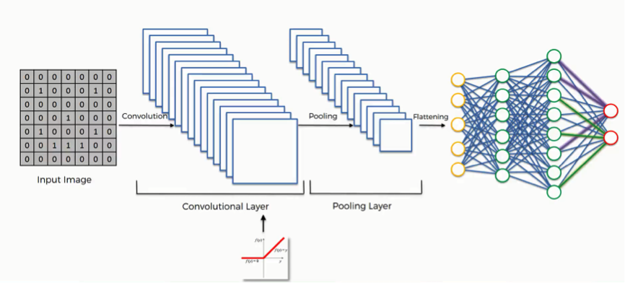
2. BACKGROUND INFORMATION
2.1 Convolutional Neural Networks
  Convolutional Neural Networks are regularized versions of Multilayer Perceptron or Fully Connected Layers.
  There are additional operations in CNNs for regulations such as convolution, pooling, flattening layers etc.
Figure 2: CNN Example [3]

Slide 9
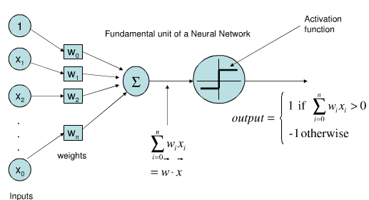
2. BACKGROUND INFORMATION
2.2 Perceptron
  Perceptron is a fundamental unit of Neural Networks
  Perceptron is the equivalent of neurons in our neural system.
  Perceptron gets inputs and multiply these inputs with their weight coefficients and sums up all these multiplication results, then uses the activation function to produce an output.
  Perceptrons can only classify linearly separable set of vectors.
Figure 3: Perceptron[4]

Slide 10
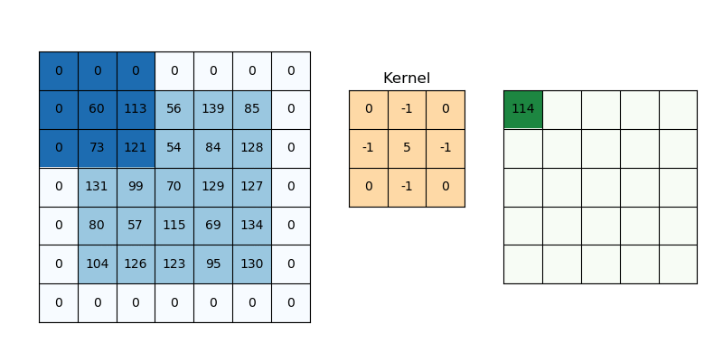
2. BACKGROUND INFORMATION
2.3 Convolutional (Filtering) Layer
  Convolutional Layer is the layer that uses various size of 2 or 3 dimensional kernels to extract features from given image by applying convolution (Cross Correlation) operation with using corresponding part of image and filter kernel weights.
  We need also zero padding before convolutional filtering to avoid data loss at edges of the image.
Figure 4: Convolutional Filtering Example (Sharpening Kernel)[5]

Slide 11
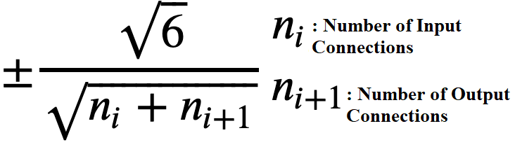
2. BACKGROUND INFORMATION
2.4 Initialization of Filter Weights
  Since we want to learn the correct weights by backpropagation and not giving exact weights to each filter, we should initialize the filter weights somehow. I have used Xavier uniform initializer which is default initializer in Keras library to initialize filter weights.
  The range formula of Xavier uniform initializer is shown below:
Figure 5: Xavier Uniform Initializer [6]

Slide 12
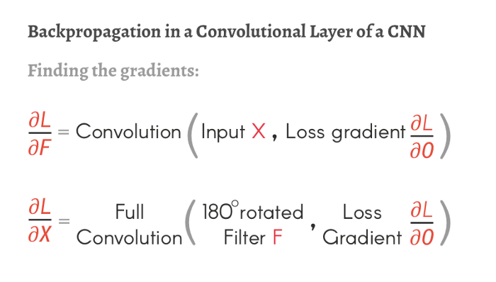

2. BACKGROUND INFORMATION
2.5 Updating of Filter Weights
Filter weights are updated to minimize the loss function output by using backpropagation. This is important for Self Learning process.
  I used binary cross-entropy as a loss function in my model.
  Figure 6 states the gradient descent algorithm(optimization).
  If the learning rate “a” is too high, there could be overshooting problem.
  So, picking suitable learning rate is very important for optimization.
Figure 6: Updating Filter weights and bias [7]
Figure 7: Gradients [8]

Slide 13
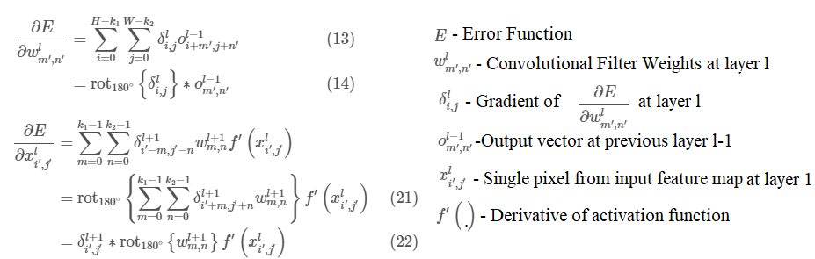
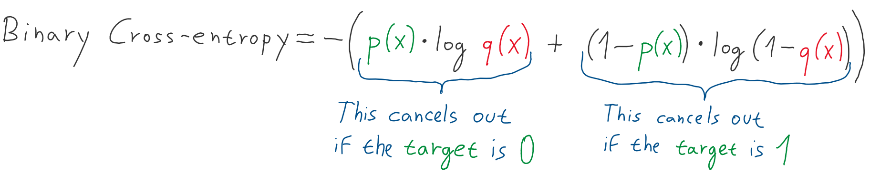
2. BACKGROUND INFORMATION
2.5 Updating of Filter Weights
Figure 8: Detailed Formula for Filter Weight Update[13]
Figure 9: Detailed Formula for Binary cross entropy[14]

Slide 14
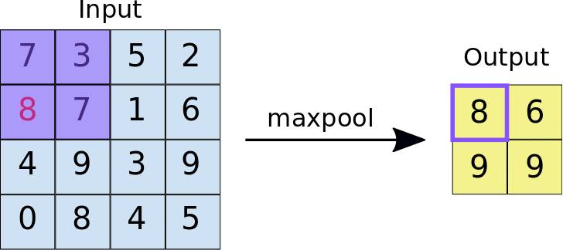
2. BACKGROUND INFORMATION
2.6 Max Pooling Layer
  Max pooling is used to reduce dimensionality, and this results less required computation power for learning the features.
  Max pooling algorithm takes input data and chooses maximum value of given input.
  In my case the input is 2D Matrix which are results of convolutional filtering and max pooling layer has size of 2 (2x2 kernel).
Figure 10: Max Pooling Example [9]

Slide 15
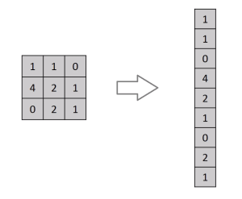
2. BACKGROUND INFORMATION
2.7 Flattening Layer
  Flattening Layer is responsible for converting N x N input to 1x N*N output to make the data processable by multilayer perceptron (Dense).
Figure 11: Flattening Layer Example [10]

Slide 16
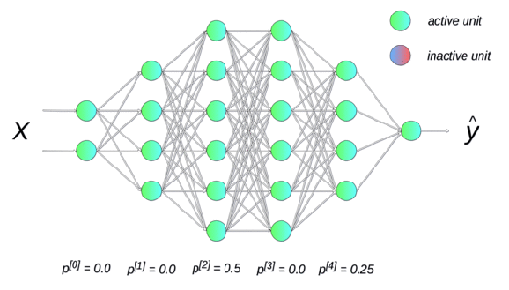
2. BACKGROUND INFORMATION
2.8 Dropout Layer
  Dropout Layer is used to prevent overfitting.
  This layer resets(make 0)(off) random input due to frequency as given rate and multiplies other ones which have not been reset with 1/(1-rate) to maintain summation of all inputs same.
Figure 12: Dropout Layer Example [11]

Slide 17
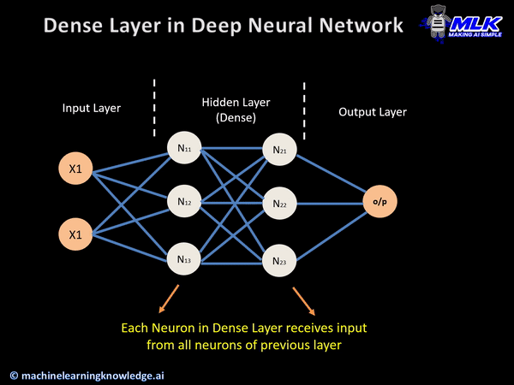
2. BACKGROUND INFORMATION
2.9 Dense Layer (Multilayer Perceptron, Fully Connected Layer)
  Dense layer consists of perceptrons.
  Each perceptron from each layer has a connection between all perceptrons at the next layer. The name “Fully Connected Layer” comes from this topology.
  In my project dense layer used to predict tumor grade for the given Brain MRI (HGG or LGG)
Figure 13: Dense Layer Example [12]

Slide 18
3. PROPOSED SOLUTION AND DESIGN PROCESS
3.1 Model Creating
  The CNN based model should be created to predict with high accuracy.
  My model has 4 convolutional layers, details given below:
    Filter sizes= (16,32,64,128)
    Kernel size= (3x3)
    Activation function= (ReLU,Sigmoid)
    Input shape for just first layer =(240,240,3)
  Each Convolutional layer followed by 2x2 Max Pooling Layer
  There are Dropout Layer at just before and between dense layers with rate= (0.25,0.25,0.25).
  There are 3 dense layers with sizes (64,16,1)
  The last dense layer has a size of 1 and the output of it is in the range of [0,1] so if the output is 0 then the input image is labeled as HGG, and if the output is 1 then it is labeled as LGG.

Slide 19
3. PROPOSED SOLUTION AND DESIGN PROCESS
3.2 Training a Model
  Models should be trained on reliable and consistent datasets.
  I have used a reliable dataset named as “Brats2020” which stands for “Brain Tumor Segmentation Challenge”. This dataset was prepared by Perelman School of Medicine, which is a subdivision of University of Pennsylvania.
  The dataset consists of MR images of 369 different patients; each had 155 axial slices. Generally, the 78th slices are the most detailed slice.
  Since deep learning models require more than 369 slices to process, but I have a limited number of patients, I used more than one slice for each person.
  To be exact, I took slices from 74 to 83 of patients numbered less than or equal to 225; so I have 2250 slices for HGG, and slices from 64 to 93 of patients numbered between 260 and 336; so I have 2250 slices for LGG too. Then I removed some part of these images since they are like each other(reduced to 1127 images for each).

Slide 20
3. PROPOSED SOLUTION AND DESIGN PROCESS
3.3 Optimization and Early Stopping Algorithms
  I tried various parameters to optimize my model by increasing accuracy while decreasing loss at the same time.
  I have changed dropout rate, epoch number, steps per epoch, validation steps, patience for early stopping and added extra dense layers to optimize my model.
  Also, I have used Early Stopping and Model Checkpoint functions which are in Keras library.
  Early Stopping compares validation accuracy with previous validation accuracy values to find if validation accuracy increased by minimum delta or not.
  The size of previous validation accuracy value array is based on “Patience” parameter in Early stopping function.
  I used Model Checkpoint function to store best model which has best validation accuracy up to the epoch at that time.

Slide 21
3. PROPOSED SOLUTION AND DESIGN PROCESS
Epoch | Steps per epoch | Validation Steps | Minimum Delta (Early Stopping) | Patience (Early Stopping) | Accuracy General (Test Data) | HGG accuracy(Test Data) | LGG Accuracy (Test Data) | Loss (Test Data)
34/50 | 99 | 16 | 0.001 | 10 | 0.9970 | 0.9940 | 1.000 | 0.0172
30 | 70 | 16 | 0.001 | 10 | 0.9881 | 0.9940 | 0.9821 | 0.0668
30 | 50 | 20 | 0.001 | 6 | 0.9643 | 0.9583 | 0.9702 | 0.0845
30 | 50 | 16 | 0.001 | 10 | 0.9642 | 0.9523 | 0.9761 | 0.0901
30 | 60 | 16 | 0.001 | 6 | 0.9583 | 0.9404 | 0.9761 | 0.1660
30 | 60 | 16 | 0.001 | 10 | 0.9554 | 0.9107 | 1.0000 | 0.0814
30 | 30 | 16 | 0.001 | 10 | 0.9286 | 0.8750 | 0.9821 | 0.1842
30 | 40 | 16 | 0.001 | 10 | 0.9226 | 0.875 | 0.9702 | 0.1064
20 | 50 | 16 | 0.001 | 3 | 0.8720 | 0.8273 | 0.9166 | 0.3010
30 | 20 | 20 | 0.001 | 3 | 0.8095 | 0.7321 | 0.8869 | 0.4656
Table 1: Optimization of Accuracy and Loss[12]

Slide 22
4. CONCLUSION
To conclude the project, I have created a model with 99.7 percent accuracy and 1 percent loss, which satisfies my design target. I gained a lot of experience in dataset manipulation, creating models to classify tumors, accurately, fundamental concepts of Convolutional Neural Networks and Deep Learning in Python.

Slide 23
5. REFERENCES
[1] J. Brownlee, “What is deep learning?,” Machine Learning Mastery, 14-Aug-2020. [Online]. Available: https://machinelearningmastery.com/what-is-deep-learning/. [Accessed: 06-Jan-2022].
[2] http://www.aboutcancer.com/ana_astro.jpg
[3] https://miro.medium.com/max/866/0*2FRpjIwA-Ip3bYiX.png
[4] https://ahmetasimsengul.files.wordpress.com/2015/05/kuvpq.png
[5] https://editor.analyticsvidhya.com/uploads/99433dnn4.gif
[6] https://miro.medium.com/max/2400/1*H6t3yYBLlinNRUwmL-d7vw.png
[7] https://studymachinelearning.com/wp-content/uploads/2019/12/weight_update-2.png
[8] https://miro.medium.com/max/2400/1*JFoSzff2lxlWn8nJjGZcMw.png
[9] https://nico-curti.github.io/NumPyNet/NumPyNet/images/maxpool.gif
[10] https://miro.medium.com/max/300/0*mUxIJt1aTq3slUSO
[11] https://miro.medium.com/max/1156/0*EnYtZ880d5H3ZYYq
[12] https://machinelearningknowledge.ai/wp-content/uploads/2020/10/Keras-Dense-Layer-Example-in-Deep-Neural-Network.gif
[13] Jefkine, “Backpropagation in Convolutional Neural Networks,” DeepGrid, 05-Sep-2016. [Online]. Available: https://www.jefkine.com/general/2016/09/05/backpropagation-in-convolutional-neural-networks/. [Accessed: 06-Jan-2022].
[14] https://miro.medium.com/max/2000/1*wz59MnXkXdWxrq_fkA2wew.png

