Slide 1
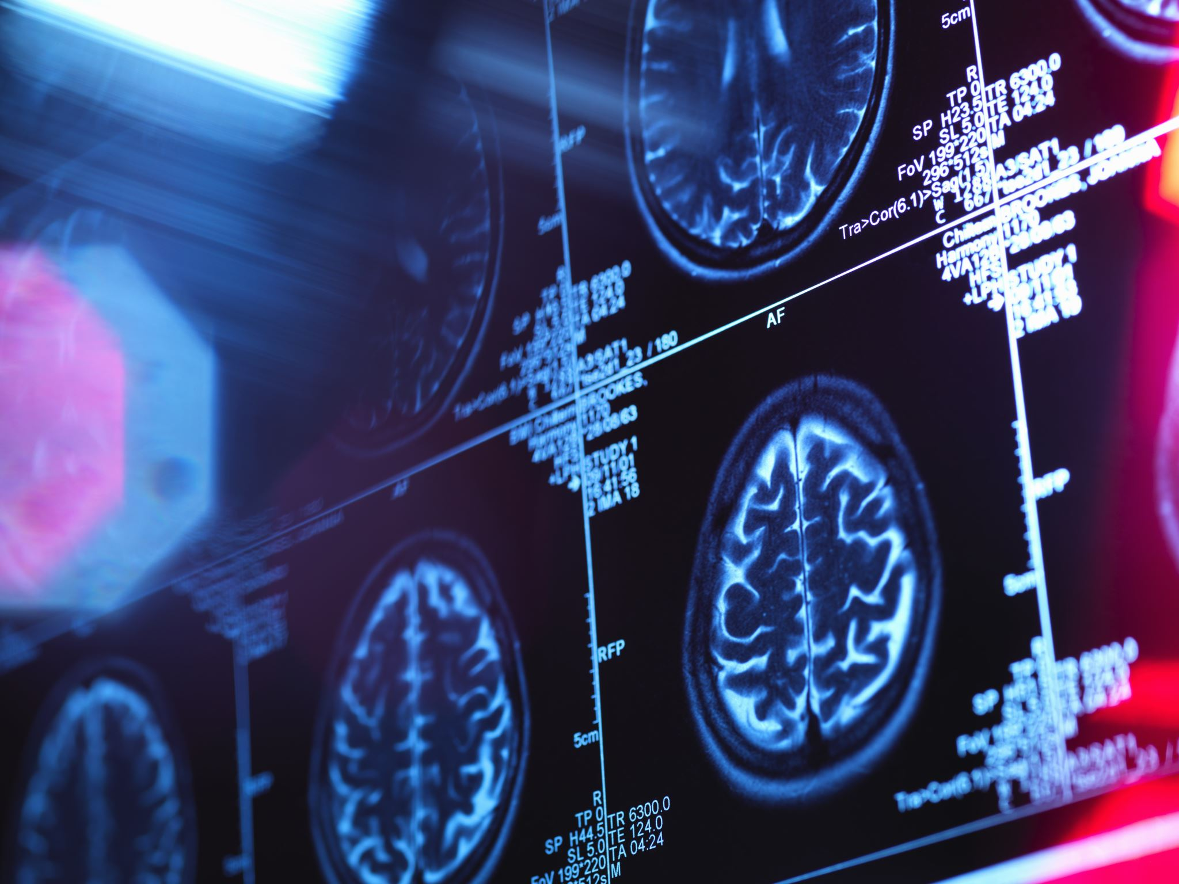

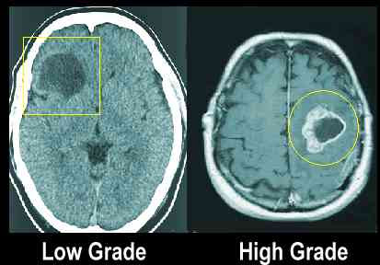
Binary Classification of Tumors from MR Images using Deep Learning
Utku ACAR
Supervisor: Dr. M. Zübeyir Ünlü
izmir ınstitute of technology, electrical & electronics engineering department
Abstract
Algorithm of the project
In this project report there are both theoretical knowledge about and practical applications about Binary Classification of Brain Tumors with using Convolutional Neural Networks by Deep Learning. There is also introduction about each layer in CNNs. The aim of this project is designing a deep learning model-based decision support system for brain tumor classification with the highest accuracy possible to help physicians. Since the class of tumors in the brain is critical to choosing the treatment method, this model can aid in this critical decision process of physicians. Since algorithms for deep learning are complex, functions in Keras library have been used to create model. The model created on Python programming language. There are many cases to reach best accuracy in this report. In the end, the project reached its design goal.
1. Input (Brain MR Images)
2. Zero Padding (Kernel Fitting)
3. Convolution Filtering (Getting Features)
4. Max-Pool (Removing Unnecessary Features)
5. Convolution Filtering (Getting More Detailed Features)
6. Max-Pool (Removing Unnecessary Detailed Features)
7. Flattening (Matrix to Array Conversion)
8. Multi-Layer Perceptron (Dense) (Comparing multiple samples)
9. Activation Function (Decide HGG or LGG)
10. Output (Giving Prediction Results)
Introductıon
Since the technology evolved so much such that, they can recognize any objective from any image even from noisy environments, machines can also learn from before and predict future with using old data. This learning process is heavily dependent on finding “Feature” to distinguish any object or person from each other. The name of this distinction of any object with using these features is “Machine Learning”. There are many ways to train a machine just like “Supervised Learning” where data are labelled or “Unsupervised Learning” where data is not labelled or “Reinforcement Learning” which based on reward/penalty system. After some time, the researchers think that what if we have a model that we do not need to give features and force the model to learn the distinctive features by itself: The self-learning models are named as “Deep Learning”. These kinds of models are more detailed subdivision of machine learning. This project is aims to use this advantage of self-learning ability of deep learning models to classify brain tumors as HGG or LGG and aid physicians or radiology technicians with this classification process.
Test Results
Best accuracy has been found when Epoch was 50 but early stopped at 34 while steps per epoch was 99, validation steps was 16, minimum delta was 0.001 which was same for all cases and patience was 10. This configuration reached 99.7% accuracy and 1.7% loss. For determining false negative and false positive cases, the accuracy broke into two as HGG and LGG accuracy. For the best case, the model predicts LGG patients by 100% and HGG patients by 99.4% correctness and predict HGG falsely by 0.6%. Generally, while we are increasing steps per epoch, the accuracy is also increasing. These results can be found in Table 1.
What is Deep Learning and Why we are using it?
Deep learning is a subfield of machine learning which focuses on mimicking neuron activities such as deciding, learning, recognizing in our brains [1]. Deep learning models are used to find complex relationships between variables even if they look like independent.
Epoch | Steps per epoch | Validation Steps | Minimum Delta (Early Stopping) | Patience (Early Stopping) | Accuracy General (Test Data) | HGG accuracy (Test Data) | LGG Accuracy (Test Data) | Loss (Test Data)
34/50 | 99 | 16 | 0.001 | 10 | 0.9970 | 0.9940 | 1.000 | 0.0172
30 | 70 | 16 | 0.001 | 10 | 0.9881 | 0.9940 | 0.9821 | 0.0668
30 | 50 | 20 | 0.001 | 6 | 0.9643 | 0.9583 | 0.9702 | 0.0845
30 | 50 | 16 | 0.001 | 10 | 0.9642 | 0.9523 | 0.9761 | 0.0901
30 | 60 | 16 | 0.001 | 6 | 0.9583 | 0.9404 | 0.9761 | 0.1660
30 | 60 | 16 | 0.001 | 10 | 0.9554 | 0.9107 | 1.0000 | 0.0814
30 | 30 | 16 | 0.001 | 10 | 0.9286 | 0.8750 | 0.9821 | 0.1842
Difference Between Low- and High-Grade Gliomas
There are 2 grades of Gliomas. These grades based on differentiation of cells, levels of aggression, etc.
•Low-Grade Gliomas (LGG) are less aggressive and has slower growth rate.
•High-Grade Gliomas (HGG)are more aggressive and has rapid growth rate.
Figure 1 HGG vs LGG Example [1]
Table 1 Accuracy and Loss Results for Several Cases
Problem Definition
Conclusion
Problem is, understanding how CNNs work by figuring out which layer is responsible for which operations exactly.
To conclude the project, I have created a model with 99.7 percent accuracy and 1 percent loss, which satisfies my design target. I gained a lot of experience in dataset manipulation, creating models to accurately classify tumors, and fundamental concepts of Convolutional Neural Networks and Deep Learning in Python. Also, I have seen how accuracy and loss differ with changing various parameters and changing layer configurations.
References
[1] “MRI Appearance of Primary Brian Tumors,” MRI picture of a glioblastoma. [Online]. Available: http://www.aboutcancer.com/mri_gbm.htm. [Accessed: 08-Jan-2022].
2018-2019 Fall Semester, İzmir Institute of Technology, Electronics and Communication Engineering

