Slide 1
Framework for writing ZKPs

Slide 2
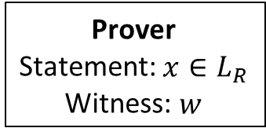
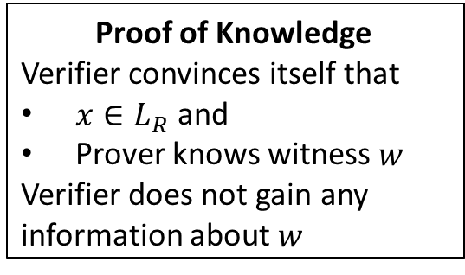
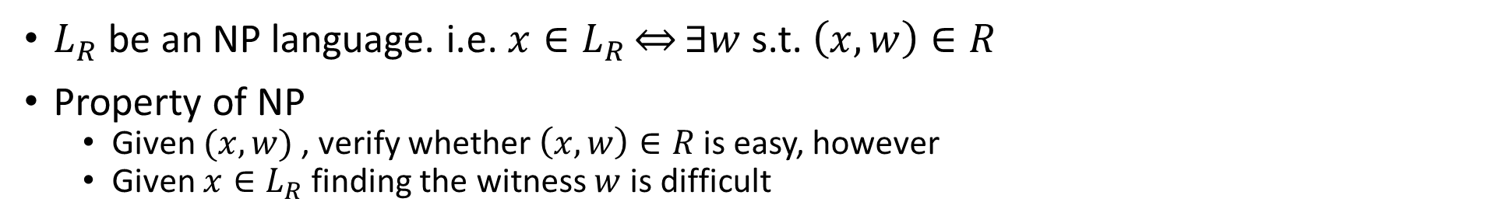
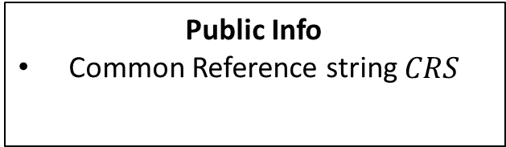
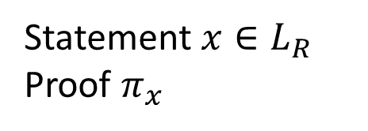
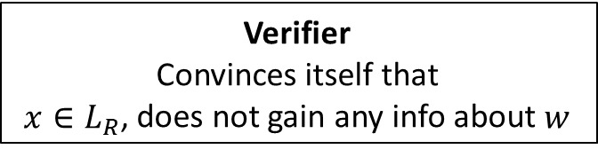
What is zero Knowledge?
$L_{R}$ be an NP language. i.e. $x∈L_{R}\overset{⇔}{}∃w$ s.t. $\left(x,w\right)∈R$
Property of NP
Given $(x,w)$ , verify whether $\left(x,w\right)∈R$ is easy, however
Given $x∈L_{R}$ finding the witness $w$ is difficult
Prover
Statement: $x∈L_{R}$
Witness: $w$
Statement$x∈L_{R}$
Proof $π_{x}$
Verifier
Convinces itself that
$x∈L_{R}$, does not gain any info about $w$
Public Info
Common Reference string $CRS$
Proof of Knowledge
Verifier convinces itself that
$x∈L_{R}$ and
Prover knows witness $w$
Verifier does not gain any information about $w$

Slide 3
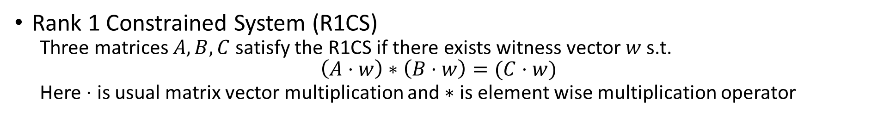
Zero Knowledge Frameworks
High Level Statement
Front End
Low Level Statement
Back End
Proof
High Level Witness
Low Level Witness
Gadgets
Syntax depends on the choice of Front End framework
Verifier
Usually one of the following:
R1CS
Arithmetic Circuit
Boolean Circuit
Yes/No
Rank 1 Constrained System (R1CS)
Three matrices $A,B,C$ satisfy the R1CS if there exists witness vector $w$ s.t.
$$\left(A⋅w\right)∗\left(B⋅w\right)=(C⋅w)$$
Here $⋅$ is usual matrix vector multiplication and $∗$ is element wise multiplication operator

Slide 4
Previous Work: Zkinterface: what does it do?
A tool for zero knowledge interoperability
Different zero knowledge domain specific libraries
Gadget Libraries
Proving Systems
Defines Flatbuffer (https://google.github.io/flatbuffers/) based serialized interface
Currently only supports R1CS

Slide 5
Drawbacks of zkinterface
Deployment is still complicated
Can we assume existence of a trusted server that runs the FE and Verifier only verifies the low level R1CS ?
If not we need to ensure FE is deterministic and the Verifier can rerun the FE to generate the same low level R1CS
For CRS based Backend Proof systems zk-interface does not provide complete interoperability
Proofs are not interoperable, i.e. we need the same prover/verification stack
Constrained System representations such as:
Boolean systems
Arithmetic circuits
Algebraic systems
are NOT yet supported.

Slide 6
R1cs-select based zkframework
Alternative to zk-interface
Focus on simplicity
R1cs rust library as frontend
Bulletproof and Bellman as backend
More backend support in future

