Slide 1
Blockchain Selection Framework
Jeff Stollman
Notes:
Find out audience composition

Slide 2
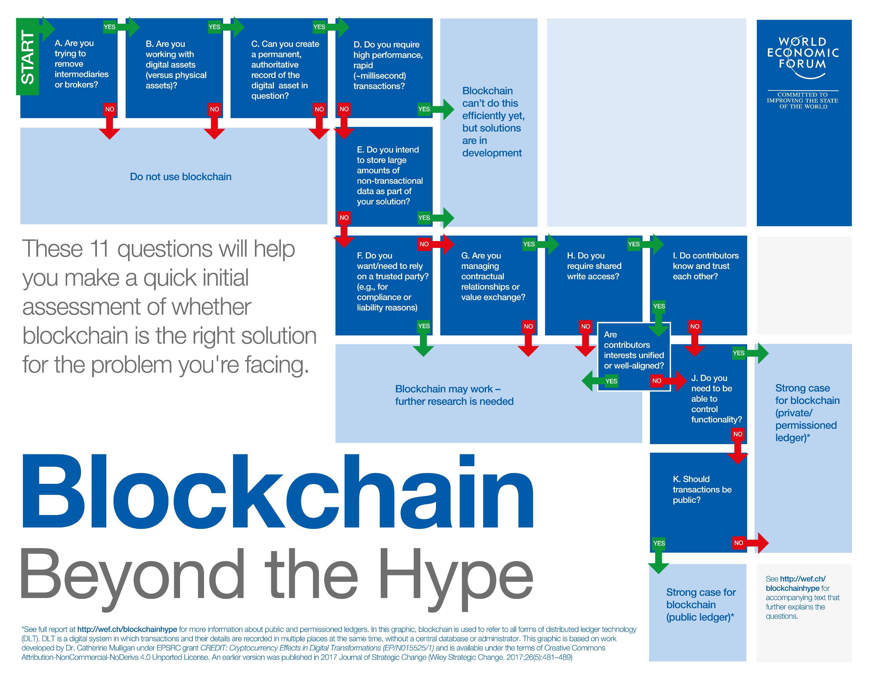
Notes:
I think that this framework was based on a single use case (which they don’t define.
As such, I find the results don’t apply to many of the use cases that I can imagine.
I didn’t like this framework because it dictates HOW, rather than WHAT.
E.g., the first question, “Are you trying to remove intermediaries?” shouldn’t be a specification; it should be a result.
This applies also to Item C, F,
I also take issue with some of their conclusions.
E.g., Item B suggests that blockchain is not appropriate if you are dealing with physical assets. This is crazy. I believe that supply chain of physical assets is one of the best groups of use cases for blockchain.

Slide 3
High-Level Framework
Many writers?
Diverging Incentives?
Hege-mony?
Data Integrity?
Parties Untrusted?
Tampering Easy?
Yes
Yes
Yes
Yes
Yes
Yes
No
No
No
No
No
No
Attack Incentive?
Yes
No
Recourse Difficult?
Yes
Consider Blockchain Alternatives
No
Consider Blockchain
Notes:
The problem is not strictly linear?
Are there many writers?
Do the many writers have diverging incentives (I.e., is there an incentive to cheat)?
Are the many writers concerned about one or more parties owning (i.e., exercising hegemony over) the results?
Is data integrity of high importance?
Are the parties untrusted by one another?
Would tempering without detection be easy in a typical database?
Is legal, or contractual, or other off-chain recourse difficult or expensive to remedy bad behavior?
Is there a strong incentive for outsiders to attack the system?
Are the parties known to one another?
Are the data subject to attack by outside adversaries? (Is the data valuable to outside parties?)
There might be multiple versions of this. For example, there may be a version for high-value transactions that yields different results than low-value transactions.
It may be necessary to combine several of the factors because, by themselves, they are insufficient to differentiate. For example, Diverrging Incentives may not be dispositive by itself, but makes a difference in combination with Hegemony, Data Integrity, Parties Untrusted, and Tampering Easy.

Slide 4
Hegemony
Is the solution provider likely to exercise undesirable influence over the solution process integrity?
Yes
Consider a blockchain solution
No
Do not use as a decision criterion
Notes:
1. Hegemony:
A zealous claim by many blockchain enthusiasts is that centralization is bad and decentralization is always good. But frequently the issue is not really centralization vs decentralization. It is a question of hegemony.
Hegemony is the power to control others who commonly resent that control. In cases where there is hegemony, the decentralization provided by blockchain may be beneficial. For example, consider the situation where a single company has a monopoly on facilitating cross-border payments from a migrant worker to his family back in a poor country. The payment service has a monopoly because it has established an expensive infrastructure to support its service: offices in various cities in both countries, cash reserves to make payments and an internal network to transfer funds from its banks in Country 1 to its banks in Country 2. And because the intermediary has a monopoly, he may exact a high fee for facilitating such payments. A blockchain solution may be established that uses a shared infrastructure. And it is not necessary that the currency exchanges at either end of the transaction be owned by the company providing the cryptocurrency payment solution. (For example, the migrant worker may be able to use a public exchange to buy Bitcoin. He can then send it to his family for a limited transaction fee. The family can then use another exchange to exchange the Bitcoin for fiat. Neither the exchanges nor the payment application (Bitcoin) need be owned by the same entity.)
But sometimes, an intermediary is beneficial and decentralization is not optimal. Sometimes, the intermediary serves as a trust enabler. In the trading of large fancy diamonds, trust is enabled by a small number of diamond certifying agents. Thee Gemological Institute of America (GIA), the American Gemological Society (AGS), the European Gemological Laboratory (EGL) and the International Gemological Institute (IGI) are the only trusted certification labs in the world. A certification provided by this oligopoly is valued. They enable buyers and sellers to agree on the color, cut, clarity, and caret weight of large, fancy diamonds. They facilitate trust without asserting their hegemony over the market. It would make little sense to decentralize the certification business and give certifying authority to all traders of diamonds. Such certifications would not be trusted. Other industries agree on an independent third party to make and enforce the rules for all the trading partners. In the pharmaceutical industry, SAFE-Biopharma is a non-profit administrator providing identity credential services to members of the pharmaceutical industry to facilitate inter-company collaboration. This single centralized solution is welcomed by the industry and preferred to having each company separately credentialing every third-party with whom they work.
The point here is that removing intermediaries is not always beneficial. And decentralization of power is not always beneficial. Therefore, it is less important to know whether there is an intermediary that controls the solution. What is actually important is whether some enterprise or group of enterprises exercises hegemony over the rest of the participants. If this is the case, blockchain is likely to be recommended. If not, this characteristic may be of limited value in making the decision of whether or not to use blockchain.
So rather than asking about centralization and/or removing intermediaries, I believe that a more important question is, "Is the current solution provider (or envisioned future service provider) likely to exercise undesirable influence over the process? If the answer is "yes", a blockchain should be consider. If the answer is "no", this issue should not be considered in the analysis.
*If the answer to the above decision is “YES”, we may need another decision block to consider whether governance solves the problem.

Slide 5
Incoming Data Veracity
Is there a problem with incoming data veracity?
Will blockchain help detect/resolve this problem?
Yes
Yes
Consider a blockchain solution
No
No
Do not use as a decision criterion
Fix the problem
Notes:
1. Incoming Data Veracity:
Incoming Data Veracity addresses the quality of the data coming in to the system. The concern is that having an immutable blockchain data structure is of little value if the data being recorded is of poor quality. (Garbage In = Garbage Out).
Poor quality data has at least two sources.
One source arises when a data writer intentionally attempts to game the system to his/her advantage by providing false or misleading information as input to the system. For example, if there is not a good identify solution for patients, a patient may get someone else to pose as himself to provide a urine sample to avoid having some condition detected that would preclude a desired treatment.
Another source arises from data that are difficult to characterize without ambiguity. This need not be the result of a data writer trying to game the system. If a case of pharmaceuticals is swapped out in transit that have the same identity labels as the authentic originals, the recipient of that shipment may be unaware that the received goods are counterfeit at the time they are received. He/she may record receipt of the counterfeit products with complete integrity -- having been duped by the counterfeiter who swapped out the cases in transit. In another instance, a copy of an art work may be indistinguishable from the original and the purchaser of the copy may report having purchased the original without any suspicion that he has been duped.
Recognizing this input data veracity problem is important because if it cannot be solved, the blockchain will merely serve to propagate bad information.
Until this problem is solved, any attempt at a solution may be flawed.
In some cases, blockchain may be an important part of solving this incoming data veracity problem. For example, in the pharmaceutical solution described above, the reporting of the sale of the original authentic case can be detected by the blockchain that tracks change of ownership. A manual investigation would likely be needed to determine which case is authentic and which case is fraudulent. But once the authentic case is determined, correcting entries can be made in the blockchain to fix the problem. But in the case of the false urine sample, better vetting and authentication of identities and/or better controls in the urine sample handling process must first be implemented to resolve the identification problem, before considering a blockchain solution for downstream tracking. However, if there is no problem with incoming data integrity, this decision criterion should not impact the decision of whether blockchain is appropriate.

Slide 6
Blockchain Selection – Public vs. Private
Many writers?
Hegem-ony?
Data Integrity?
Parties Trusted?
Attackers?
Parties Known?
Yes
Yes
Yes
Yes
Yes
Yes
No
No
No
No
No
No
Many writers?
Hegem-ony?
Data Integrity?
Parties Trusted?
Attackers?
Parties Known?
Yes
Yes
Yes
Yes
Yes
Yes
No
No
No
No
No
No
Do not use Blockchain
Public Blockchain
Attackers?
Private Blockchain

Slide 7
Blockchain Selection – Permissionless vs. Permissioned
Many writers?
Hegem-ony?
Data Integrity?
Parties Trusted?
Attackers?
Parties Known?
Yes
Yes
Yes
Yes
Yes
Yes
No
No
No
No
No
No
Many writers?
Hegem-ony?
Data Integrity?
Parties Trusted?
Attackers?
Parties Known?
Yes
Yes
Yes
Yes
Yes
Yes
No
No
No
No
No
No
Do not use Blockchain
Permissionless
Attackers?
Permissioned

Slide 8
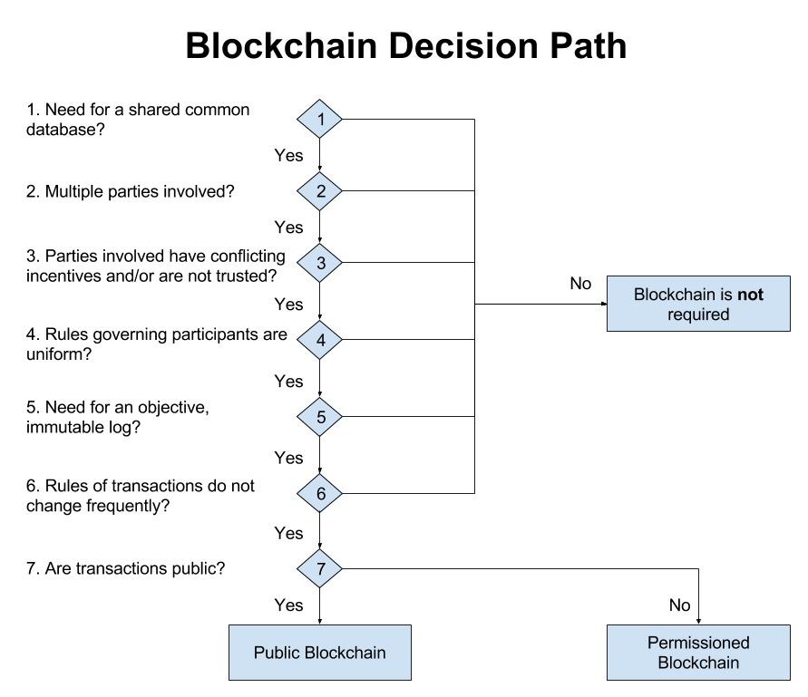
Source: Hyperledger

Slide 9
