Slide 1
Donor Milk Blockchain Solution

Slide 2
Building Digital Relationships
BLOCKCHAIN
Decentralized networks to build a trusted relationship among its suppliers, partners, factories and customers.
Blockchain technology as a tool for the movement of money, goods and agreements
Manage and audit transactions between different trading partners in an immutable, non-repudiable and secure manner.
Blockchain is the intermediary
Digital signatures based on pairs of cryptographic private and public keys put network participants in a position to authenticate which participant initiated a transaction, owns an asset, signed a smart-contract, or registered data.

Slide 3
Advantages of Blockchain
Provence
Less/No Traceability of transaction
Lack of visibility to all peers
Capability to trackdown to root of transactions
Complete Audit trail - Who does, What, When
Any changes will reflect in shared Ledger
Visible to all Peers
Immutability
Data or transactions are mutable
Once a block is committed with data / transaction, No one. not even administrator can modify without approval from all peers
Centralized systems managed by single party
Monopoly of powerful entity
Valuables provenance
Guarantees that all transactions in the system has go through a peer verification process before it approves
Reduces the scope of manipulation from a single peers
Consensus
Multiple sources to save data
Lot of reconciliation process required to prepare final data
One Single Source of Truth, Shared Ledger
All updates are available to all Peers
Finality

Slide 4
Donor Milk Solution for Blockchain
Commitment to continuous improvement towards the accuracy and availability of donor milk, Rapid is considering the integration of Donor Milk app with Hyperledger (leading blockchain platform) for the provenance, Immutability, consensus and Finality
PoC to implement the Hyperledger to integrate the Peers and write the smart contracts to trigger the transactions
Peers in scope are
Donor Bank / Lab / NICU
Nurse
EMR
Inventory Store
Following process are consider for integration.
Donor Milk Enrolment
Creating Donor Milk Label
Donor Milk Verification
Feeding the infant

Slide 5
Background Info
‘Mother’s Milks and Donor Milk ’ currently solves the need for immediate infant identification validation with the correct bottle of milk when feeding infant
Mother’s milk integrates with existing EMR system to fetch the patient/infant details
Advanced smart barcoding has been integrated to validate the correctness of data such as infant details, donor milk details etc
Mother’s milk allows to identify human errors and system issues that may leads to misidentifying the donor milk bottle, causing a misfeed incidents
Critical validation points are Donor milk data, the labelling of the bottle of the donor milk and infant data
Mother’s Milk allows NICU staff members to go Digital and eliminates the handwritten process, manual work around as well as two level nurse verification process to reduce the human error.
Information immediately displayed in the Mother’s milk app at the time of feeding verify the correctness of data to accept or deny the feeding.

Slide 6
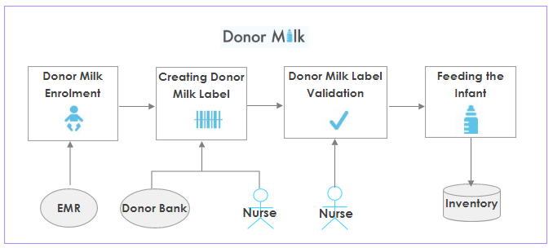
Donor Milk Workflow
Peers
EMR
Donor Bank
Nurse/NICU
Inventory
Consensus
Barcode verification
Scan the baby’s wristband, confirm the patient info and enroll the baby into the Donor Milk program.
Scan the baby’s wristband to validate the baby’s information. Scan the Donor Milk bottle barcode. The GSI data is read parsed and populates the Donor Milk label with the Lot Number and Serial Number.
If the baby is enrolled in the Donor Milk program the nurse can create and print labels to place on the feeding bottles.
Scan the baby’s wristband and the label on the bottle. If all data matches the nurse will receive a “Verified” message. Else nurse will receive a “Denied” message

Slide 7
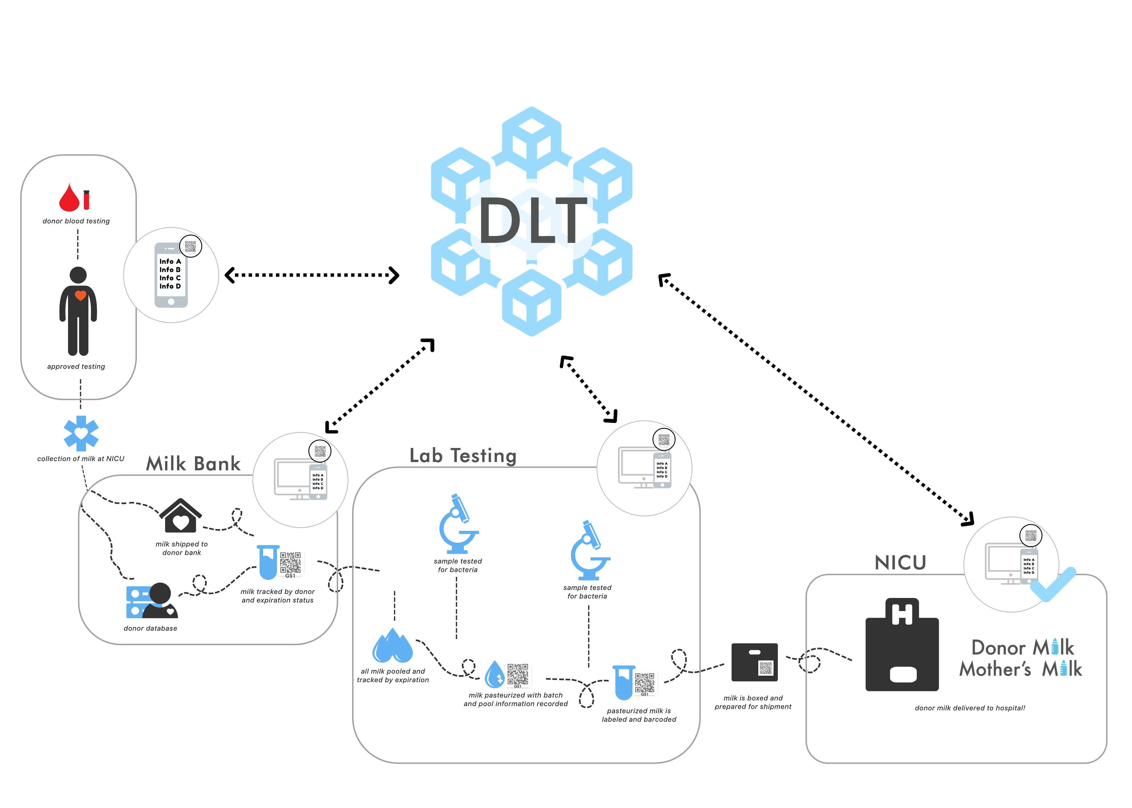
Assets
Inventory (Human Donor Milk) Lab Testing Data
Peers
Donor Milk Bank LAB/Supplier NICU

Slide 8
Technical Scope
Support to setup the Blockchain environment (Cloud / On-Premise)
Build Blockchain engine using Redhat Hyperledger Fabric platform
Configuration and scripting of Membership Service Provider (MSP)
Creation of Smart Contract using Golang
Implementation of Business network (Peers/Channels/Org)
Swagger UI for Functionality verification build under Blockchain

Slide 9
Project Deliverables
Phases | Deliverables
Analysis & Design | Detailed Design Document
Build | Unit tested Code, Swagger UI
Functional Testing | Functional Tested Code & Test report
User Acceptance Test | UAT Support

Slide 10
Schedule
Phases | Wk1 | Wk2 | Wk3 | Wk4 | Wk5 | Wk6
Analysis & Design
Build
Functional Testing
User Acceptance Test
On Delivering the agreed scope and Deliverables of the PoC requirements.
The payment milestones will be discussed and mutually agreed at the time of contracting.
Resources working in the PoC will be working on American / India business hours and any support required outside the business hours will be discussed and agreed between both parties

