Slide 1
Interoperability Testing

Slide 2
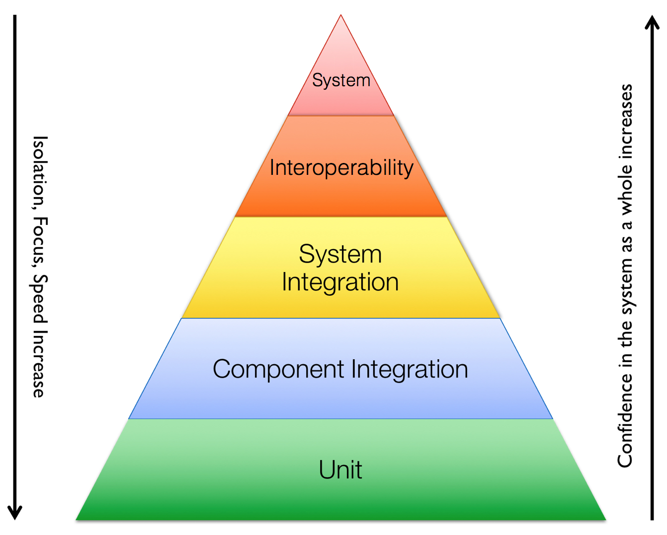
Test Pyramid
Function Test

Slide 3
Test Workflow Phases
Published builds
Unit test
Function test
System test
Integration
Interoperability
Tests that ensure components and systems work together
Validation tests that are not expected to stress the system
Using test friendly configuration but real implementations
Can be mocked (component) or live (system/end-to-end)
Each user consumable feature should extend these suites
Use a small number of assets (eg. chaincode, peers, orgs) across multiple tests
Merge
Interoperability testing is compatibility integration testing.
Should be the same test suite containing very few tests that are executed after merges in each repository are performed.
Not feature based or necessarily updated often
Use a the maximum number of assets in order to verify compatibility between commits
Verifies that a build combination is good and is able to be published for use with other repositories
Merges happen before; Publishing happens after

Slide 4
Automation
Repos will need to pull Nexus build images instead of building all component images
Publishing no longer takes place after a CR is merged to master.
Just because a CR makes it to master does not mean that it will be published. Publishing is the goal!
The interoperability tests should be executed as a separate job that is downstream from the merge jobs with the built artifacts from the merge job.
The system BDD tests will be used for post-merge interoperability testing

Slide 5
Interoperability Process
Fabric | Fabric-CA | Node-SDK | Java-SDK |  | What to do
merge |  |  |  |  | 1. Pull published build (Nexus, stable packages) for fabric-ca and all sdks 2. Receive as artifacts the built components from merged repo (peer, orderer, configtxgen, idemixgen) 3. Execute Interop tests 4. Upon success, publish newly built components
 |  |  | merge |  | 1. Pull published build (Nexus, stable packages) for fabric-peer, fabric-orderer, fabric-ca, etc. 2. Receive as artifacts the built package from merged repo (maven package) 3. Execute Interop tests 4. Upon success, publish new package
 |  | merge |  |  | 1. Pull published build (Nexus, stable packages) for fabric-peer, fabric-orderer, fabric-ca, etc. 2. Receive as artifacts the built package from merged repo (npm package) 3. Execute Interop tests 4. Upon success, publish new package

Slide 6
Other Considerations
Fabric-samples repository
A change to the other components should trigger a test run of fabric-samples - do tests (other than fabric-ca) exist for these?
A change to fabric-samples should only trigger samples tests
Nexus build notations
The git sha must be in the build name in Nexus for easy traceability
Consider adding a commit file that contains the commit sha and image names that are needed when executing integration tests.

