Slide 1
Agenda
Recap test strategy (1 chart)
Delivery squad function test coverage for 1.2
How to utilize the new E2E test framework
How to manage and track in Jira

Slide 2
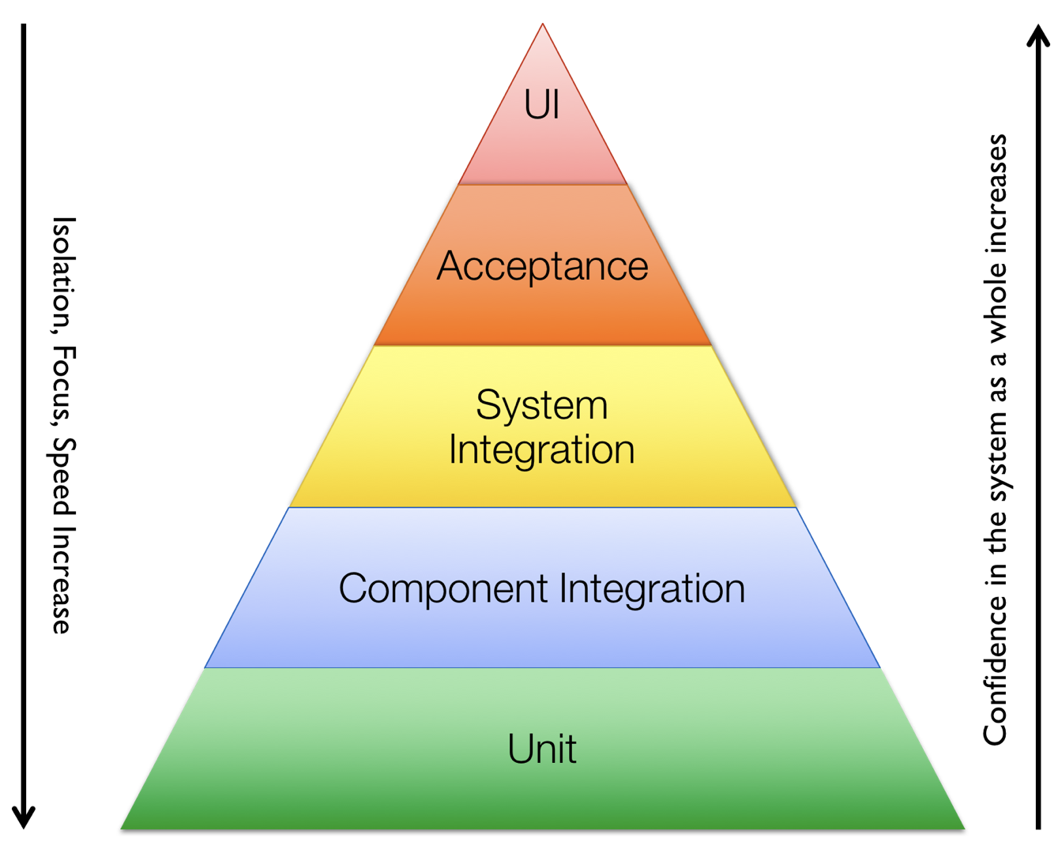
(SDK)
(E2E)

Slide 3
Test strategy – 2018
Feature delivery squads
Test squads
go test
go test
PTE, LTE, OTE, etc
ginkgo based BDD
Unit test
Function test
System test
Integration Test
E2E
Production code structured for test
True unit tests with high coverage
Tool generated mocks for dependencies
Tests that ensure unit tested components work together
Tested outside of the production package implementations
Using test friendly configuration but real implementations
Orchestrated tests that use documented, user facing assets
Each user consumable feature should extend this suite
These are validation tests, not tests that are expected to stress the system or introduce errors
Use a small number of deployed assets (eg. chaincode, peers, orgs) across multiple tests
Limit execution time to seconds per variation, not minutes

Slide 4
V1.2 integration test strategy
Lots of good progress has been made, but we can’t swallow everything at once.
Fabric is not well structured for integration test in v1.2 timeframe
How to cover integration test gap while we evolve towards true integration test?
Expand Unit test coverage
Expand E2E coverage

Slide 5
Test strategy – V1.2 Phased approach
Feature delivery squads
Test squads
go test
go test
PTE, LTE, OTE, etc
ginkgo based BDD
Unit test
Function test
System test
Integration Test
E2E
Not ready in v1.2 timeframe
Production code structured for test
True unit tests with high coverage
Tool generated mocks for dependencies
Tests that ensure unit tested components work together
Tested outside of the production package implementations
Using test friendly configuration but real implementations
Orchestrated tests that use documented, user facing assets
Each user consumable feature should extend this suite
These are validation tests, not tests that are expected to stress the system or introduce errors
Use a small number of deployed assets (eg. chaincode, peers, orgs) across multiple tests
Limit execution time to seconds per variation, not minutes
Strategy
Production code structured for test (best effort)
Combination of true unit tests and “unit integration tests”
Tool generated mocks for dependencies
Orchestrated tests that use documented, user facing assets
Each user consumable feature should extend this suite
These are validation tests, not tests that are expected to stress the system or introduce errors
Use a small number of deployed assets (eg. chaincode, peers, orgs) across multiple tests
Limit execution time to seconds per variation, not minutes
V1.2

Slide 6
E2E test tool demo (Latitia)
….........
............

Slide 7
Jira management
For each v1.2 Epic add the following
1 task that describes test coverage for the EPIC, UT, Integration test, E2E, SVT
We know integration test will not happen in v1.2 – describe how UT and E2E coverage covers the gap
Add 1 task for each automated E2E test you plan to add.
Add Epic Link
Add label ‘E2ETest’
Add Fix Version/s to be 1.2

Slide 8
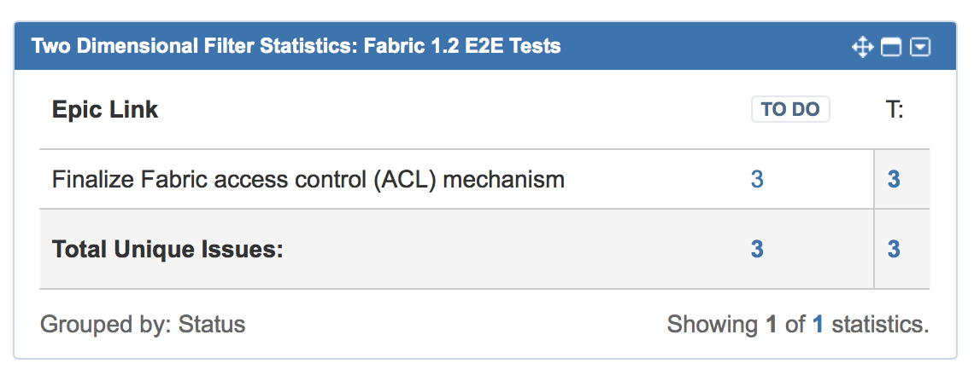
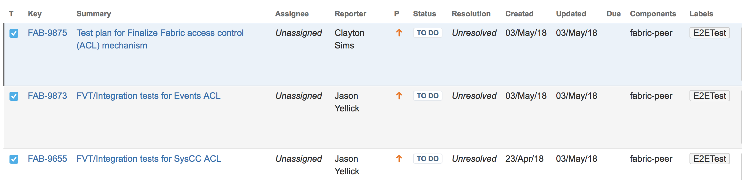
Jira management – Example
https://jira.hyperledger.org/secure/Dashboard.jspa?selectPageId=1070
Bottom left widget

