Slide 1








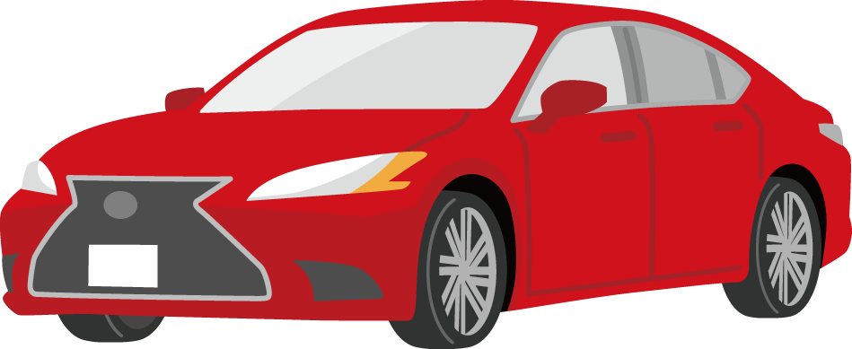
2. Remittance
4. Remittance
User
Ethreum Blockchain
for private coin
1. Request for Trading
3. Transfer of the right of use
owner of the car
User
User
5. Receiving
Transaction Results
Fabric Blockchain
for controlling the
right to use the car

