Slide 1
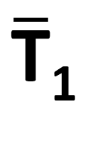
Blockchain A
Blockchain B
O₁^{begin}
Ledger transfer
Ō₁^{end}
T₁
$\overline{\text{T}}$₁

