Slide 1
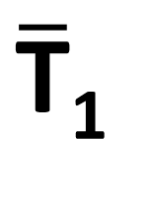
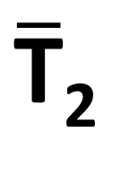
Blockchain A
Blockchain B
O₁^{begin}
Ō₁^{end}
T₁
$\overline{\text{T}}$₁
Ledger transfer
Ō₂^{end}
O₂^{begin}
$\overline{\text{T}}$₂
T₂

