Slide 1
⚠️ Warning: This PowerPoint deck was generated by HyperAgent. You should carefully check and verify the contents.
Learn more about HyperAgent

Slide 2
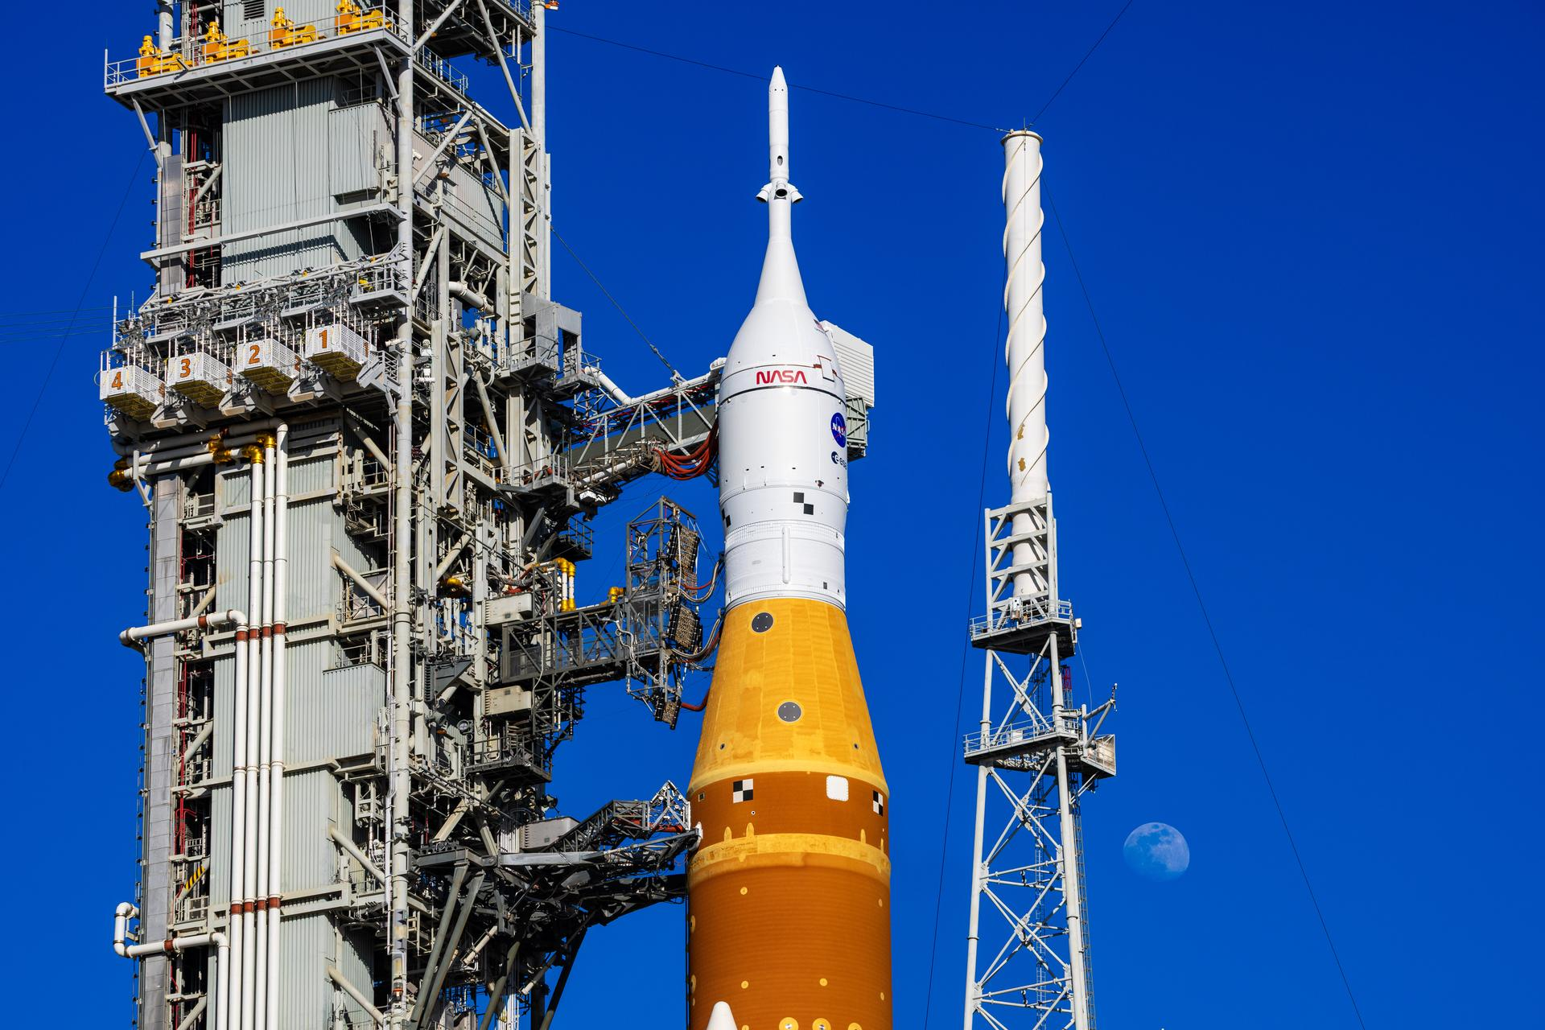
NASA ARTEMIS II
First Crewed Mission Around the Moon Since Apollo 17 (1972)
NASA Artemis II Mission Briefing | April 2026
1

Slide 3
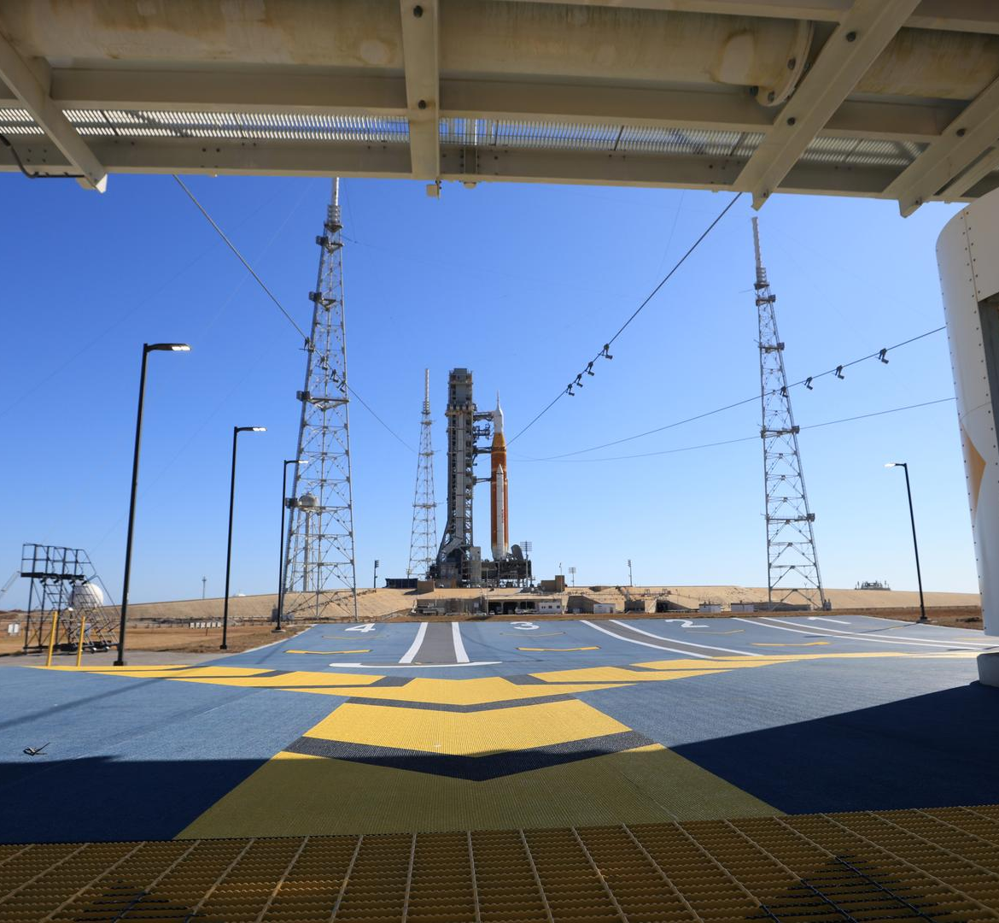
MISSION OVERVIEW
Artemis II is NASA's first crewed flight test of the Space Launch System (SLS) rocket and Orion spacecraft around the Moon. The mission will send four astronauts on an approximately 10-day journey, verifying crew life-support systems and validating capabilities needed for long-duration deep space missions.
First crewed lunar flyby since Apollo 17 in December 1972
Approximately 10-day mission duration
Crew of 4 astronauts — 3 NASA, 1 CSA
Tests life support, navigation, and communication systems
Flies within ~100 km of the lunar surface
Maximum distance from Earth: ~370,000 km
Validates Orion's heat shield at lunar re-entry speeds
Paves the way for Artemis III — the first woman on the Moon
SLS & Orion on Launch Pad 39B, Kennedy Space Center
NASA Artemis II Mission Briefing | April 2026
2

Slide 4
MEET THE CREW
Four astronauts charting humanity's return to the Moon
NASA Artemis II Mission Briefing | April 2026
3

Slide 5
ARTEMIS II CREW
Reid Wiseman
Victor Glover
Christina Koch
Jeremy Hansen
Commander
Pilot
Mission Specialist 1
Mission Specialist 2
NASA
NASA
NASA
CSA
U.S. Navy Captain, ISS veteran Selected: 2009 | Spaceflights: 1 165 days in space
U.S. Navy Captain, SpaceX Crew-1 Selected: 2013 | Spaceflights: 1 167 days in space
Electrical Engineer, ISS record holder Selected: 2013 | Spaceflights: 1 328 days in space
Canadian Forces Colonel, Fighter Pilot Selected: 2009 | Spaceflights: 0 First Canadian to fly to the Moon
NASA Artemis II Mission Briefing | April 2026
4

Slide 6
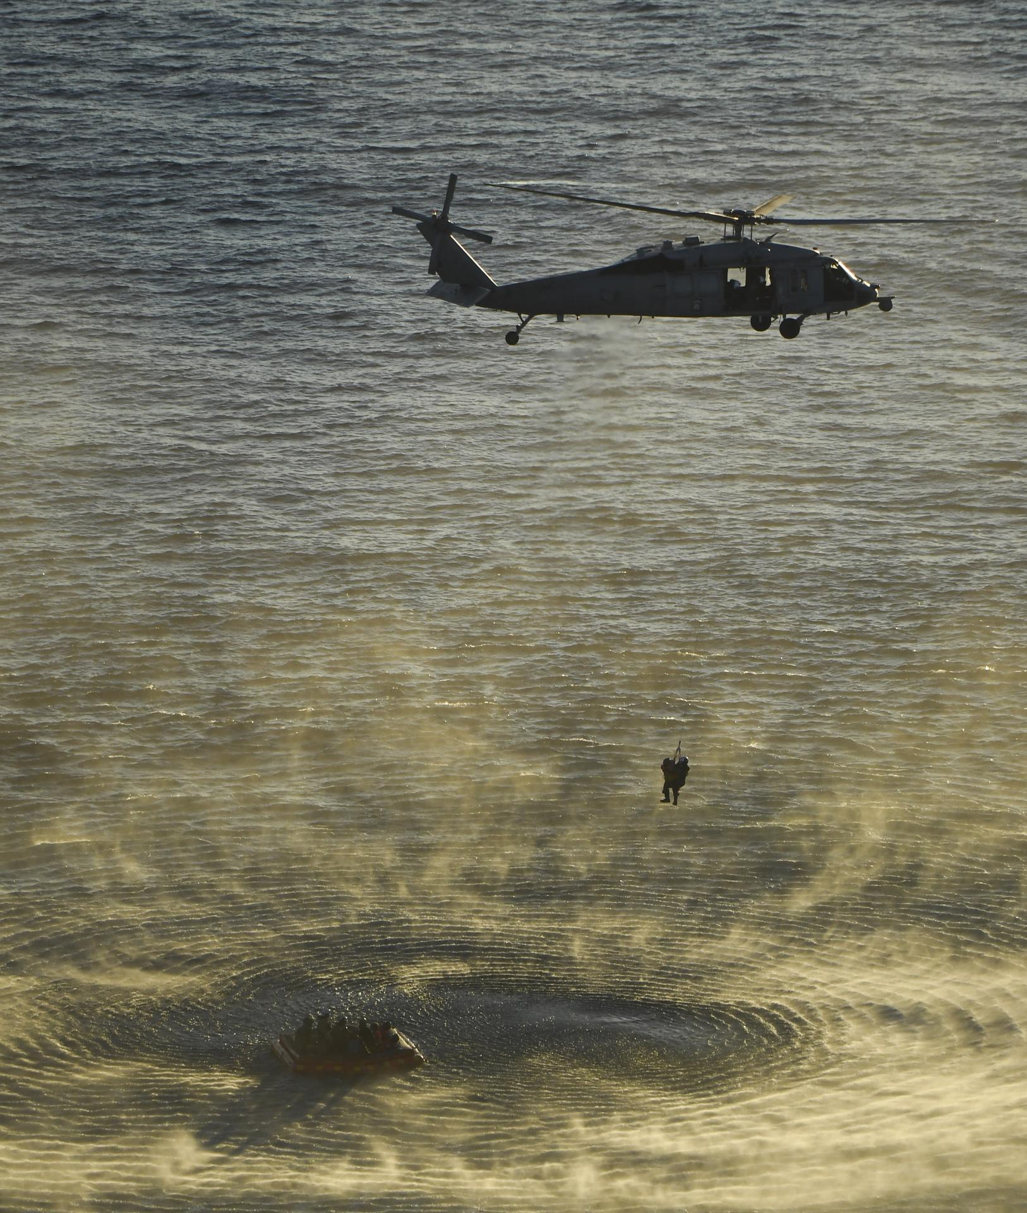
THE ARTEMIS II CREW
Training for humanity's return to deep space
NASA Artemis II Mission Briefing | April 2026
5

Slide 7
SPACECRAFT SPECIFICATIONS
Space Launch System & Orion Multi-Purpose Crew Vehicle
NASA Artemis II Mission Briefing | April 2026
6

Slide 8
SPACE LAUNCH SYSTEM (SLS)
Vehicle Type | Super Heavy-Lift Launch Vehicle
Configuration | Block 1 Crew
Height | 98.1 m (322 ft)
Diameter | 8.4 m (27.6 ft) Core Stage
Payload to TLI | 27,000 kg (59,500 lb)
Payload to LEO | 95,000 kg (209,000 lb)
Core Stage Engines | 4x RS-25 (2,279 kN each)
Solid Boosters | 2x 5-Segment SRBs (16,000 kN each)
Total Thrust (Liftoff) | 39,144 kN (8.8 million lbf)
Upper Stage | Interim Cryogenic Propulsion Stage (ICPS)
ICPS Engine | 1x RL10B-2 (110 kN)
Propellant | Liquid Hydrogen / Liquid Oxygen
98.1m
VEHICLE HEIGHT
8.8M
LBF THRUST
4
RS-25 ENGINES
2
SOLID BOOSTERS
The SLS Block 1 is the most powerful rocket ever built, generating 15% more thrust than the Saturn V at liftoff. Its core stage is powered by four RS-25 engines — upgraded Space Shuttle Main Engines — flanked by two five-segment solid rocket boosters.
NASA Artemis II Mission Briefing | April 2026
7

Slide 9
ORION CREW VEHICLE
Crew Module Diameter | 5.02 m (16.5 ft)
Habitable Volume | 8.95 m³ (316 ft³)
Crew Capacity | 4 astronauts
Service Module | European Service Module (ESM) by ESA/Airbus
ESM Solar Array Span | 19 m (62.3 ft)
ESM Engine | 1x Orbital Maneuvering System (OMS-E) — 26.7 kN
ESM Auxiliary Thrusters | 8x R-4D-11 (490 N each)
Heat Shield | AVCOAT ablative — 5 m diameter, largest ever built
Re-entry Speed | ~40,000 km/h (Mach 32)
Mission Duration | Up to 21 days (6 crew days active)
Launch Abort System | 3-motor LAS (abort, attitude, jettison)
Life Support | ECLSS — active CO₂ removal, O₂ generation
5.02m
CAPSULE DIAMETER
19m
SOLAR ARRAY SPAN
5m
HEAT SHIELD DIA.
Mach 32
RE-ENTRY SPEED
Built by Lockheed Martin with ESA's European Service Module, Orion is designed for deep space. Its AVCOAT heat shield — the largest ever built — must withstand temperatures of ~2,760°C (5,000°F) during lunar return re-entry at 40,000 km/h.
NASA Artemis II Mission Briefing | April 2026
8

Slide 10
MISSION FLIGHT PLAN
1
2
3
4
5
6
Launch
Earth Orbit
Outbound Coast
Lunar Flyby
Return Coast
Re-entry
SLS lifts off from Pad 39B, KSC
ICPS performs trans-lunar injection burn
4-day transit to the Moon
Free-return trajectory ~100 km altitude
Gravity-assisted return to Earth
Orion enters at ~40,000 km/h
NASA Artemis II Mission Briefing | April 2026
9

Slide 11
ARTEMIS II BY THE NUMBERS
~10 Days
370,000 km
~100 km
40,000 km/h
Mission Duration
Maximum Distance from Earth
Closest Lunar Approach
Re-entry Speed
NASA Artemis II Mission Briefing | April 2026
10

Slide 12
8.8M
LBF
Liftoff thrust — 15% more than Saturn V
NASA Artemis II Mission Briefing | April 2026
11

Slide 13
ARTEMIS PROGRAM MILESTONES
Artemis I | Artemis II | Artemis III | Artemis IV
Uncrewed test flight — Nov 2022 | First crewed lunar flyby — 2025 | First woman on the Moon — 2026+ | Gateway station assembly — 2028+
Date | Milestone | Status
Nov 16, 2022 | Artemis I launch — uncrewed Orion to lunar orbit and back | ✅ Complete
Dec 11, 2022 | Artemis I splashdown — Orion returns after 25.5 days | ✅ Complete
Mar 2024 | SLS core stage for Artemis II arrives at Kennedy Space Center | ✅ Complete
Sep 2024 | Full Artemis II stack assembled on Mobile Launcher at VAB | ✅ Complete
Nov 2024 | Artemis II stack rolled out to Launch Pad 39B | ✅ Complete
2025 | Artemis II crewed flight test — 4 astronauts around the Moon | ⏳ Upcoming
2026+ | Artemis III — first crewed lunar landing since 1972 | 📅 Planned
2028+ | Artemis IV — Gateway station & Starship HLS missions | 📅 Planned
NASA Artemis II Mission Briefing | April 2026
12

Slide 14
APOLLO vs ARTEMIS II
Specification | Apollo (Saturn V + CM) | Artemis II (SLS + Orion)
Launch Vehicle Height | 110.6 m (363 ft) | 98.1 m (322 ft)
Liftoff Thrust | 34,020 kN (7.65M lbf) | 39,144 kN (8.8M lbf)
Crew Size | 3 astronauts | 4 astronauts
Crew Module Volume | 5.9 m³ (210 ft³) | 8.95 m³ (316 ft³)
Heat Shield Diameter | 3.9 m (12.8 ft) | 5.02 m (16.5 ft)
Max Mission Duration | ~12 days | ~21 days (design)
Solar Power | Fuel cells only | 4x Solar arrays (11 kW)
Digital Systems | Apollo Guidance Computer (74 KB RAM) | Modern avionics + glass cockpit
Abort Capability | Launch escape tower | Launch Abort System (LAS)
International Partners | USA only | NASA + ESA + CSA + JAXA
NASA Artemis II Mission Briefing | April 2026
13

Slide 15


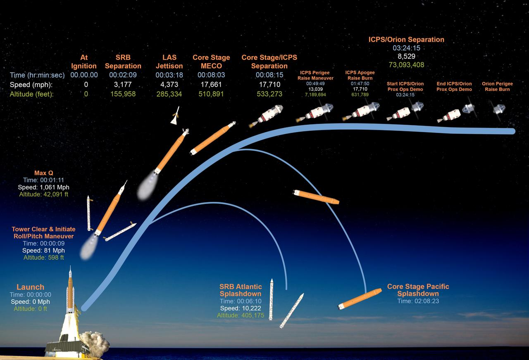
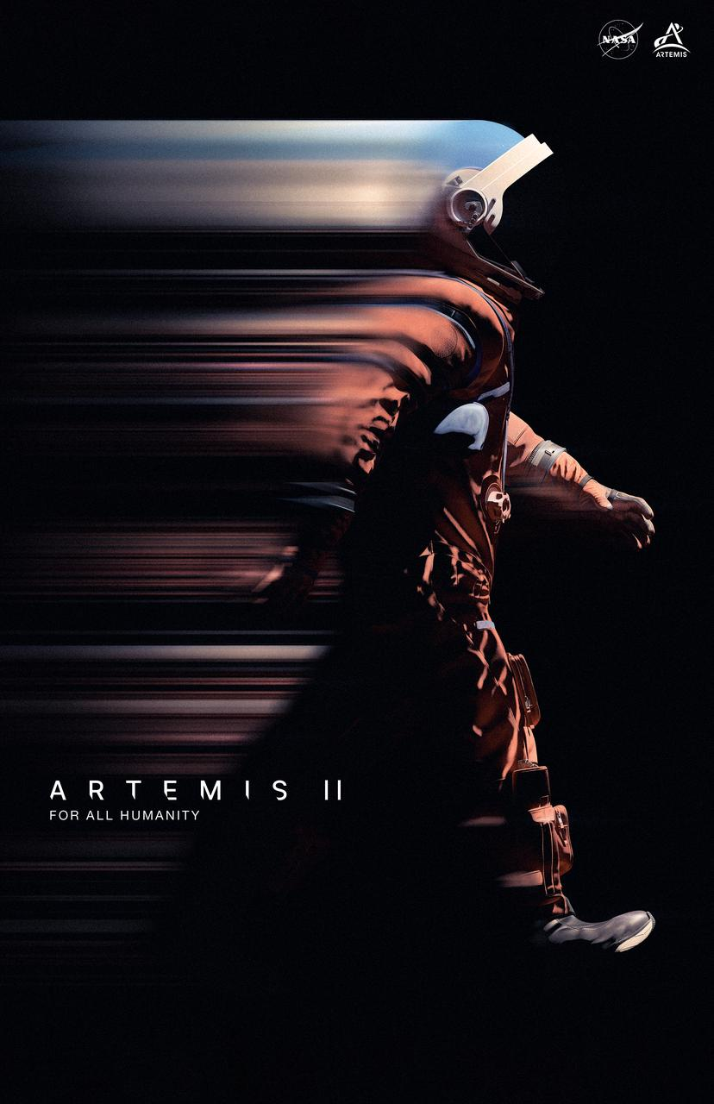
ARTEMIS II MISSION GALLERY
NASA Artemis II Mission Briefing | April 2026
14

Slide 16
TO THE MOON
Artemis II — Returning humanity to deep space
NASA Artemis II Mission Briefing | April 2026
15
Notes:
Closing image: Full Artemis II stack at Launch Pad 39B with the Moon visible behind it.

Slide 17
WE ARE GOING
Artemis II will carry four astronauts farther from Earth than any human has ever traveled.
nasa.gov/artemis
National Aeronautics and Space Administration Artemis Program • Exploration Systems Development
NASA Artemis II Mission Briefing | April 2026
16

