Slide 1
⚠️ Warning: This PowerPoint deck was generated by HyperAgent. You should carefully check and verify the contents.
Learn more about HyperAgent

Slide 2
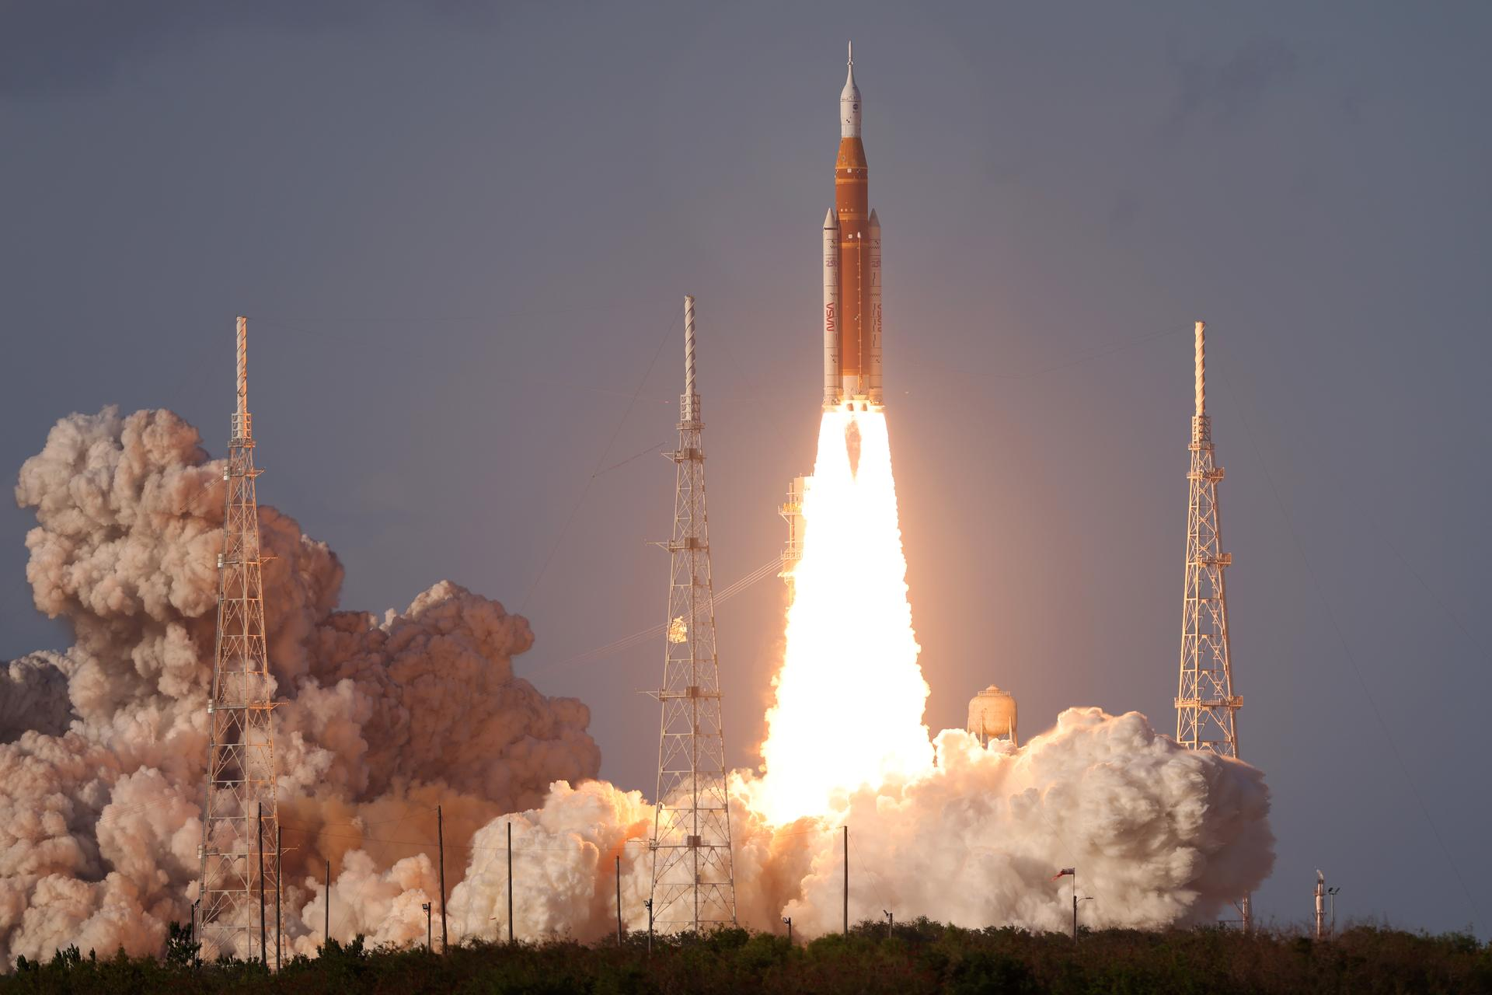
ARTEMIS II
Humanity Returns to the Moon
1
Notes:
Artemis II launched April 1, 2026 at 6:35 PM ET from Kennedy Space Center Launch Complex 39B. This was the first crewed lunar mission in over 50 years, carrying 4 astronauts on a 10-day journey around the Moon aboard NASA's Orion spacecraft atop the SLS rocket.

Slide 3
Mission at a Glance
10
4
~240K
53
DAYS IN SPACE
CREW MEMBERS
MILES TO THE MOON
YEARS SINCE APOLLO 17
2
Notes:
Artemis II was a 10-day mission (April 1-10, 2026) carrying 4 astronauts approximately 240,000 miles to the Moon and back. This was the first crewed lunar mission since Apollo 17 in December 1972 — a gap of 53 years.

Slide 4
The Artemis II Crew
First humans to journey to the Moon in the 21st century
RW
VG
CK
JH
Reid Wiseman
Victor Glover
Christina Koch
Jeremy Hansen
COMMANDER
PILOT
MISSION SPECIALIST
MISSION SPECIALIST
NASA | U.S. Navy Captain ISS Expedition 41 165 days in space prior Selected 2009
NASA | U.S. Navy Captain SpaceX Crew-1 Pilot 167 days in space prior Selected 2013
NASA | Electrical Engineer ISS Record: 328 days First all-female EVA Selected 2013
CSA | CF-18 Fighter Pilot First Canadian to lunar orbit CapCom for ISS missions Selected 2009
NASA | Canadian Space Agency | First international crew to fly beyond low Earth orbit
3
Notes:
The Artemis II crew: Commander Reid Wiseman (NASA), Pilot Victor Glover (NASA), Mission Specialist Christina Koch (NASA), and Mission Specialist Jeremy Hansen (CSA). Hansen made history as the first Canadian astronaut to fly to lunar orbit. Koch, who held the ISS record for longest single spaceflight by a woman at 328 days, participated in the first all-female EVA.

Slide 5
The Vehicles: SLS & Orion
SPACE LAUNCH SYSTEM (SLS)
ORION SPACECRAFT
322 ft
Height (Block 1)
8.8M lbs
Max Thrust
16.5 ft
Crew Module Diameter
316 ft²
Habitable Volume
5,750°F
Exhaust Temperature
27 t
Payload to TLI
25,000 mph
Re-entry Speed
5,000°F
Heat Shield Temp
Most powerful rocket ever flown
Twin 5-segment solid rocket boosters
4 RS-25 engines (Space Shuttle heritage)
Interim Cryogenic Propulsion Stage (ICPS)
European Service Module (ESA partnership)
4 solar array wings: 33 kW power
Life support for 21 days (crew of 4)
Largest heat shield ever built: 16.5 ft dia.
4
Notes:
The SLS Block 1 configuration stands 322 feet tall and generates 8.8 million pounds of thrust at liftoff — 15% more than the Saturn V. It uses four RS-25 engines derived from the Space Shuttle main engines plus twin 5-segment solid rocket boosters. Orion features the European Service Module built by ESA, has 316 sq ft of habitable volume, and re-enters Earth's atmosphere at approximately 25,000 mph with a heat shield reaching temperatures of 5,000°F.

Slide 6
Mission Timeline: 10 Days Around the Moon
1
2
3
4
5
6
Launch
Earth Orbit
Trans-Lunar
Lunar Flyby
Return
Splashdown
April 1, 6:35 PM ET KSC Pad 39B
Systems check & TLI burn
4-day coast to the Moon
April 6: Far side 7 hrs observations
Free-return trajectory
April 10 Pacific Ocean
5

Slide 7
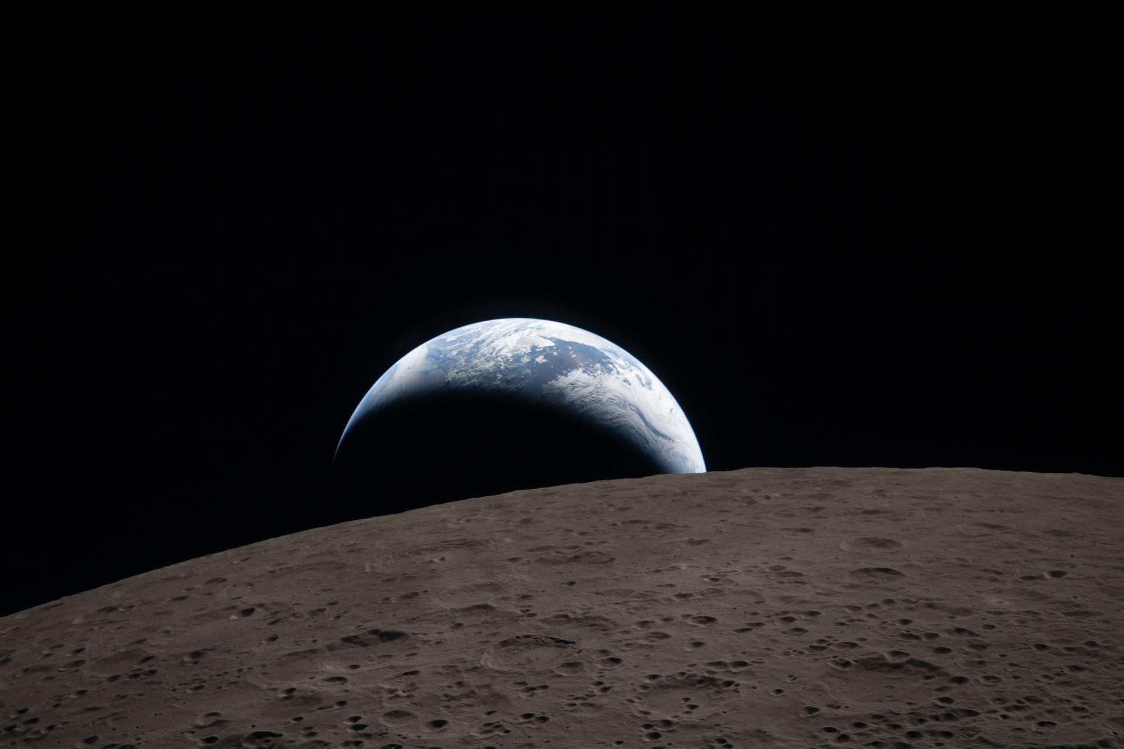
Earthset
April 6, 2026 — 6:41 PM EDT Captured by the Artemis II crew as Earth set behind the lunar surface
6
Notes:
This stunning image of Earthset was captured through the Orion spacecraft window at 6:41 PM EDT on April 6, 2026, during the Artemis II crew's flyby of the Moon. Earth appears as a muted blue sphere with bright white clouds setting behind the cratered lunar surface. The dark portion of Earth was experiencing nighttime. On Earth's day side, swirling clouds were visible over the Australia and Oceania region.

Slide 8
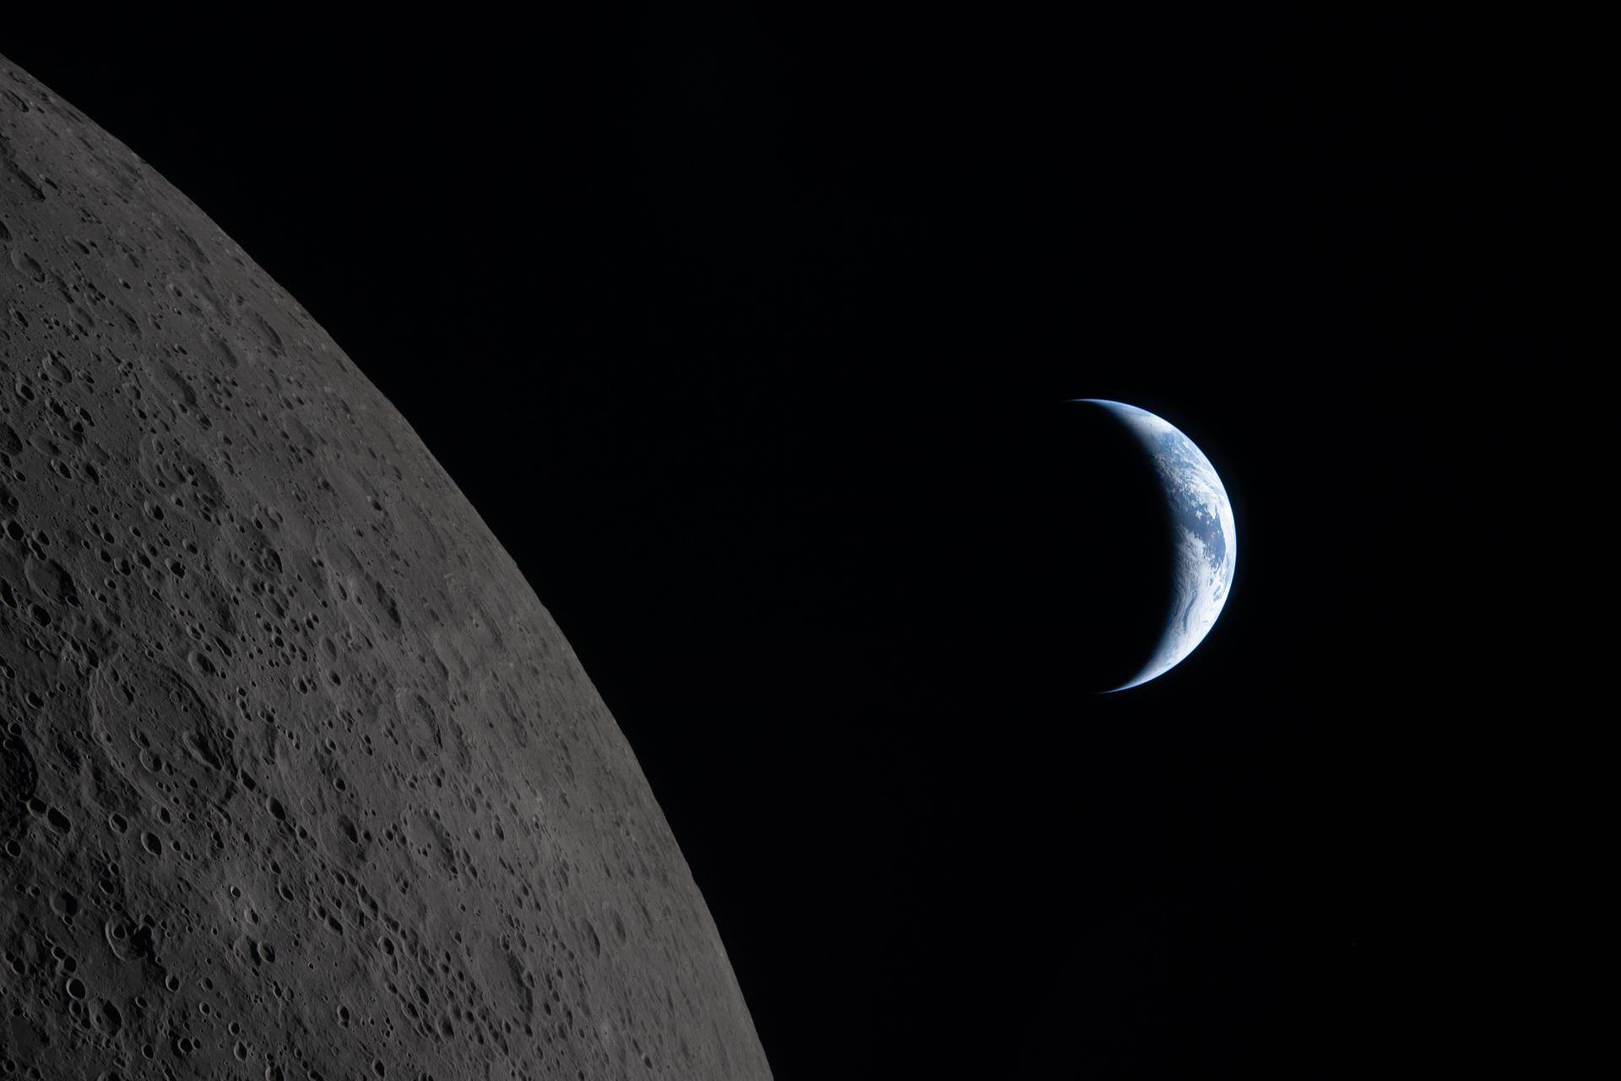
The Lunar Flyby: April 6, 2026
Humanity's first close-up view of the Moon in over half a century
FLYBY HIGHLIGHTS
7 hours of dedicated lunar observations
40 minutes behind the Moon with no Earth contact
Closest approach: ~80 miles above lunar surface
Crew photographed both near and far sides
Orientale Basin (600-mi wide) imaged in detail
Hertzsprung Basin ring structures documented
Earthset and Earthrise captured on camera
Solar eclipse viewed from behind the Moon
Science data transmitted to teams on Earth
"The Edge of Two Worlds" — Earth draws closer to passing behind the Moon, captured by the Artemis II crew
7
Notes:
On April 6, 2026 (Day 6 of the mission), the Artemis II crew performed their lunar flyby. They spent approximately 7 hours taking turns at the Orion windows, capturing science data and stunning photographs. At closest approach, they were approximately 80 miles above the lunar surface. They went behind the Moon and lost contact with Earth for 40 minutes. The Orientale Basin, a 600-mile-wide impact crater visible on the boundary of the near and far sides, was documented in spectacular detail.

Slide 9
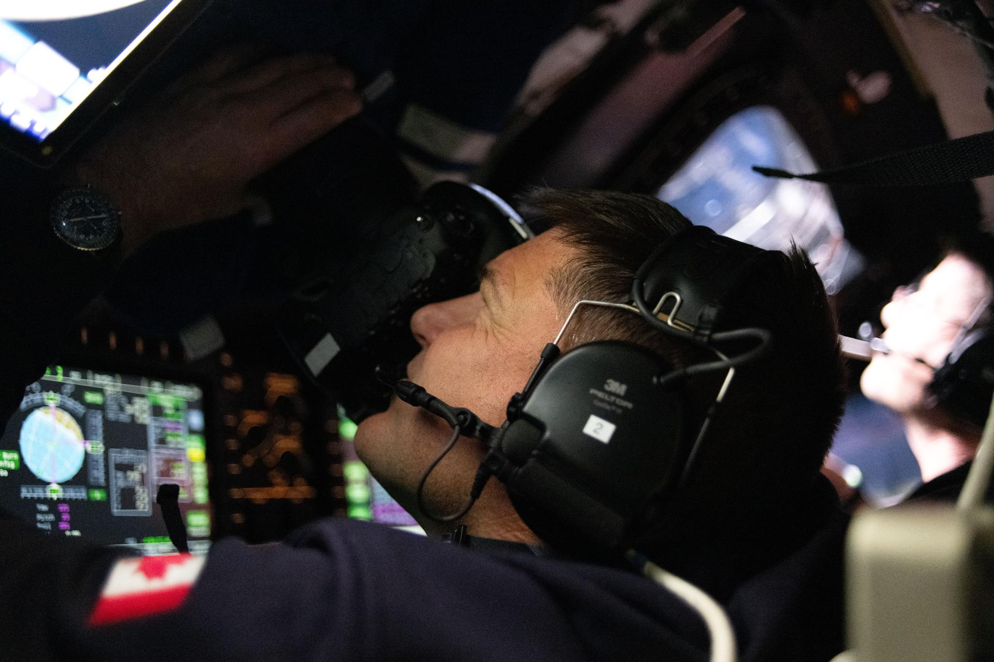
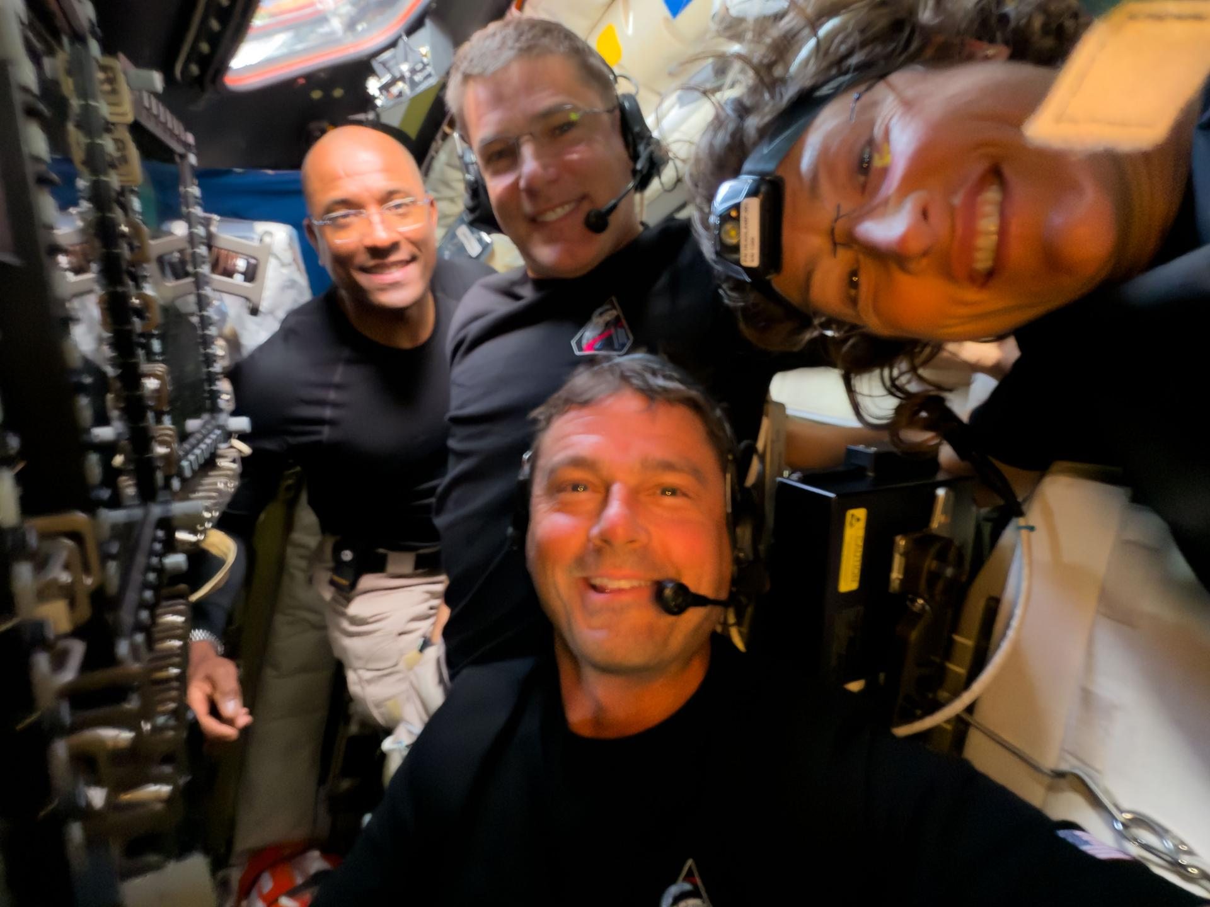
Inside Orion: The Crew at Work
Jeremy Hansen captures images of the lunar surface through the Orion spacecraft window
The crew pauses for a selfie aboard Orion — Wiseman, Glover, Koch & Hansen
The crew spent 7 hours taking turns at the Orion windows during the flyby, capturing photos and recording scientific observations of the lunar surface for teams on Earth.
8
Notes:
CSA astronaut Jeremy Hansen is seen taking images through the Orion spacecraft window early in the lunar flyby. The crew members took turns at the windows, following a choreographed camera schedule developed during extensive training at NASA's Johnson Space Center. The crew selfie shows all four astronauts together inside Orion during the observation period.

Slide 10
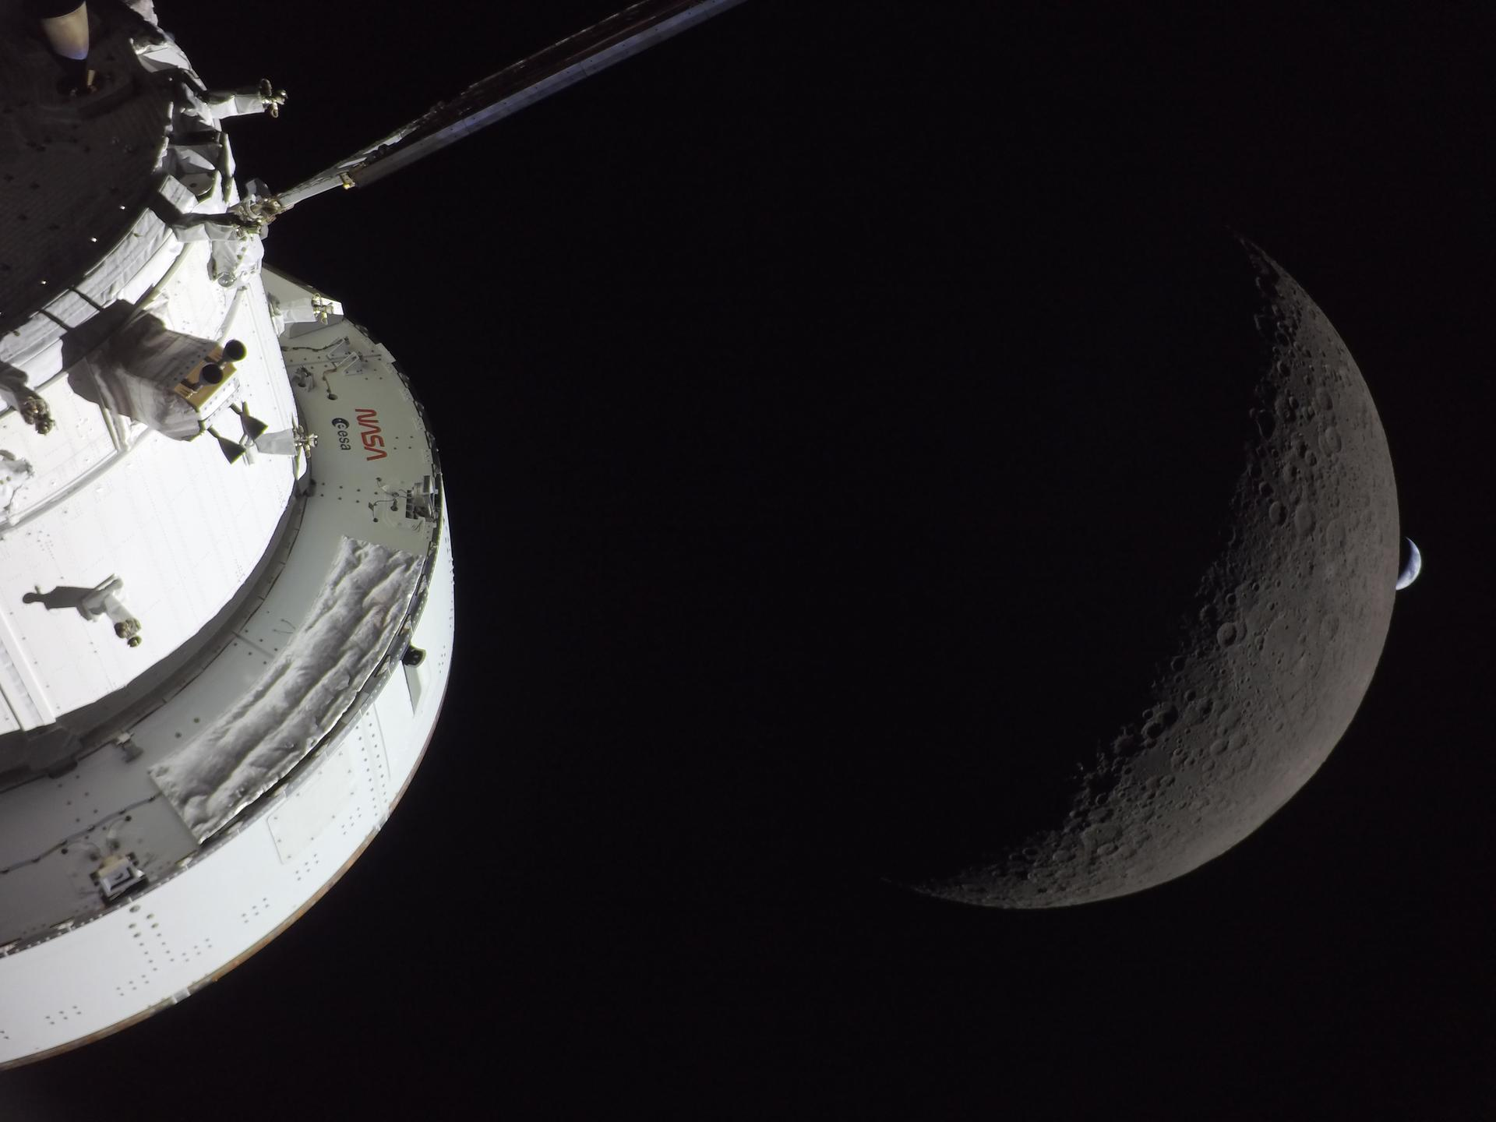
Destination and Home
Orion spacecraft with the Moon and a crescent Earth — April 6, 2026, 6:42 PM ET
9
Notes:
NASA's Orion spacecraft captures the Moon and Earth in one frame during the Artemis II crew's deep space journey at 6:42 PM ET on April 6. The right side of Orion is lit up by the Sun. A waxing crescent Moon is visible behind it, and a crescent Earth, tiny compared to the Moon, is about to set below the Moon's limb. This image captures the scale of the journey — 240,000 miles from home.

Slide 11
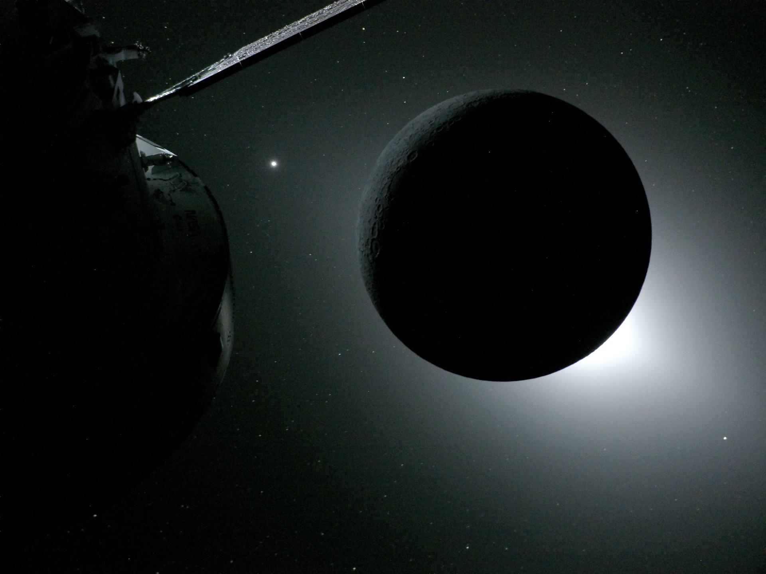
Solar Eclipse from the Far Side
Captured from Orion's solar array camera as the Moon blocked the Sun — a view never before seen by human eyes
10
Notes:
The solar eclipse was captured from a camera mounted on one of the Orion spacecraft's solar array wings during the Artemis II crew's flyby of the Moon's far side. Scientists are investigating whether the glow around the Moon is from zodiacal light (interstellar dust reflecting sunlight), the solar corona, or a combination of the two. Unlike minutes-long eclipses seen from Earth, this was a sustained view unique to deep space.

Slide 12
Artemis II: By the Numbers
6:35 PM
ET LIFTOFF TIME
8.8M
POUNDS OF THRUST
322 ft
SLS ROCKET HEIGHT
~17,500
MPH ORBITAL VELOCITY
~240K
MILES TO THE MOON
~80 mi
CLOSEST LUNAR APPROACH
40 min
BEHIND THE MOON (LOS)
7 hrs
LUNAR OBSERVATIONS
25,000
MPH RE-ENTRY SPEED
5,000°F
HEAT SHIELD TEMP
10 days
TOTAL MISSION DURATION
4
NATIONS / AGENCIES
11
Notes:
A comprehensive statistical overview of the Artemis II mission. Launch stats: 6:35 PM ET liftoff, 8.8 million pounds of thrust, 322-foot rocket. Journey stats: ~240,000 miles to the Moon, ~80 miles closest approach, 40 minutes of loss of signal behind the Moon, 7 hours of observation. Return stats: 25,000 mph re-entry, 5,000°F heat shield temperature, 10-day total mission. International partnership between NASA, CSA (Canada), ESA (Europe), and JAXA (Japan contributions).

Slide 13
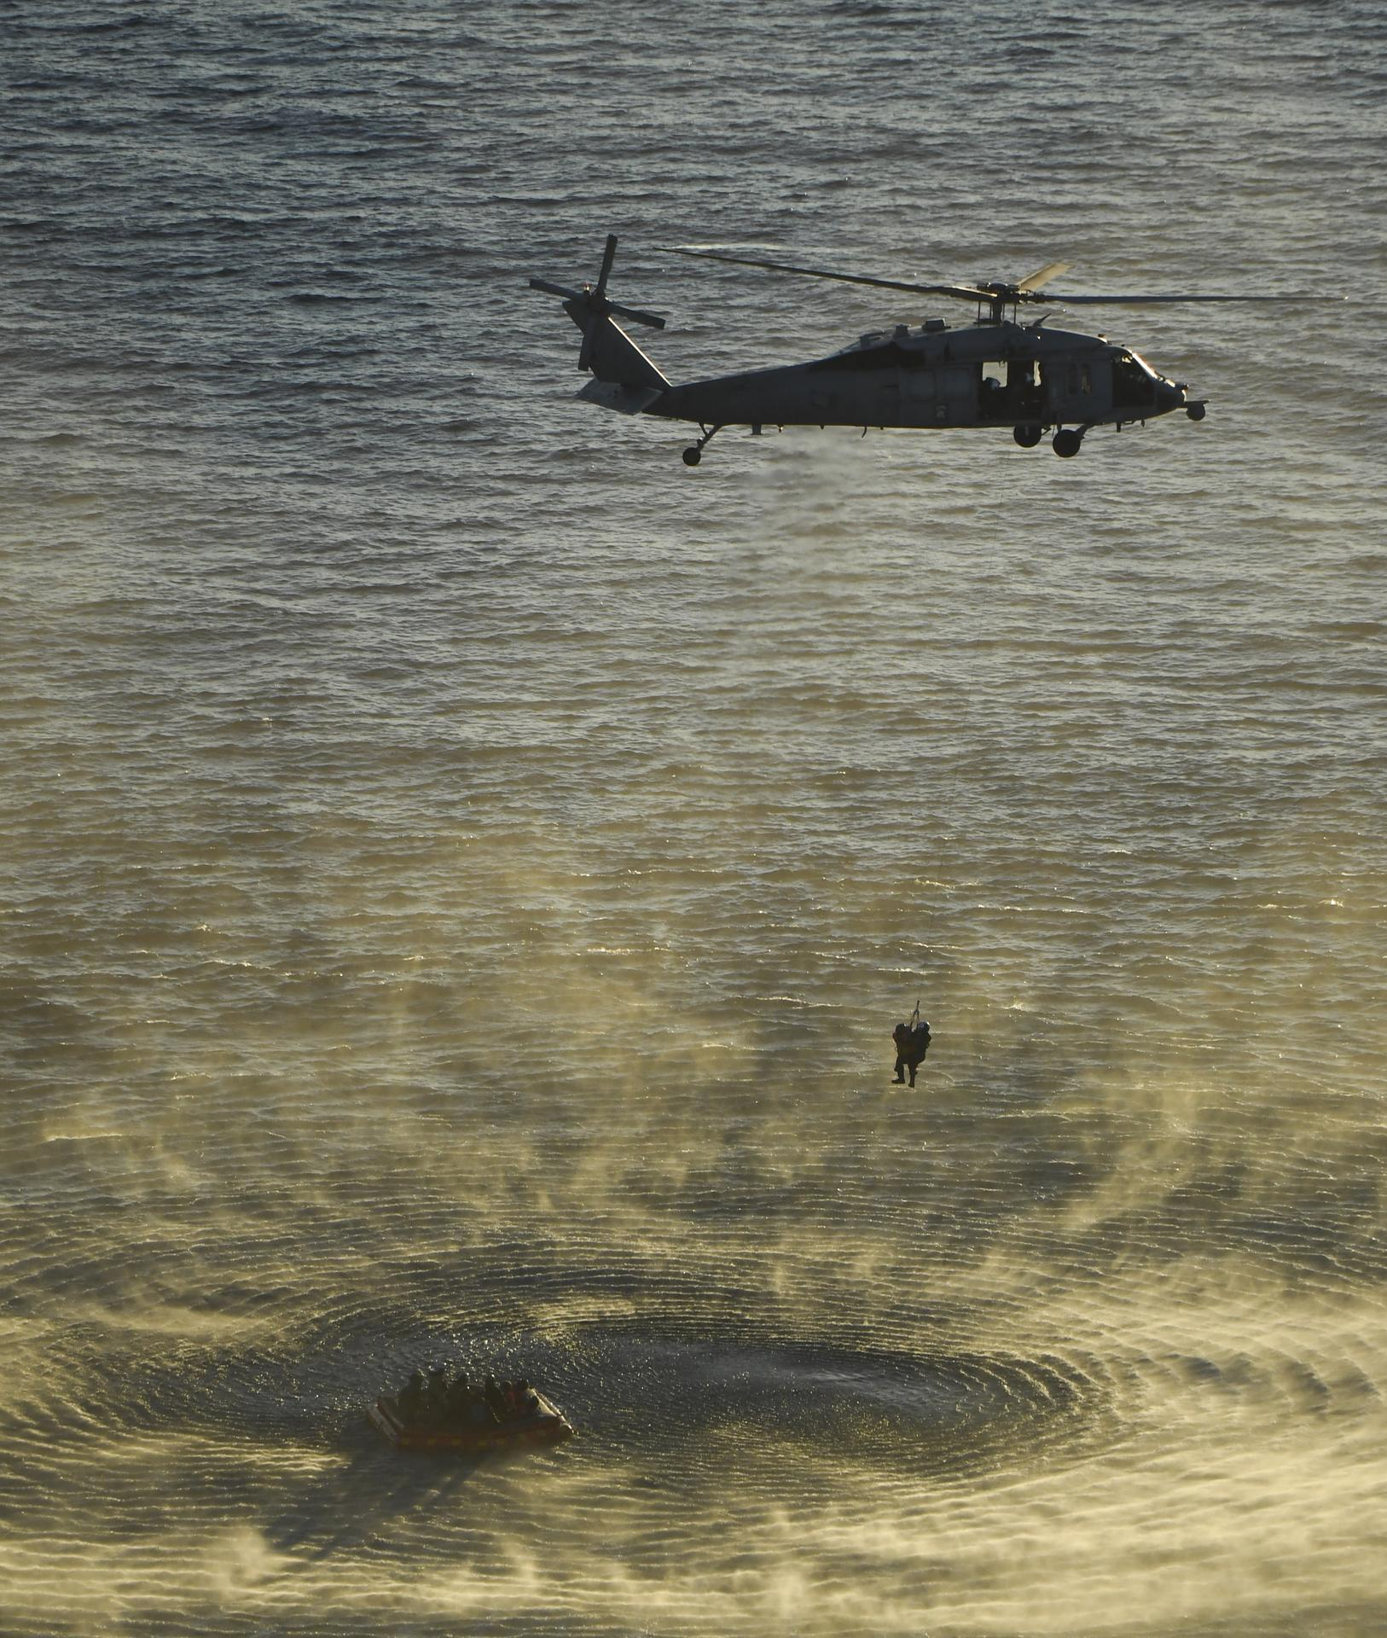
Welcome Home
April 10, 2026 — Crew recovery in the Pacific Ocean U.S. Navy divers support the Artemis II astronauts after splashdown
12
Notes:
On April 10, 2026, U.S. Navy divers and the Artemis II astronauts were aboard an inflatable raft following splashdown and egress from Orion. Helicopters approached to lift the crew to the recovery ship. The crew returned home to Houston the following day, April 11, where they were greeted at Ellington Airport near Johnson Space Center by NASA Administrator Jared Isaacman, JSC Director Vanessa Wyche, CSA President Lisa Campbell, and friends, family, and colleagues.

Slide 14
The Artemis Roadmap: What's Next?
Each mission builds on the last — leading to a sustained presence on the Moon and beyond
ARTEMIS I
ARTEMIS II
ARTEMIS III
ARTEMIS IV+
Nov 2022 ✓ COMPLETE
Apr 2026 ✓ COMPLETE
~2028 | UPCOMING
2029+ | FUTURE
Uncrewed test flight
Orion flew 1.4M miles
25.5 day mission
Heat shield validated
First crewed lunar flyby
4 astronauts, 10 days
Tested life support
Earthset captured
First lunar landing
SpaceX Starship HLS
South Pole region
First woman on Moon
Gateway space station
Sustained lunar presence
SLS Block 1B upgrade
Path to Mars
Artemis II Mission Achievements
Achievement | Detail | Significance
First crewed lunar flight since 1972 | 4 astronauts to lunar distance | Proves Orion + SLS crew-rated
First Canadian beyond LEO | Jeremy Hansen (CSA) | International exploration partnership
Crew photos of Earth from Moon | 7 hrs of observations | New science + public engagement
Solar eclipse from far side | Captured by Orion cameras | Unprecedented scientific view
13
Notes:
The Artemis program roadmap: Artemis I (Nov 2022) was the uncrewed test flight that validated the SLS and Orion systems over 25.5 days and 1.4 million miles. Artemis II (Apr 2026) was the first crewed flight. Artemis III (~2028) will be the first crewed lunar landing since Apollo 17, using SpaceX's Starship Human Landing System to reach the Moon's south pole region — putting the first woman and first person of color on the Moon. Artemis IV and beyond will build the Gateway orbital platform and establish a sustained human presence on and around the Moon.

Slide 15
“
We went to the Moon, and what we discovered was the Earth.
”
— The View from Artemis II, Echoing the words of Apollo astronauts — renewed for a new generation
14
Notes:
This quote captures the transformative perspective shift that comes from seeing Earth from deep space. The Artemis II crew, like the Apollo astronauts before them, experienced the 'Overview Effect' — a cognitive shift in awareness reported by astronauts who have seen Earth from space. The Earthset images captured during the mission remind us of the fragility and beauty of our home planet.

Slide 16
Be Part of the Journey
The Artemis generation is here. Here's how you can get involved:
🚀 FOLLOW THE MISSION
🎓 STEM & EDUCATION
🔭 CITIZEN SCIENCE
nasa.gov/artemis @NASA on social media NASA+ streaming platform Artemis II multimedia gallery
NASA STEM Engagement Artemis Student Challenges NASA Internships Program Space Grant Consortium
science.nasa.gov/citizenscience Moon observation projects Artemis photo analysis Globe Observer app
👩‍🚀 CAREERS AT NASA
🌍 INTERNATIONAL PARTNERS
📺 WATCH & EXPLORE
nasajobs.nasa.gov Astronaut applications Engineering & Science roles Contractor opportunities
ESA (European Service Module) CSA (Jeremy Hansen's agency) JAXA (Japan Aerospace) Australian Space Agency
"Moonbound: For All Humanity" NASA+ documentaries Virtual Guest Program KSC Visitor Complex tours
nasa.gov/mission/artemis-ii | nasa.gov/artemis-ii-multimedia | #Artemis #ArtemisII
Image Credits: NASA/Joel Kowsky/Bill Ingalls • All images courtesy of NASA
15
Notes:
Encourage the audience to follow the Artemis program and get involved. Key resources: nasa.gov/artemis for mission updates, NASA STEM Engagement for education programs, citizen science opportunities at science.nasa.gov, NASA careers and internships, the Moonbound: For All Humanity documentary series on NASA+, and virtual guest program for future launches.

