Slide 1
⚠️ Warning: This PowerPoint deck was generated by HyperAgent. You should carefully check and verify the contents.
Learn more about HyperAgent

Slide 2
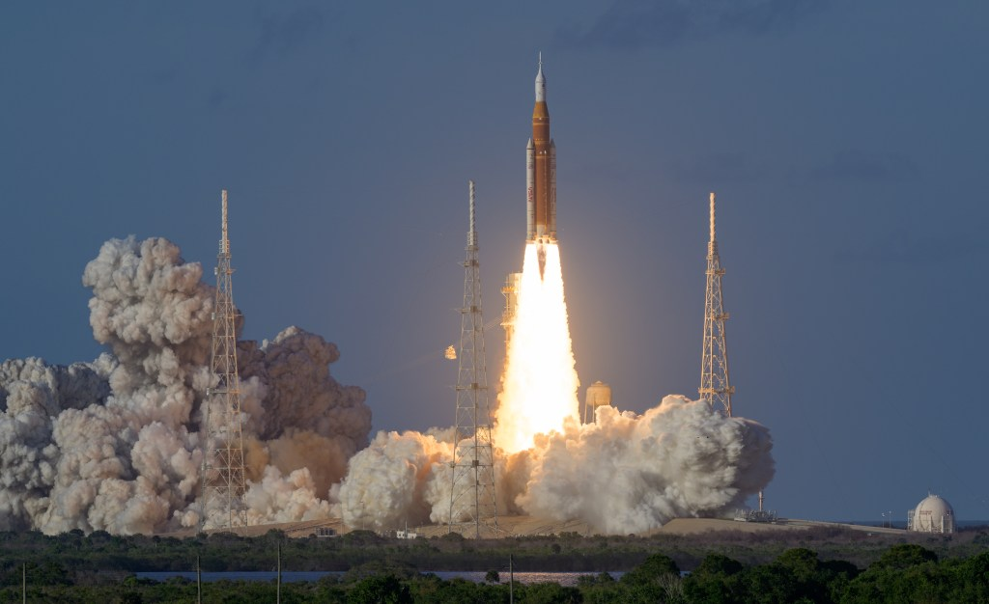
ARTEMIS II
Humanity Returns to the Moon | April 1–10, 2026
NASA Artemis II | Source: nasa.gov/mission/artemis-ii | April 2026
1
Notes:
Artemis II launched April 1, 2026 from Kennedy Space Center Launch Complex 39B at 6:35 PM EDT. NASA's first crewed lunar flyby mission in over 50 years.

Slide 3
240,000
MILES
Farthest humans from Earth in 50+ years
NASA Artemis II | Source: nasa.gov/mission/artemis-ii | April 2026
2
Notes:
Artemis II sent 4 astronauts approximately 240,000 miles from Earth, the farthest since Apollo 17 in December 1972.

Slide 4
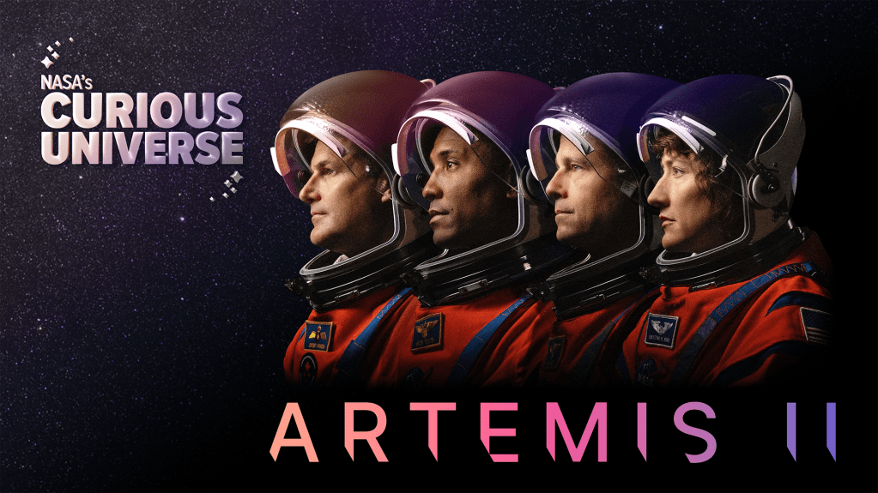
MISSION OVERVIEW
Artemis II was NASA's first crewed mission on the Space Launch System rocket and Orion spacecraft. Four astronauts flew around the Moon on a 9-day mission, testing critical deep-space systems and paving the way for Artemis III lunar landings.
9d 1h 32m
MISSION DURATION
April 1, 2026
LAUNCH DATE
322,000 km/h
MAX VELOCITY
8.9M lbs
SLS THRUST
LC-39B
LAUNCH PAD
4
CREW MEMBERS
NASA Artemis II | Source: nasa.gov/mission/artemis-ii | April 2026
3
Notes:
Key mission facts: Launched April 1, 2026 at 6:35 PM EDT from LC-39B. SLS generated 8.8 million pounds of thrust. Mission lasted 9 days, 1 hour, 32 minutes. Splashdown April 10, 2026.

Slide 5
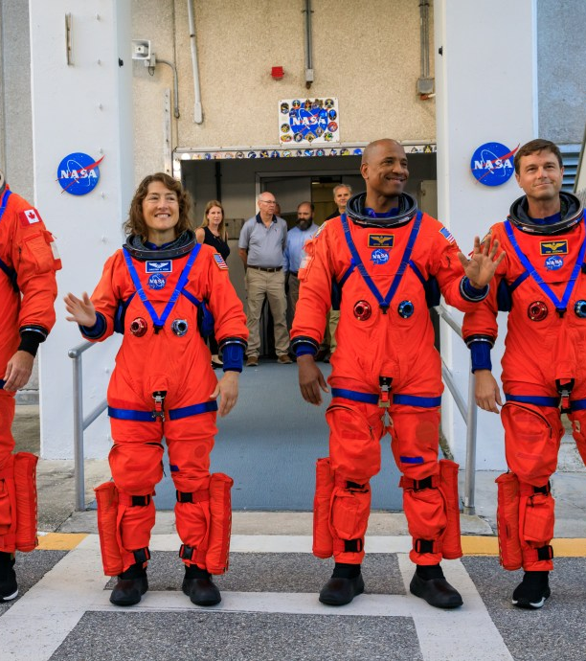
MEET THE CREW
Reid Wiseman
Commander • NASA
U.S. Navy Captain, ISS veteran
Victor Glover
Pilot • NASA
U.S. Navy Captain, SpaceX Crew-1
Christina Koch
Mission Specialist • NASA
Longest single spaceflight by a woman
Jeremy Hansen
Mission Specialist • CSA
First Canadian to fly to the Moon
NASA Artemis II | Source: nasa.gov/mission/artemis-ii | April 2026
4
Notes:
Crew: Commander Reid Wiseman (NASA), Pilot Victor Glover (NASA), Mission Specialist Christina Koch (NASA), Mission Specialist Jeremy Hansen (CSA). Hansen became the first Canadian to fly to the Moon.

Slide 6
BY THE NUMBERS
386,243 km
98.3 m
26,000 kg
50+ years
Max Distance from Earth
SLS Rocket Height
Orion Spacecraft Mass
Since Humans Last Flew to Moon
NASA Artemis II | Source: nasa.gov/mission/artemis-ii | April 2026
5
Notes:
Artemis II reached approximately 386,243 km from Earth. The SLS Block 1 rocket stands 98.3 meters tall. The Orion crew module weighs approximately 26,000 kg.

Slide 7
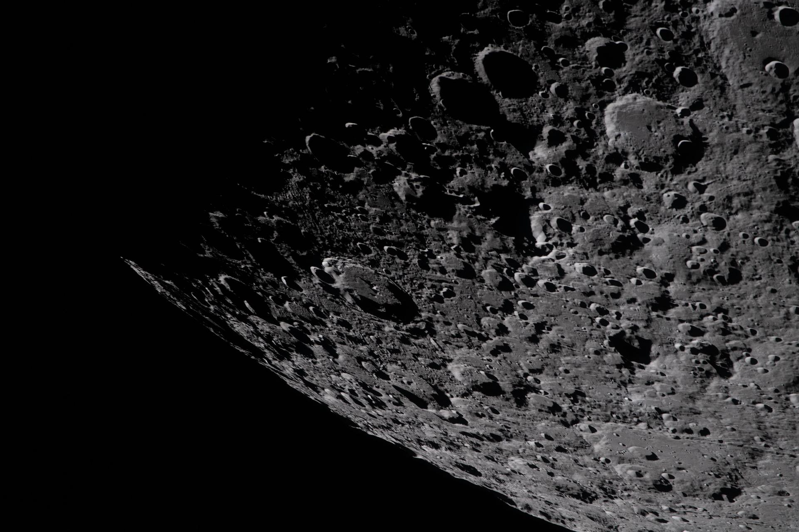
A View of Home
Photographed by Commander Reid Wiseman from Orion's window after translunar injection, April 2, 2026
NASA Artemis II | Source: nasa.gov/mission/artemis-ii | April 2026
6
Notes:
Photo taken by Reid Wiseman from one of Orion's four main windows after the TLI burn on April 2, 2026.

Slide 8
MISSION TIMELINE
1
2
3
4
5
6
Launch
Earth Orbit
TLI Burn
Lunar Flyby
Return
Splashdown
SLS lifts off from LC-39B
Systems checkout
Translunar injection
Free-return trajectory
Coast back to Earth
Pacific Ocean, Apr 10
NASA Artemis II | Source: nasa.gov/mission/artemis-ii | April 2026
7

Slide 9
THE SPACECRAFT & THE ROCKET
ORION SPACECRAFT
SLS ROCKET
Designed for deep space crew missions
Proven on Artemis I uncrewed flight (2022)
Life support for 21-day missions
3,600°F heat shield - largest ever built
11 parachutes for ocean splashdown
European Service Module by ESA
Most powerful rocket ever built
8.8 million lbs of thrust at liftoff
322 ft (98.3m) tall - Block 1
Two 5-segment solid rocket boosters
4 RS-25 engines (Shuttle heritage)
Only rocket sending crew to Moon
NASA Artemis II | Source: nasa.gov/mission/artemis-ii | April 2026
8
Notes:
Orion built by Lockheed Martin with ESA European Service Module. Heat shield withstands 3,600F during re-entry at 25,000 mph. SLS uses four RS-25 engines plus two solid rocket boosters.

Slide 10
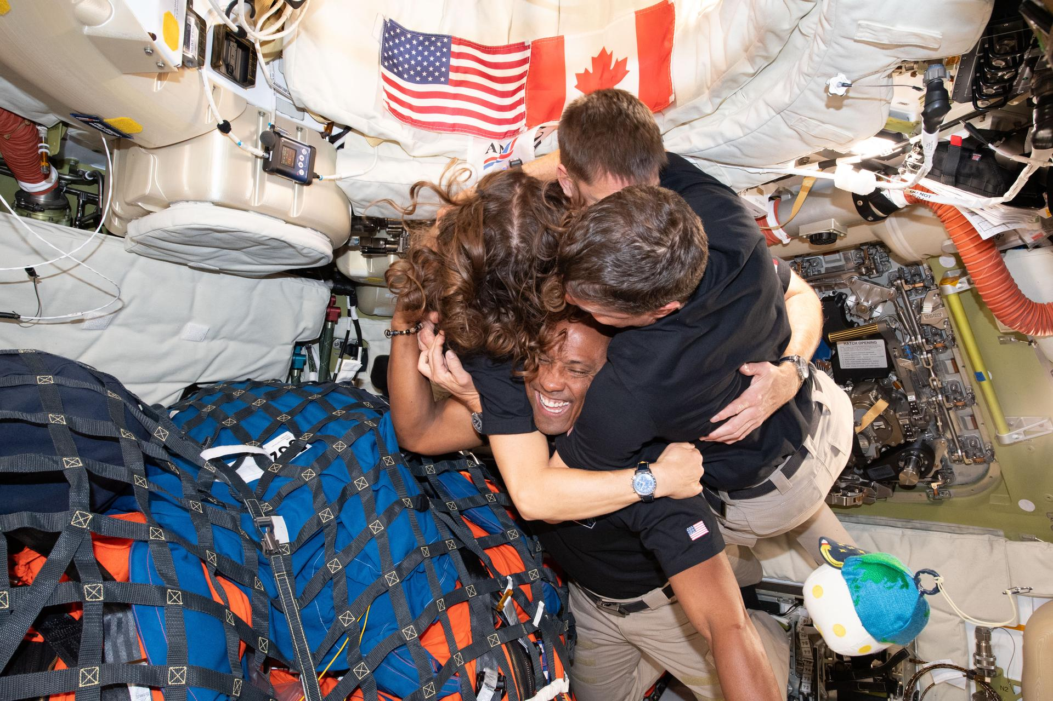
Into the Deep
Crew photography from aboard Orion during the lunar flyby
NASA Artemis II | Source: nasa.gov/mission/artemis-ii | April 2026
9
Notes:
Image captured by the Artemis II crew during their lunar flyby, documenting views not seen since the Apollo era.

Slide 11
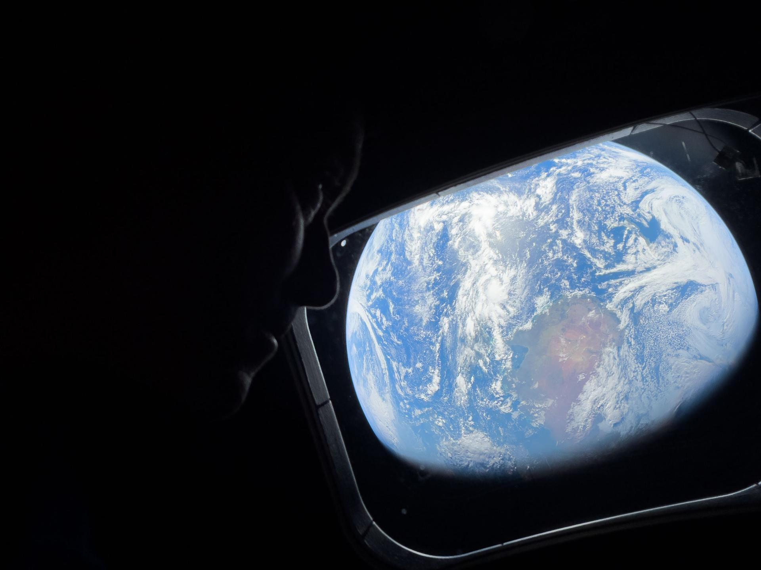
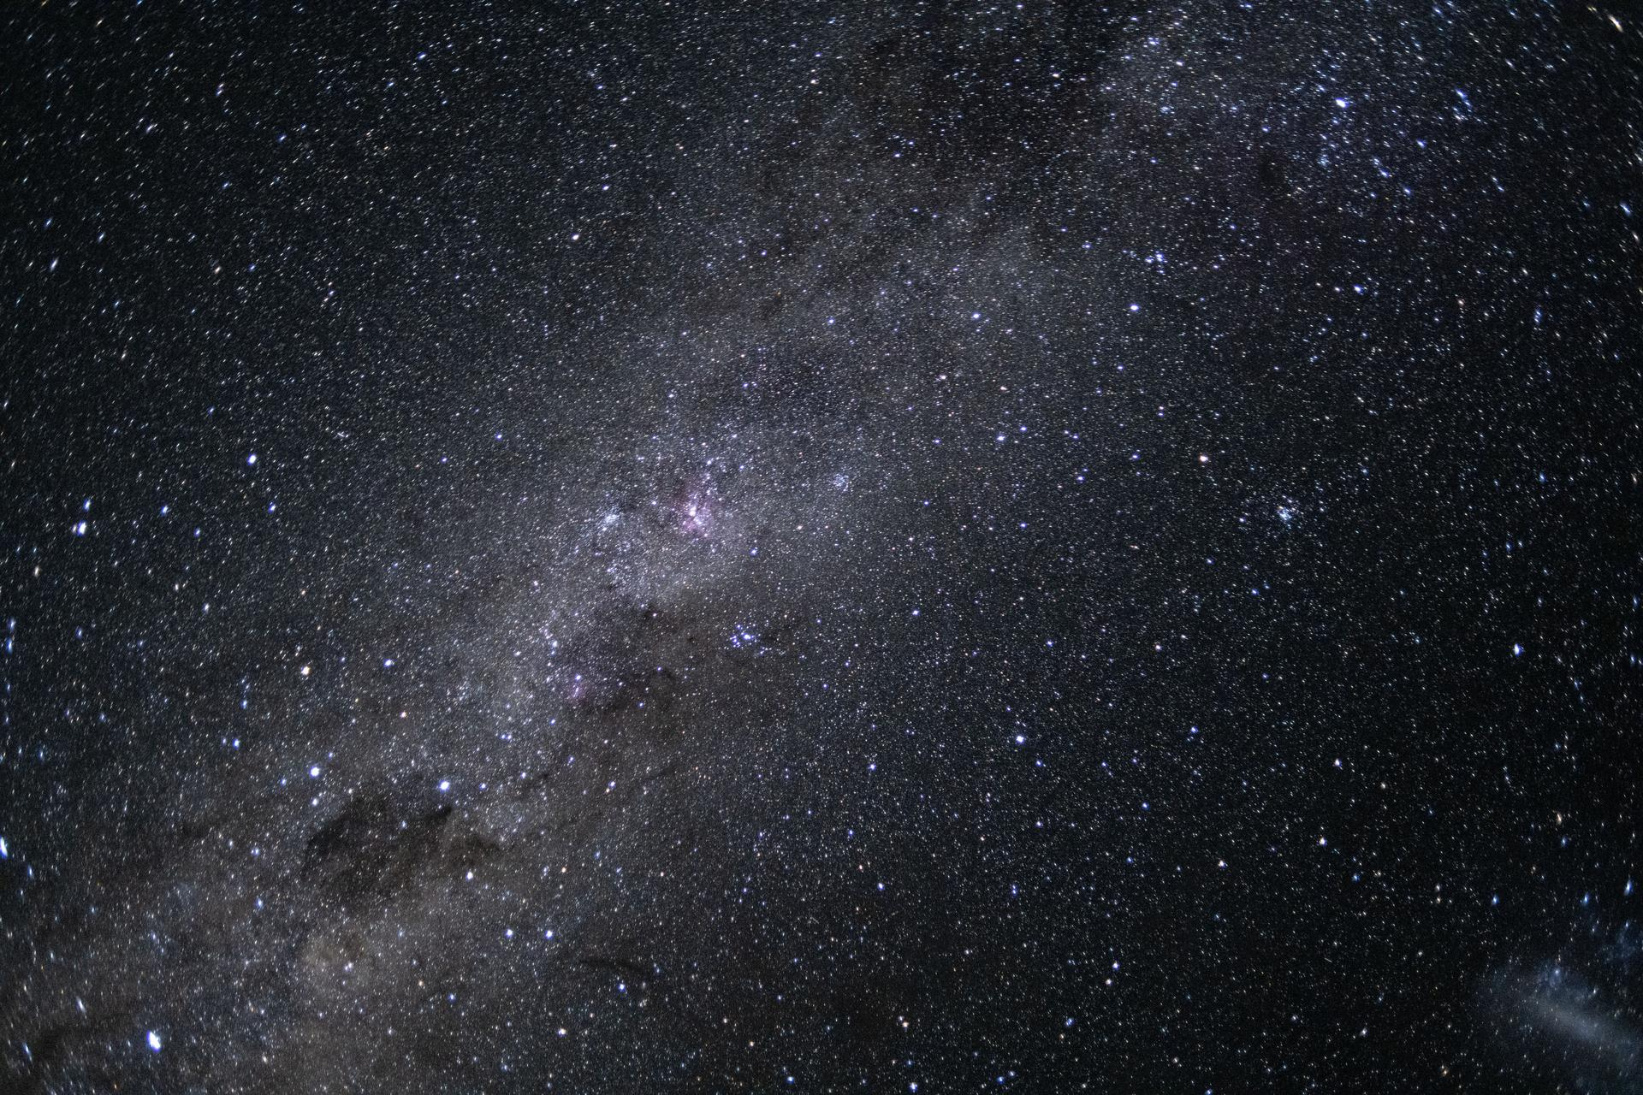
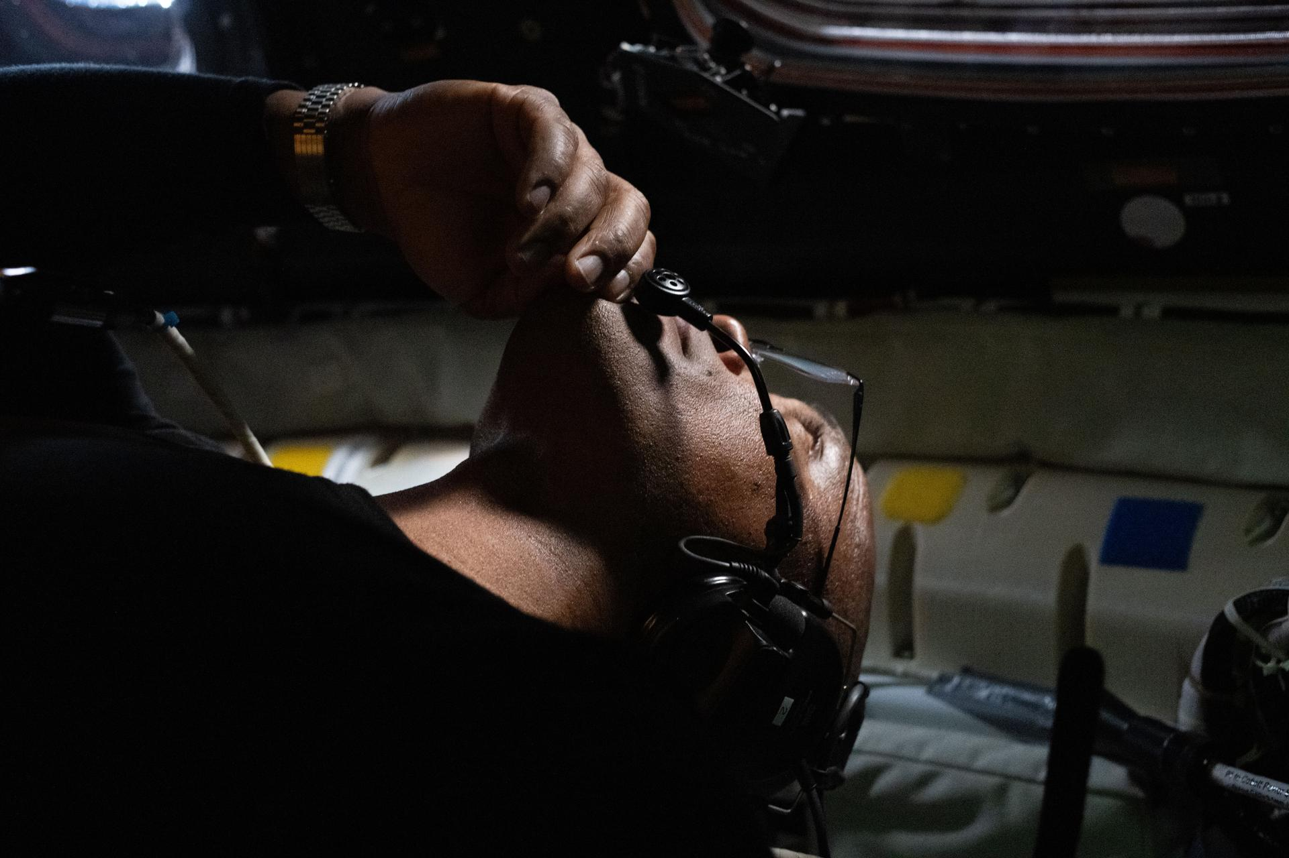
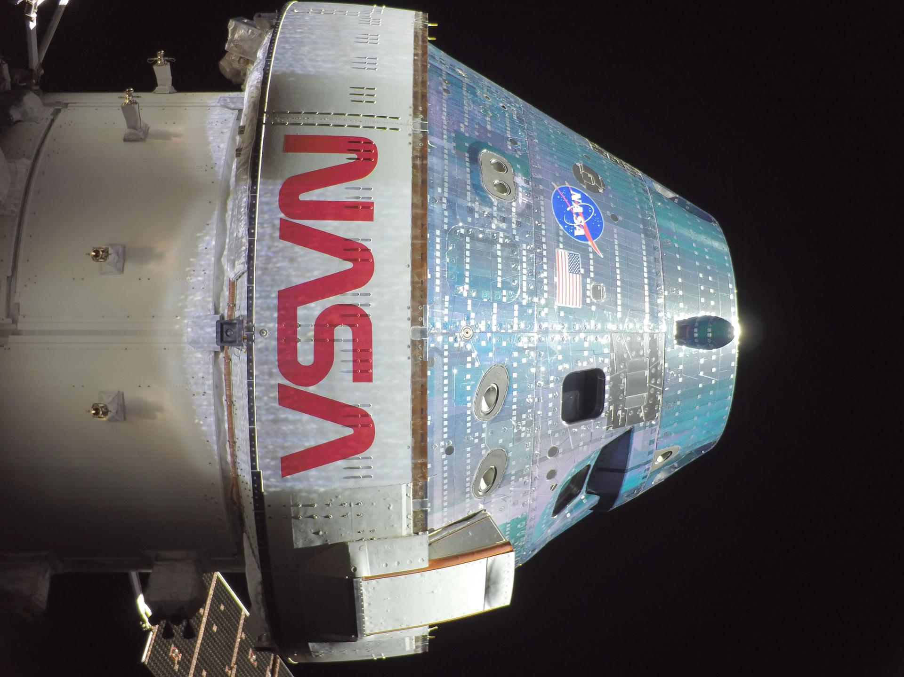
CREW PHOTOGRAPHY FROM THE MISSION
View from Orion
Lunar approach
Deep space vista
Through Orion's window
NASA Artemis II | Source: nasa.gov/mission/artemis-ii | April 2026
10
Notes:
Photographs taken by the Artemis II crew during their 9-day mission. Views of Moon, Earth, and deep space not seen by human eyes in over 50 years.

Slide 12
ARTEMIS II SCIENCE
Science operations laying the foundation for safe human exploration of the Moon and Mars.
AVATAR Investigation
Radiation Mapping
Organ-on-a-chip devices studying effects of radiation and microgravity on human health
Measured deep space radiation beyond the Van Allen belts to protect future crews
Optical Navigation
Biological Research
Tested navigation by photographing star fields, Earth, and Moon from deep space
Seeds, fungi, and biological samples exposed to the deep space environment
NASA Artemis II | Source: nasa.gov/mission/artemis-ii | April 2026
11
Notes:
AVATAR used organ-on-a-chip devices to study radiation/microgravity effects. Crew tested optical navigation and measured deep space radiation beyond Van Allen belts.

Slide 13
MISSION MILESTONES
6:35 PM
3,600°F
25,000 mph
~1 Million
EDT Launch Time, April 1
Heat Shield Re-entry Temp
Re-entry Speed
Launch Spectators at KSC
NASA Artemis II | Source: nasa.gov/mission/artemis-ii | April 2026
12
Notes:
Launched at 6:35 PM EDT. Heat shield endured 3,600F at approximately 25,000 mph re-entry. Estimated 1 million spectators at Kennedy Space Center.

Slide 14
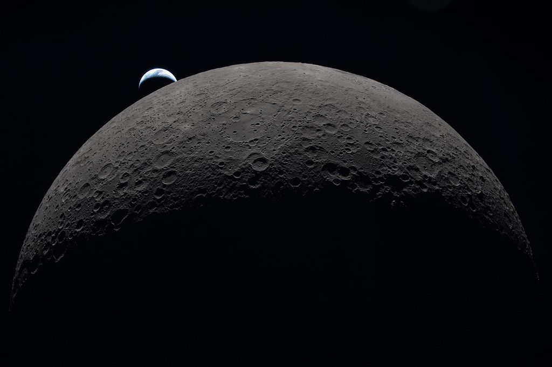
Earthset
Earth setting behind the lunar horizon, photographed from the far side of the Moon
NASA Artemis II | Source: nasa.gov/mission/artemis-ii | April 2026
13
Notes:
Earth setting behind the lunar horizon as seen from the far side of the Moon during the Artemis II mission.

Slide 15
“
We are going to the Moon, not to leave footprints and come home. We are going to learn how to live and work on another world for the benefit of all humanity.
”
— NASA Administrator, Artemis Program Vision
NASA Artemis II | Source: nasa.gov/mission/artemis-ii | April 2026
14
Notes:
The Artemis program aims to establish a sustainable human presence at the Moon, building infrastructure for eventual Mars missions.

Slide 16
WHAT'S NEXT FOR ARTEMIS
Artemis II | Artemis III | Artemis IV | Artemis V+
Crewed flyby (DONE) | First landing | Gateway assembly | Sustained presence
ARTEMIS III
First crewed lunar landing since 1972. SpaceX Starship HLS. First woman and first person of color on the Moon.
LUNAR GATEWAY
Small space station orbiting the Moon, providing a staging point for surface missions and deep space research.
MOON TO MARS
Artemis is NASA's stepping stone to Mars. Technologies tested at the Moon will enable human missions to the Red Planet.
NASA Artemis II | Source: nasa.gov/mission/artemis-ii | April 2026
15
Notes:
Artemis III will land first woman and person of color on the Moon using SpaceX Starship HLS. Artemis IV begins Gateway station assembly. Long-term goal: sustainable lunar presence as Mars proving ground.

Slide 17
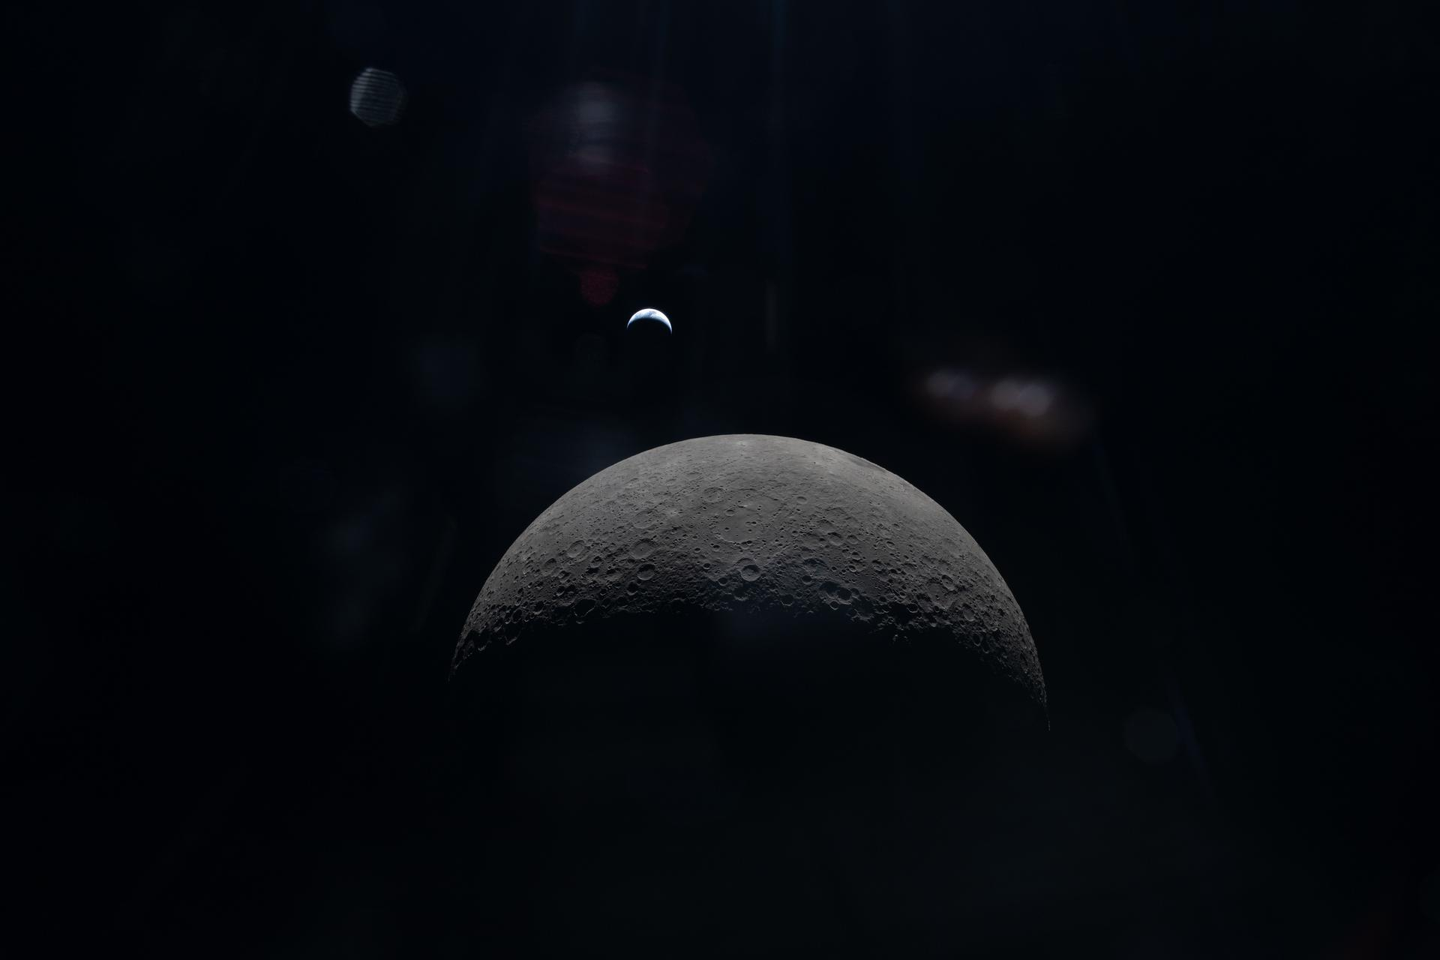
BE PART OF THE JOURNEY
The Artemis generation is just getting started. Here's how you can get involved:
Join Artemis
Follow Live
STEM Resources
nasa.gov/joinArtemis
nasa.gov/live
nasa.gov/stem
Citizen Science
Multimedia
NASA Careers
science.nasa.gov
nasa.gov/artemis-ii-multimedia
nasa.gov/careers
NASA Artemis II | Source: nasa.gov/mission/artemis-ii | April 2026
16
Notes:
Ways to get involved: Join Artemis events, follow live coverage, access STEM education, citizen science projects, explore multimedia, and NASA careers.

Slide 18
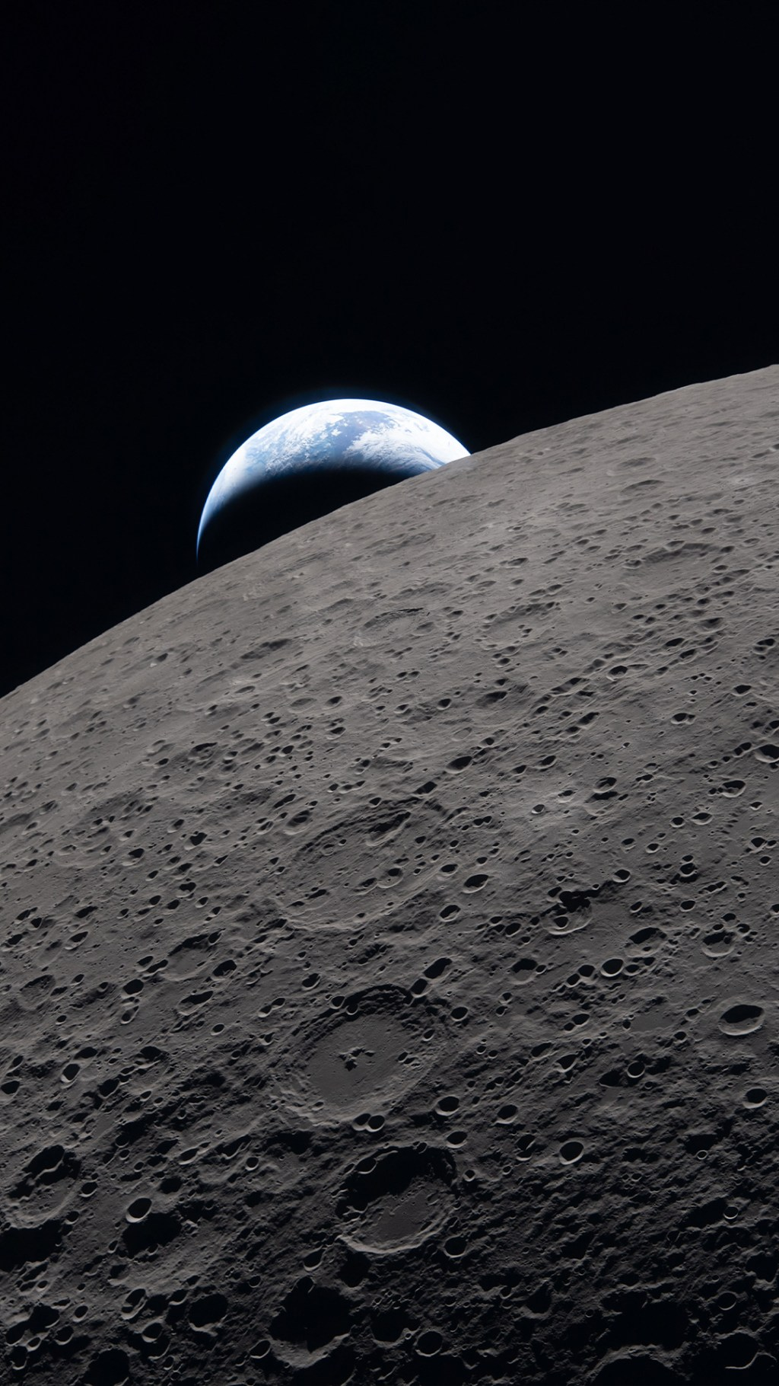
We Are Going
To the Moon. To Mars. Together.
NASA Artemis II | Source: nasa.gov/mission/artemis-ii | April 2026
17
Notes:
The Artemis program is the next giant leap. We are returning to the Moon to stay, building the foundation for Mars and beyond.

