Slide 1
⚠️ Warning: This PowerPoint deck was generated by HyperAgent. You should carefully check and verify the contents.
Learn more about HyperAgent

Slide 2
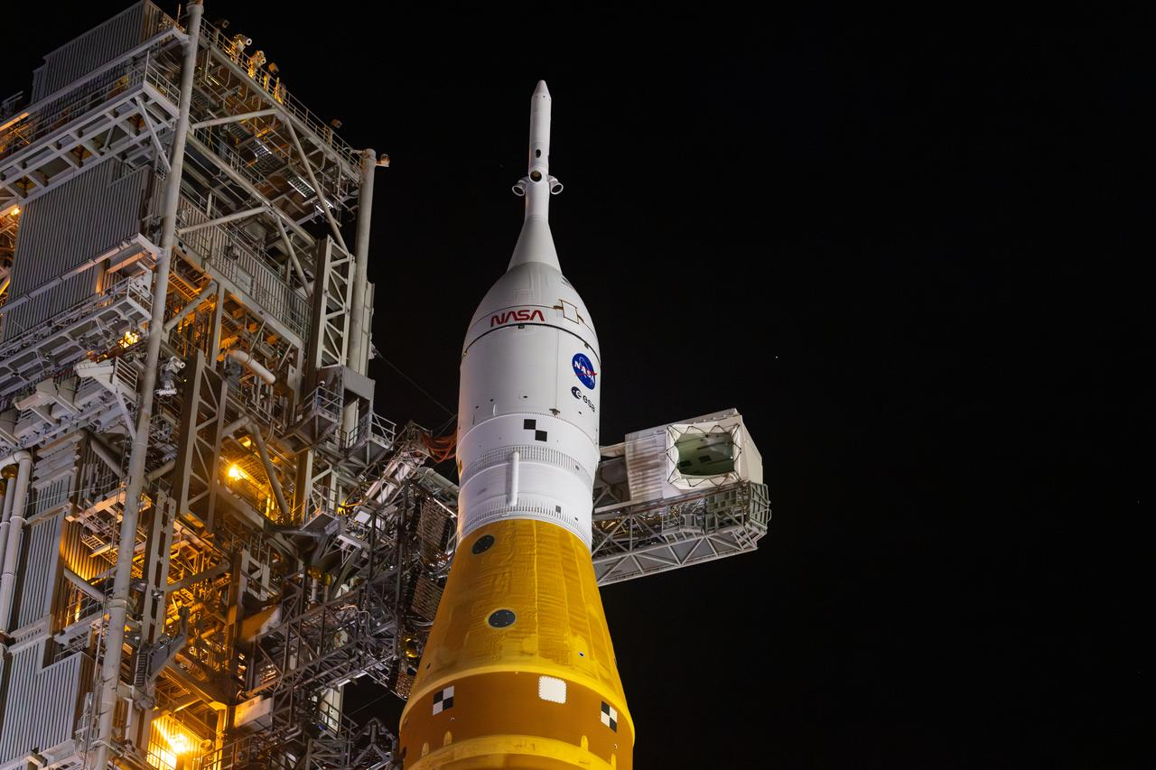
ARTEMIS II
Humanity's Return to Deep Space The First Crewed Lunar Flyby in Over 50 Years
NASA Artemis II | Images: NASA/JSC | nasa.gov/mission/artemis-ii
1
Notes:
Artemis II launched from Kennedy Space Center in 2026, marking the first time humans traveled beyond low Earth orbit since Apollo 17 in 1972.

Slide 3
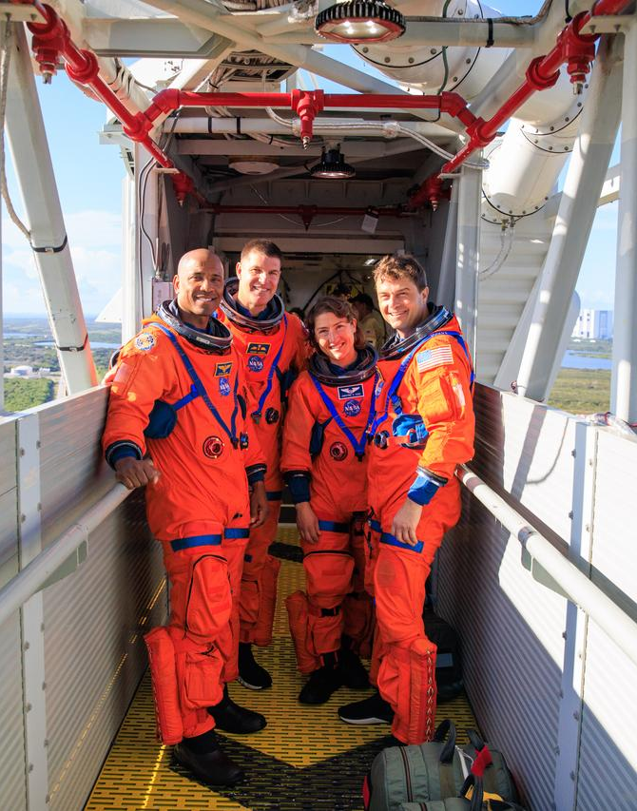
MISSION OVERVIEW
Artemis II was a historic 10-day mission that sent four astronauts around the Moon aboard NASA's Orion spacecraft, launched atop the Space Launch System (SLS) rocket from Kennedy Space Center's Launch Complex 39B.
It was the first crewed flight of the Orion spacecraft and the first time humans ventured beyond low Earth orbit since Apollo 17 in December 1972.
The crew tested critical life support, navigation, and communication systems in deep space, laying the groundwork for Artemis III which will land astronauts on the lunar surface.
NASA Artemis II | Images: NASA/JSC | nasa.gov/mission/artemis-ii
2
Notes:
Artemis II is the second mission in NASA's Artemis program. While Artemis I was an uncrewed test flight in 2022, Artemis II carried astronauts for the first time.

Slide 4
ARTEMIS II BY THE NUMBERS
~10
~1.4M
~230K
4
DAY MISSION
MILES TRAVELED
MILES FROM EARTH
CREW MEMBERS
NASA Artemis II | Images: NASA/JSC | nasa.gov/mission/artemis-ii
3
Notes:
The Artemis II mission lasted approximately 10 days. The crew traveled roughly 1.4 million miles on a free-return trajectory around the Moon.

Slide 5
THE ARTEMIS II CREW
COMMANDER
PILOT
MISSION SPECIALIST
MISSION SPECIALIST
Reid Wiseman
Victor Glover
Christina Koch
Jeremy Hansen
NASA Astronaut U.S. Navy Captain Selected 2009 Expedition 41 (ISS) 165 days in space Leader of humanity's return to deep space
NASA Astronaut U.S. Navy Captain Selected 2013 SpaceX Crew-1 Pilot 168 days in space First Black astronaut on a lunar mission
NASA Astronaut Electrical Engineer Selected 2013 Record: 328-day flight Longest by a woman First woman on a lunar mission
CSA Astronaut Canadian Forces Col. Selected 2009 Fighter pilot (CF-18) First Canadian in deep space & first non-American on lunar
NASA Artemis II | Images: NASA/JSC | nasa.gov/mission/artemis-ii
4
Notes:
The Artemis II crew includes several historic firsts: Victor Glover is the first Black astronaut on a lunar mission, Christina Koch is the first woman, and Jeremy Hansen is the first Canadian and first non-American.

Slide 6
230K
MILES
Farthest from Earth since Apollo 17 in 1972
NASA Artemis II | Images: NASA/JSC | nasa.gov/mission/artemis-ii
5
Notes:
At its farthest point, Artemis II reached approximately 230,000 miles from Earth, passing behind the far side of the Moon.

Slide 7
THE VEHICLE: SLS & ORION
SLS (Space Launch System)
Orion Spacecraft
Most powerful rocket ever built
322 feet tall (Block 1 crew)
8.8 million lbs of thrust at liftoff
Twin 5-segment solid rocket boosters
4 RS-25 engines on core stage
Only rocket sending Orion + crew to Moon in one launch
Crew + European Service Module
Habitable volume: ~316 cu ft
Designed for up to 21 days in space
Heat shield: 16.5 ft diameter (largest ever)
Withstands 5,000°F at 25,000 mph re-entry
Launch Abort System for crew safety
NASA Artemis II | Images: NASA/JSC | nasa.gov/mission/artemis-ii
6
Notes:
SLS generates 8.8 million pounds of thrust at liftoff, 15% more than the Saturn V. The Orion heat shield is the largest ever built.

Slide 8
ARTEMIS II MISSION TIMELINE
1
2
3
4
5
6
Launch
Trans-Lunar Injection
Outbound Coast
Lunar Flyby
Return Transit
Splashdown
SLS lifts off from Pad 39B, Kennedy Space Center
ICPS fires to send Orion to the Moon
~4 days traveling, crew tests systems
Free-return trajectory behind the Moon
Gravity-assisted path back to Earth
Re-entry at 25,000 mph, Pacific Ocean landing
NASA Artemis II | Images: NASA/JSC | nasa.gov/mission/artemis-ii
7

Slide 9
SLS ROCKET — RAW POWER
8.8M
322
5,000°F
Mach 32
LBS OF THRUST
FEET TALL
RE-ENTRY HEAT
RE-ENTRY SPEED
NASA Artemis II | Images: NASA/JSC | nasa.gov/mission/artemis-ii
8
Notes:
SLS generates 15% more thrust than Saturn V. The heat shield protects the crew as Orion re-enters at approximately Mach 32.

Slide 10
VIEWS FROM DEEP SPACE
Photos captured by the Artemis II crew during their historic lunar flyby
NASA Artemis II | Images: NASA/JSC | nasa.gov/mission/artemis-ii
9

Slide 11
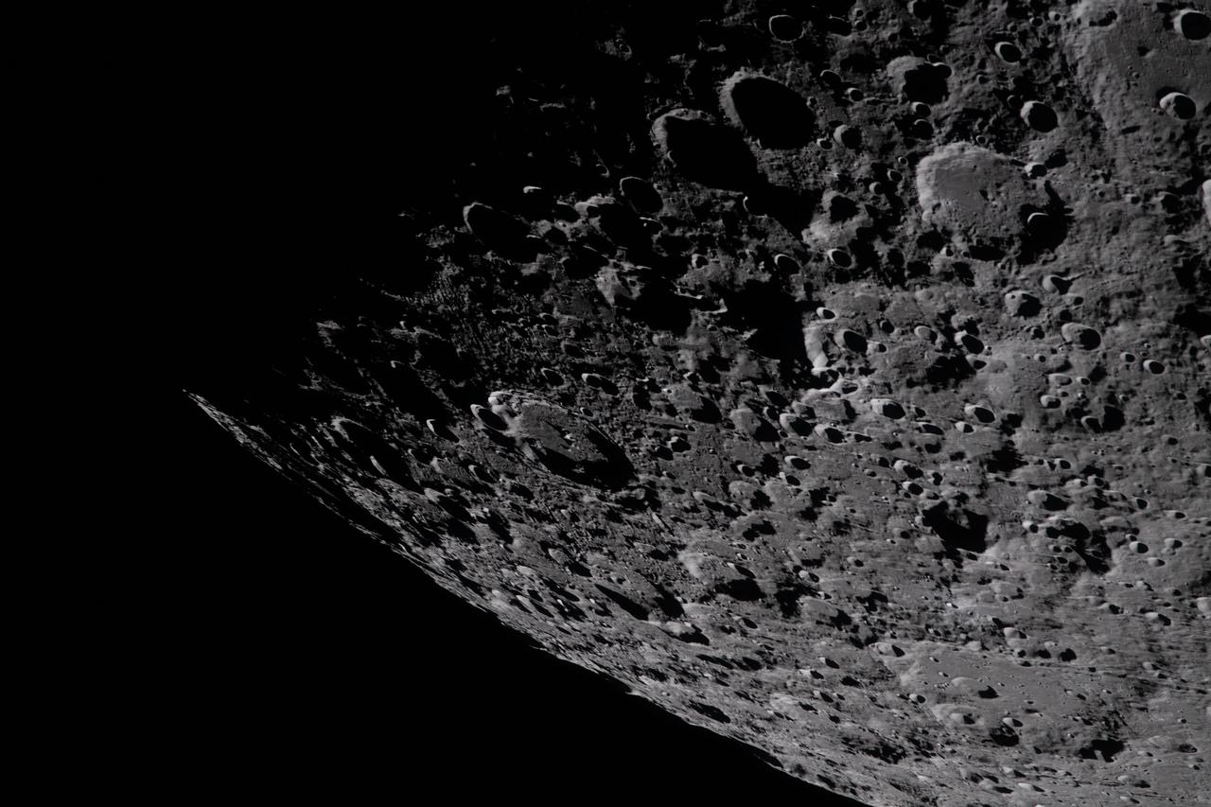
Through the Window of Orion
The Artemis II crew captured stunning views during their journey around the Moon
NASA Artemis II | Images: NASA/JSC | nasa.gov/mission/artemis-ii
10
Notes:
This image was taken by the Artemis II crew during the mission. The art002e prefix in NASA's image catalog designates official Artemis II expedition photos.

Slide 12
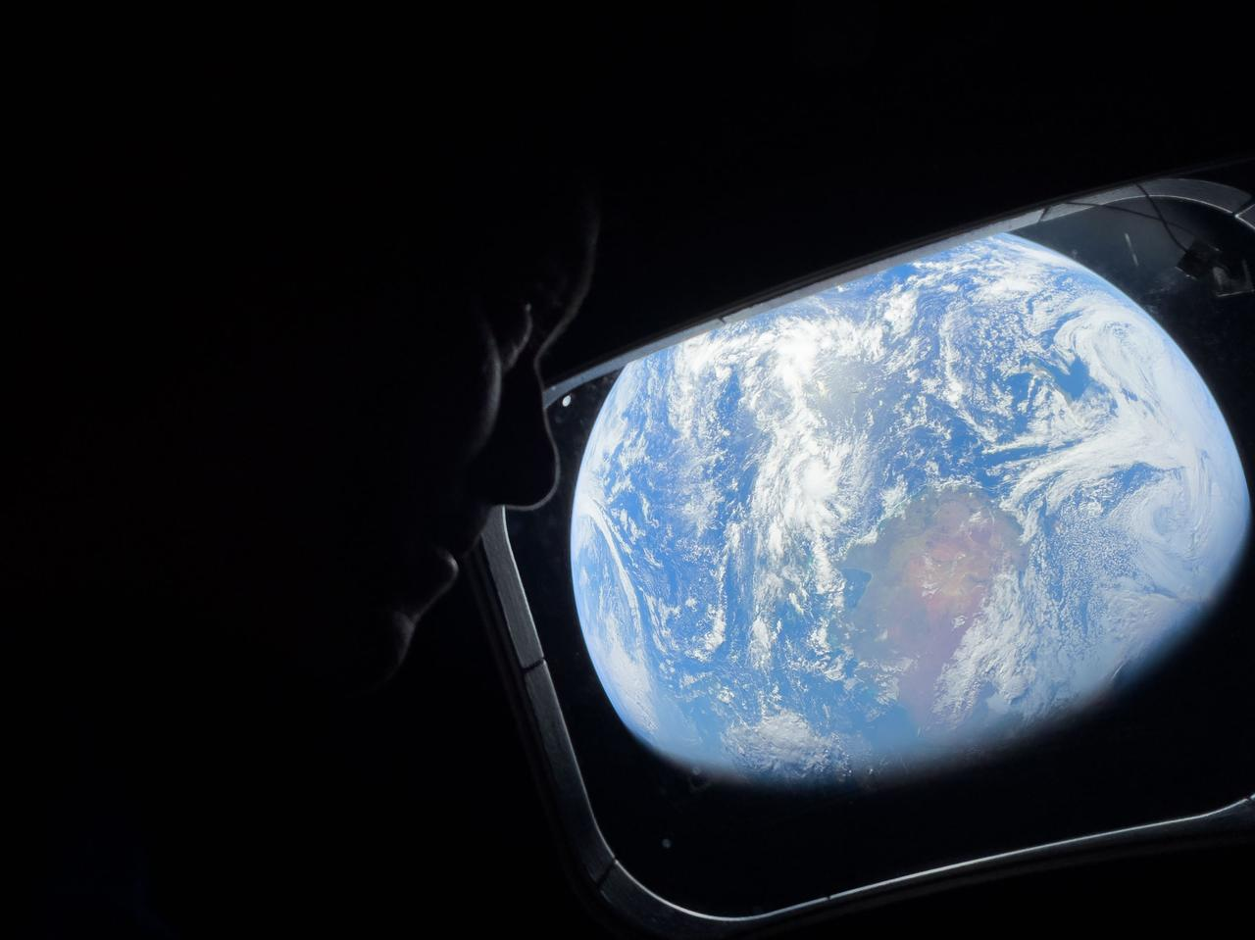
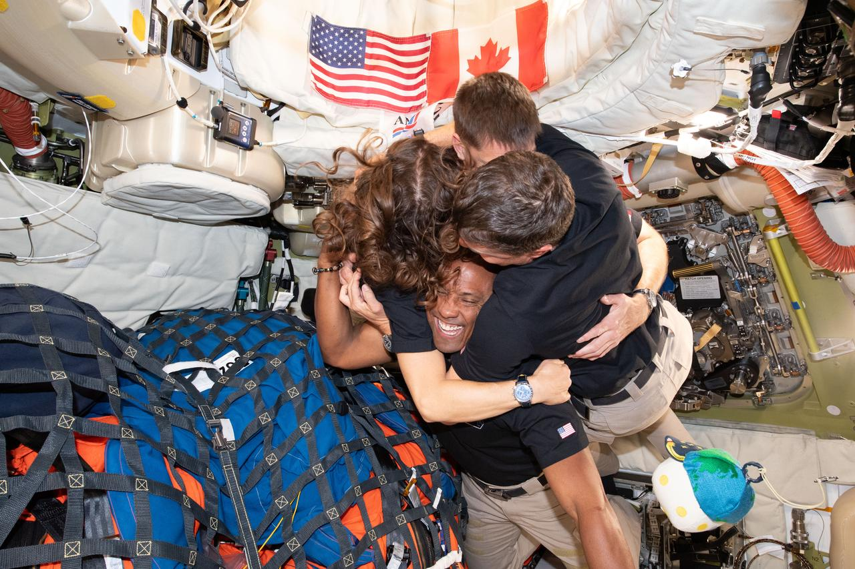
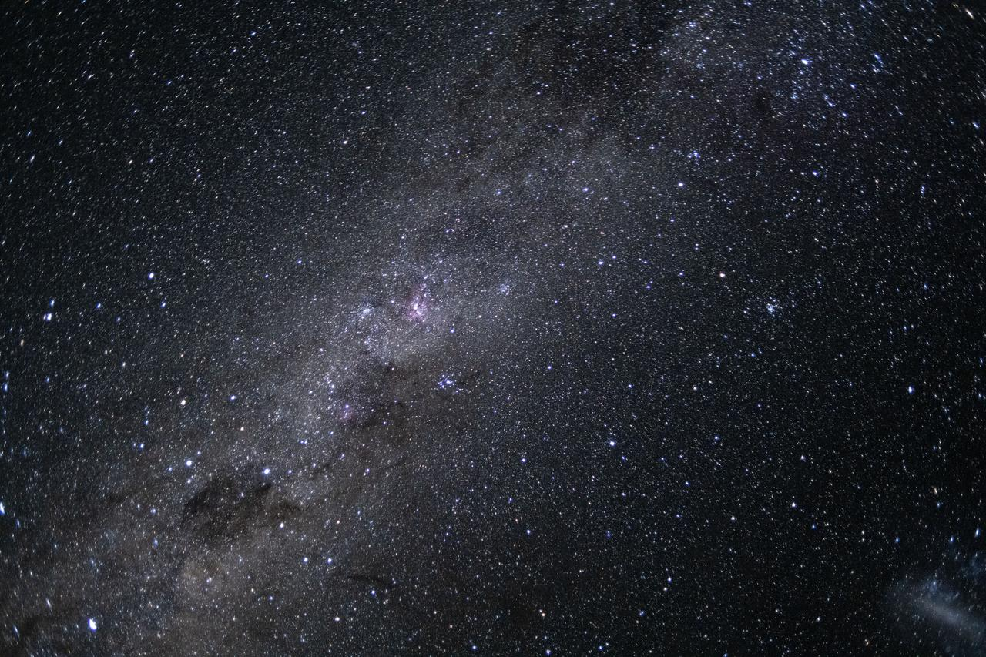
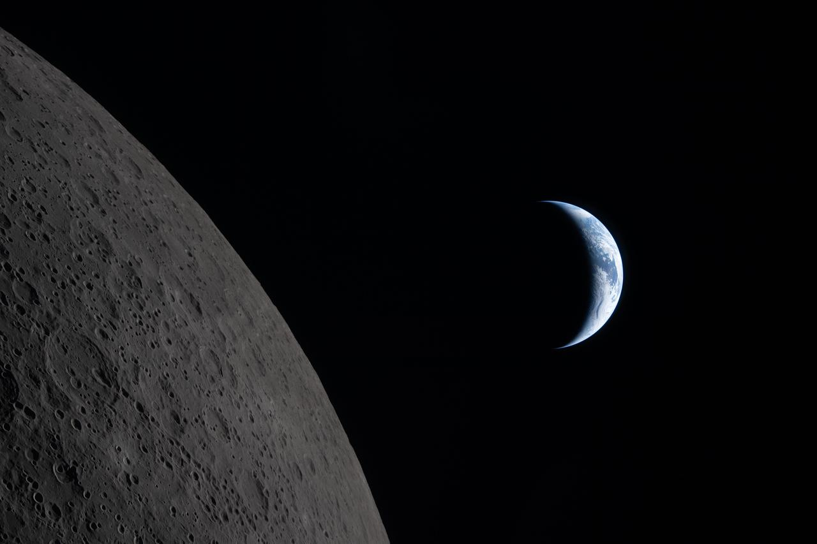
ARTEMIS II CREW PHOTOGRAPHY
Crew Activity
Deep Space View
Lunar Approach
Inside Orion
NASA Artemis II | Images: NASA/JSC | nasa.gov/mission/artemis-ii
11
Notes:
These photos were taken by the Artemis II crew during their 10-day mission. The collection includes views of Earth from deep space, the lunar surface, and life aboard the Orion spacecraft.

Slide 13
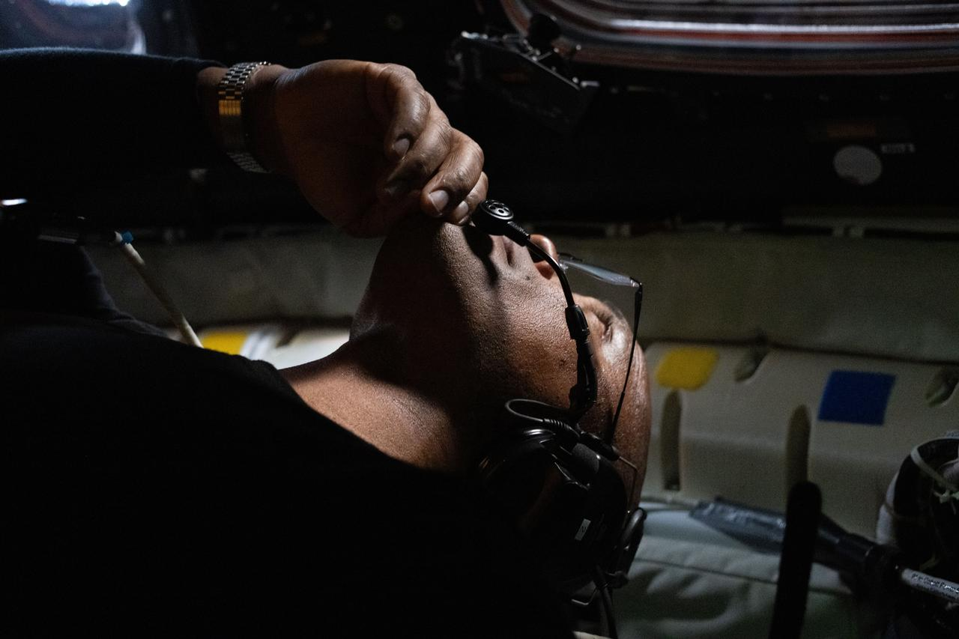
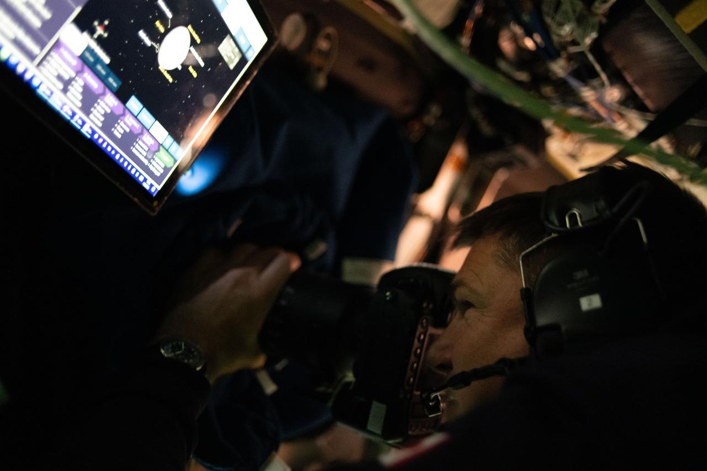
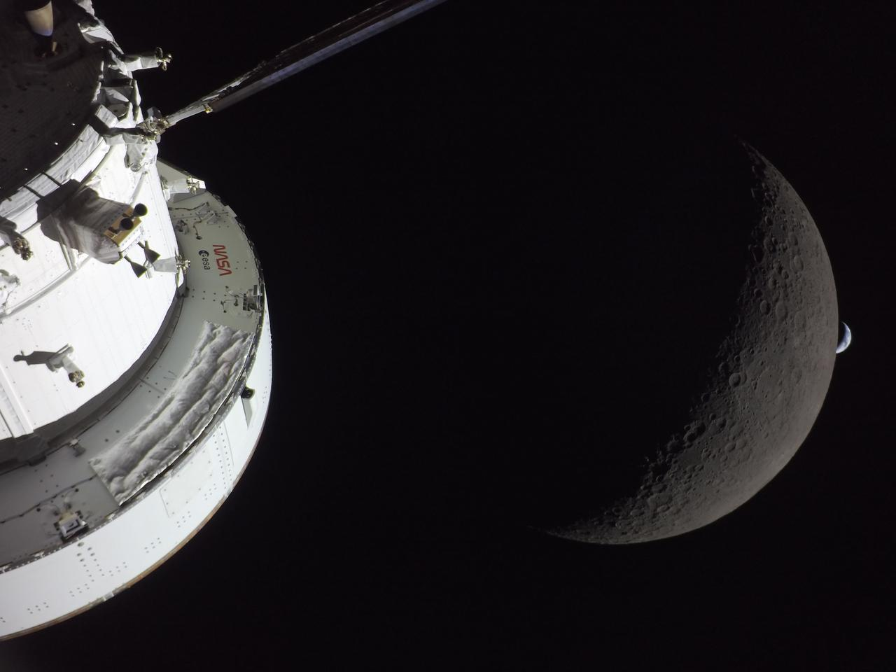
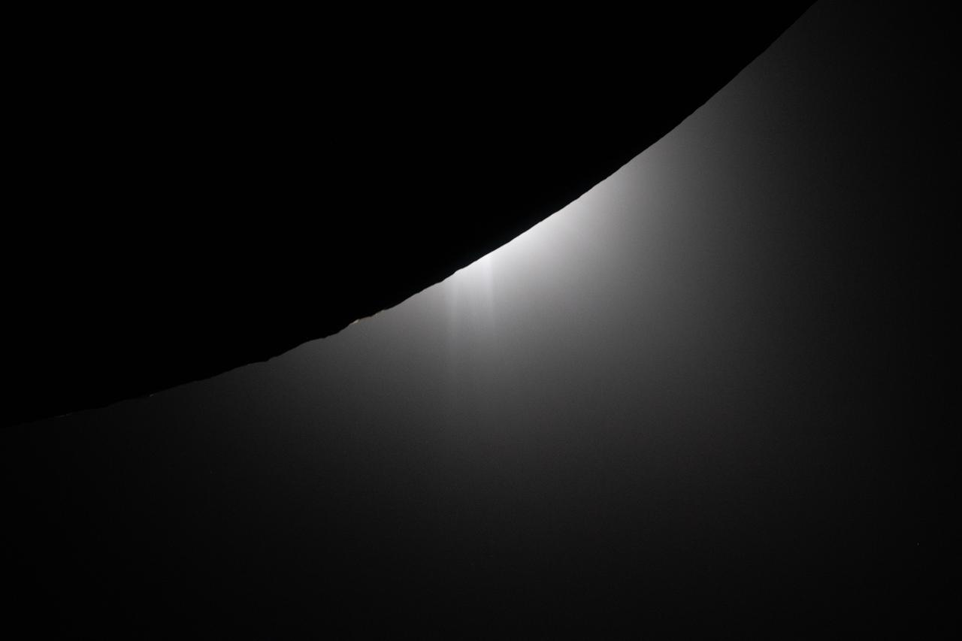
MORE FROM THE MISSION
Mission Operations
Crew at Work
Deep Space Vista
Earth from Afar
NASA Artemis II | Images: NASA/JSC | nasa.gov/mission/artemis-ii
12
Notes:
Additional crew photography from the Artemis II mission showing the crew conducting science experiments and capturing views from beyond low Earth orbit.

Slide 14
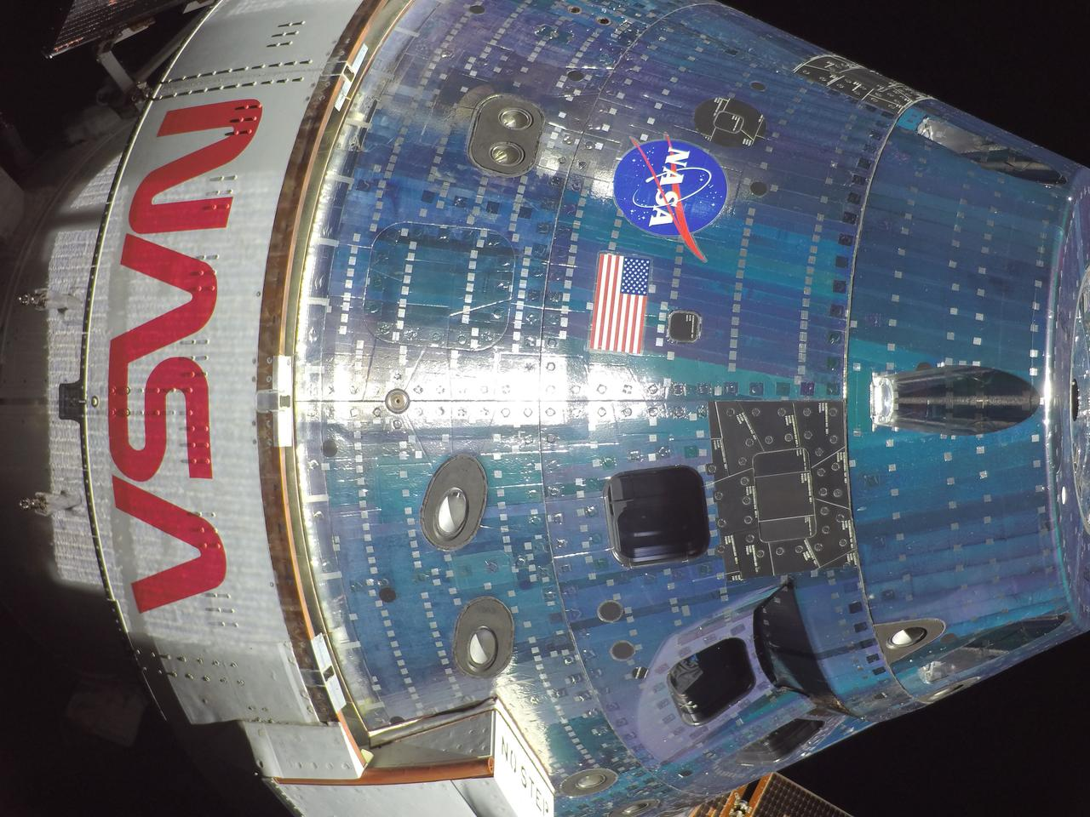
NASA Artemis II | Images: NASA/JSC | nasa.gov/mission/artemis-ii
13
Notes:
A stunning view captured by the Artemis II crew. For the first time in over 50 years, human eyes witnessed the Earth and Moon from this perspective in deep space.

Slide 15
SCIENCE & DISCOVERY
Human Health Research
Systems & Navigation
AVATAR: Organ-on-chip devices studying radiation & microgravity effects on human tissue
Radiation dosimetry measuring deep space exposure levels beyond Earth's magnetosphere
Crew health monitoring in the unique deep space environment
Data informing countermeasures for longer Artemis missions to the lunar surface
First crewed test of Orion life support & environmental control systems
Deep space navigation and communication testing with DSN
Manual piloting demonstrations near the Moon
Validating crew procedures for future lunar landing missions (Artemis III+)
NASA Artemis II | Images: NASA/JSC | nasa.gov/mission/artemis-ii
14
Notes:
Artemis II carried several science investigations and technology demonstrations. The AVATAR experiment used organ-on-a-chip technology to study the effects of deep space radiation and microgravity on human tissues.

Slide 16
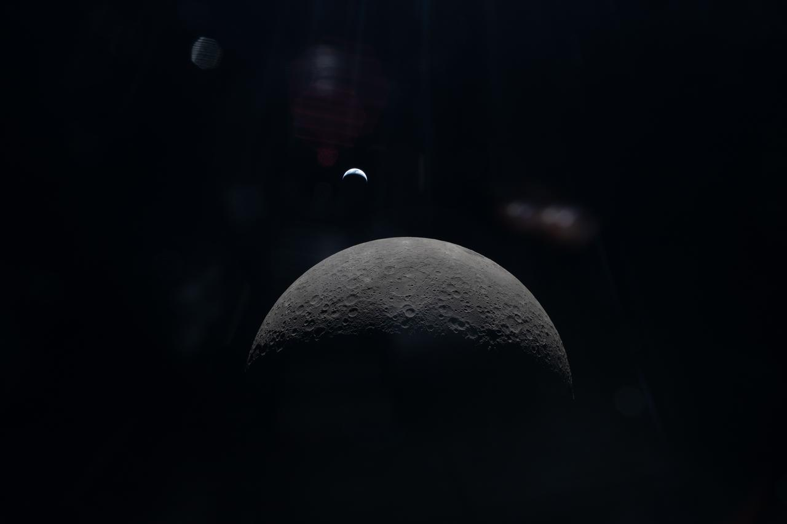
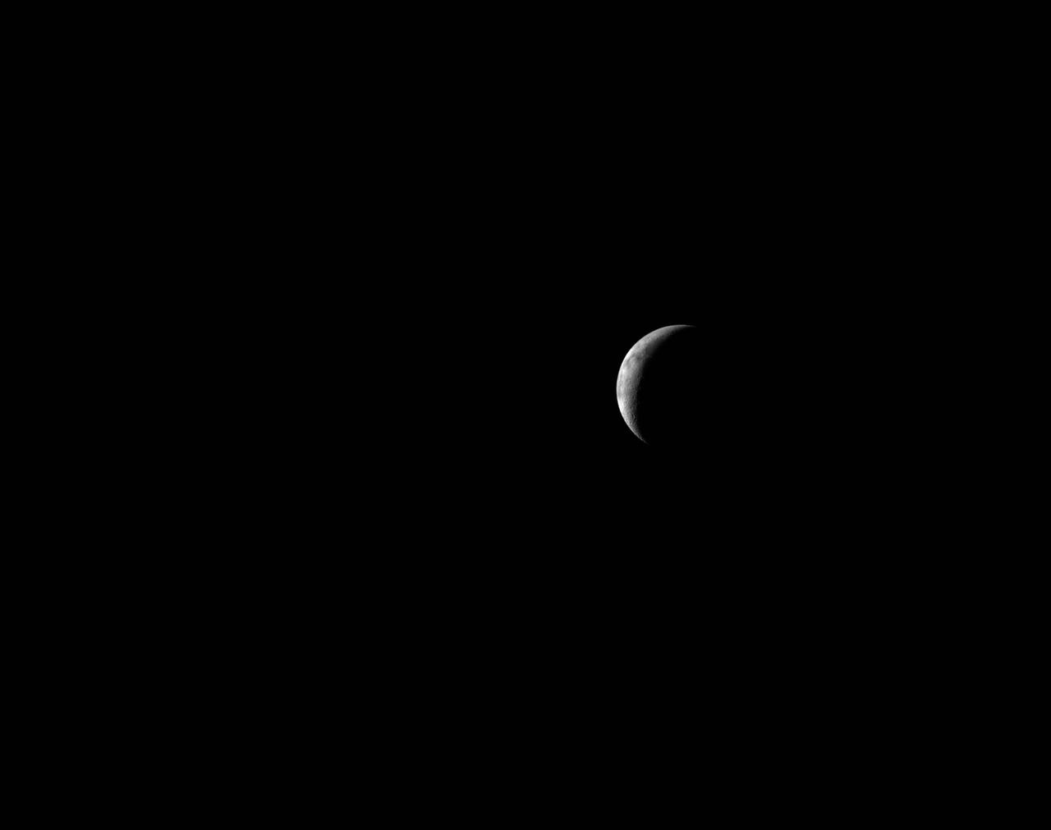
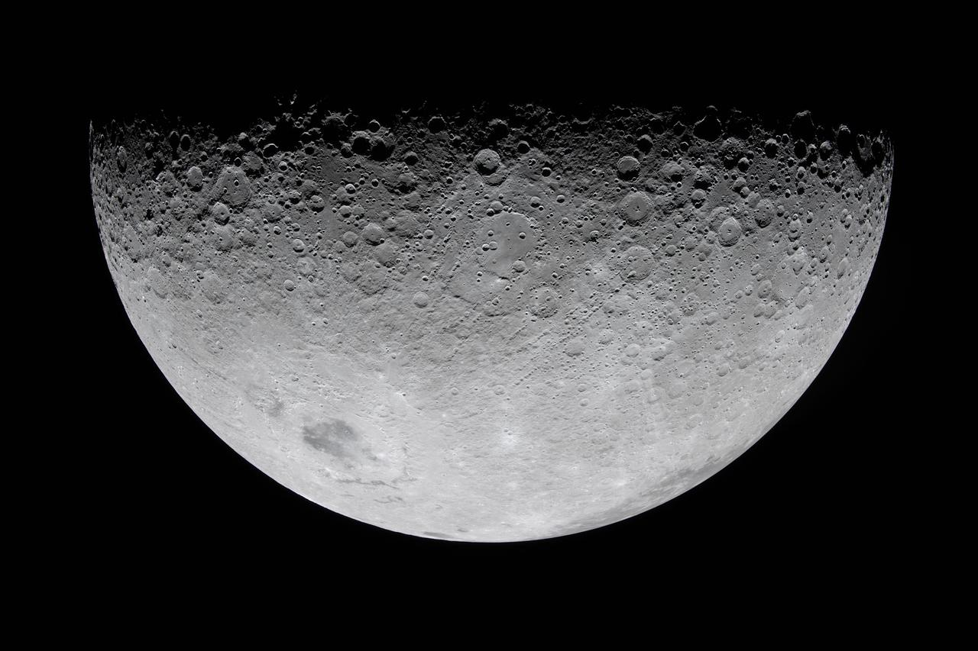
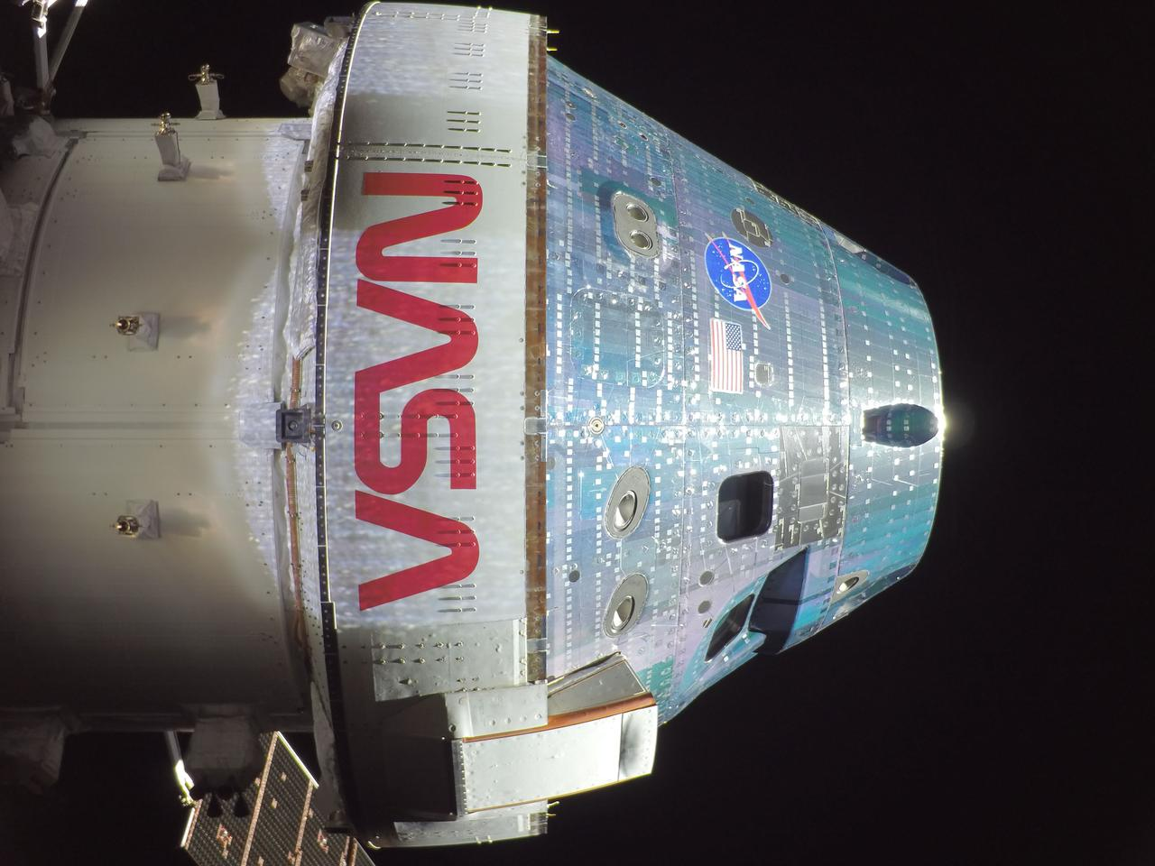
MISSION HIGHLIGHTS
Crew Operations
Mission Activity
Crew View
On the Way
NASA Artemis II | Images: NASA/JSC | nasa.gov/mission/artemis-ii
15
Notes:
More photos from the Artemis II crew during their 10-day journey to the Moon and back.

Slide 17
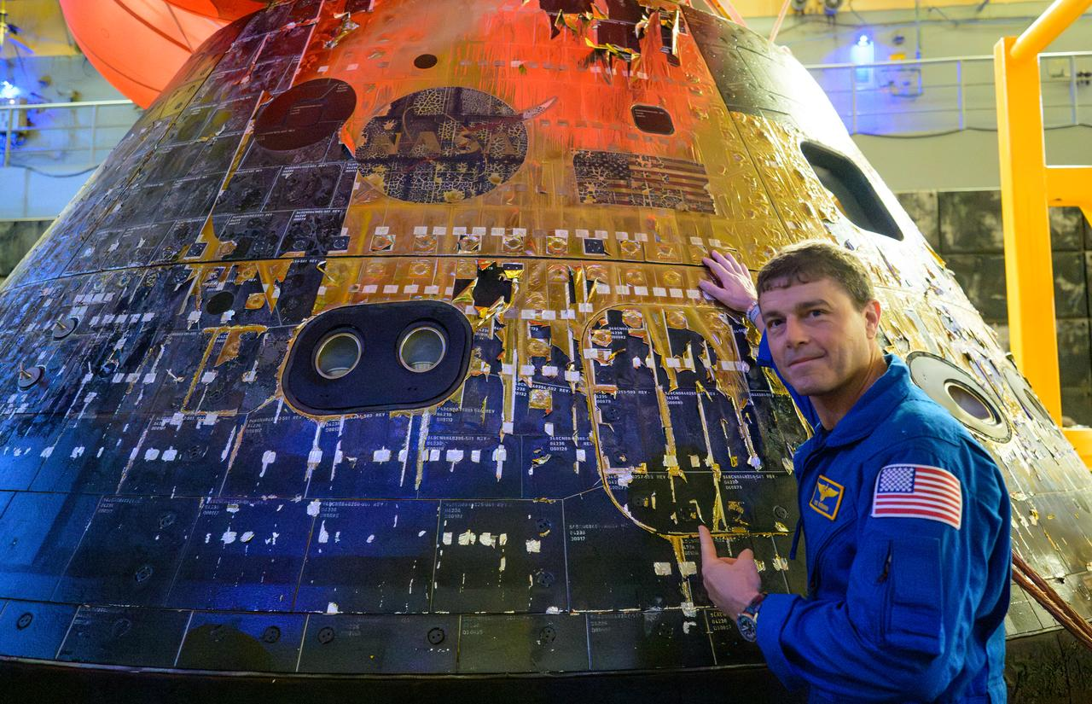
WELCOME HOME
Artemis II crew returns safely to Earth after 10 days in deep space
NASA Artemis II | Images: NASA/JSC | nasa.gov/mission/artemis-ii
16
Notes:
The Artemis II crew splashed down safely in the Pacific Ocean after their historic mission, marking the successful completion of humanity's first crewed lunar flyby in over 50 years.

Slide 18
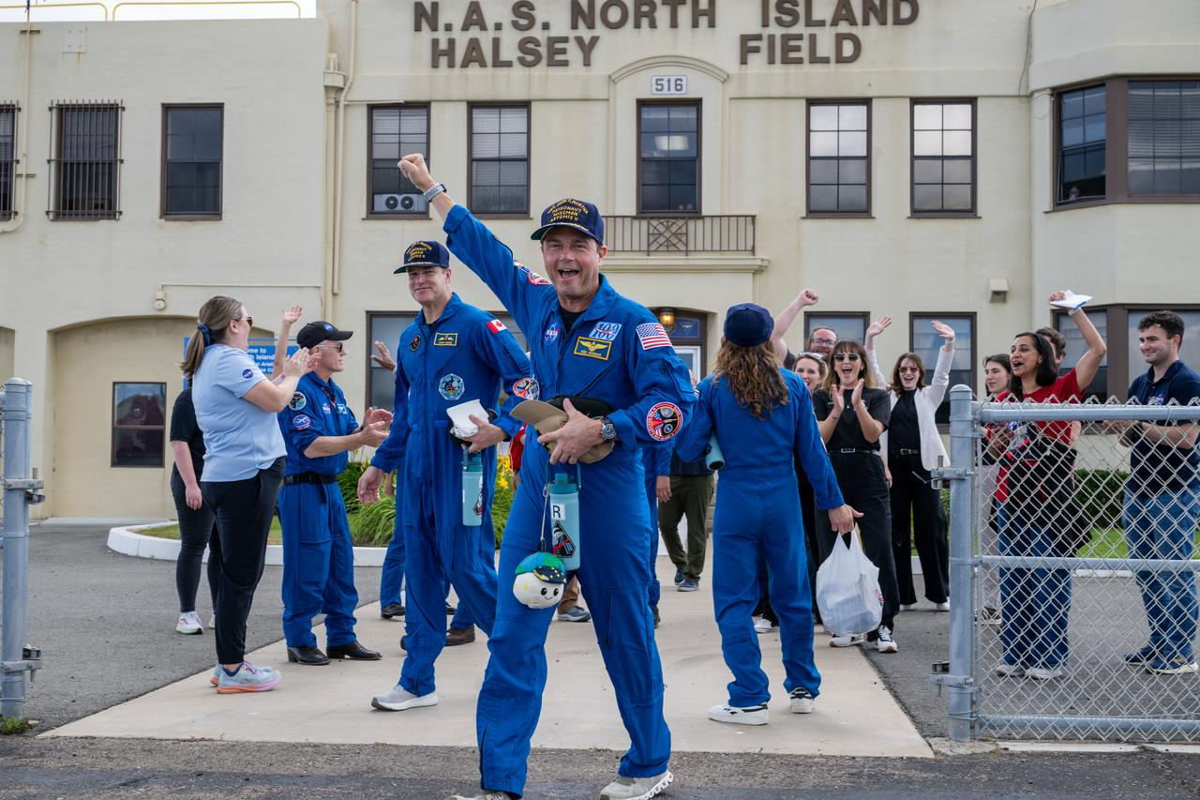
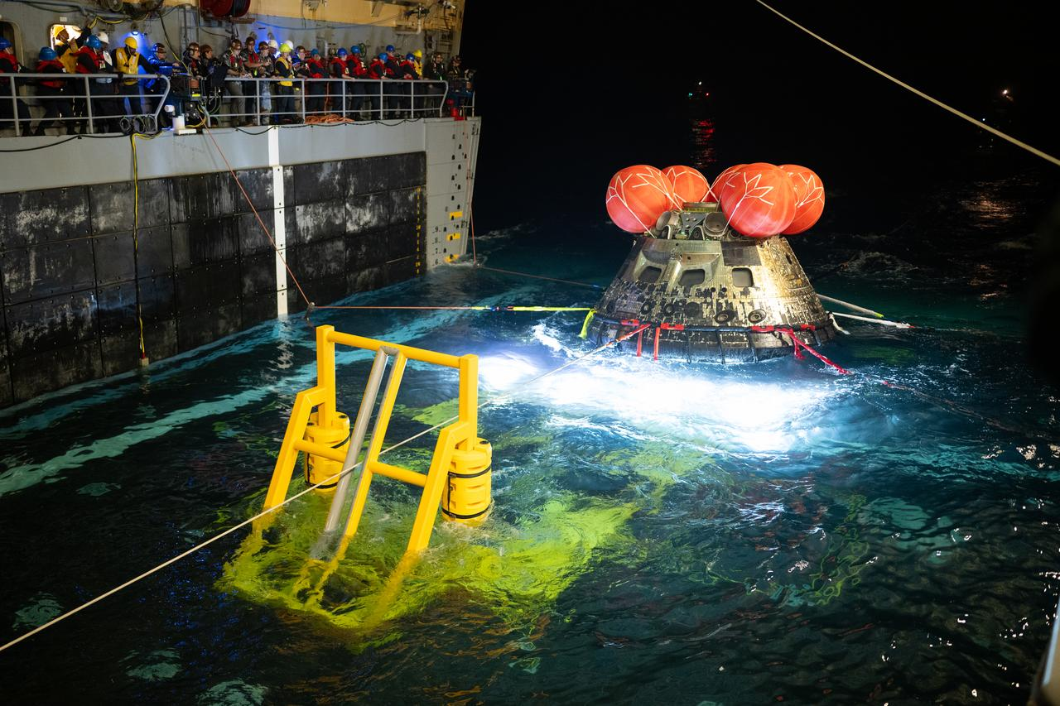
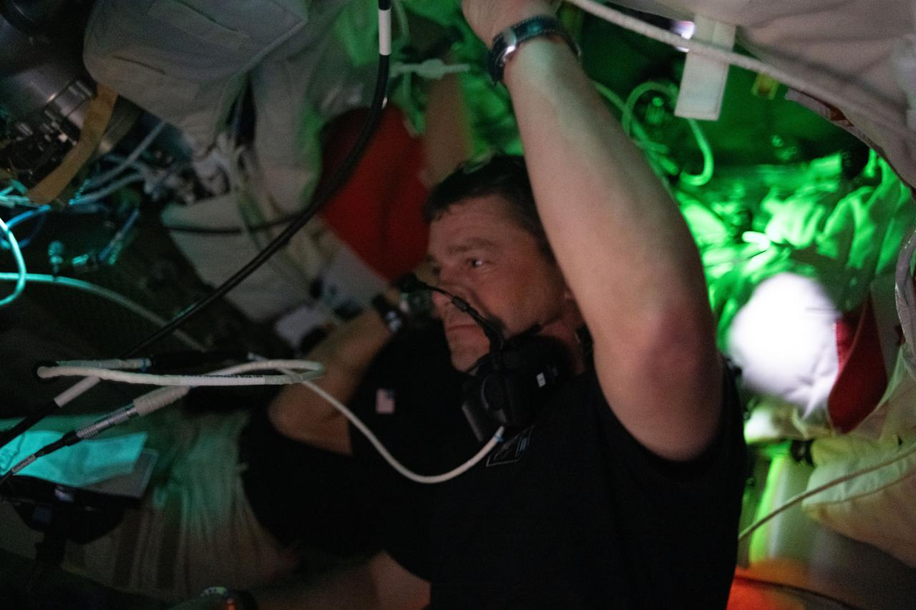
SPLASHDOWN & RECOVERY
Recovery Operations
Crew Return
Welcome Home
Final Mission View
NASA Artemis II | Images: NASA/JSC | nasa.gov/mission/artemis-ii
17
Notes:
The Artemis II crew was recovered in the Pacific Ocean. Orion's heat shield withstood temperatures of 5,000 degrees Fahrenheit during re-entry at approximately 25,000 mph.

Slide 19
THE ARTEMIS PROGRAM ROADMAP
NASA Artemis II | Images: NASA/JSC | nasa.gov/mission/artemis-ii
18

Slide 20
WHAT COMES NEXT
ARTEMIS III
ARTEMIS IV
THE VISION
First Lunar Landing
Gateway Assembly
Moon to Mars
First woman on the Moon
First person of color on Moon
SpaceX Starship HLS lander
South Pole landing site
~30 day mission
Surface EVAs planned
First crew to Gateway station
Lunar orbital outpost
International partnerships
SLS Block 1B upgrade
Extended operations
Science & tech demos
Sustained lunar presence
Lunar base camp
In-situ resource utilization
Proving ground for Mars
International collaboration
Multi-planetary future
NASA Artemis II | Images: NASA/JSC | nasa.gov/mission/artemis-ii
19

Slide 21
ARTEMIS II: A MISSION OF FIRSTS
1st
1st
1st
1st
CREWED ORION FLIGHT
WOMAN TOWARD MOON
BLACK ASTRONAUT TO MOON
CANADIAN IN DEEP SPACE
NASA Artemis II | Images: NASA/JSC | nasa.gov/mission/artemis-ii
20
Notes:
Plus the first crewed lunar flyby since Apollo 17 in 1972.

Slide 22
“
We are the Artemis Generation. This is just the beginning of a new era of exploration that will take us farther than we have ever gone before.
”
— NASA, Artemis Program
NASA Artemis II | Images: NASA/JSC | nasa.gov/mission/artemis-ii
21

Slide 23
GET INVOLVED
Be Part of Humanity's Journey to the Moon and Beyond
FOLLOW THE MISSION
STEM & EDUCATION
nasa.gov/mission/artemis-ii
nasa.gov/artemis-ii-multimedia
Follow @NASA on social media
NASA STEM Engagement programs
Artemis Student Challenges
Virtual Guest Program
CAREERS & INTERNSHIPS
CITIZEN SCIENCE
nasa.gov/careers
Pathways Intern Program
Join the Artemis Generation
science.nasa.gov/citizen-science
Moon mapping & observation
Help analyze mission data
NASA Artemis II | Images: NASA/JSC | nasa.gov/mission/artemis-ii
22
Notes:
Visit nasa.gov/mission/artemis-ii for the latest.

Slide 24
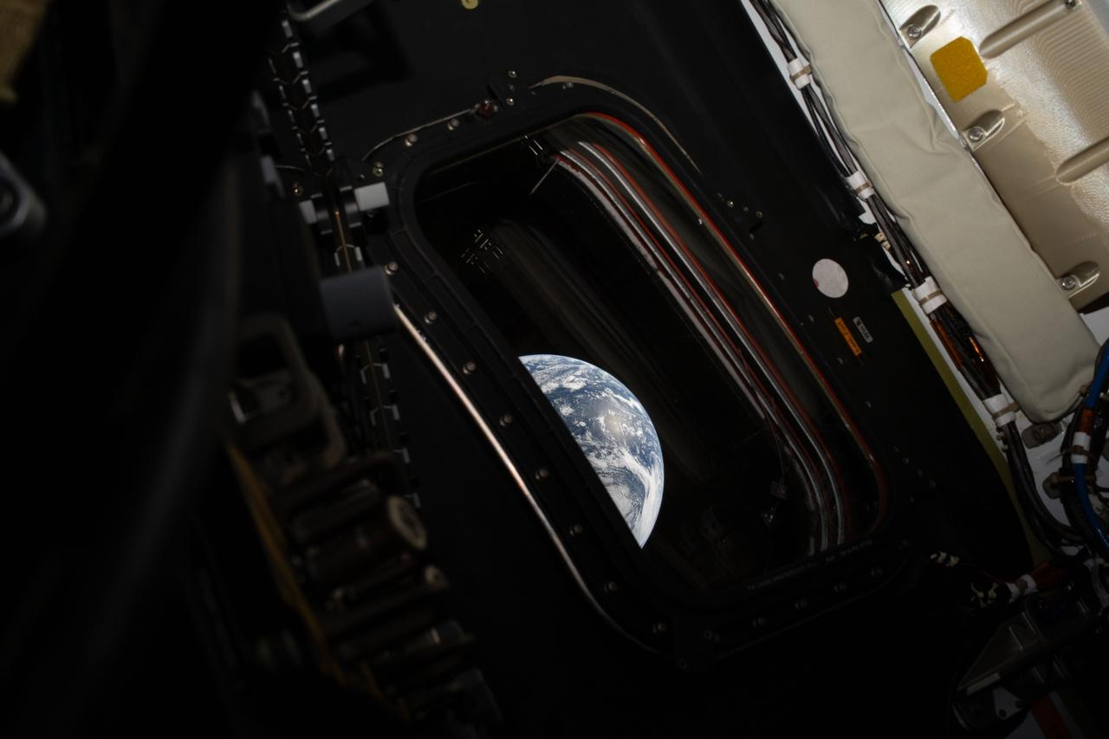
WE ARE THE ARTEMIS GENERATION
The Moon is just the beginning. nasa.gov/artemis
NASA Artemis II | Images: NASA/JSC | nasa.gov/mission/artemis-ii
23

