Slide 1
SWARN
The autonomous ML engineer that learns from every run
Engine built. 57/57 tests passing. Ready for benchmark validation.
Investor & Leadership Briefing · July 2026 · Confidential

Slide 2
THE PROBLEM
ML engineering is still a manual, week-long loop
Write, run, read, fix, repeat
Coding agents stop at code
Expertise does not compound
Engineers hand-drive every experiment: scripts, logs, failures, metrics — for days per model.
Cursor, Claude Code and Codex write scripts but do not own the experiment loop or the outcome metric.
Lessons live in people's heads. Every new task, every new hire, starts from zero.
10×
the speed-up autonomous ML agents already claim over manual iteration — the category leader markets exactly this number.
SWARN

Slide 3
MARKET MOMENT
The category is proven — and beatable
HeyNeo ('Neo') validated autonomous ML engineering as a product: paid tiers from $29 to $199/month, enterprise plans, a #1 MLE-Bench claim (34.2%, Aug 2025), and distribution across VS Code, Cursor and Claude Code.
Sequential engine
No memory
Opaque credits
No resume
Expands one solution at a time — wall-clock is their ceiling
Every task starts cold; nothing learned is reused
Undocumented Lite/Pro modes and credit burn rates
Long runs that die must start over
Their four structural gaps are our four wedges — each is already built into Swarn.
SWARN

Slide 4
OUR SOLUTION
One command in, the best model out
swarn solve "Predict churn. Metric: AUC." --workers 4
1
Understands
2
Explores
3
Iterates
4
Delivers
Previews your data, recalls lessons and similar past wins
Writes complete competing solutions, runs them in parallel in a sandbox
Debugs failures, improves winners — within explicit time/token budgets
Best solution script, full experiment report, and new lessons learned
Fully autonomous, fully inspectable: every attempt is a node in a solution tree you can open, resume, and audit.
SWARN

Slide 5
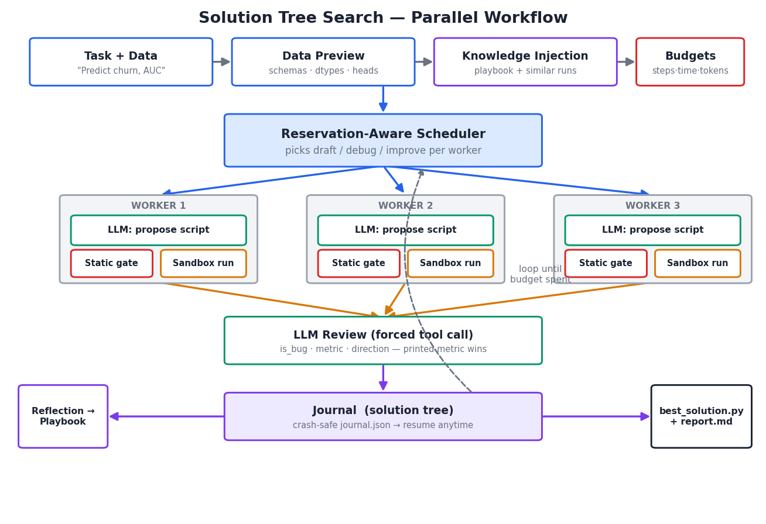
WHY WE WIN
Advantage 1 — Parallel exploration
The category leader tries one solution at a time. Swarn runs a scheduler that generates, executes and reviews many complete solutions concurrently — same LLM spend, a fraction of the wall time.
4×
candidate solutions in the wall time of one
0
sandbox runs wasted on code that cannot run (static gate)
SWARN

Slide 6
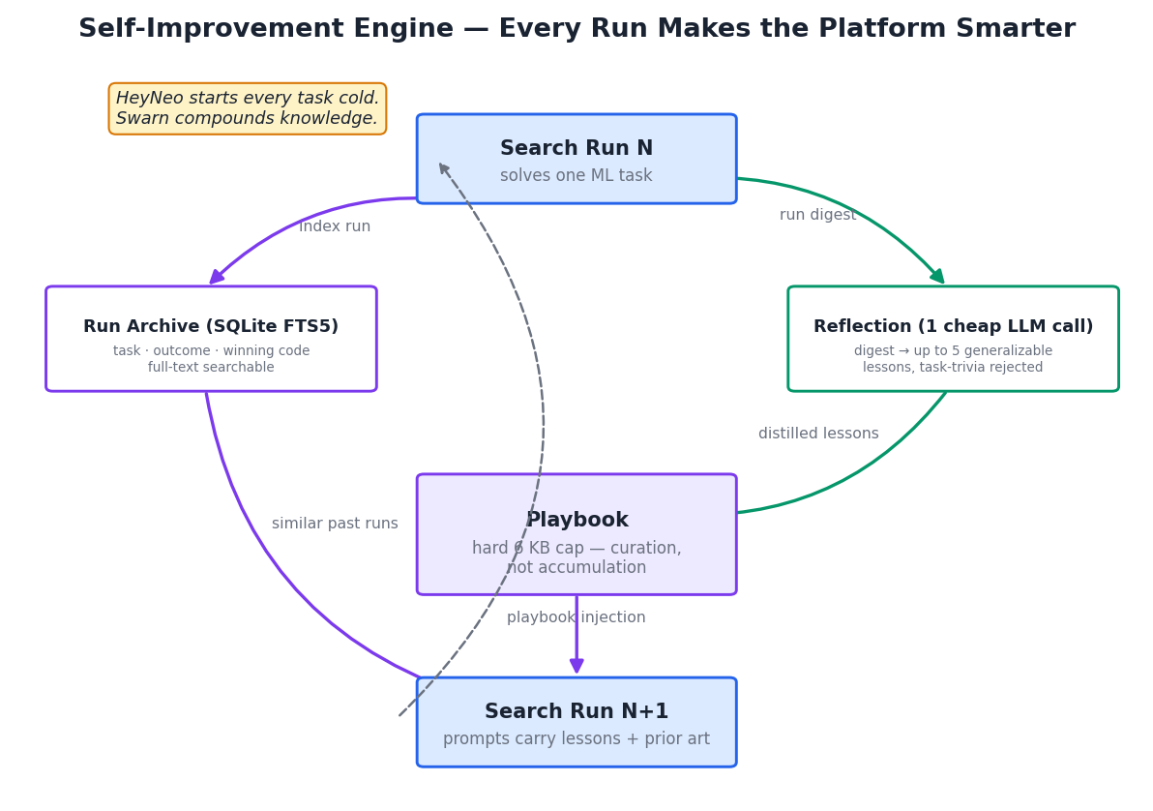
WHY WE WIN
Advantage 2 — It gets smarter with every run
The compounding moat
After every run, Swarn distills generalizable lessons into a curated playbook and archives the winning approach.
Every future run starts with that knowledge injected — and the archive doubles as fine-tuning data for our own deployed model.
HeyNeo starts every task cold. Our platform's 100th run is better than its 1st — theirs isn't.
SWARN

Slide 7
WHY WE WIN
Advantage 3 — Transparency customers can audit
Swarn
HeyNeo
Explicit budgets
Steps, wall-clock and token caps per run — finance-predictable AI spend
Opaque 'credits'; burn rates undocumented
Resumable runs
Crash-safe journal; continue any run — spot-GPU friendly
Days-long runs restart on failure
Local-first + own model
Data stays on customer infra; our self-hosted deployed model — zero marginal token cost
Rented frontier APIs; cloud upload caps
Inspectable artifacts
Solution tree, code, metrics, reports for every run
Artifacts, but tree/policy internals hidden
SWARN

Slide 8
USE CASES
One engine, every ML engineering workload
Model building & AutoML
LLM evals & benchmarking
Fine-tuning
Churn, fraud, forecasting, anomaly detection on tabular data
Eval harnesses, model comparisons, prompt optimization
LoRA/QLoRA domain models, quantized edge exports
RAG systems
Agents & pipelines
Debug & optimize
Repo & multimodal RAG (PDF, OCR, audio), retrieval tuning
Multi-agent builds, data pipelines, deploy packaging
Fix broken training, hunt leakage, speed up inference
Plus continuous engineering: nightly retrains and regression gates driven from CI or any MCP-capable agent.
SWARN

Slide 9
DISTRIBUTION
Meet engineers where they already work
CLI + REPL
Web dashboard
MCP server
IDE extension
Managed cloud
Scriptable, CI-ready
Live runs, solution trees, playbook
Claude Code · Cursor · Windsurf · Zed
VS Code / Cursor sidebar
Zero-setup hosted runs, per-seat billing
SHIPPED
SHIPPED
SHIPPED
NEXT
NEXT
The MCP server makes every AI coding assistant a distribution channel: their agent delegates ML work to ours.
SWARN

Slide 10
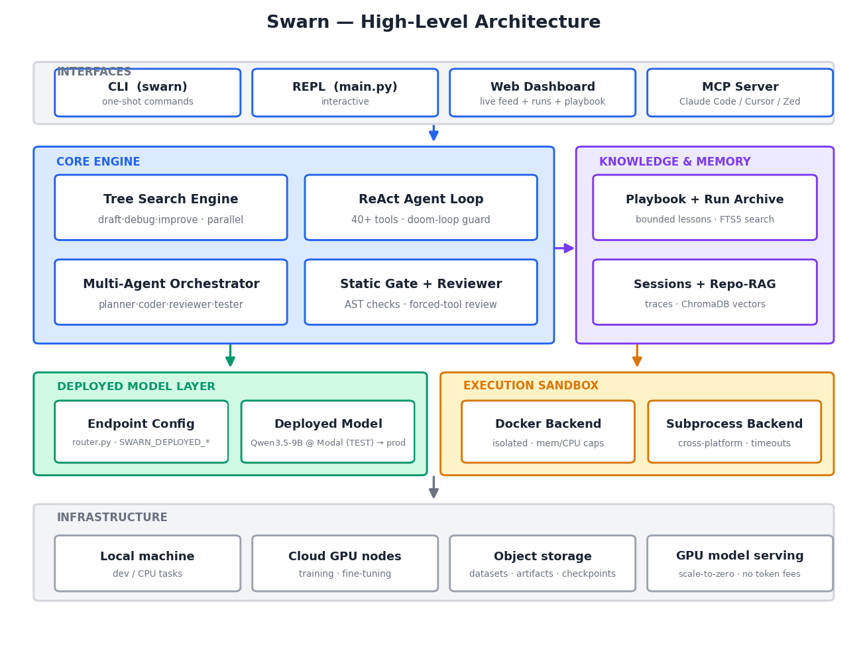
ARCHITECTURE
Built like a platform, not a demo
Engineering posture
One self-hosted deployed model, one endpoint — no vendor lock, no per-token fees
Sandboxed execution with hard timeouts and runaway-kill
Everything degrades gracefully — no single dependency can kill a run
57 automated tests run the full engine offline in seconds
~10.5k LOC Python, fully owned — no framework risk
SWARN

Slide 11
RESOURCES
What we need to go to market
LLM serving budget
GPU cloud
Benchmark validation + demo environments
Fine-tuning + serving the deployed model (TEST: Qwen 3.5 9B on Modal)
$15–30k one-time GPU spend for MLE-Bench-style validation; then predictable GPU-hour COGS
T4/A10G spot for ≤7B LoRA; 1–2 A100/H100 nodes serve production; scale-to-zero in test
Storage & infra
People
Datasets, checkpoints, run artifacts
IDE extension + managed cloud beta
Object storage (GB→TB, lifecycle rules) + CPU VM pool for hosted runs
2–3 engineers, 8–10 weeks to close both roadmap surfaces
No proprietary model training, no Kubernetes, no data lake required for v1 — the engine is local-first by design.
SWARN

Slide 12
STATUS
Where we are today
100%
57/57
$0
4
of the core engine built and working
automated tests passing, fully offline
per-token LLM fees — one self-hosted deployed model
distribution surfaces shipped
Verified end-to-end
Parallel search produces valid, dense solution trees under concurrency
Killed runs resume exactly where they stopped; token budgets stop runaway spend
Self-improvement cycle proven: run 1 learns a lesson → run 2's prompts carry it automatically
Next milestone: published MLE-Bench-style results on our deployed model — the marketing centerpiece
SWARN

Slide 13
PLAN
Roadmap to launch
1
2
3
4
Weeks 1–3
Weeks 3–7
Weeks 6–12
Ongoing
Benchmark validation
IDE extension
Managed cloud beta
Enterprise hardening
MLE-Bench-style suite with frontier models; tune policy; publish results
VS Code/Cursor sidebar on the shipped MCP server; live tree view
Auth, run queue, VM pool, artifact downloads, transparent metering
Secrets vault, isolation, SSO/audit, richer guardrails
SWARN

Slide 14
The autonomous ML engineer
that compounds.
Category proven by a well-funded incumbent. Engine built and tested. Four structural advantages they cannot patch quickly.
Ask: greenlight benchmark validation + 2–3 engineers for the IDE extension and cloud beta.
SWARN · July 2026

