Slide 1
E-locutio: Stitching Styles and Pulling Threads in Electronic Literature
Helen J Burgess
NC State University
@polyrhetor

Slide 2
Elocutio (style)
Chiasmus: “ask not what your country can do for you. Ask what you can do for your country.”
Parataxis: Aristotle’s ”lexis eiromene" "to fasten together in rows" or "to string”
Hypotaxis: subordinate clause(s).
Anaphora: “we shall fight on the beaches,we shall fight on the landing grounds,we shall fight in the fields and in the streets…” (Churchill).
Zeugma: “Yet time and her aunt moved slowly” (Austen).

Slide 3
Style and choice
Rudrata, Kavyalankara (Poetic Figures of Speech) – CE880
Auchitya (propriety): the appropriate fit of figurative language to task
Decorum: the deployment of style in the most fitting manner in order to achieve ethical persuasive effect

Slide 4
Knight’s Tour (Rudrata)

Slide 5
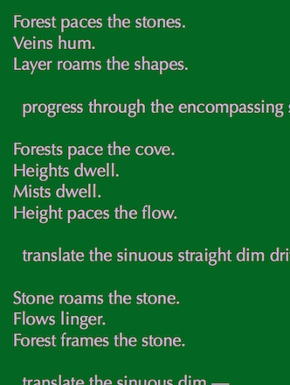
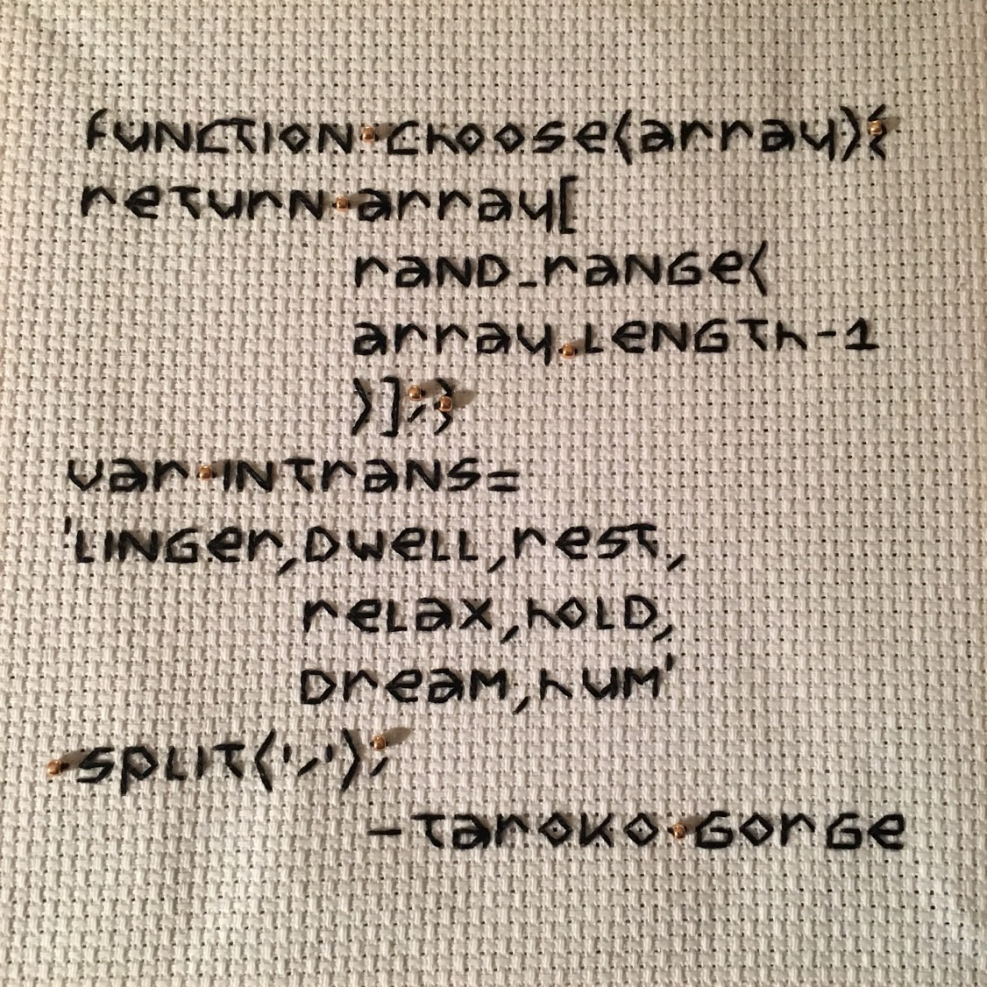

Slide 6
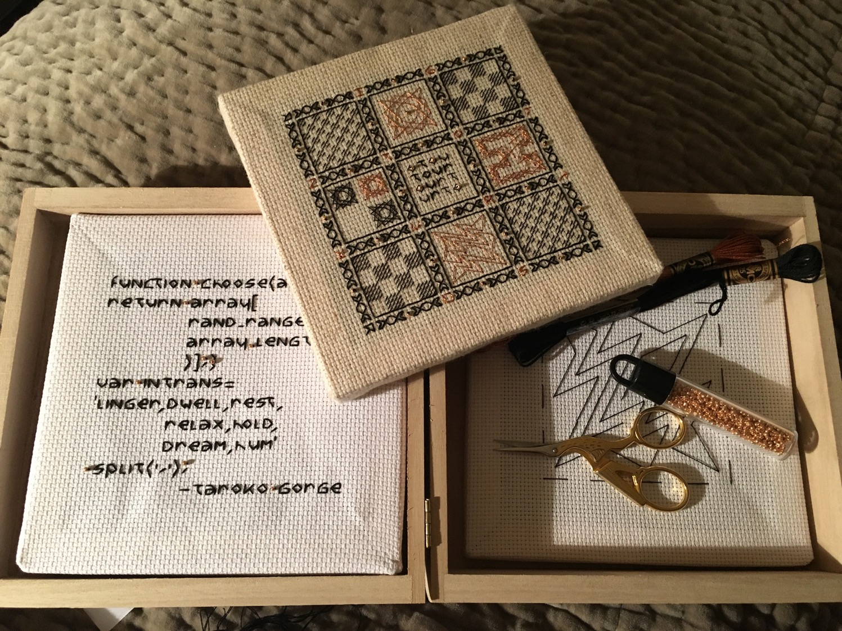
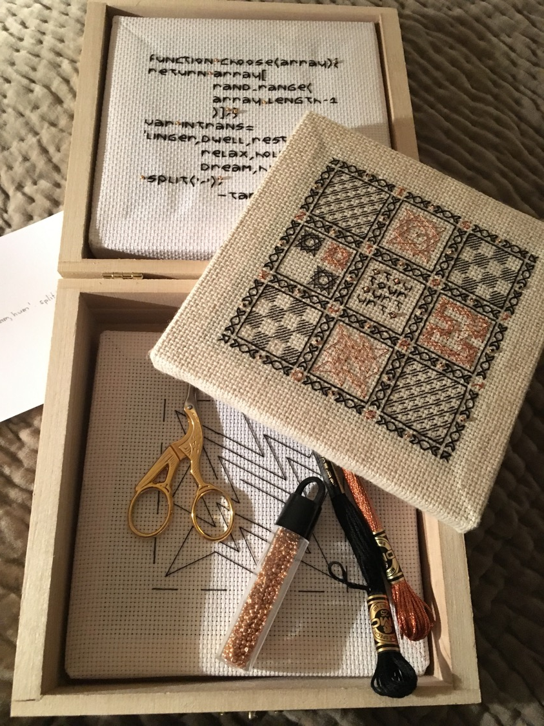

Slide 7
