Slide 1

Hyperspace
Pay-as-you-go VPN paths for AI agents
https://hyperspace.zone | gatekeepers@hyperspace.zone | @yadren_a

Slide 2
Market
Current market
Agents already buy APIs and compute
Network access still requires human signup
VPNs are subscriptions, not resources
Why now
pay.sh makes paid resources discoverable
MPP / HTTP 402 turns payment into protocol
DoubleZero makes low-jitter routes worth selling
Sources: pay.sh, MPP / HTTP 402, DoubleZero, WireGuard
Thesis: connectivity becomes a priced HTTP resource

Slide 3
User insights
Users
Hosted agent platforms
Research and crawler agents
Automation tools
RPC and indexer workflows
Needs
Reliable isolated egress
Low-jitter paths for long tasks
Caps, top-ups and revocation
No human signup or subscription
Insight: agents need network access that software can buy, cap, top up and revoke.

Slide 4
Problem
Autonomous software needs network access, but VPNs are built for humans.
Signup, cards and dashboards block agents
Static accounts are hard to cap or revoke
Best-effort internet routes create jitter
Result
Agents can pay for APIs, but cannot reliably buy the network path required to use them.

Slide 5
Solution
Hyperspace turns connectivity into a paid API call.
Discover endpoint in pay-skills
Receive MPP / HTTP 402 payment challenge
Pay USDC
Get a prepaid WireGuard config
Meter, top up or revoke the session

Slide 6
Tech overview
Flow
Agent -> pay.sh gateway
MPP / HTTP 402 challenge -> Solana SPL USDC payment
Hyperspace API -> control plane -> gate agents
WireGuard routes traffic over DoubleZero-optimized paths
Metering records time, bandwidth, top-ups and revoke state

Slide 7
Competitors
Why we are different
Traditional VPNs: human signup and subscriptions
Cloud proxies: HTTP-only, weak full-tunnel coverage
Self-hosted WireGuard: ops burden, no payment API
Hyperspace: agent-paid prepaid WireGuard with route health and DoubleZero paths

Slide 8
Current stage
Ready now
Web UI + customer API
Control plane + gate agents
London / Helsinki / Stavanger staging
Config issue, download and revoke
Mainnet MPP payment smoke test
Next
Byte-level enforcement
Production pay.sh listing
More gates and route SLAs
Long-running agent sessions

Slide 9
Team
Andrey Manolov
Co-founder & CTO
15+ years building products; Solana since 2022
Cambrian Deputy CEO, 05.2024-07.2025
Solana restaking devtools: pre-seed, pivot, Rust/CPO hiring
Jito/Solayer/Fragmetric/KyrosFi partnerships; 2 pilots
stakr.space
Solana validator since 2021
Telegram: @stakrspace
Validator and node infrastructure
Gate operations, Linux networking and monitoring
Reliability for Solana and Hyperspace infra

Slide 10
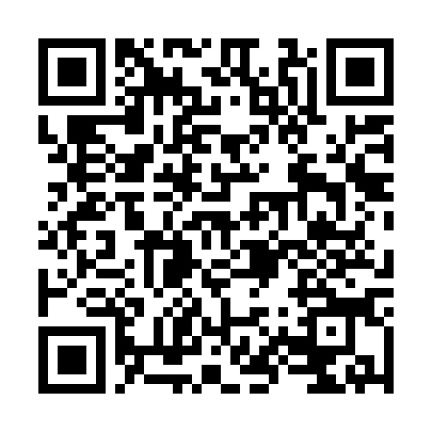
Demo proof
Payment smoke
Mainnet-beta payment confirmed
Client paid 0.000001 USDC
Server wallet received funds
WireGuard config issued and revoked
SVG -> LON outcomes
Target: 185.97.160.8:443
p95: 98.535 -> 33.007 ms
stddev jitter: 23.400 -> 0.206 ms
mean abs delta: 19.316 -> 0.209 ms
median: 29.054 -> 32.599 ms
Demo repo: https://github.com/hyperspace-zone/hyperspace-agent-vpn-demo/tree/main

Slide 11
Contacts
Project: Hyperspace
Website: https://hyperspace.zone
Email: gatekeepers@hyperspace.zone
Telegram: @yadren_a

