Slide 1
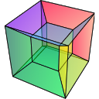


3D EDS Microanalysis by FIB-SEM
Data processing with hyperspy
Pierre Burdet
Notes:
Dans cette présentation, parler de la technique
Cartogrpahie X utilisant un EDS-MEB
en 3D grace a nu FIB
Cette technique souffre d'une limitations
un bas angle d'émergence
A travers un échantillon
nous allons considérez les apects positif et négatifs de cette limitations

Slide 2
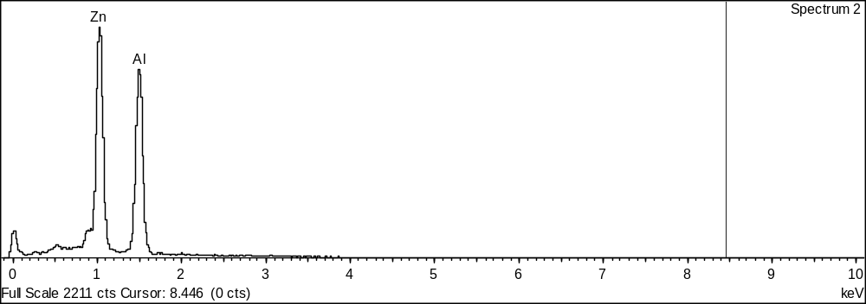
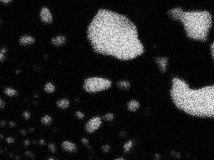
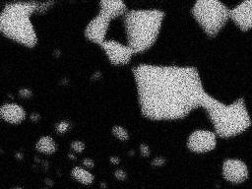
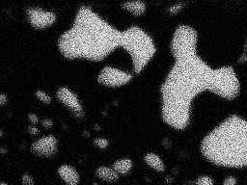
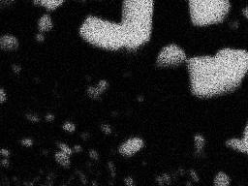

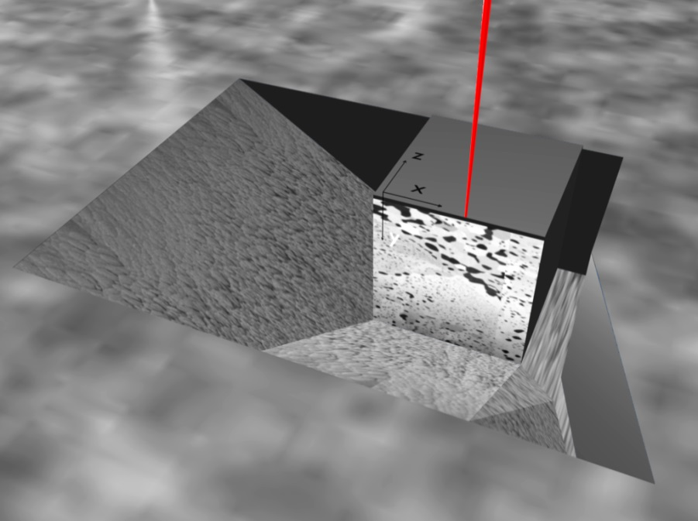
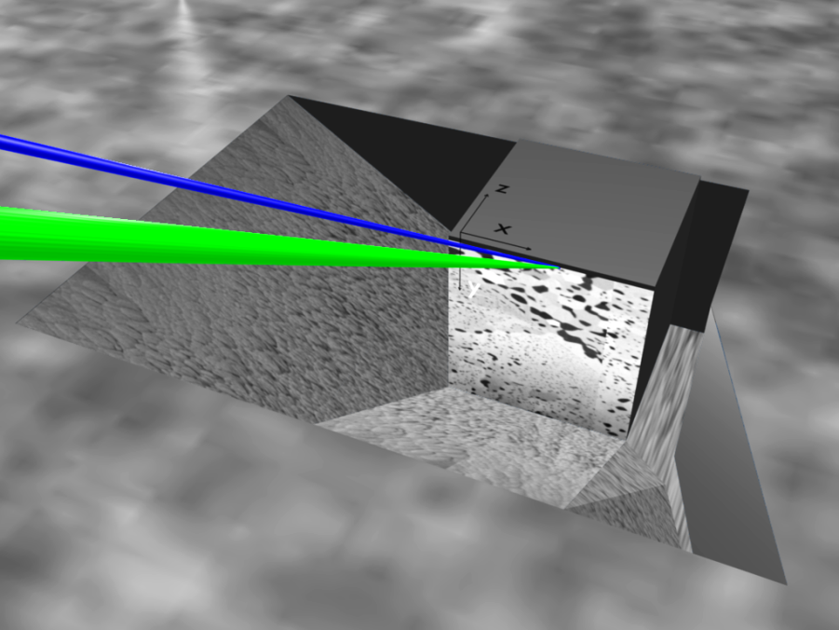
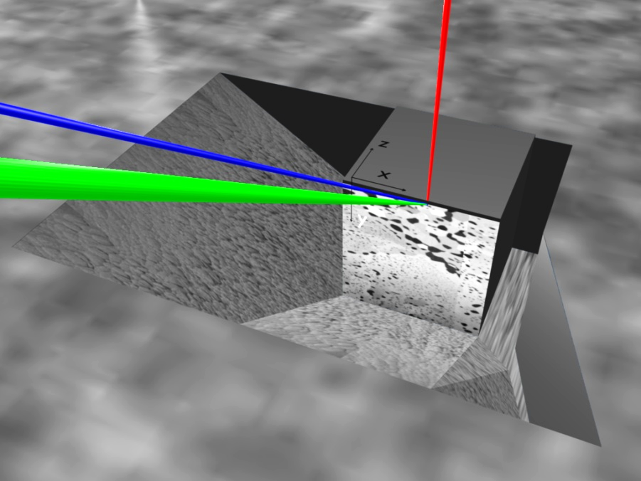
3D EDS by FIB/SEM
  3D EDX by FIB/SEM
    Analyzed surface at 36°
    Serial acquisition
Stack of EDX spectral images
keV
I-beam
I-beam
EDX
EDX
e-beam
e-beam
Acquisition geometry
Notes:
Commenssons d'abords par l'acquistin
Géometre d'acqui
Cartogrtaphie
découpe
La géométrie vue de côté
Surface inclinée
Un faible angle d'émergence

Slide 3
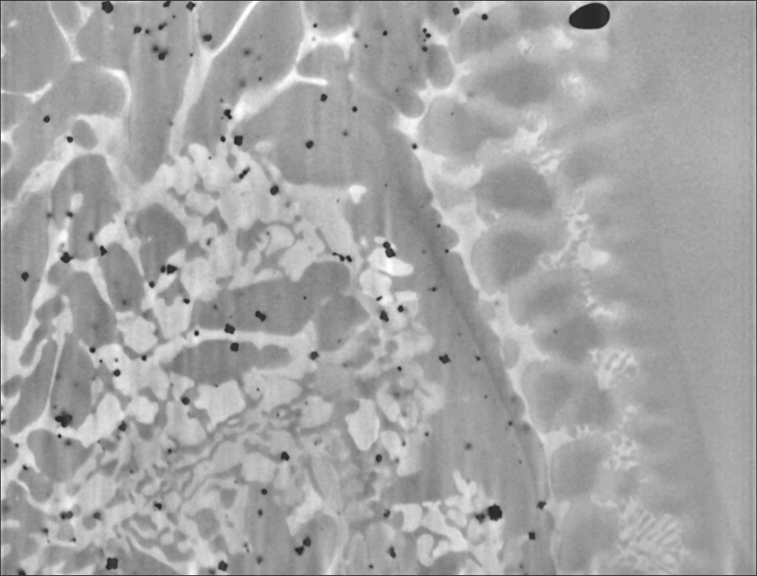
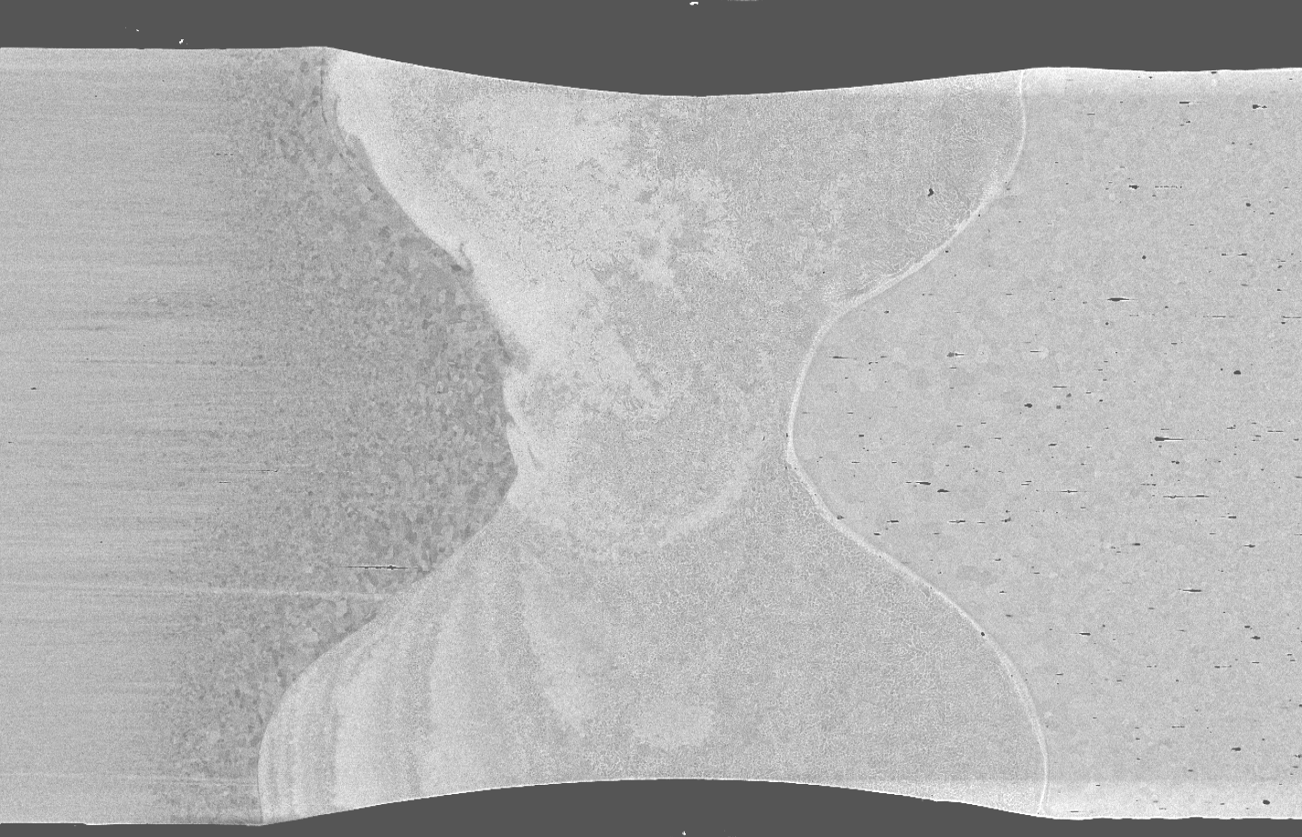
Sample
Welding of NiTi-stainlesss steel (SS)
SE images
2 μm
Weld
SS
NiTi
100 μm
Ch 3.1 p. 24-25
3
Notes:
Al/Zn
Al particle (black) in Zn matrix (White)
Particle round
NiTi-SS
NiTi, Weld, SS
Weld motlen, convection, solidified
Mechanical test= fracture location
Brittle intermetallic= location of analyse
SE images of milled section
Line is more complex
Complex microstructure
Needs 3D and chemical
Microstructure is fined
3D EDS is appropriate / challenging
Tr. Lets look now to the experimental parameter for this two sample

Slide 4
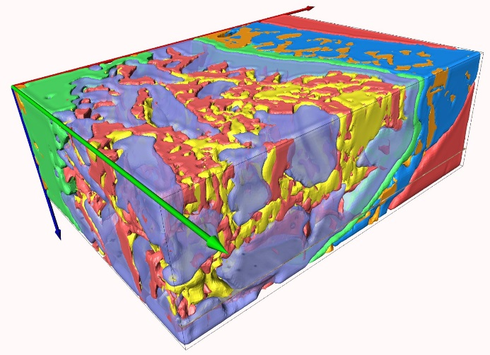
Want to know more?
IT10: P. Burdet, Tuesday 15:45
Ch 3.1 p. 24-25
4
Notes:
Al/Zn
Al particle (black) in Zn matrix (White)
Particle round
NiTi-SS
NiTi, Weld, SS
Weld motlen, convection, solidified
Mechanical test= fracture location
Brittle intermetallic= location of analyse
SE images of milled section
Line is more complex
Complex microstructure
Needs 3D and chemical
Microstructure is fined
3D EDS is appropriate / challenging
Tr. Lets look now to the experimental parameter for this two sample

