Slide 1
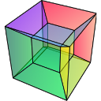


How to contribute to hyperspy?
Pierre Burdet
Notes:
Dans cette présentation, parler de la technique
Cartogrpahie X utilisant un EDS-MEB
en 3D grace a nu FIB
Cette technique souffre d'une limitations
un bas angle d'émergence
A travers un échantillon
nous allons considérez les apects positif et négatifs de cette limitations

Slide 2
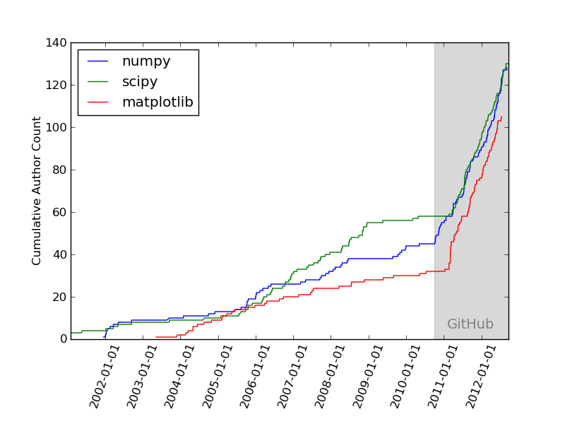
Github
2

Slide 3
How to contribute?
Release
0.7.3
Review
github.com/
hyperspy/
hyperspy
upstream
master
7. merge
1. fork
6. pull request
master
github.com/
mine/
hyperspy
origin
DOC_typos
2. clone
5. push
master
DOC_typos
My computer
3. Create new branch
4. commit
4. commit
Ch 3.1 p. 24-25
Correct some typos
Correct some others
Notes:
Al/Zn
Al particle (black) in Zn matrix (White)
Particle round
NiTi-SS
NiTi, Weld, SS
Weld motlen, convection, solidified
Mechanical test= fracture location
Brittle intermetallic= location of analyse
SE images of milled section
Line is more complex
Complex microstructure
Needs 3D and chemical
Microstructure is fined
3D EDS is appropriate / challenging
Tr. Lets look now to the experimental parameter for this two sample

Slide 4
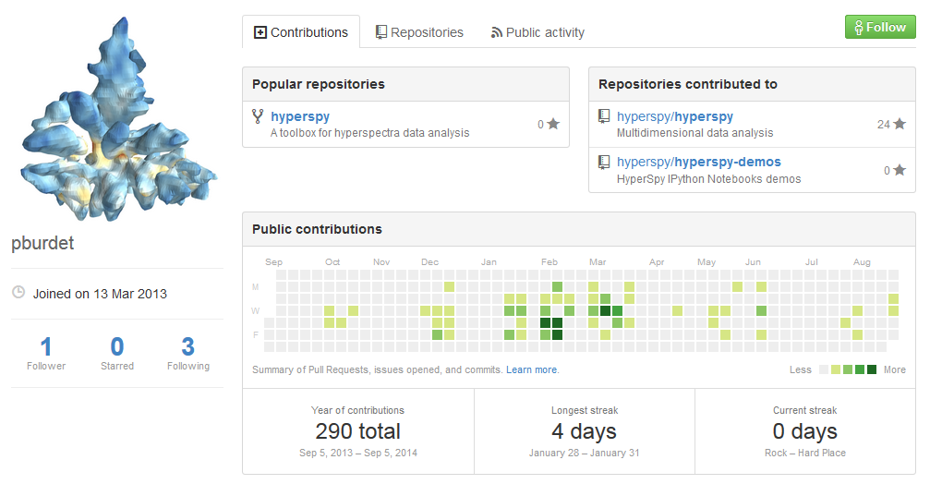
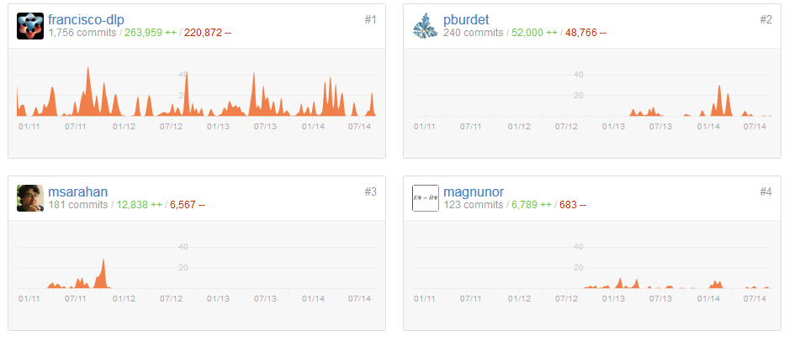
Retribution
On your github profile
On hyperspy github

Slide 5
How to work with others?
github.com/
hyperspy/
hyperspy
upstream
master
1. Pull upstream
master
4. fetch
Review
github.com/
Francisco-dpl/
hyperspy
remote
9. merge
NEW_algo
6. Create branch
8. pull request
5. checkout
NEW_algo
master
7. commit
My computer
2. checkout
3. merge
Some changes
Ch 3.1 p. 24-25
EHN_function
Notes:
Al/Zn
Al particle (black) in Zn matrix (White)
Particle round
NiTi-SS
NiTi, Weld, SS
Weld motlen, convection, solidified
Mechanical test= fracture location
Brittle intermetallic= location of analyse
SE images of milled section
Line is more complex
Complex microstructure
Needs 3D and chemical
Microstructure is fined
3D EDS is appropriate / challenging
Tr. Lets look now to the experimental parameter for this two sample

