Slide 1

CRITIQUE ON VISUALISATIONS
MILESTONE 1
TEAM MEMBERS (GROUP P1-8):
MUHAMMAD HAIQAL BIN RAZALI
NURUL NATASHA BINTE MD ZAIRONIZAM
YIP XUE YING MAGDALENE

Slide 2
01
GOVERNMENT STRINGENCY INDEX RATE

Slide 3
Data- Task- Idiom Model
Data (what)
Date (Ordinal – Qualitative)
Task (why)
How (Idiom)
To understand the response level of each country, based on their time period
Represent the index rate in a way where we can see the trend over a period of time
Stringency Index (Ordinal – Qualitative)
Location (Nominal)

Slide 4
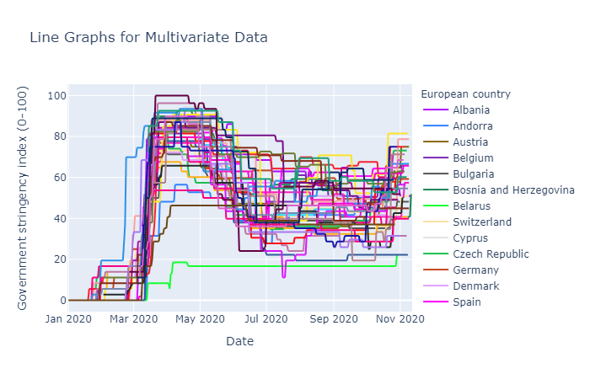

Slide 5



CHART BREAKDOWN
Idiom
Marks
Channel
Multiple line graph
1. Line marks to represent relationship between x and y axis
1. Colours used to identify the different countries
2. Tinted background with axis indicators for easier identification

Slide 6
PROBLEMS IDENTIFIED
Channel Effectiveness Factors:
→ Unable to ascertain a country from one another (Discriminability)
→ Overlapping lines (Separability)
→ Colours have similar shades (Albania, Denmark, Spain) (Separability)
→ The grid lines shouldn’t be there as there are too many lines, serves no purpose and it does not help in identifying the data (Separability)
→ Tinted background blends in with the colour for the line (Salience)
Notes:
Colours have similar shades (Albania, Denmark, Spain) (Separability)

Slide 7
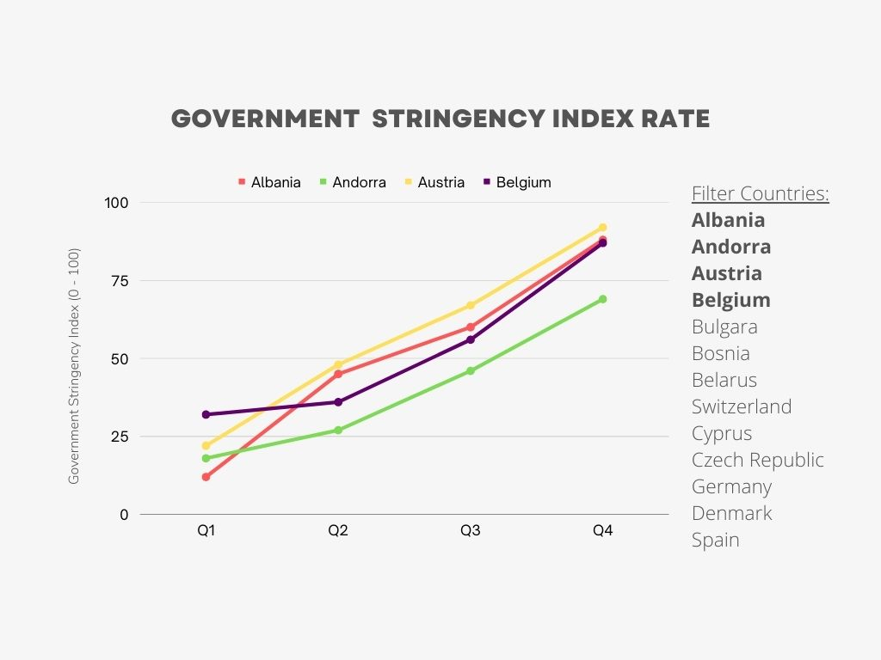
IMPROVEMENTS
→ Quarters
→ Clickable legends
(Increase discriminability)
→ Filter for year (dropdown box)
→ Primary and tertiary colours
→ Replacing of tinted background with a white background

Slide 8
02
TOTAL REVENUE BY PRODUCT

Slide 9
Data- Task- Idiom Model
Data (what)
Revenue (Ordinal – Qualitative)
Task (why)
How (Idiom)
Show total revenue of all products for a specific period of time
To show the best performing/revenue generating product in the company in order to improve sales
Period of Time (Ordinal – Qualitative)
Product (Nominal)

Slide 10
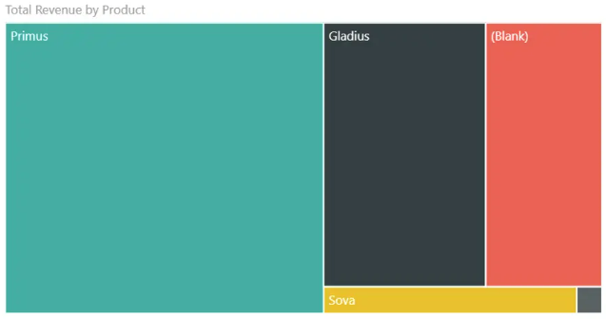

Slide 11
CHART BREAKDOWN
Idiom
Marks
Channel
Area Chart
1. Area to represent the revenue of the products, quantitative data
1. Colors based
on products
2. Size of each cuboid is based on the revenue
Notes:
What is data – displaying the revenue made for each product of the company.
Why – To show the best performing/revenue generating product in the company in order to improve sales

Slide 12
PROBLEMS IDENTIFIED
Wrong Idiom
→ Not much information can be derived from the current idiom
→ The bottom right square is too small to include text to identify
Channel Effectiveness Factors:
→ No indication of the amount of revenue made, unable to distinguish the difference in revenue made for each product (Accuracy)
→ Does not give you the period for the revenue (Accuracy)
→ Color of some products are hard to differentiate (Separability)
Notes:
Color of some products (Gladius and the bottom right) is similar, can be confusing (Separability)

Slide 13
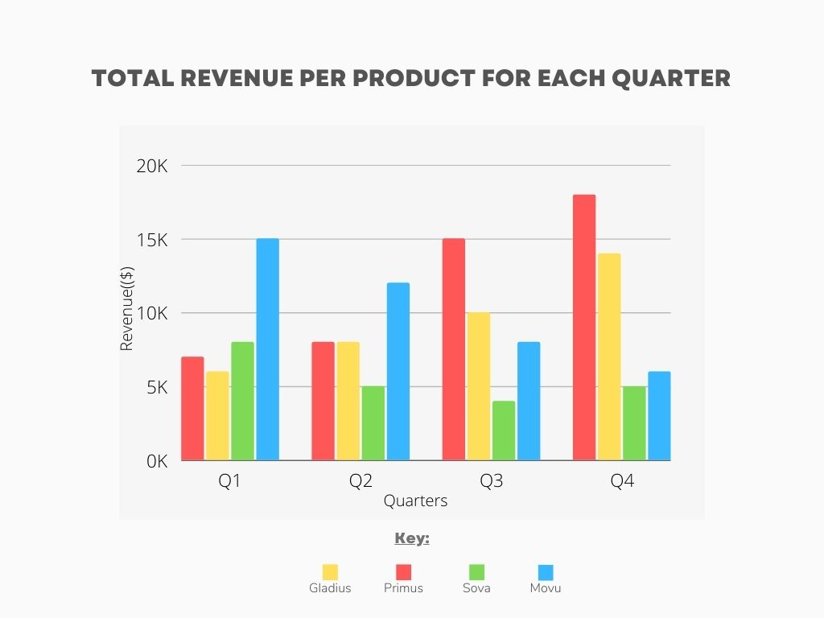
IMPROVEMENTS
Use clustered bar chart instead
→ Add x -axis (quarter) and y-axis(revenue amount)
→ Cleaning of data which results in the blank field to be removed
→ Use a combination of primary and tertiary colours for easier identification of products
Notes:
Color of some products (Gladius and the bottom right) is similar, can be confusing (Separability)

