Slide 1
CSC3007- Information Visualization
Milestone 2
TEAM MEMBERS (GROUP P1-8):
MUHAMMAD HAIQAL BIN RAZALI
NURUL NATASHA BINTE MD ZAIRONIZAM
YIP XUE YING MAGDALENE

Slide 2
01
Introduction
02
Project Implementation
03
Design Specifications
04
Future Work
Story behind our visualization charts
Different phases of implementation, how the task is split amongst the 3 of us, technology stack used
Design Decisions, Principles and Challenges
Possible implementation in the near future

Slide 3
01
Introduction

Slide 4
Story Behind our Charts
COVID-19
CASES
Stringency Index Score
DEATH

Slide 5
Dataset Attained
COVID-19 Dataset from OWID
Automatically updated on a daily basis
eg; Date, Country, New Covid Cases, Stringency Index, New Death and Population

Slide 6
02
Project Implementation

Slide 7
Project Phases
Ideation of Topic
Haiqal, Natasha, Magdalene
Back- end (Data Cleaning and Processing)
Haiqal
Front- end (Design and Development)
Natasha
Front- end (Graph Loading)
Haiqal, Natasha, Magdalene
Finalizing visual charts and story
Haiqal, Magdalene

Slide 8




Implementation Stack

Slide 9
03
Design Specifications

Slide 10
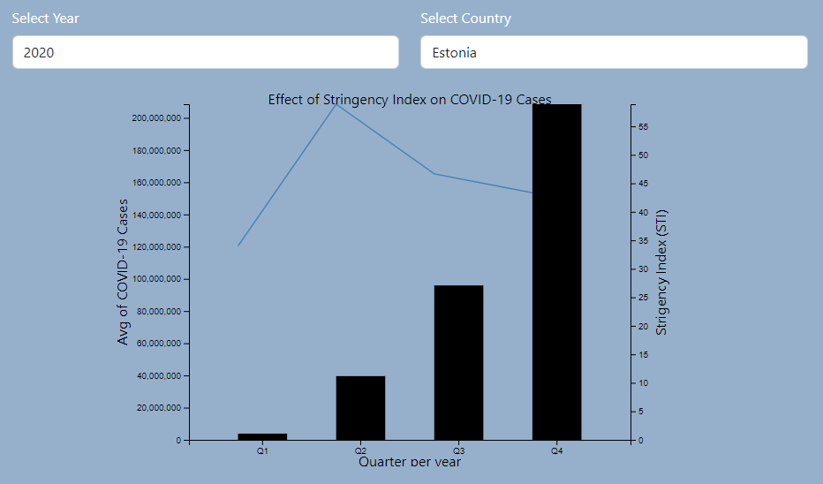
Design Principles- Viz Charts
Channel Effectiveness
✓ Discriminability
Seperability
Viz Interactivity
Manipulation
On Selection
Facet
Superimpose layer
Reduce
Aggregate

Slide 11
Design Challenges
Processing of the data
Loading of line graph on bar graphs
Generating a dual axis using d3

Slide 12
4. Future Work
Adding more interactions
Providing tooltips for insights
Using dataset to generate more charts
Animation between chart changes

