Slide 1
PHASE 1 / BUILD & OBSERVE
Private Network
Four Macs.
One private app.
Yash
DNS + main client
10.7.23.39
Ritesh
nginx + TLS + load balancer
10.7.18.84
Parul
Backend A :3001
app.team1.test:8443
10.7.1.11
Dhruv
Backend B :3002 + client
Presented by Yash
10.7.20.186
01 / 05
Notes:
YASH ONLY. Target 38 seconds. Automatic entrance animation; click once to advance.
SAY:
Hi, I’m Yash, presenting our Computer Networks Phase 1 project, Build and Observe. We built the system on four physical Macs connected to the same LAN. My laptop runs private DNS and the main client. Ritesh runs nginx with HTTPS and load balancing. Parul runs Backend A on port 3001. Dhruv runs Backend B on port 3002 and also tests as a second client. The client resolves our private domain, connects to Ritesh, and receives a response from one of the two backends.
EVIDENCE SOURCE:
network.env and docs/architecture.md. Roles describe the implemented architecture.

Slide 2
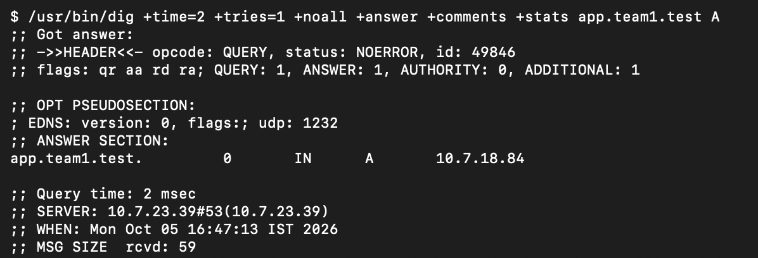
PHASE 1 / BUILD & OBSERVE
Private DNS and trusted HTTPS
app.team1.test
10.7.18.84
HTTPS :8443 Certificate trust enabled
02 / 05
Notes:
YASH ONLY. Target 39 seconds. Automatic entrance animation; click once to advance.
SAY:
First, DNS turns the private name into the edge server’s address. Both app.team1.test and api.team1.test resolve through my DNS server to Ritesh at 10.7.18.84. The screenshot shows the actual resolver and answer. The client then connects on port 8443 and validates the server certificate. Our HTTPS checks pass using the installed certificate trust, without curl’s insecure option. DNS success and HTTPS success are separate checks: finding an address does not prove that the service or certificate works.
EVIDENCE SOURCE:
evidence/collected/01_Yash/dns-and-https.png and verified-results.txt. Screenshot excerpt preserves the response and resolver. Both names and certificate trust are supported by the complete records.

Slide 3
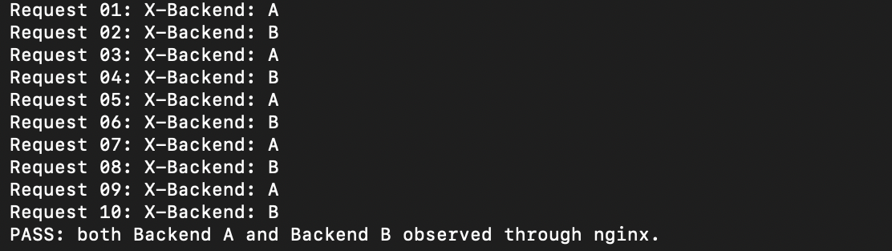
PHASE 1 / BUILD & OBSERVE
One URL reaches both backends
Parul / A :3001
Dhruv / B :3002
10 requests 5 responses from A 5 from B
03 / 05
Notes:
YASH ONLY. Target 37 seconds. Automatic entrance animation; click once to advance.
SAY:
Next, we checked both backends directly from Ritesh’s laptop. Each returned HTTP 200, valid JSON, and its own X-Backend header. nginx forwards requests to these two servers using round robin. In this recorded ten-request test, the responses alternate between A and B, five times each. The client keeps using the same HTTPS domain. Only nginx needs the backend addresses, and it creates a separate HTTP connection to whichever backend it selects.
EVIDENCE SOURCE:
evidence/collected/01_Yash/balancing-and-caching.png. Ritesh direct tests: evidence/collected/02_Ritesh/direct-backends-and-pings.png. Parul local response: evidence/collected/03_Parul/backend-a-and-pings.png. These two originals contain a failed ping to Ritesh; no all-pairs-ping success claim is made.

Slide 4
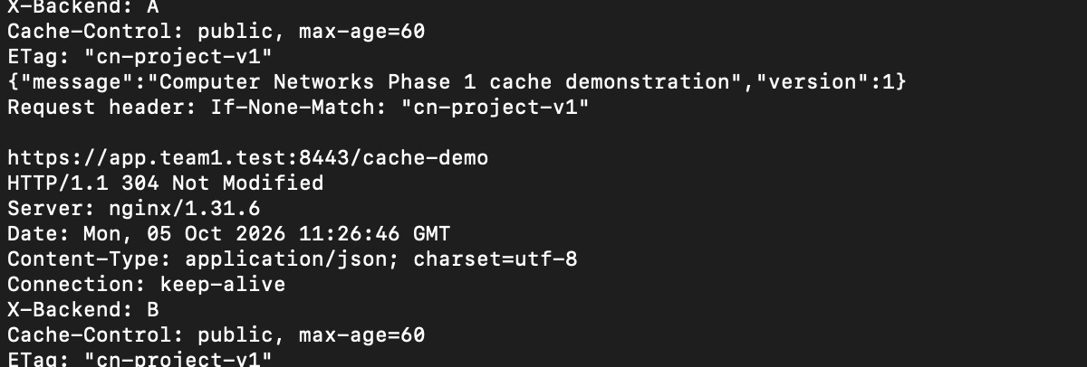
PHASE 1 / BUILD & OBSERVE
Caching: 200, then 304
60s
Freshness
lifetime
Same ETag
No body
Cache-Control + ETag + If-None-Match
304 Not Modified
04 / 05
Notes:
YASH ONLY. Target 37 seconds. Automatic entrance animation; click once to advance.
SAY:
The caching check starts with a normal 200 response. Cache-Control allows a cache to treat the content as fresh for sixty seconds, and the ETag identifies its version. We then send If-None-Match with that same ETag. The server replies 304 Not Modified without a response body, allowing reuse of the stored content. Both backends serve the same cache representation. This screenshot comes from the second-client test supplied after Dhruv’s certificate-trust setup.
EVIDENCE SOURCE:
evidence/collected/04_Dhruv/https-balancing-caching.jpeg. Attribution to Dhruv comes from the supplied conversation, not a visible username. Original screenshot includes 200, Cache-Control, ETag, request If-None-Match and 304.

Slide 5
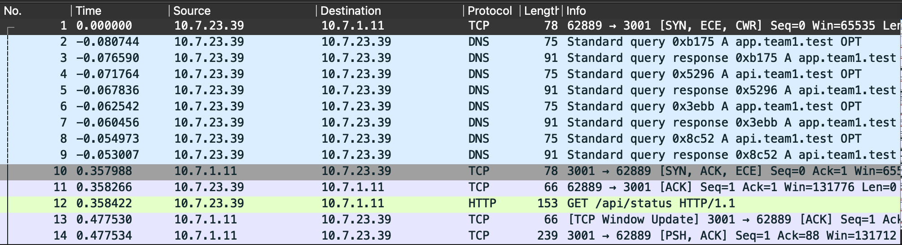
PHASE 1 / BUILD & OBSERVE
The packets behind the response
TCP
SYN SYN-ACK ACK
TLS
Hello + certificate Encrypted application data
532 real packets saved in phase1.pcapng
05 / 05
Notes:
YASH ONLY. Target 44 seconds. Automatic entrance animation; click once to advance.
SAY:
Finally, our saved Wireshark capture contains 532 real packets. It records DNS questions and answers, followed by TCP connection setup and TLS negotiation. For TCP, we identify SYN, SYN-ACK, and ACK. A separate TLS 1.2 request exposes the server certificate, followed by encrypted handshake messages and application data. HTTPS keeps the payload encrypted on the wire, while curl displays the decrypted headers. Together, these records demonstrate private DNS, trusted HTTPS, two working backends, round-robin balancing, and conditional caching on our four-Mac network.
EVIDENCE SOURCE:
evidence/collected/05_Packets/wireshark-dns-tcp.png and phase1.pcapng. TCP stream 2 frames 34/40/41. TLS stream 20 frames 513/516/520/522/524/526. TLS details come from the saved capture, beyond the screenshot visible rows. No claim that the five failure demonstrations or all-pairs ping are completed.

