Slide 1
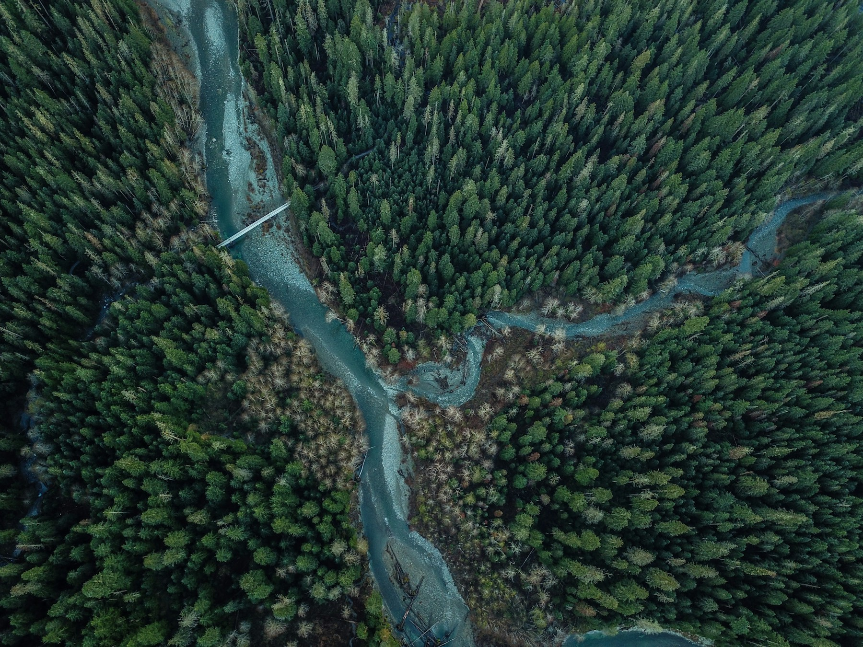
PROJECT 18
Water Quality
Prediction
Gradient boosting and
deep neural networks
A chronological study of a calculated
surface-water index
TEAM-ID (replace) / SECTION (replace)
Team details are editable dummy values
Notes:
Project 18 compares a strong tabular baseline with an MLP on one continuous target. State the scope as source-index emulation from the start. Source: https://doi.org/10.6084/m9.figshare.27800394.v2. Decorative photo: David Kovalenko, https://unsplash.com/photos/birds-eye-view-of-river-and-green-trees-qYMa2-P-U0M, Unsplash license. The photograph does not depict a documented monitoring station. Team: Team Member 1 (Enrollment 1), Team Member 2 (Enrollment 2), Team Member 3 (Enrollment 3), Team Member 4 (Enrollment 4).

Slide 2
Problem and research question
Can a small neural network improve on a strong tree model when estimating a documented water-quality index?
What the project delivers
Prediction inputs must be meaningful for the intended use.
One continuous target on a 0–100 scale
A shared, chronological evaluation protocol
Model comparison and feature explanations
An explicit audit of how the target was created
Water Quality Prediction
2 / 12
Notes:
The assignment permits regression of a documented index or classification under a defined class scheme. We choose only CCME_Values. https://doi.org/10.6084/m9.figshare.27800394.v2

Slide 3
The dataset and eight measurements
2,827,977 rows
Available inputs
1940–2023 · Five countries
Ammonia and BOD
Dissolved oxygen
Orthophosphate
pH and temperature
Nitrogen and nitrate
No turbidity, conductivity or dissolved-solids columns are supplied.
Water Quality Prediction
3 / 12
Notes:
Source: https://doi.org/10.6084/m9.figshare.27800394.v2. Data audit: Results/ inside Datasets/water_quality_project_outputs.zip: data_audit.json. England supplies 75.3% of rows. Original data are already harmonized and imputed.

Slide 4
The derived-target audit
100% of released labels
reconstruct within 0.0000001 from the same eight inputs
Source-defined row-level calculation
This evaluates an index emulator.
Upper-only objectives
F1 = F2 for an individual row
Denominator = 12 for eight variables
Official CCME WQI requires a defined assessment period and suitable objectives.
Water Quality Prediction
4 / 12
Notes:
Source notebook: the Figshare release harmonization notebook. Our formula audit is Notebooks/01_eda.ipynb. Official definition: https://ccme.ca/en/res/wqimanualen.pdf. Maximum reconstruction error = 2.84e-14. The denominator 12 is inferred by exact agreement with every delivered label, while the source notebook uses len(df.columns).

Slide 5
Preprocessing and temporal evaluation
Partition | Period | Available rows | Role
Training | 1940–2018 | 2,478,761 | 300,000 shared rows
Validation | 2019 | 87,177 | Tuning and model selection
Calibration | 2020 | 49,182 | Residual interval radius
Testing | 2021–2023 | 202,886 | Final frozen comparison
Remove 9,971 exact duplicates. Preserve pollution extremes.
Flag invalid readings. Fit median imputation on training only.
Use asinh and standard scaling for the MLP and Ridge.
Water Quality Prediction
5 / 12
Notes:
Sources: Results/ inside Datasets/water_quality_project_outputs.zip: data_audit.json and Results/ inside Datasets/water_quality_project_outputs.zip: split_manifest.json. All transforms fit on the shared training sample. Historical sites can recur. The temporal holdout does not remove the structural dependence of the target on its inputs.

Slide 6
Model design and bounded tuning
XGBoost
PyTorch MLP
Thresholds and tabular interactions
Learned nonlinear combinations
Depths 4 and 6
Learning rate 0.05
Up to 1,000 boosting rounds
Validation early stopping
Hidden layers: 64/32 or 128/64
ReLU and dropout 0.1
AdamW with weight decay
Up to 60 training epochs
Both use eight measurements plus eight missing/invalid flags.
Water Quality Prediction
6 / 12
Notes:
Methods: https://doi.org/10.1145/2939672.2939785; https://www.deeplearningbook.org/contents/mlp.html; https://arxiv.org/abs/2207.08815. Exact configuration: Notebooks/Preprocessing.ipynb and Notebooks/02_Model_Application.ipynb. Two candidates per learned family, one seed. The MLP reaches the 60-epoch budget, so full convergence is not established. Mean and Ridge are additional fixed baselines.

Slide 7
XGBoost leads the individual models
Test RMSE in index points
Model | MAE | RMSE | R²
Mean baseline | 11.791 | 13.458 | -0.4141
Ridge | 4.344 | 5.568 | 0.7580
XGBoost | 0.110 | 0.426 | 0.9986
MLP | 0.447 | 0.916 | 0.9934
Blend | 0.127 | 0.422 | 0.9986
Selected blend
90% XGBoost + 10% MLP
Water Quality Prediction
7 / 12
Notes:
Measured sources: Results/ inside Datasets/water_quality_project_outputs.zip: metrics.csv and Results/ inside Datasets/water_quality_project_outputs.zip: validation_candidates.csv. All test scores use 202,886 held-out rows. Model family and blend weight use 2019 validation RMSE. The blend has a small RMSE improvement and worse MAE than XGBoost. No significance claim follows from one seed.

Slide 8
Orthophosphate drives model reliance
Increase in validation MAE after shuffling
These inputs directly enter the source formula. Attribution does not establish causation.
Water Quality Prediction
8 / 12
Notes:
Measured source: Results/ inside Datasets/water_quality_project_outputs.zip: permutation_importance.csv. Each measurement and its quality flag move together, with three shuffle repeats on 2,000 validation rows. Values below are for XGBoost. Native TreeSHAP provides a second explanation in Results/ inside Datasets/water_quality_project_outputs.zip: shap_importance.csv. These explain a calculated index and cannot establish environmental causality.

Slide 9
Interval coverage varies by index band
89.3% overall coverage
Nominal coverage: 90%. The interval has one global residual radius.
45.2%
coverage for
Marginal rows
Water Quality Prediction
9 / 12
Notes:
Measured source: Results/ inside Datasets/water_quality_project_outputs.zip: subgroup_metrics.csv, selected Blend, source_index_band groups. Intervals use 2020 held-out absolute residuals with the finite-sample order statistic. https://arxiv.org/abs/2107.07511. Exchangeability is not established under temporal shift. Poor coverage=51.9%, Marginal=45.2%.

Slide 10
Three notebooks cover the full workflow
Run the notebooks in order
EDA → Preprocessing → Model Application
Explore and audit the data, fit training-only transforms, then train and compare the models.
The model notebook reloads saved weights and predicts new measurements. Charts are exported to figures/.
Results describe index emulation, with explicit limitations.
Water Quality Prediction
10 / 12
Notes:
Code: Notebooks/01_eda.ipynb, Notebooks/Preprocessing.ipynb and Notebooks/02_Model_Application.ipynb. The model notebook trains, evaluates, saves and reloads models. Set RETRAIN=False to use the included trained models. Datasets/water_quality_project_outputs.zip contains weights, preprocessors, histories and measured tables. Use original headers and units. Load joblib files only from trusted sources.

Slide 11
What the results establish
What we verified
Research limits
A documented target audit
A fair tree-versus-MLP comparison
Measured explanations and coverage
A reproducible inference workflow
Target depends on the same inputs
Prior imputation and unit questions
Unequal country representation
One seed and bounded tuning
A stronger study needs independent outcomes or a defined reduced sensor panel.
Water Quality Prediction
11 / 12
Notes:
Sources: README.md and Reports/Water_Quality_Project_Report.pdf. The evidence supports source-index emulation under the stated chronological protocol. It does not show independent water quality outcomes, a new site holdout, future-target forecasting or uniform uncertainty coverage.

Slide 12
Conclusion and references
XGBoost is the stronger individual model.
The blend gives a small RMSE improvement.
When every formula input is available, the transparent source calculation is the best way to reproduce this exact index.
Karim et al. (2025), Surface Water Quality Dataset, Figshare v2
CCME (2017), Water Quality Index User Manual
Chen & Guestrin (2016), XGBoost, KDD
Goodfellow et al. (2016), Deep Learning, chapter 6
Angelopoulos & Bates (2021), Conformal Prediction, arXiv:2107.07511
github.com/hypnoastic/Water_Quality_Prediction
Water Quality Prediction
12 / 12
Notes:
Dataset: https://doi.org/10.6084/m9.figshare.27800394.v2. Official standard: https://ccme.ca/en/res/wqimanualen.pdf. XGBoost: https://doi.org/10.1145/2939672.2939785. Feedforward networks: https://www.deeplearningbook.org/contents/mlp.html. Tabular benchmark: https://arxiv.org/abs/2207.08815. Uncertainty: https://arxiv.org/abs/2107.07511. Repository-organization reference: https://github.com/abhi-7-7/Flight_Delay_Prediction. Design inspiration: https://canva.link/jhwgwqkgeon4gbs. Team metadata intentionally contain dummy values at user request.

