Slide 1
TURNFLOW HOME
How the System Works
A visual guide to the product, user journeys, architecture, data, security, delivery, and the safest places to extend the code.
Home
Request
Shared work
Proof history
Repository state: 30 September 2026
Carlos Sanchez Gonzalez
TURNFLOW HOME • SYSTEM GUIDE
01
Notes:
Purpose: orient a mixed audience to TurnFlow Home. Sources: README.md, package.json, repository inspection. Visual language adapted from the supplied h777 reference deck.

Slide 2
ORIENTATION
Six lenses on one product
Each section answers a different question about TurnFlow Home
1
Product
2
Experience
3
Architecture
Why it exists and where it stops
What each role sees and does
How requests and data move
4
Code
5
Trust
6
Delivery
Where responsibilities live
How access and evidence stay scoped
How to verify, deploy, and extend
TURNFLOW HOME • SYSTEM GUIDE
02
Notes:
Source: deliverable structure requested by the user, adapted to the repository evidence.

Slide 3
ORIENTATION
TurnFlow Home in one picture
A homeowner-owned repair record with request-scoped help
Vendor
Assigned work and closeout
Maintenance request
Homeowner
Scope, costs, proof, tasks, updates, decisions, closeout
Owns the durable record
Collaborator
Shared context and updates
The owner shares one repair, not the whole account
CURRENT MATURITY
Launch-oriented SaaS proof of concept
TURNFLOW HOME • SYSTEM GUIDE
03
Notes:
Sources: README.md product direction and current POC readiness; docs/ENDPOINT_EXPERIENCE_MAP.md.

Slide 4
ORIENTATION
The product boundary
TurnFlow keeps the home record coherent without becoming a property-management platform
Today
TurnFlow
Photos live in text threads
ONE
HOME
RECORD
One request ties decisions to evidence
Quotes and receipts separate from the repair
Only invited helpers see shared work
The next owner decision is easy to miss
Closeout preserves proof and final cost
Recurring care starts over from memory
Reminders extend the record into prevention
Not in scope: dispatch operations, payroll, open vendor marketplace, or payment processing
TURNFLOW HOME • SYSTEM GUIDE
04
Notes:
Sources: README.md Product Direction, Core Features, and Remaining Product Gaps.

Slide 5
EXPERIENCE
Roles and data reach
The owner controls the record. Vendor and collaborator access stays request-scoped
O
V
C
OWNER
VENDOR
COLLABORATOR
Properties, all owned requests, vault, reminders, sharing, backups, notifications
Assigned request, bid, tasks, proof, work sessions, closeout, read-only billing context
Shared request context and updates. No unrelated owner records
TURNFLOW HOME • SYSTEM GUIDE
05
Notes:
Sources: lib/auth/dal.ts, app/vendor/page.tsx, app/collaborator/page.tsx, docs/ENDPOINT_EXPERIENCE_MAP.md.

Slide 6
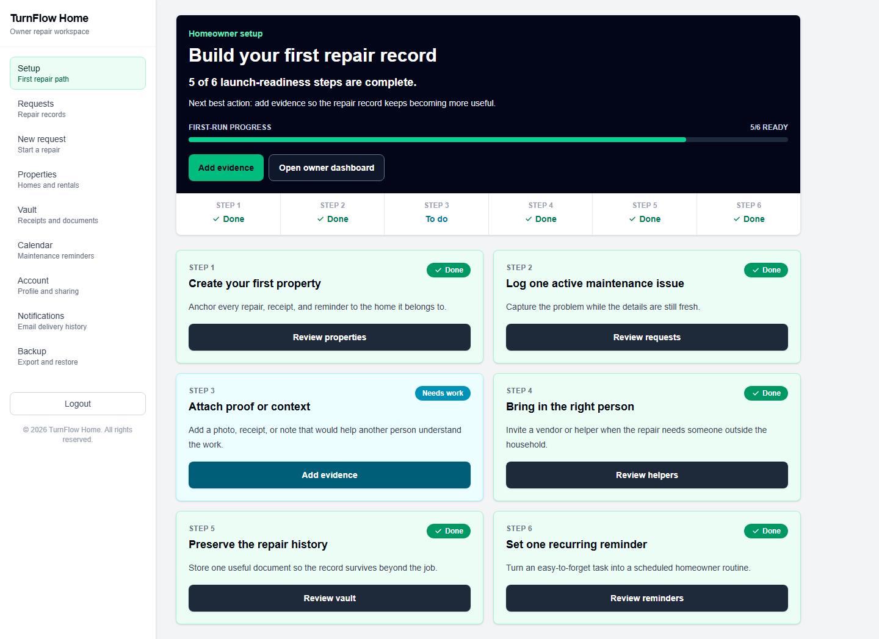
EXPERIENCE
Owner journey
Setup turns an empty account into a repair record that can survive the next handoff
1
Add the home
2
Capture the issue
3
Attach proof
4
Share one request
5
Close and preserve
TURNFLOW HOME • SYSTEM GUIDE
06
Notes:
Sources: app/owner/onboarding/page.tsx, lib/owner-readiness.ts, screenshot screenshots/ux-owner/setup-desktop.png.

Slide 7
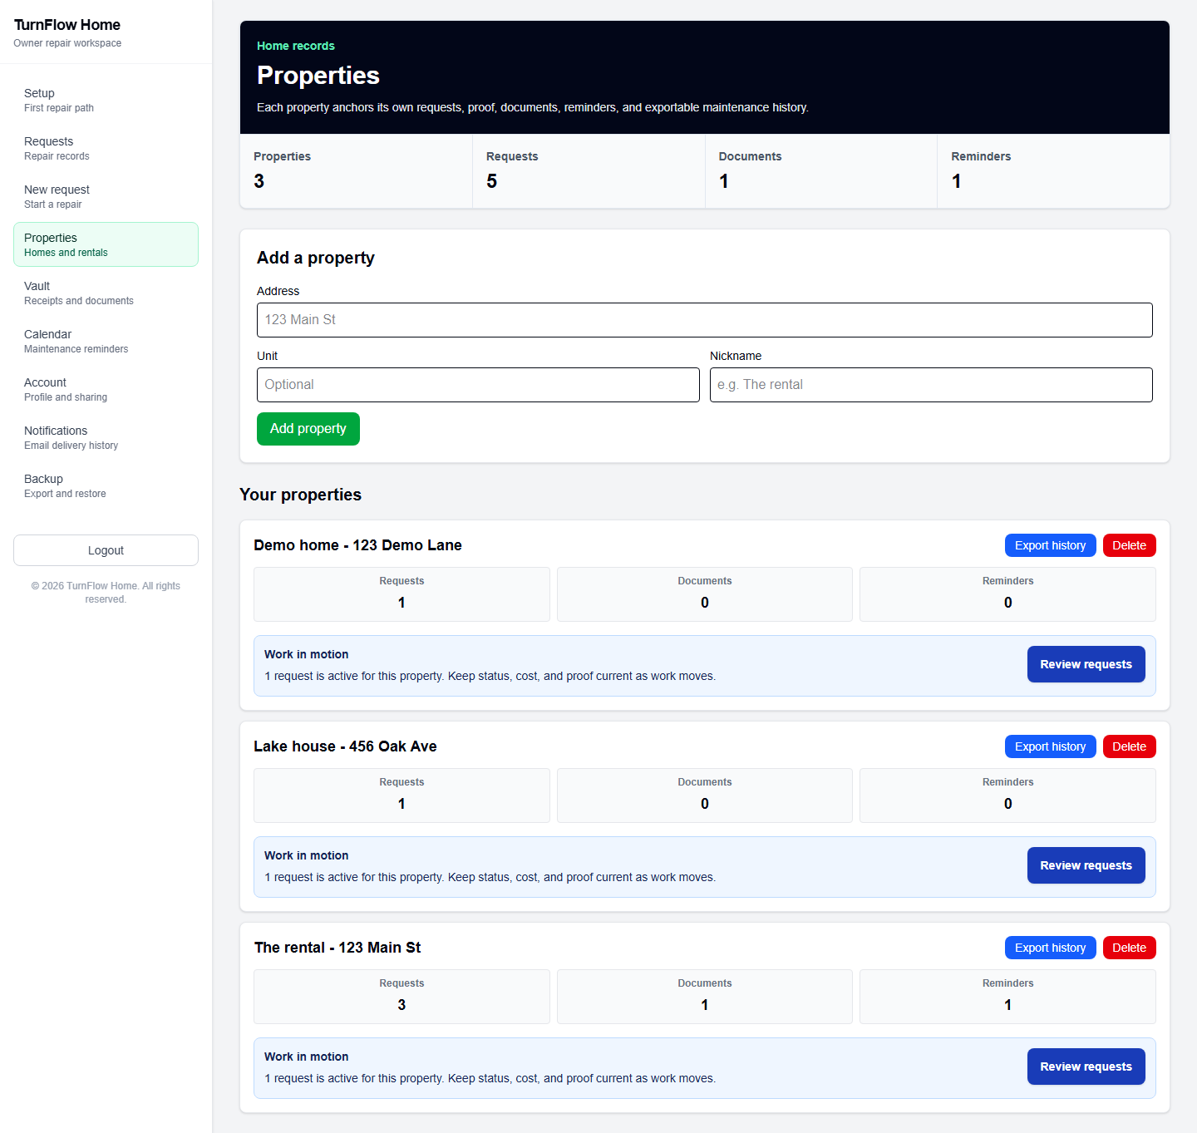
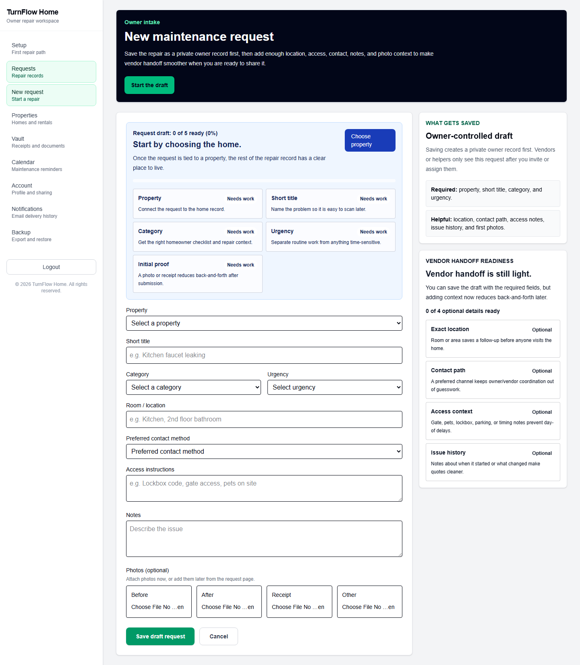
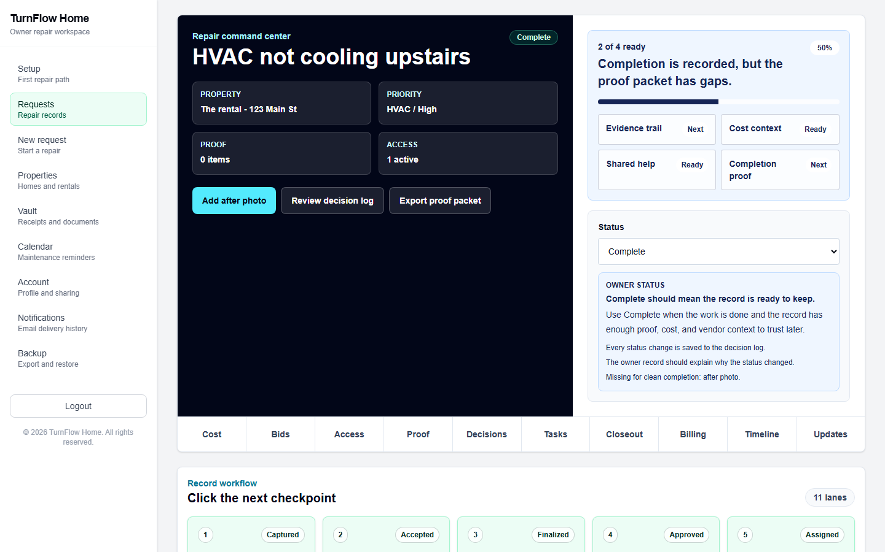
EXPERIENCE
The owner workspace
Each screen answers one maintenance question
PROPERTIES
REQUEST INTAKE
REQUEST DETAIL
What does each home need?
What happened and what context matters?
What must happen next?
TURNFLOW HOME • SYSTEM GUIDE
07
Notes:
Sources: screenshots/ux-owner/properties-desktop.png, screenshots/ux-owner/new-request-desktop.png, screenshots/04-request-detail.png.

Slide 8
EXPERIENCE
The request lifecycle
Statuses communicate progress while evidence and decisions preserve the real history
Draft
Needs Quote
Waiting
Scheduled
In Progress
Needs Review
Complete
Archived
PHOTOS
QUOTES
TASKS
WORK EVENTS
CLOSEOUT
BILLING RECORD
DECISION LOG
Status is a summary. The durable record is the evidence and decisions attached to the request.
TURNFLOW HOME • SYSTEM GUIDE
08
Notes:
Sources: lib/db/schema.ts request_status enum, lib/request-workflow.ts, lib/actions/requests.ts.

Slide 9
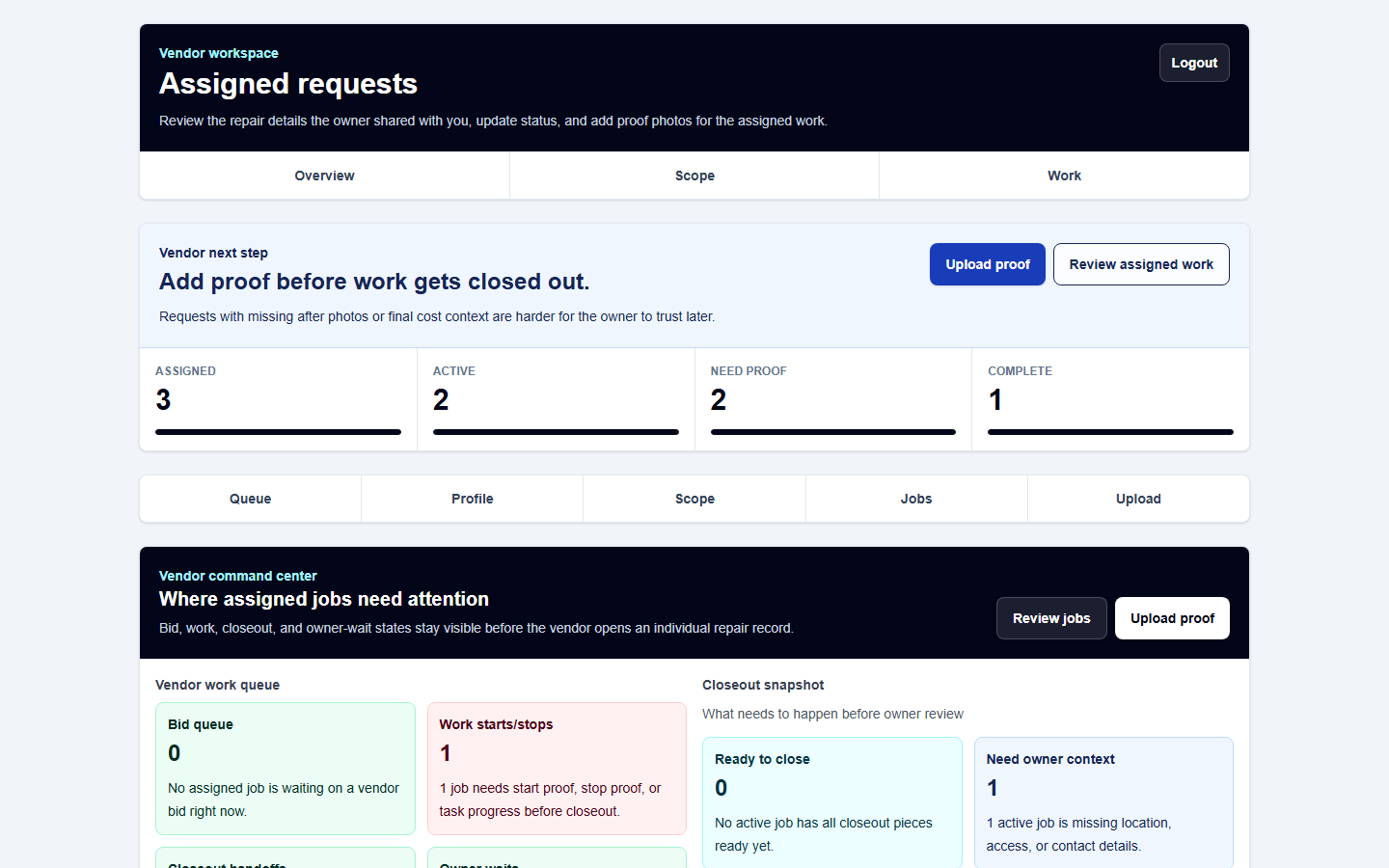
EXPERIENCE
Vendor work lane
The portal selects the next useful action from bid, proof, work, closeout, and owner review state
Assigned
Owner invite or assignment
Bid
Private price and availability
Work
Before proof, then start/pause/resume/stop
Closeout
After proof, completed tasks, final amount, notes
Owner review
Approve or request a documented revision
TURNFLOW HOME • SYSTEM GUIDE
09
Notes:
Sources: components/VendorPortal.tsx, lib/vendor-lifecycle.ts, lib/closeout-submissions.ts, screenshot screenshots/ux-helper/vendor-desktop.png.

Slide 10
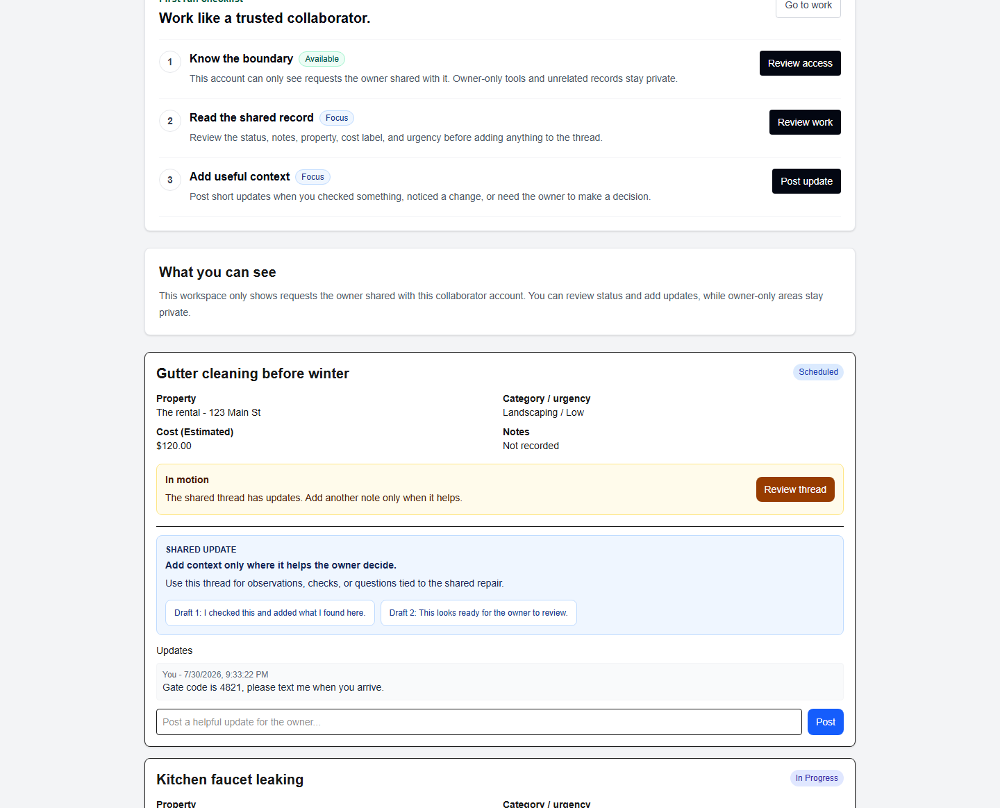
EXPERIENCE
Scoped collaboration
A collaborator can help with one shared request while the owner keeps account-wide control
Visible
Shared request
One request
Context, readiness, updates
Not visible
Other homes, vault, billing controls
Owner can remove accepted access and the decision log records the change
TURNFLOW HOME • SYSTEM GUIDE
10
Notes:
Sources: app/collaborator/page.tsx, lib/actions/invites.ts, screenshot screenshots/ux-helper/collaborator-desktop.png.

Slide 11
ARCHITECTURE
System architecture
Auth.js
The browser talks to one Next.js application that owns the server boundary
Credentials and JWT session
Next.js 16
App Router
Server Components
Server Actions
Route Handlers
Neon Postgres
Resend
Browser
Server-rendered pages and interactive components
Drizzle schema and queries
Optional delivery plus log
Vercel Blob
Private proof and vault files
Vercel hosts the app and invokes the daily reminder cron
TURNFLOW HOME • SYSTEM GUIDE
11
Notes:
Sources: package.json, lib/db/index.ts, lib/auth/config.ts, app/api/blob-upload/route.ts, lib/email.ts, vercel.json.

Slide 12
ARCHITECTURE
One mutation from click to durable history
Every important write repeats identity, record authorization, validation, and audit work
Component
Server Action
DAL and policy
Drizzle
Postgres
Side effects
submit
authorized input
log, email, revalidate
session + role
database write
The page-level role check improves UX. The action-level ownership check protects the data.
NEXT.JS SECURITY RULE
TURNFLOW HOME • SYSTEM GUIDE
12
Notes:
Sources: installed Next.js 16 authentication/data-security guides, lib/auth/dal.ts, representative actions under lib/actions/.

Slide 13
CODE
Repository map
The code is organized by delivery boundary, then by workflow helpers
turnflow-home-main
Next.js application
app/
components/
lib/actions/
lib/
drizzle/
Routes, pages, APIs
Interactive workflow UI
Authorized mutations
Policy and guidance
Schema migrations
Tests mirror the pure policy helpers. Scripts exercise real browser and deployment flows.
TURNFLOW HOME • SYSTEM GUIDE
13
Notes:
Sources: repository file inventory, app/, components/, lib/, drizzle/, __tests__/, scripts/.

Slide 14
CODE
Frontend to backend mapping
Routes compose workflow components. Components call narrowly scoped actions
/owner/requests/new
NewRequestForm
createRequestAction + blob upload
/owner/requests/[id]
RequestDetailView
requests, quotes, tasks, invites, closeout, billing
/vendor
VendorPortal
bids, work sessions, task status, closeout
/collaborator
Helper portal components
comments on shared requests
/owner/account
sharing and profile controls
invite lifecycle + access removal
TURNFLOW HOME • SYSTEM GUIDE
14
Notes:
Sources: app route pages and imported components/actions found by repository inspection.

Slide 15
CODE
Business rules live in two layers
Pure helpers explain the state. Server entry points enforce it
Guidance helpers
Server enforcement
requestGuidance
requestWorkflowSteps
vendorNextAction
closeoutReadiness
Shared policy
requireRole
ownership check
validation
database write
statuses, proof rules, normalized inputs
UI copy helps the user act. The action remains safe when the UI is bypassed.
318 unit tests cover deterministic rules for status, files, auth limits, cron, and guidance
TURNFLOW HOME • SYSTEM GUIDE
15
Notes:
Sources: lib/* guidance helpers, lib/actions/*, __tests__/*.test.ts. Test count verified with npm test on 2026-09-30.

Slide 16
DATA
The request-centered data model
Nineteen primary tables support ownership, repair coordination, history, and future workspace billing
Repair work
Ownership
photos
quotes
tasks
work_sessions
users
workspaces
memberships
billing_accounts
requests
property, owner, workspace, status, costs, access
History and closeout
Property memory
VENDOR PROFILE
comments
decision_log
closeout_submissions
billing_records
notification_log
properties
vault_documents
reminders
contacts
Foreign keys preserve structure. Owner/request IDs remain the active authorization anchors.
TURNFLOW HOME • SYSTEM GUIDE
16
Notes:
Source: lib/db/schema.ts. Primary tables counted from exported pgTable declarations.

Slide 17
TRUST
Authentication and authorization
Defense in depth keeps navigation friendly and mutations authoritative
1
2
3
4
5
Credentials
Session
Routing
Server policy
Data boundary
Zod parses input. Rate limits and bcrypt protect login.
Auth.js stores user ID and role in a JWT session.
proxy.ts redirects signed-out and cross-role page visits.
DAL and actions re-check role plus resource ownership.
Foreign keys and scoped queries limit related records.
TURNFLOW HOME • SYSTEM GUIDE
17
Notes:
Sources: lib/auth/config.ts, lib/auth/dal.ts, proxy.ts, representative Server Actions, lib/db/schema.ts.

Slide 18
TRUST
Permission matrix
Capabilities follow the durable owner record and request assignment
Capability
Owner
Assigned vendor
Collaborator
View owned property records
Yes
No
No
View one shared request
Yes
Yes
Yes
Change request status
Yes
Working states
No
Add request evidence
Yes
Yes
No
Manage quotes and final cost
Yes
Vendor bid only
No
Submit closeout
Review
Yes
No
Manage vault, backup, reminders
Yes
No
No
Remove shared access
Yes
No
No
TURNFLOW HOME • SYSTEM GUIDE
18
Notes:
Sources: action authorization checks, app/vendor/page.tsx, app/collaborator/page.tsx. Matrix summarizes current code, not a generalized future organization policy.

Slide 19
TRUST
Evidence upload boundary
The server authorizes both the user and the destination path before storing a file
Browser
Upload route
Record check
Private Blob
File route
Compresses large images and posts multipart data
Checks token, type, size, session, and path syntax
Owner or assigned vendor for request; owner for property
Stores an authorized path with a random suffix
Re-checks record access before streaming bytes
Allowed types: JPEG, PNG, WebP, HEIC, PDF. Server limit: about 4 MB.
New uploads return /api/files URLs. Revoking request access also revokes the ability to read private evidence.
TURNFLOW HOME • SYSTEM GUIDE
19
Notes:
Sources: app/api/blob-upload/route.ts, app/api/files/route.ts, lib/blob-upload-client.ts, lib/blob-paths.ts, lib/file-access.ts.

Slide 20
DELIVERY
Runtime operations
Health, reminders, notifications, and backups make the POC operable without hiding failures
PUBLIC HEALTH
/api/health returns monitor-safe status with no caching
DEEP HEALTH
Bearer-protected database and configuration checks
DAILY CRON
13:00 UTC reminder digest protected by CRON_SECRET
EMAIL
Resend when configured. Every attempt enters notification_log
PORTABILITY
JSON backup/restore, CSV history, PDF proof packets, ICS reminders
TURNFLOW HOME • SYSTEM GUIDE
20
Notes:
Sources: app/api/health, app/api/cron/reminder-digest, lib/email.ts, vercel.json, backup and PDF utilities.

Slide 21
DELIVERY
Quality map
Fast policy tests protect business rules. Browser scripts prove the role handoffs
318 unit tests
Browser smoke scripts
npm run verify
34 files
Guidance and state rules
Auth, file, cron policy
Forms, headers, and health
Public routes
Owner routes and first flow
Invite acceptance
Helper portals
Full bid-to-closeout loop
Lint
TypeScript
Unit tests
Production audit
Schema drift
Production build
Verified here: all 318 tests, lint, TypeScript, and the production build passed
TURNFLOW HOME • SYSTEM GUIDE
21
Notes:
Sources: package.json scripts, __tests__/, scripts/ux-*.ts. Local verification run on 2026-09-30.

Slide 22
DELIVERY
Deployment topology
The application is designed around managed Vercel services and explicit environment checks
Neon
Postgres
Vercel
External monitor
GitHub
Next.js runtime
serverless routes
cron
security headers
Public health
Protected deep health
Future alerting
main branch and CI
Vercel Blob
Private objects via /api/files
Resend
Optional email
poc:ready checks database, auth, URLs, Blob, cron, health, and email posture before user testing
TURNFLOW HOME • SYSTEM GUIDE
22
Notes:
Sources: docs/DEPLOYMENT.md, .env.local.example, package.json, vercel.json, next.config.ts.

Slide 23
READINESS
Implemented, partial, and missing
The POC covers the coordination loop but does not claim a full commercial platform
IMPLEMENTED
PARTIAL OR ENVIRONMENT-DEPENDENT
PLANNED OR MISSING
Owner, vendor, collaborator lanes
Email delivery and cron verification
Invite-time vendor/helper signup
Request, proof, quotes, tasks, closeout
Workspace policy beyond the owner foundation
Transactional multi-row writes
Workspace and billing record foundation
Production monitoring outside health endpoints
Durable audit retention + quote uniqueness
Tests, health, deployment runbook
Hosted POC environment confirmation
Moderated homeowner testing
TURNFLOW HOME • SYSTEM GUIDE
23
Notes:
Sources: README.md Current POC Readiness and Remaining Product Gaps, docs/DEPLOYMENT.md, docs/USER_TESTING.md.

Slide 24
READINESS
Risk and readiness priorities
Most risk sits at the boundary between a strong demo and a real external-user launch
1
Human validation
Moderated homeowner and vendor sessions remain the documented launch gate.
2
Access onboarding
Invited vendors and helpers cannot yet create the required account from the invite.
3
Data integrity
Multi-row mutations need transactions; quote approval uniqueness needs enforcement.
4
Audit durability
Decision history currently follows request deletion instead of surviving it.
5
Operations
Private-Blob migration, demo reset, email, cron, and alerting need environment proof.
TURNFLOW HOME • SYSTEM GUIDE
24
Notes:
Sources: README.md gaps, docs/DEPLOYMENT.md, docs/UI_UX_REVIEW.md, __tests__/security-headers.test.ts.

Slide 25
LEARNING
Where to make common changes
Start at the business rule, then move outward to data, server entry points, UI, and verification
Policy
Schema
Mutation
Experience
Verification
lib/*.ts
lib/db/schema.ts + migration
lib/actions/*.ts
app/ + components/
__tests__/ + smoke script
Example: a new request field touches schema, migration, intake action, forms, backup/export, guidance, and tests.
TURNFLOW HOME • SYSTEM GUIDE
25
Notes:
Sources: repository organization and recurring change pattern visible in schema, actions, components, tests, and build log.

Slide 26
LEARNING
A two-minute explanation
Use four beats and name the product boundary before the stack
1
2
3
4
Problem
Product
System
Maturity
Repair evidence and decisions fragment across messages, files, and memory.
The owner keeps one property record and shares only the request that needs help.
Next.js owns the server boundary. Postgres stores history. Blob stores files.
The full POC loop works. Payments, broader org policy, and user validation remain.
TURNFLOW HOME • SYSTEM GUIDE
26
Notes:
Source: explain-the-code-practice-guide.md, based on repository evidence.

Slide 27
LEARNING
A guided code-reading path
Trace one repair from page to policy, mutation, data, and proof
app/owner/requests/[id]/page.tsx
Loads the owner-scoped aggregate
components/RequestDetailView.tsx
Composes the workflow controls
lib/request-workflow.ts
Explains current state and next action
lib/actions/requests.ts
Enforces ownership and status changes
lib/db/schema.ts
Shows the stored relationships
TURNFLOW HOME • SYSTEM GUIDE
27
Notes:
Source: code-glossary.md and repository imports.

Slide 28
READINESS
Recommended next steps
Strengthen the proof of usefulness before expanding the commercial surface
NOW
NEXT
THEN
AFTER EVIDENCE
Run moderated owner and vendor sessions against the hosted seeded flow
Close invite signup and verify private-Blob migration, demo reset, email, cron, and health
Add transactions, durable audit retention, quote uniqueness, and boundary tests
Choose payments, team policy, or vendor discovery from observed demand
The current code proves coordination and recordkeeping. The next release decision should come from real workflow evidence.
TURNFLOW HOME • SYSTEM GUIDE
28
Notes:
Sources: README.md, docs/DEPLOYMENT.md, docs/USER_TESTING.md, docs/VENDOR_LIFECYCLE_ROADMAP.md.

Slide 29
The system is one request-centered record
Trace these four links and you can explain or extend TurnFlow Home with confidence.
Role
Request
Evidence
Decision
Who may act?
Which repair?
What proves it?
What changed?
Start page: PROJECT_SYSTEM_GUIDE.md
TURNFLOW HOME • SYSTEM GUIDE
29
Notes:
Close with the mental model. The central guide links the deck and all companion documents.

