Slide 1
Consumer Goods Ad-Hoc Insights
AtliQ Hardware
Presented by Md Merajuddin

Slide 2
AGENDA
Background of Company
Getting familiar with data
Ad-Hoc request along with queried result, visualization and Insights

Slide 3
Background of COmpany
Our Company
Atliq Hardwares (imaginary company) is one of the leading computer hardware producers in India and well expanded in other countries too.
Background
The management noticed that they do not get enough insights to make quick and smart data-informed decisions. They want to expand their data analytics team by adding several junior data analysts. Tony Sharma, their data analytics director wanted to hire someone who is good at both tech and soft skills. Hence, he decided to conduct a SQL challenge which will help him understand both the skills.
Task
There are 10 Ad-Hoc requests for which the company need insights.
Solution
Run a SQL query to answer these requested questions and convert them into visualization to present it to top level company management.

Slide 4
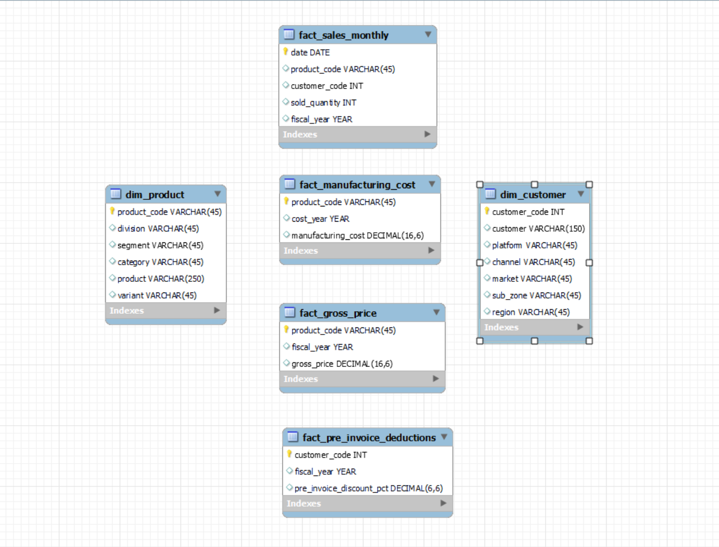
Getting familiar with Data
Data consists of sales data for FY 2020 and 2021, along with other dimension tables such as dim_customer, dim_product, fact_gross_price, fact_manufacturing_cost, fact_sales_monthly, fact_pre_invoice_deductions.

Slide 5
Ad-Hoc request along with queried result, visualization and Insights

Slide 6
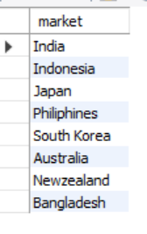
Request 1:
OUTPUT
Provide the list of markets in which customer "Atliq Exclusive" operates its business in the APAC region.

Slide 7
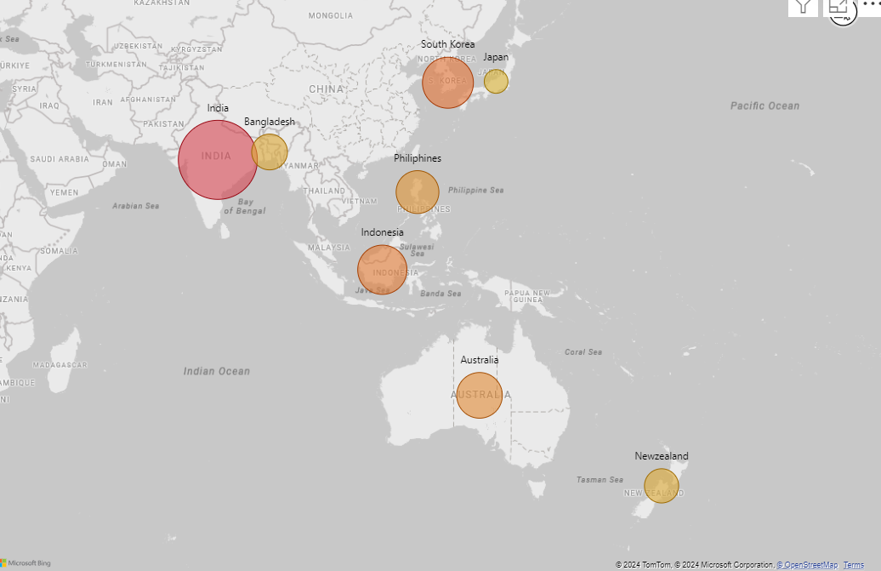
INSIGHTS
In the APAC region, our customer "Atliq Exclusive" has established its presence in 8 major markets out of which India is leading followed by South Korea, Indonesia and others.

Slide 8

Request 2:
OUTPUT
What is the percentage of unique product increase in 2021 vs. 2020?

Slide 9
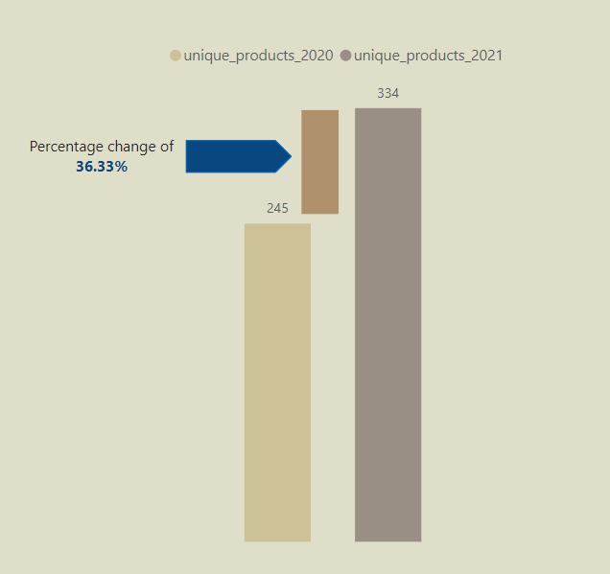
INSIGHTS
In FY 2020 we had 245 unique products while in FY 2021 we have 334 unique products an increment of 36.33%.

Slide 10
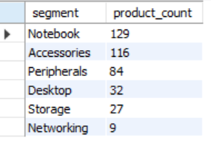
Request 3:
OUTPUT
Provide a report with all the unique product counts for each segment and sort them in descending order of product counts.

Slide 11
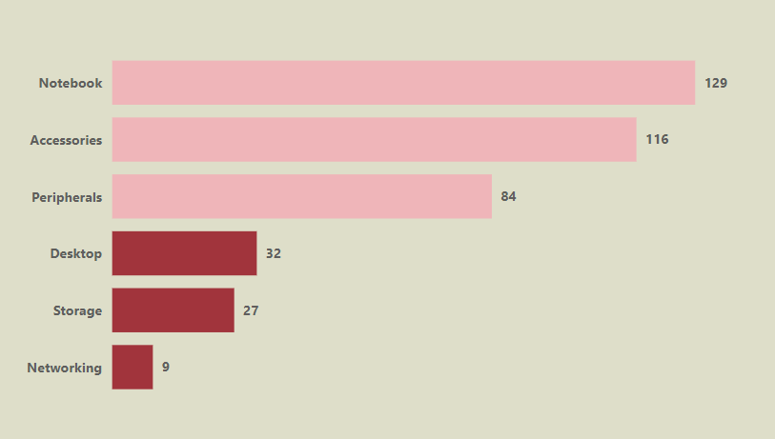
INSIGHTS
We have a wide variety of products under the segments of Notebooks, Accessories, Peripherals, Desktop, Storage and Networking. However, we need to diversify our production in the Segment of Desktop, Storage and Networking as they have lower production.

Slide 12
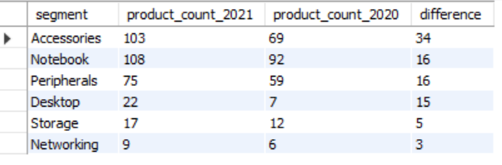
Request 4:
OUTPUT
Which segment had the most increase in unique products in 2021 vs 2020?

Slide 13
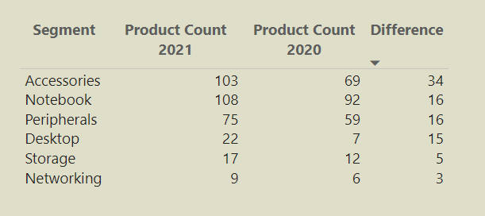
INSIGHTS
Desktop segment saw highest increase in its products of 34 followed by Notebook 16 and Peripherals 16.

Slide 14

Request 5:
OUTPUT
Get the products that have the highest and lowest manufacturing costs.

Slide 15
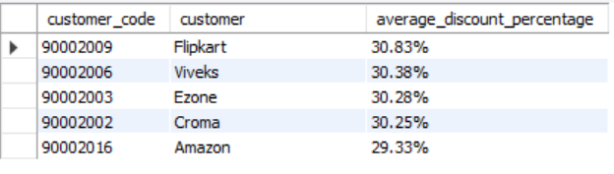
Request 6:
OUTPUT
Generate a report which contains the top 5 customers who received an average high pre invoice discount percentage for the fiscal year 2021 and in the Indian market.

Slide 16
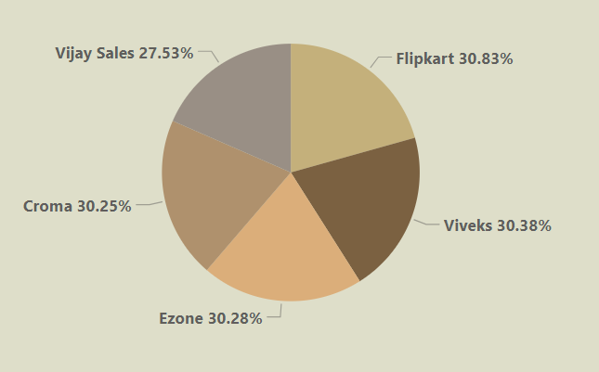
INSIGHTS
For Indian market in 2021, we offered nearly equal discount percentage to all top 5 our customers on which Flipkart received highest discount of 30.83%.

Slide 17
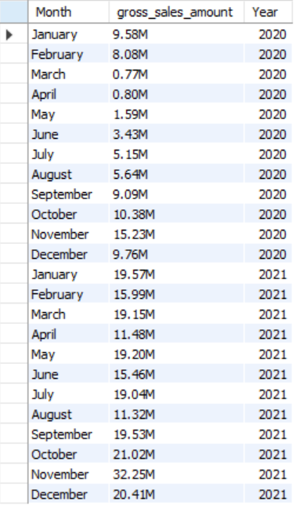
Request 7:
OUTPUT
Get the complete report of the Gross sales amount for the customer “Atliq Exclusive” for each month.

Slide 18
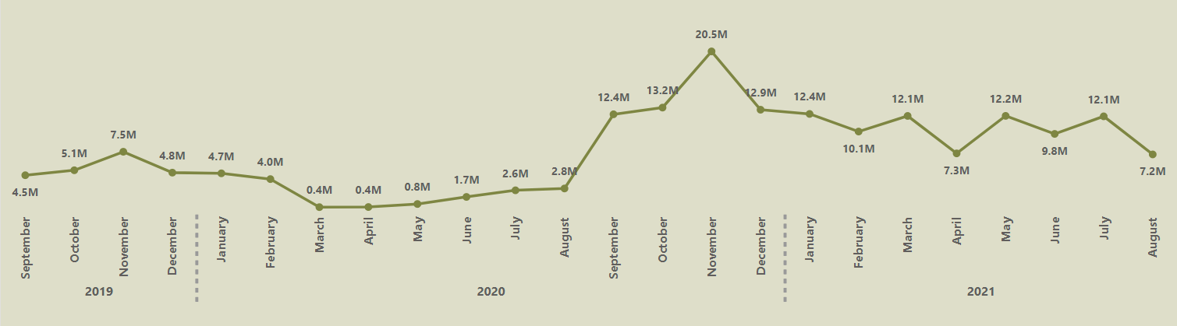
INSIGHTS
For our customer Atliq Exclusive, November 2020 was highest sales of 20.5M and March 2020, April 2020 saw a lowest sales of 0.4M each because of Covid-19 pandemic. After the month of August market started growing and we witnessed an increase in sales afterwards.

Slide 19
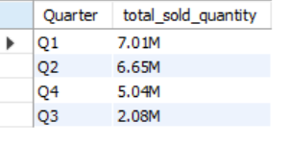
Request 8:
OUTPUT
In which quarter of 2020, got the maximum total sold quantity?

Slide 20
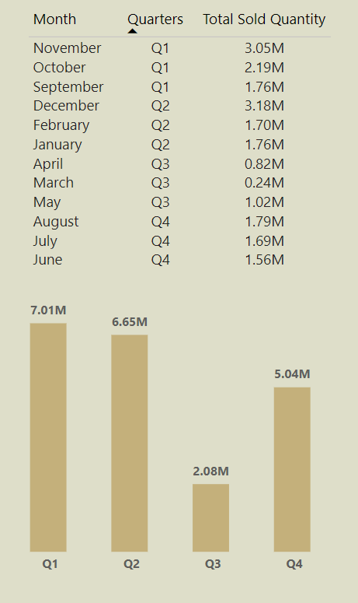
INSIGHTS
For FY 2020, we witnessed highest total sold quantity of 7.01M in which November month generated 3.05M. The effect of Covid-19 is clearly seen as total sold quantity decreased to 2.08M in Q3 on which March and April have only 02.4M and 0.82M sales.

Slide 21
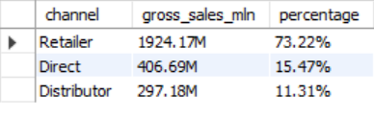
Request 9:
OUTPUT
Which channel helped to bring more gross sales in the fiscal year 2021 and the percentage of contribution?

Slide 22
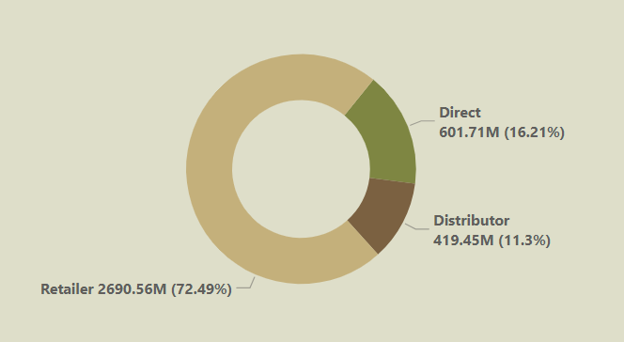
INSIGHTS
The majority of sales took place via Retailer which is 2690.56M (72.49%), followed by Direct of 601.71M (16.21%) and Distributor of 419.45M (11.3%)

Slide 23
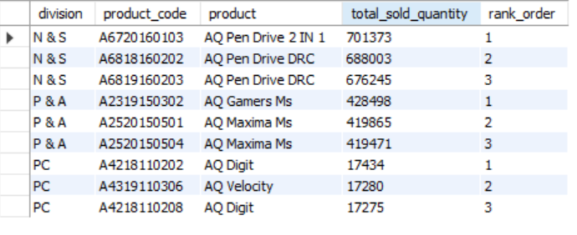
Request 10:
OUTPUT
Get the Top 3 products in each division that have a high total sold quantity in the fiscal year 2021?

Slide 24
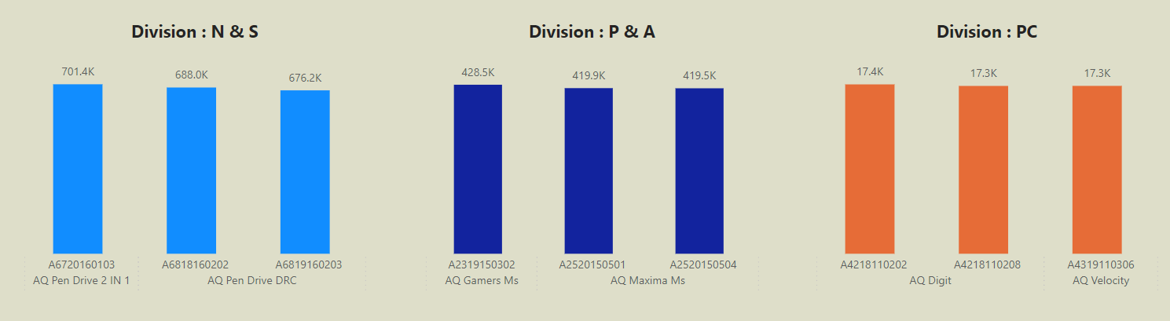
INSIGHTS
The top 3 selling products in N&S is pen drive.
The top 3 selling products in P&A is mouse.
The top 3 selling products in PC is Laptop.

Slide 25
THANK YOU!

