Slide 1
Formally proving crypto properties of pseudorandom number generators
Katherine Ye ’16
advised by Andrew Appel and Matt Green

Slide 2
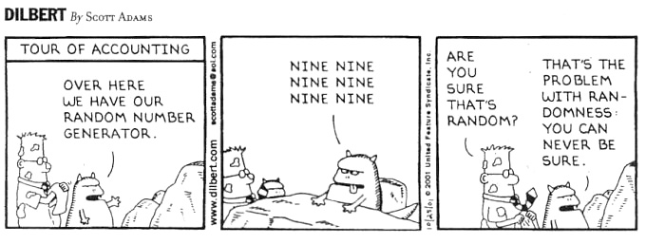
Notes:
xkcd

Slide 3
Most modern cryptosystems rely on random numbers
e.g. RSA generates random big primes that become a private key
Reducing the entropy of a cryptosystem’s pseudo-random number generator (PRG) is an easy way to break the entire cryptosystem

Slide 4
Random number generator
RNG
00001011100110101011000010110010000011111101111000111110011011101000000001000011

Slide 5

Pseudo-random number generator
1100101
PRG
01111111011111101001010110011010001000111101111110101110001010101000110001110100

Slide 6
Pseudo-random number generator
1100101
PRG
01111111011111101001010110011010001000111101111110101110001010101000110001110100
≈
00001011100110101011000010110010000011111101111000111110011011101000000001000011

Slide 7
Pseudo-random number generator
1100101
PRG
01111111011111101001010110011010001000111101111110101110001010101000110001110100
! ≈
00001011100110101011000010110010000011111101111000111110011011101000000001000011

Slide 8
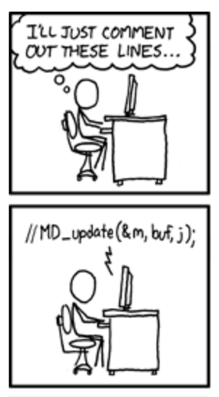
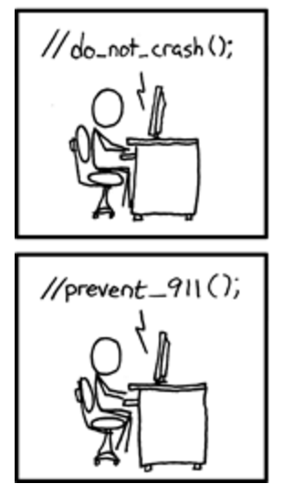
Debian OpenSSL PRG
https://www.xkcd.com/424/

Slide 9
Removed sources of system entropy → only 32,767 choices
Predictable SSL/SSH keys (Spotify, Yandex...)
Can read encrypted traffic, log into remote servers, forge messages
Have to patch servers AND replace weak keys
https://freedom-to-tinker.com/blog/kroll/software-transparency-debian-openssl-bug/
Notes:
cite // mining your ps and qs

Slide 10
We need secure PRGs
But surprisingly little work exists on proving PRGs secure, either on paper or formally
Notes:
3:01

Slide 11
Until now!

Slide 12
Goal: formally prove functional correctness and cryptographic security of a widely-used implementation of a PRG

Slide 13
Goal: prove functional correctness and cryptographic security of a widely-used implementation of a PRG
mbedTLS
HMAC-DRBG

Slide 14
Goal: prove functional correctness and cryptographic security of a widely-used implementation of a PRG
Verified Software Toolchain
Foundational Crypto Framework
mbedTLS
HMAC-DRBG

Slide 15
Our project
NIST paper spec
of HMAC-DRBG
mbedTLS implementation of HMAC-DRBG

Slide 16
Our project
x → y:
x implements y
NIST paper spec
of HMAC-DRBG
assume
correct
N’s practical
functional spec
mbedTLS implementation of HMAC-DRBG
prove with VST

Slide 17
Our project
x → y:
x implements y
Spec. of crypto properties
NIST paper spec
of HMAC-DRBG
prove with FCF
assume
correct
My crypto.
functional spec
N’s practical
functional spec
mbedTLS implementation of HMAC-DRBG

Slide 18
Our project
x → y:
x implements y
Spec. of crypto properties
NIST paper spec
of HMAC-DRBG
My crypto.
functional spec
prove equivalent in Coq
N’s practical
functional spec
mbedTLS implementation of HMAC-DRBG

Slide 19
Our project
x → y:
x implements y
Spec. of crypto properties
NIST paper spec
of HMAC-DRBG
security!
My crypto.
functional spec
N’s practical
functional spec
correctness!
mbedTLS implementation of HMAC-DRBG

Slide 20

Our project
x → y:
x implements y
Spec. of crypto properties
NIST paper spec
of HMAC-DRBG
security!
My crypto.
functional spec
N’s practical
functional spec
correctness!
mbedTLS implementation of HMAC-DRBG
Notes:
Prove correctness and security of a widely-used implementation of mbedTLS implementation of HMAC-DRBG
Prove that the functional specification guarantees the expected cryptographic properties
These properties will “flow” from the functional spec down to the compiled code
Machine-checked

Slide 21

My project
x → y:
x implements y
Spec. of crypto properties
NIST paper spec
of HMAC-DRBG
My crypto.
functional spec
prove equivalent in Coq
N’s practical
functional spec
mbedTLS implementation of HMAC-DRBG

Slide 22
Security properties of PRGs
Output indistinguishable from random to a computationally-bounded adversary
Notes:
5:44
highlight first, explain formally later

Slide 23
Security properties of PRGs
Backtracking-resistant (compromise at time t does not compromise output from time < t)
Eventually recovers from compromises of internal state

Slide 24
Related work
(there isn’t much)
Notes:
delete these

Slide 25
Our group
Appel (2015) does the first “full formal machine-checked verification of a C program: the OpenSSL implementation of SHA-256.”
Petcher, Beringer, Ye, and Appel (2015) do the same for HMAC, adding a proof of crypto security depending on SHA
Verification of a Cryptographic Primitive: SHA-256
Verified Correctness and Security of OpenSSL HMAC

Slide 26
Our group
Appel (2015) does the first “full formal machine-checked verification of a C program: the OpenSSL implementation of SHA-256.”
Petcher, Beringer, Ye, and Appel (2015) do the same for HMAC, adding a proof of crypto security depending on SHA
hence HMAC-DRBG
Verification of a Cryptographic Primitive: SHA-256
Verified Correctness and Security of OpenSSL HMAC

Slide 27
Paper proofs
One proof by Hirose (2009) about HMAC-DRBG; not peer-reviewed
Several crypto papers analyze the security of PRGs and propose new security properties, e.g. Dodis et al.
http://repo.flib.u-fukui.ac.jp/dspace/bitstream/10098/2126/1/art.pdf
https://eprint.iacr.org/2013/338.pdf

Slide 28
PRG internals
Notes:
10 slides (3 outline slides)

Slide 29
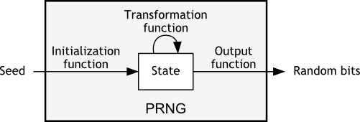
Pseudo-random number generator
http://pit-claudel.fr/clement/blog/how-random-is-pseudo-random-testing-pseudo-random-number-generators-and-measuring-randomness/

Slide 30
Pseudo-random number generator
Instantiate
Generate (bits)
Reseed (add entropy)
Update (internal state)
http://pit-claudel.fr/clement/blog/how-random-is-pseudo-random-testing-pseudo-random-number-generators-and-measuring-randomness/

Slide 31
Chaining:
K = secret key; V = initialization vector;
H = hash function (e.g. HMAC); || = concatenate rand_bits =
H(K, V)
|| H(K, H(K, V))
|| H(K, (H(K, H(K, V)))...
Generate (simplified)
outputs used again as inputs

Slide 32
Generate (simplified)
rec loop K V n =
if n = 0 then ([], V)
else
let (result, V’) := loop K V (n-1) in
let V’’ := HMAC K V’ in
(result ++ V’’, V’’)
fun Generate K V n reseed_ctr =
if reseed_ctr >= max then reseed_required
else
let (bits, V’) := loop K V n in
let (K’, V’’) := Update K V’ in
(K’, V’’, bits)
n blocks of output: recursion

Slide 33
PRG run
User/Adversary:
Instantiate,
Generate 10 blocks,
Generate 20 blocks,
Generate 1 block,
Generate 10000000 blocks,
Generate 1 block,
...
Another loop
Notes:
7:58

Slide 34
PRG run
User/Adversary:
Instantiate,
Generate 10 blocks,
Update K and V
Generate 20 blocks,
Update K and V
Generate 1 block,
Update K and V,
Generate 10000000 blocks,
Update K and V,
RESEED,
Generate 1 block,
Update K and V,
...
Complications with
Updating key and Reseed

Slide 35
Prior work
Proof of indistinguishability for inner loop of PRG (Generate function): done by collaborator
Extend to proof of indistinguishability for outer loop of PRG (multiple Generate calls with Update)
Notes:
prg pseudocode highlighted for diff. proofs, theorem in FCF + one step in FCF

Slide 36
Method
Proofs in the “sequence of games” style
Bound probability of adversary distinguishing correctly by 1/2 + negligible amount
Done in FCF in Coq, so correctness is verified

Slide 37
My project
x → y:
x implements y
Spec. of crypto properties
NIST paper spec
of HMAC-DRBG
My crypto.
functional spec
prove equivalent in Coq
N’s practical
functional spec
mbedTLS implementation of HMAC-DRBG

Slide 38
Results

Slide 39
Results
Proved pseudorandomness of simplified HMAC-DRBG on paper
Mostly done: formally proved pseudorandomness of simplified HMAC-DRBG!

Slide 40
Results
Total lemmas: 17 main ones, many smaller
Confident about all of them
Proved 4 main difficult ones

Slide 41
Results
Total lines of code: ~2000 (but not done)
Admitted lemmas: 22 (including medium-sized ones -- confident about all)

Slide 42
Results
Idea for extending pseudorandomness proof to backtracking resistance
Negative result: prediction resistance is too hard to prove

Slide 43
To do
Prove admitted lemmas
Add features to proof (e.g. additional input)
Prove backtracking resistance
Notes:
picture

Slide 44
To do
Connect it with concrete functional spec
Write a combined paper

Slide 45
Measure of success

Slide 46
Questions
How automated? (Very manual.)
How much effort? (Discussed earlier.)
Notes:
state of the art: the one paper proof, not usable, ours would be an actual proof about a system

Slide 47
Questions
Did we contribute original math? (Yes!)

Slide 48
Measures of success
What attacks can be definitively ruled out by our verification? What attacks are still possible? (TBD)
Are the security and formal verification communities excited about using or building on our work? (TBD)
Notes:
failure of entropy fn
timing/cache side-channels

Slide 49
Conclusion
We (mostly) did it!
Future work: can others do it for other things?

Slide 50
Thanks!
Notes:
9:35

