Slide 1
LIP READING SYSTEM
USING IMAGE PROCESSING
UNDER THE GUIDANCE OF
Dr. V. R. SATPUTE
B. VIKAS
CH. SAI TEJA
N. BADRINATH

Slide 2
INTRODUCTION
Lip reading, also known as speech reading, is a technique of understanding speech by visually interpreting the movements of the lips and tongue.
Most automatic speech recognition systems have concentrated exclusively on the acoustic speech signal, and therefore they are susceptible to acoustic noise.
A number of studies have revealed that the information contained in speech signals is closely related to that found in lip movements, and, if information regarding the latter is included, the perception performance of machines can be improved.
Here we implemented a geometry based Lip reading system, consisting of two major steps
Preprocessing Module
Classification Module

Slide 3
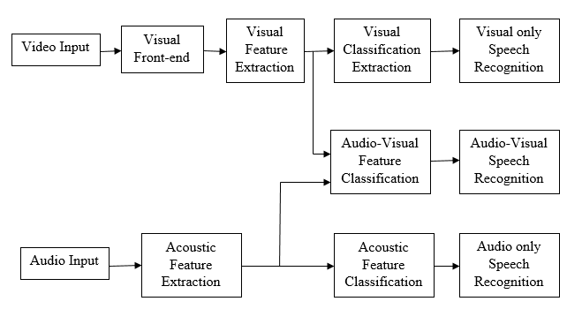
INTRODUCTION(Cont)
Audio Visual Speech Recognition system

Slide 4
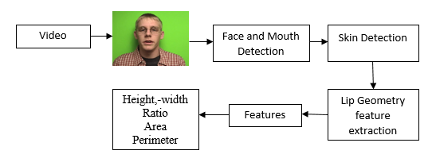
Preprocessing Module
A preprocessing module extracts the lip geometry information from the video sequence.

Slide 5
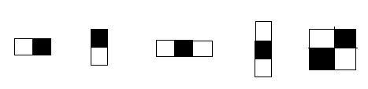
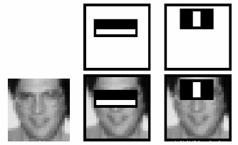
Preprocessing Module(Cont)
The main steps in the preprocessing stage are,
Face Detection (Viola Jones Algorithm)
Haar features
Integral image
AdaBoost algorithm
Cascaded classifier
Mouth detection
'Haar like' features used in training the Viola- Jones classifier
The first and second features selected by AdaBoost.

Slide 6


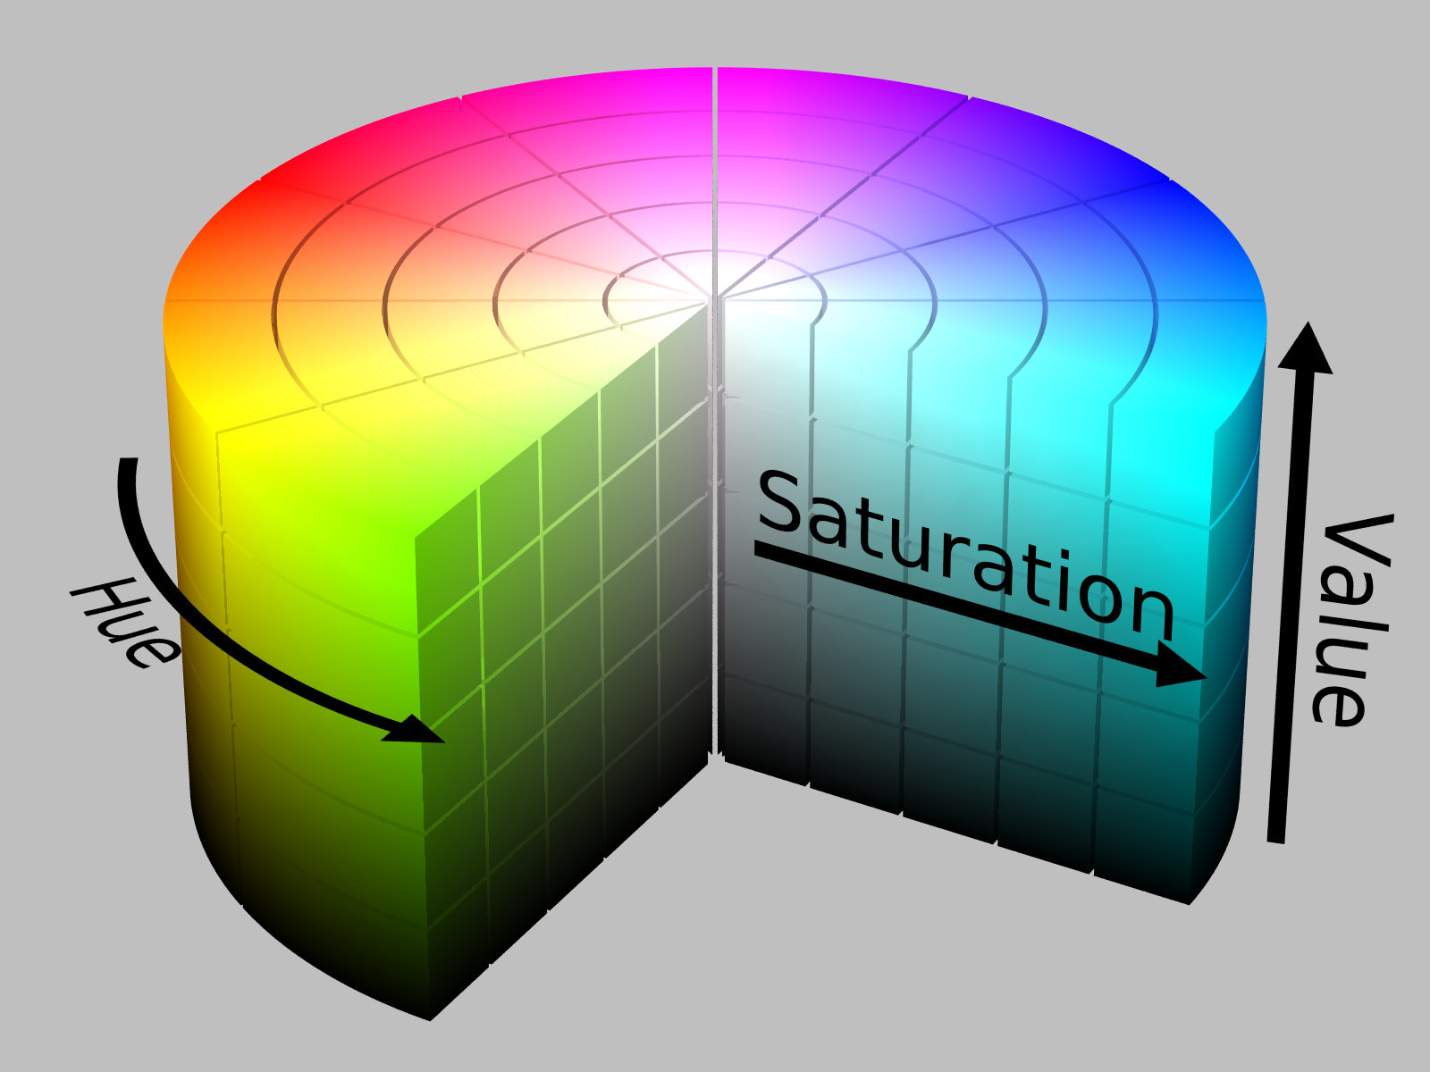


Preprocessing Module(Cont)
Skin Detection
HSV color model
Convex Hull
Boundary Tracing

Slide 7
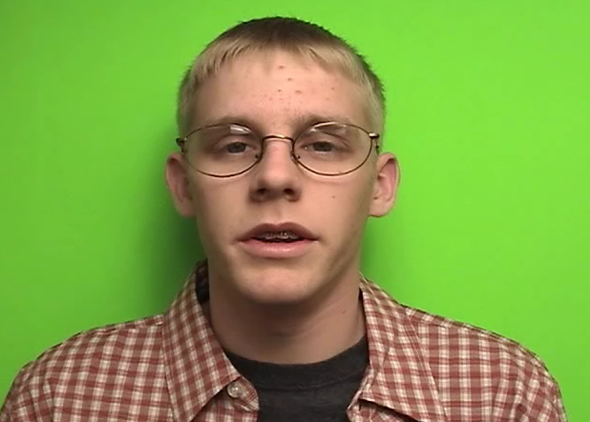
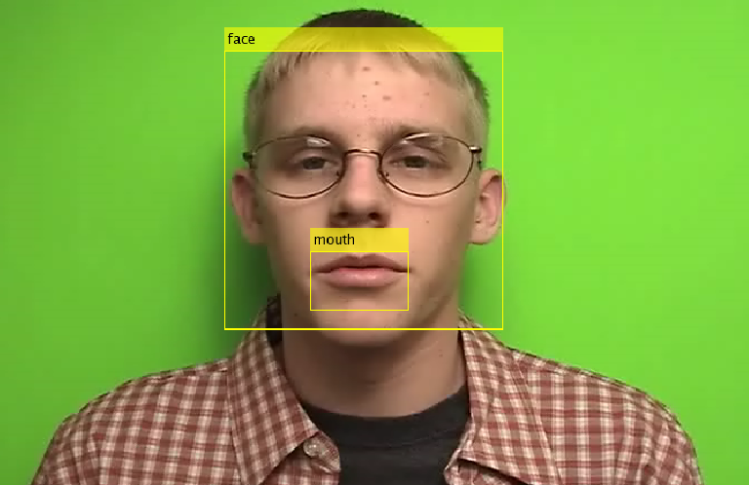
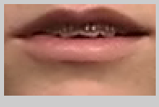

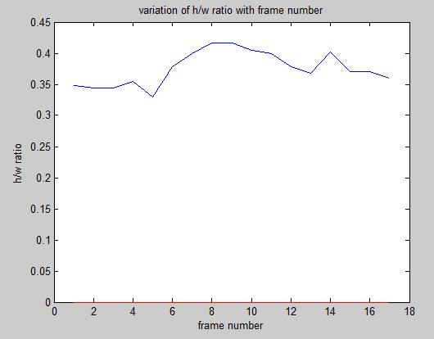

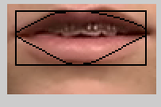
Preprocessing Module(Cont)

Slide 8
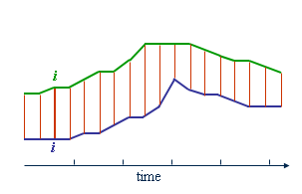
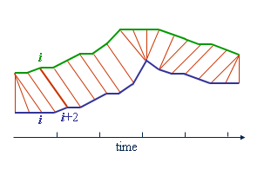
Classification Module
Dynamic Time Warping
In time series analysis, dynamic time warping (DTW) is an algorithm for measuring similarity between two temporal sequences which may vary in time or speed.
The sequences are warped non-linearly in the time dimension to determine a measure of their similarity independent of certain non-linear variations in the time dimension.

Slide 9
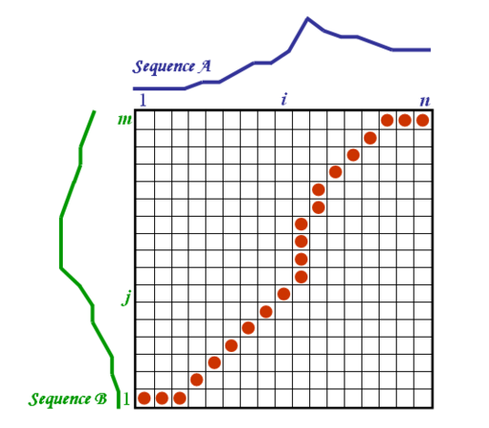
Classification Module(Cont)

Slide 10
Classification Module(Cont)
 | Feature data of different digits spoken by sample 1 given to the classifier
Feature Data of digits in the database |  | 0 | 1 | 2 | 3 | 4 | 5 | 6 | 7 | 8 | 9
 | 0 | 0.4944 | 0.6003 | 0.7661 | 0.6041 | 1.7991 | 1.3714 | 0.9826 | 0.5841 | 0.8691 | 0.5936
 | 1 | 0.7674 | 0.2633 | 1.0959 | 1.0079 | 2.4785 | 1.6597 | 1.7232 | 0.9708 | 0.3197 | 1.1615
 | 2 | 0.4570 | 0.4361 | 0.3424 | 0.4885 | 1.3280 | 1.3118 | 0.6706 | 0.5229 | 0.7740 | 0.4973
 | 3 | 0.4121 | 0.7082 | 0.2753 | 0.3431 | 1.0409 | 1.1167 | 0.6630 | 0.4094 | 1.0300 | 0.3834
 | 4 | 1.8265 | 2.0697 | 0.7998 | 0.8961 | 0.4216 | 0.9660 | 0.7543 | 1.4994 | 2.3211 | 0.9450
 | 5 | 0.8504 | 0.7403 | 0.6551 | 0.4684 | 1.2105 | 0.6512 | 0.7392 | 0.6165 | 0.6542 | 0.5262
 | 6 | 1.1828 | 1.1984 | 0.4755 | 0.5896 | 0.8363 | 0.9893 | 0.3390 | 0.8335 | 1.5266 | 0.5146
 | 7 | 0.7429 | 0.5641 | 1.2778 | 1.0400 | 2.5040 | 1.7023 | 1.9431 | 0.7877 | 0.7962 | 1.4393
 | 8 | 0.7822 | 0.4382 | 0.7021 | 0.7420 | 1.7638 | 1.6670 | 0.9433 | 0.8191 | 0.3110 | 0.6591
 | 9 | 0.7579 | 1.0788 | 0.2447 | 0.4900 | 0.8579 | 1.0578 | 0.6118 | 0.5688 | 1.3591 | 0.2733

Slide 11
Assumptions and Limitations
In an audio visual speech recognition system, both the voice signals, and the sequence of images are used to recognize the speech. Here we focus on establishing a visual-speech recognition system (VSR) or a lip reading system based on the lip image sequence.
This system cannot be a standalone system, because it needs the acoustic system part.
This system works only on the frontal view of the speakers face.
The speaker has to record his vocabularies several times before using the system, as the system is a user-dependent system.

Slide 12
Conclusion and Future work
we implemented a Lip reading system for finding the digit spoken by the speaker between (0-9). We followed a geometric feature based approach in which parameters like height, width are calculated for every frame of the input image sequence containing the spoken digit. The variation of these features over all the frames contains the information related to the spoken digit.
The variation of these features over all the frames contains the information related to the spoken digit. The feature data is compared to that in database using dynamic time warping to find the spoken digit. A recognition rate of 56.6% was observed for our system
Some challenges to improve this system are
implementation of a real time system where the processing needs to be very fast so that there is real time recognition.
designing such that the speaker need not have a stable and vertical face would ease the user.
There is also a need to design the lip reading system such that it works in combination with its audio counterpart because some words look alike even though they sound differently. Hence, using a speech recognizer along with Lip reading system can filter most of the errors that occur.

Slide 13
THANK YOU

