Slide 1
Car Wreck Fatalities in the United States 2019-2020
Katie Chen & Heather Lemon
COMP 4441
2022/05/05

Slide 2
React in chat if you think the rate when up or down
Do you think the fatality rate when up from 2019-2020 or did it go down?

Slide 3
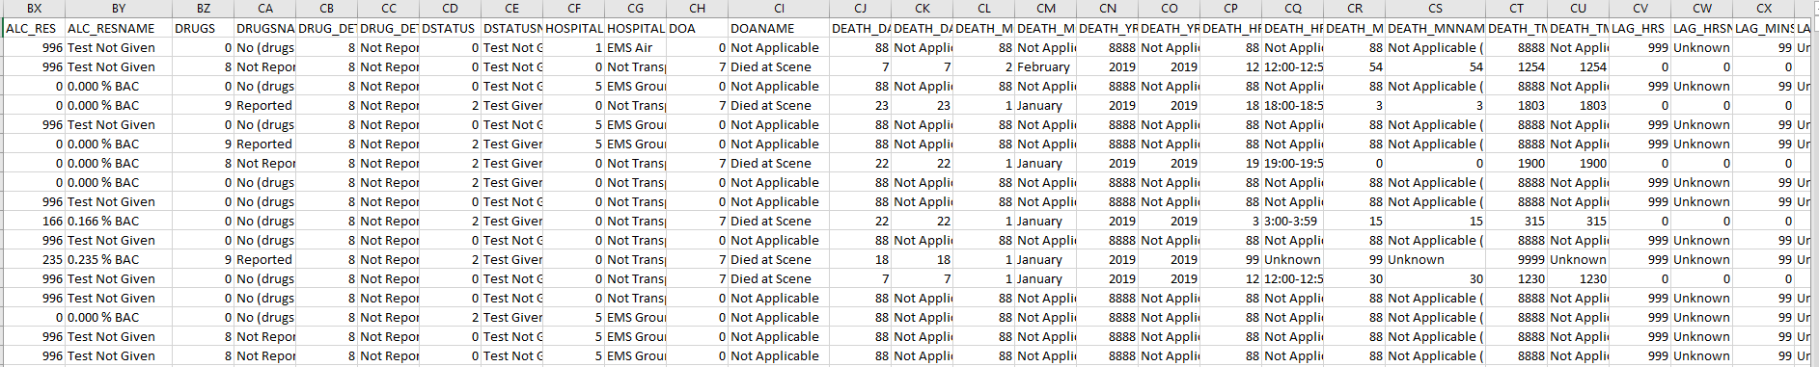
Looking at the data from FARS

Slide 4
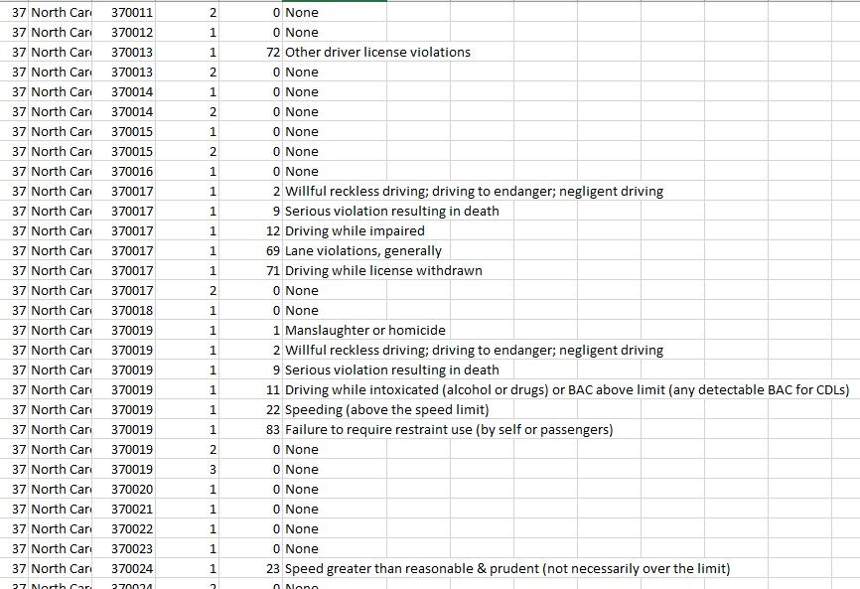
Looking at the data from FARS

