Slide 1
Road Incidents, Car Wreck Fatalities & Covid in the United States 2019-2020
Katie Chen & Heather Lemon
COMP 4441
2022/05/18

Slide 2
React in chat if you think the rate when up or down
Do you think the car wreck fatality rate went up or down from 2019-2020?

Slide 3
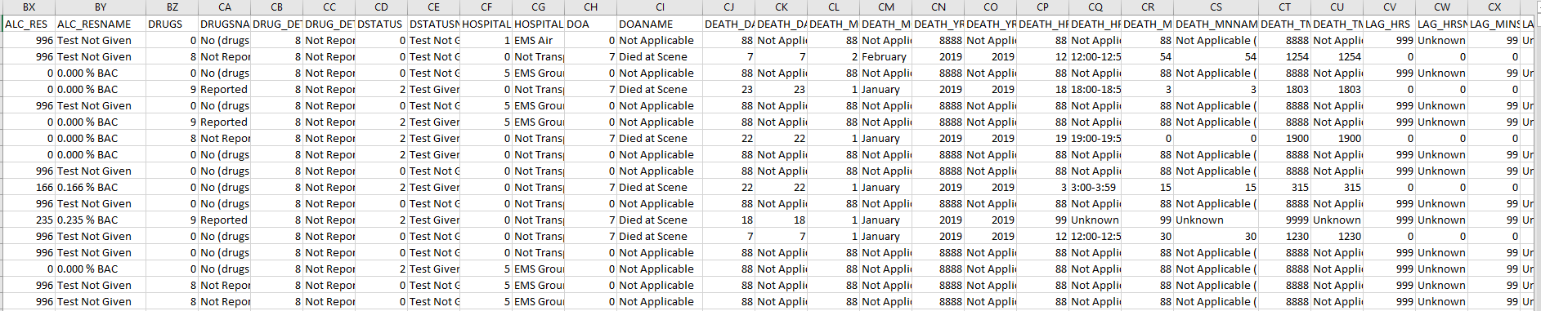
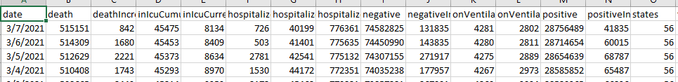
Looking at the data from FARS
Notes:
The dataset from FARS is incredibly detailed, 32 different CSVs to pull data from, and it gave details like the weather, the VIN number, make, model, etc.

Slide 4
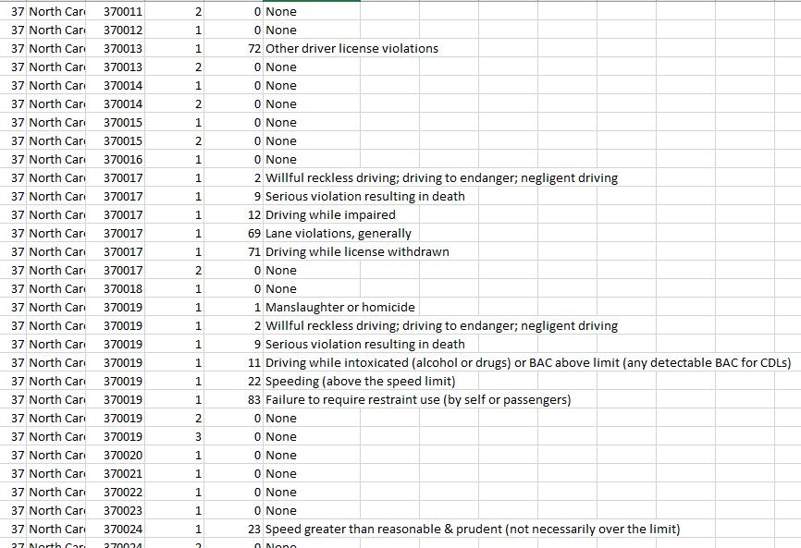
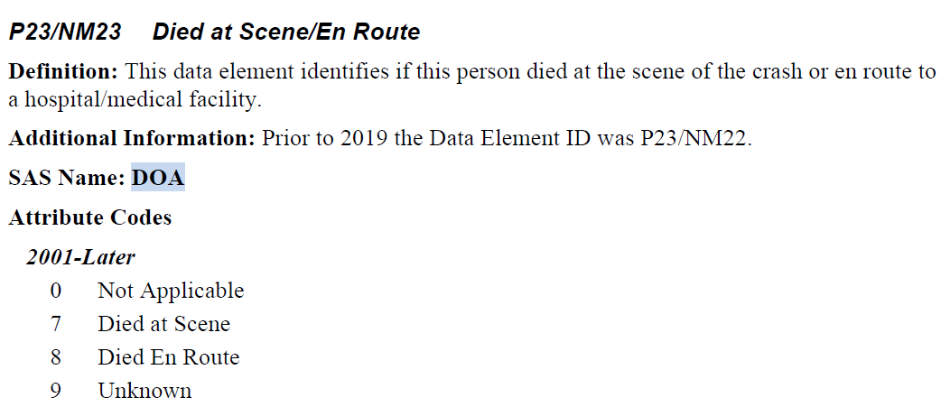
Looking at the data from FARS
Notes:
The data for FARS is both acronymed and codified so that a 7 means died at scene and you need to be able to translate the coded number into a better context

Slide 5
Dataset
FARS – 32 csv’s out of those we used 2 per year
COVID – 1 csv
The datasets were incredibly clean
The only caveat is translating the acronyms and codifying/translating the numbers to a human readable context
Extra Link to Covid dataset:
https://covidtracking.com/data/national

Slide 6
Swap to R code
Notes:
Explain results from R code
The number of over all car wrecks in general went down, but the
fatality rate went up from 2019-2020.
The results don’t show the pedestrian deaths cause by car wreck facilities

Slide 7
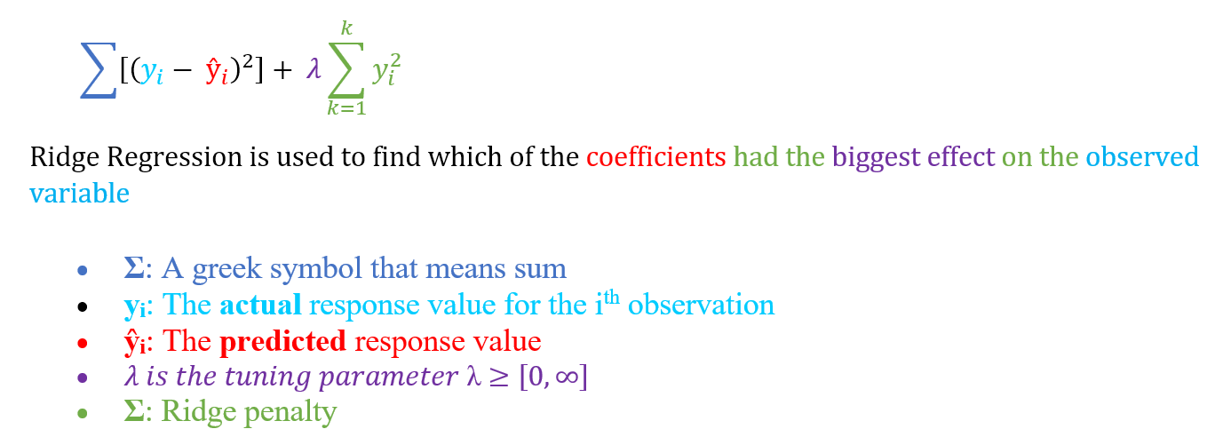
Ridge Regression Method
Notes:
Assumptions:
Linearity
Constant Variance
Independence

Slide 8
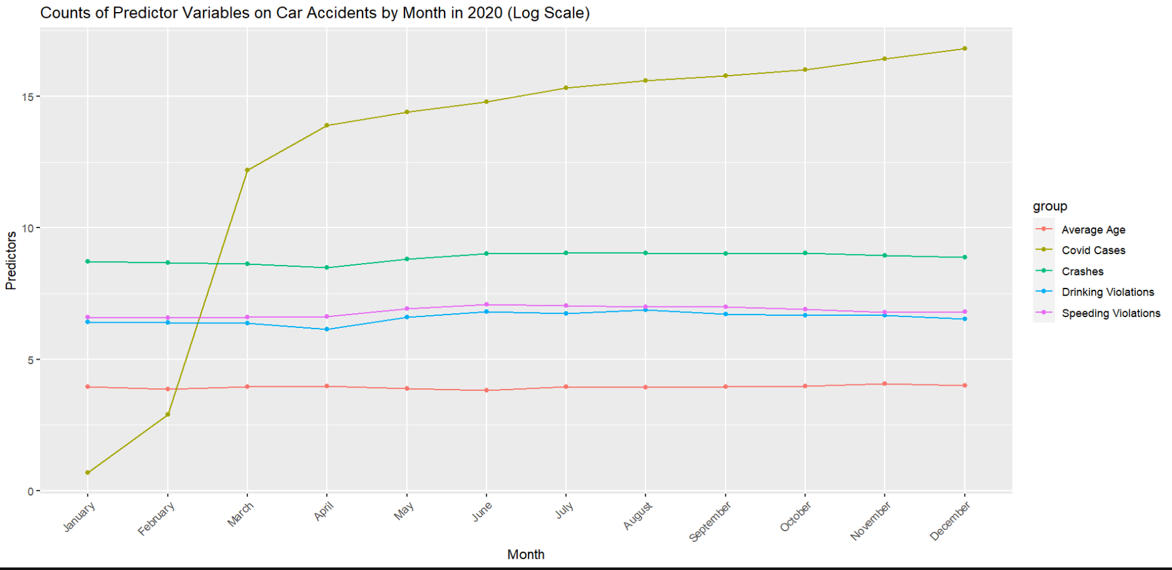
Was the covid-19 pandemic a factor in determining road incidents in 2020?

Slide 9
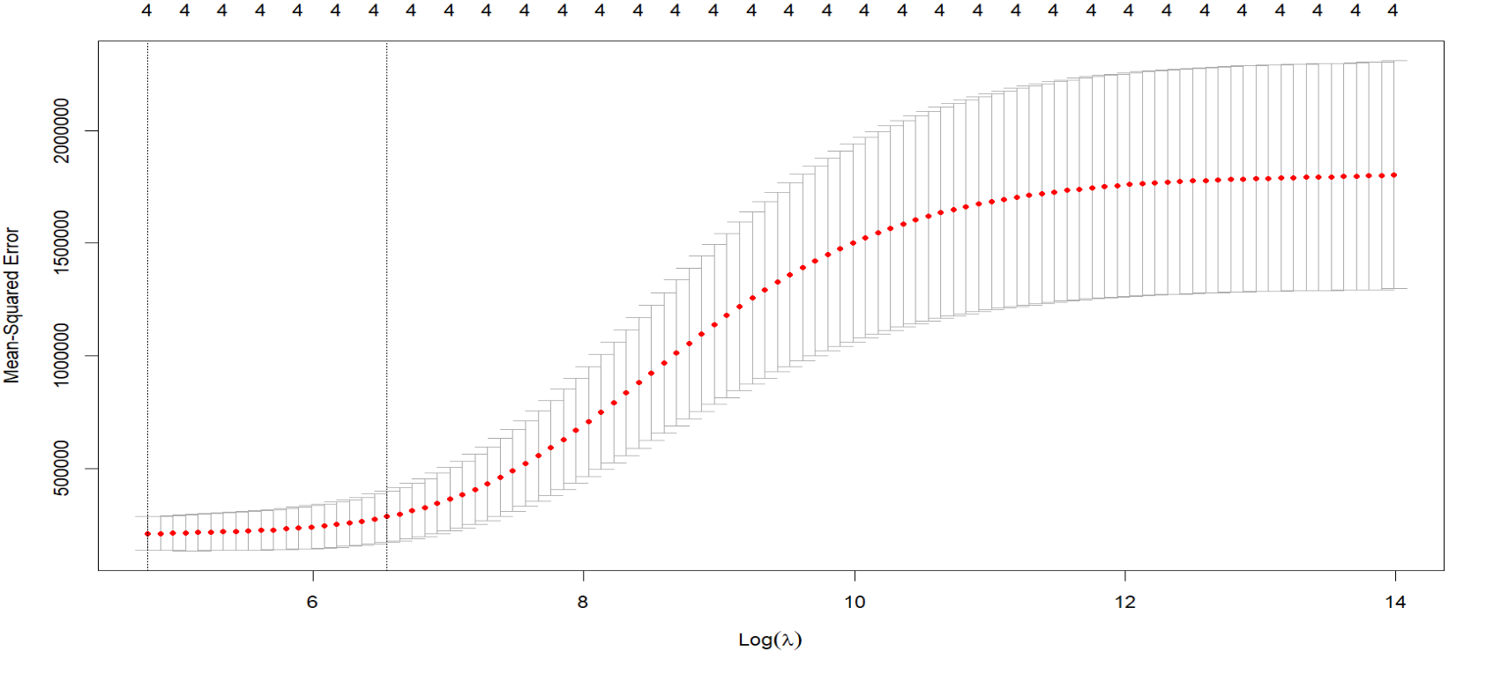
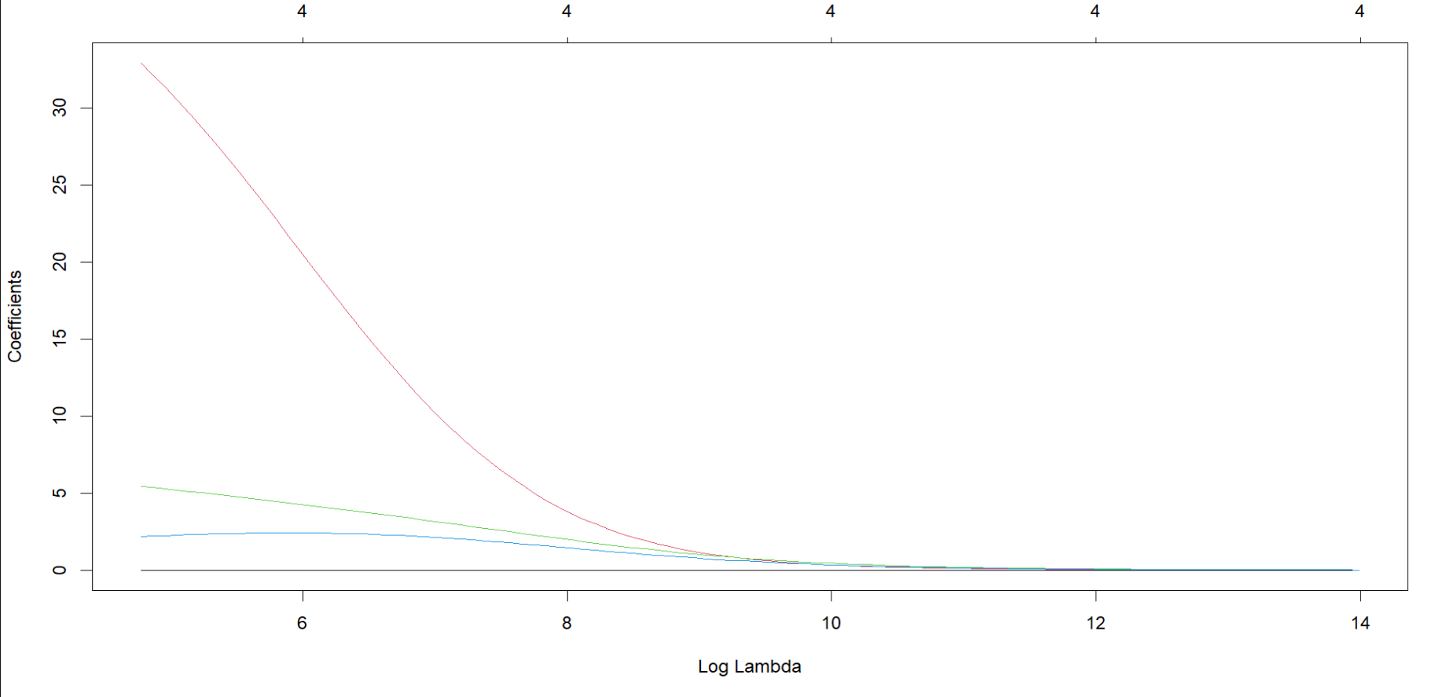
Fitting the Model

Slide 10
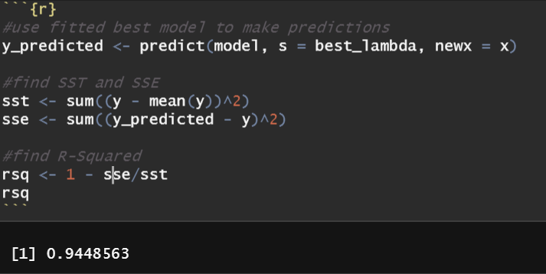
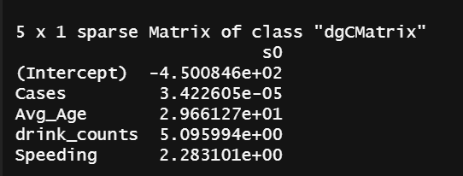
Results
Based on the following coefficients, we conclude that the Covid-19 pandemic had little to no effect on the number of road incidents reported by FARS in 2020.
Using our best fit model, we calculate the value of R^2. The image on the right shows that our model explains about 94% of the variation in our data set.

Slide 11
Wrap up & Conclusion Statement
Our accuracy could be improved if we looked at the other 30 different csv included in the FARS dataset.
Notes:
I would be hesitant to say our analysis is correct since we didn't include the pederstian datasets at all.
We only looked at 4 datasets out of the 32 given.
I would say our analysis is inconclusive and more data points need to be looked at to give a better
accurracy.

Slide 12
Extra Links to Analysis by NHTSA
the creators of the FARS
*shows fatilities differences from NHTSA*
https://crashstats.nhtsa.dot.gov/Api/Public/ViewPublication/813115
https://crashstats.nhtsa.dot.gov/Api/Public/Publication/813120
#dataset download
https://www.nhtsa.gov/file-downloads?p=nhtsa/downloads/FARS/

Slide 13
GitHub Link
Public repo hosted on GitHub
https://github.com/hypothetical-lemon/COMP4441

Slide 14
Comments & Questions ?
Thank You!
Katie Chen & Heather Lemon

