Slide 1
Machine Learning an Analysis of Steam video games
COMP 4448 Tools 2
Heather Lemon

Slide 2
Research Question
Indie game developer Liquid Courage Studios wants to publish a new game called Ace Vendetta and wants to know how much to sell their game for on Steam?
Purpose of Analysis
Adding a structural decision based on data analysis of similar cases helps game developers improve sales strategies.

Slide 3
Description of Dataset & Source
The dataset comes from Kaggle https://www.kaggle.com/datasets/deepann/80000-steam-games-dataset
The dataset contains 81048 rows and 12 columns. With a mixture of numerical and categorical data including price, name, tagged categories, genre, date of game published, and number of reviews.
One very important aspect to keep in mind is the time and price that this data was collected which was two years ago. The metrics and analysis we will perform are from data collected two years ago and will be different that what maybe be currently presented in Steam today. Games could have been removed, sales could have been happening that are no longer available, or the game could be free now.

Slide 4
What is Steam?
https://store.steampowered.com/about/
Steam is a widely popular video game distribution platform. Currently there are over 50,000 different games available for purchase. It was launched as a software client in September 2003 as a way for Valve to provide automatic updates for their games and expanded to distributing and offering third-party game publishers' titles in late 2005. Steam unit sales data is not publicly available, but we can use the number of reviews as an estimated guess of how many units were sold.

Slide 5
Boxleiter Method
Steam sales data is not publicly available, but we can use the number of reviews as a good estimate for units sold this is called the Boxleiter or New Boxleiter number method, estimating the number of Steam game unit sold based on the number of reviews they got.
https://vginsights.com/insights/article/how-to-estimate-steam-video-game-sales
https://newsletter.gamediscover.co/p/how-that-game-sold-on-steam-using

Slide 6
Description of Input/Output variables
Input
Datetime stamp, developer, publisher, description of game, popular tags, game name, id of game, price of game, number of recent user reviews, total number of all reviews, predicted number of units sold per video game based on the scaling factor.
Output
The predicted price of a video game on steam
a predicted single discrete value of how much money in USD should the indie game developer sell their video game for on Steam.

Slide 7
Data Preprocessing
Extract uuid from url in link
Extract the number of reviews from both review columns
Extract the price
Clean up datetime stamp
https://store.steampowered.com/app/945360/Among_Us/?snr=1_7_7_230_150_1
Nov 16, 2018
Buy Among Us$4.99Add to Cart
Overwhelmingly Positive(151,281)- 96% of the 151,281 user reviews in the last 30 days are positive.
Overwhelmingly Positive(224,878)- 95% of the 224,878 user reviews for this game are positive.
*used regex for most of this
Notes:
Note we used both files, the json cleaned file and the original CSV file.

Slide 8
EDA/Descriptive Statistics
What is the average price of a steam game?
10.99
Average price without free to play games?
11.16

Slide 9
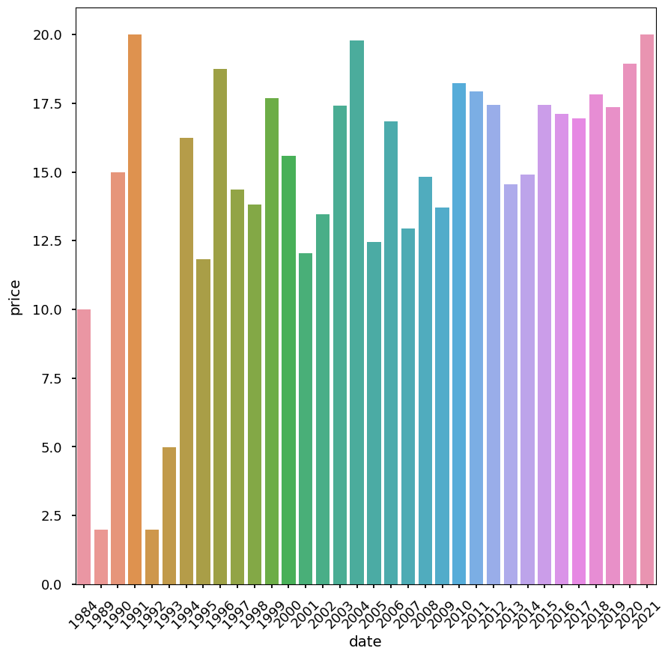
Average Yearly Price of Game

Slide 10
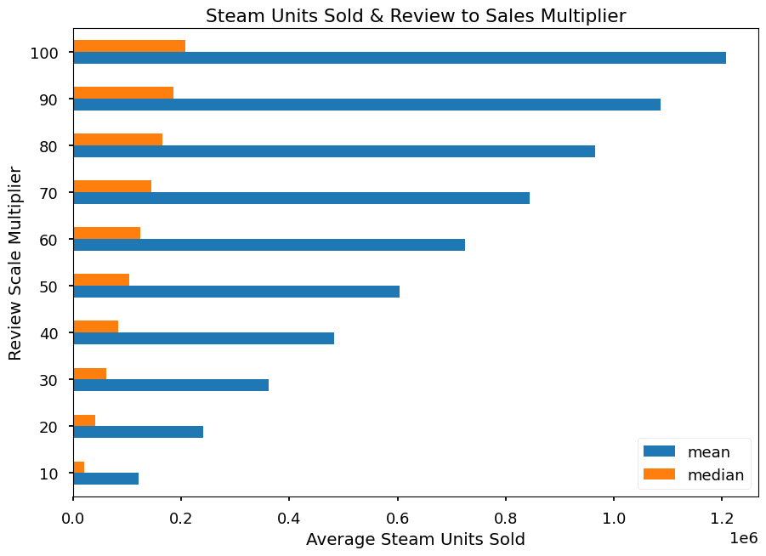
Average Units Sold vs Scaled Multiplier

Slide 11
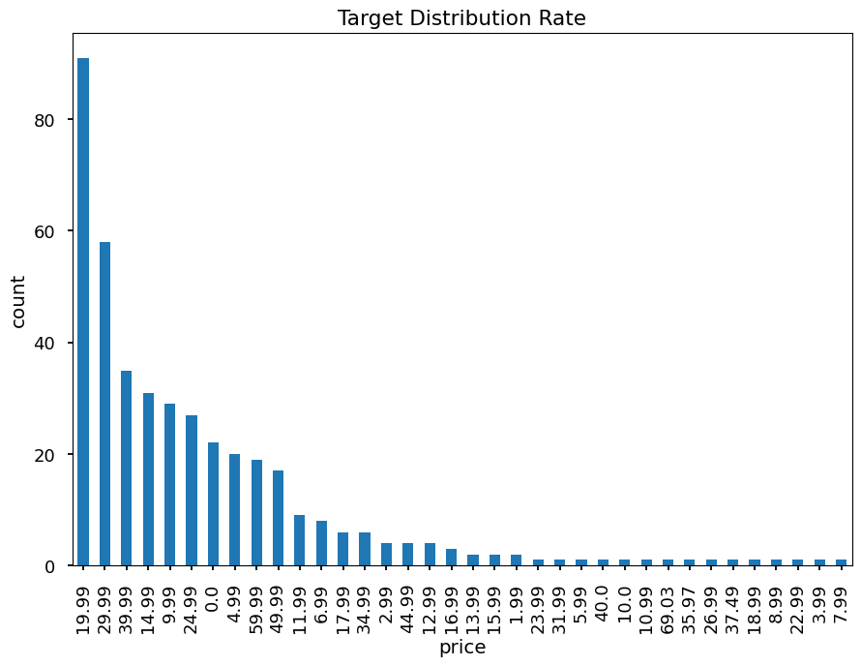
Target Distribution

Slide 12
Data Splitting
We used a split of 80/20 with 80% in training and 20% in test.
(331, 3)
(83, 3)
(331,)
(83,)
After all of the data cleaning we ended with 414 observations and 3 columns.

Slide 13
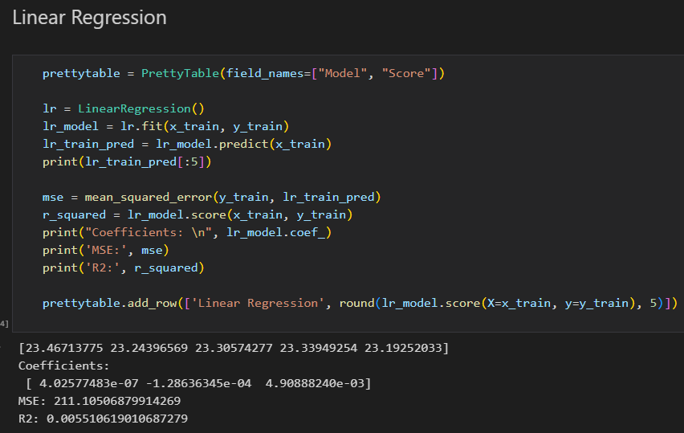
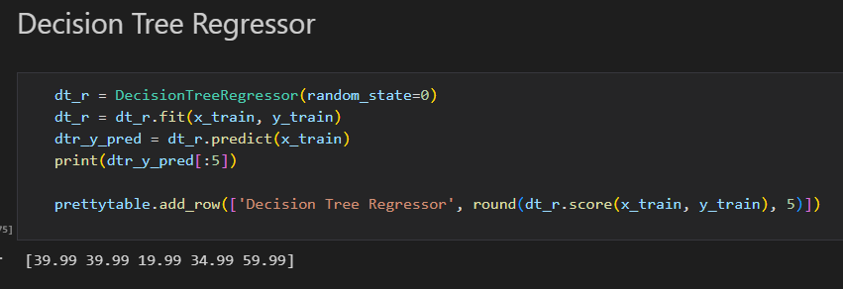
Model Building

Slide 14
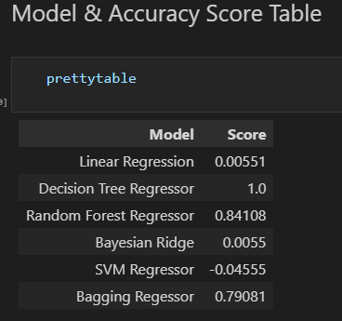
Model Selection
The decision tree regressor was overfitting but also scored the highest, followed by the random forest and bagging regressor.

Slide 15
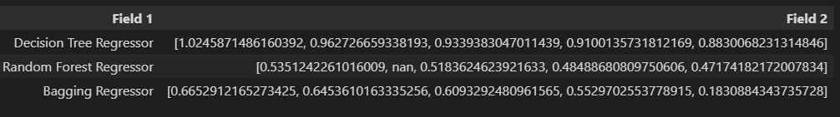
Model Evaluation
Results of cross_validation score on the top three performing models

Slide 16
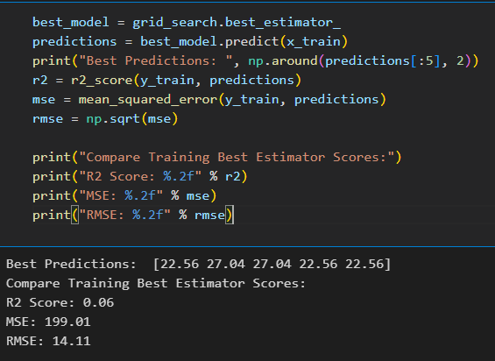
Training Validation Scores

Slide 17
Final Predictions
final_predictions = best_model.predict(x_test)
np.around(final_predictions[:5], 2)
array([22.56, 22.56, 22.56, 22.56, 22.56])
# round down
print("Final Price Prediction: ", math.floor(np.mean(final_predictions)))
Final Price Prediction: 22
Final Scores:
R2 Score: -0.08
MSE: 267.41
RMSE: 16.35

Slide 18
Conclusion
Indie game developer Liquid Courage Studios should price their game for $22.00 on Steam.

Slide 19
Future Improvements
It would have been nice to incorporate the categorical text data into the model building.
Future questions to ask
What categorical games are popular right now?
Which titles had the most estimated game sales?

