Slide 1
Heather Lemon
COMP 4449 – Midterm
Spotify

Slide 2

Understand which features about a song make it popular?

Slide 3
Data Description & Ingest
We are given 2 files. The first file is a features_df csv file that contains details about popular songs (speechiness, tempo, song name etc)
The second file contains a list of 2+ million songs collected over the year 2017. It also contains Position, number of streams, date, and region.
These files contain both numerical and categorical data.
For this project we only use region: USA and Year: 2017

Slide 4
Feature Engineering
Convert milliseconds into minutes/seconds
Convert key signature into original symbol (0,1,2 into C#, Ab)
Data Type checking
Null Checks
Drop columns that we don’t need such as URL

Slide 5
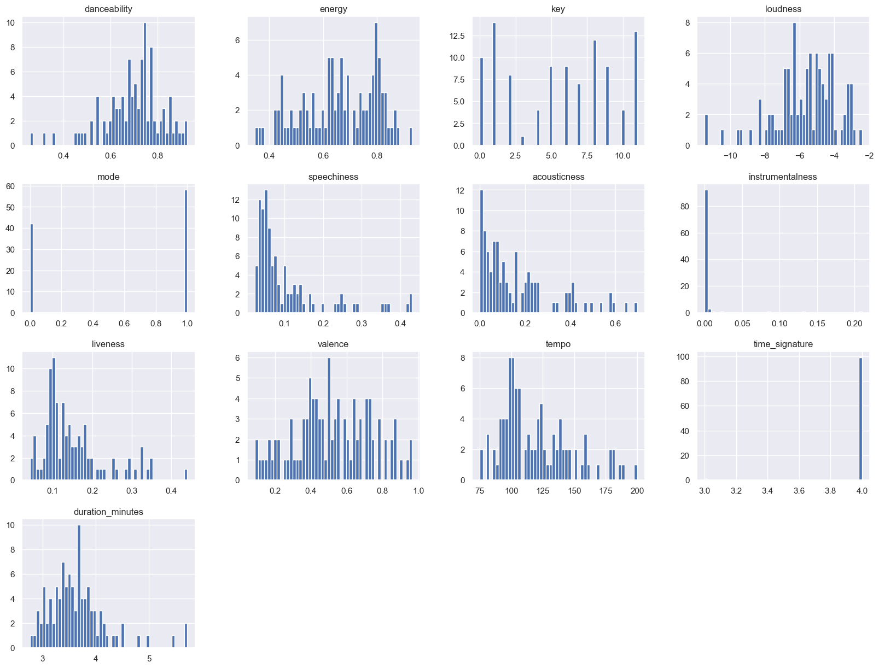
Exploratory Data Analysis
Feature Histogram Distribution Graphs

Slide 6
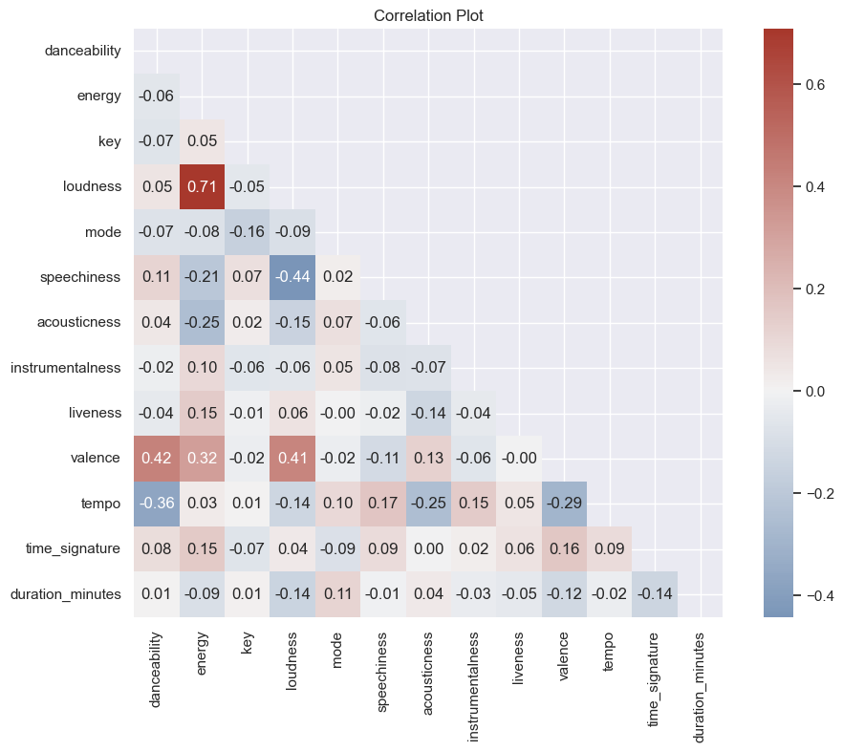
Correlation Plot

Slide 7
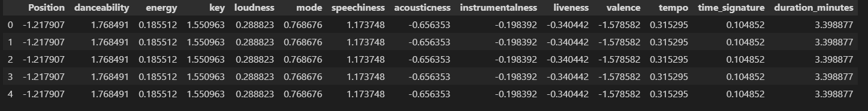
Data Scaling & Splitting
train_test_split(scaled_data, y, test_size=.20, random_state=0)
Break out time percentages for data cleaning and EDA was 50% and the other 50% was model building, evaluation, and results/conclusions.

Slide 8
Model Selection – Regression Techniques
* Linear Regression
* Decision Tree Regressor
* Random Forest Regressor
* SVM-R
* Bagging Regressor
* Ridge Regressor
* OLS Summary Report

Slide 9
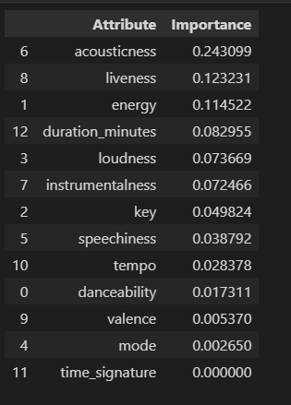
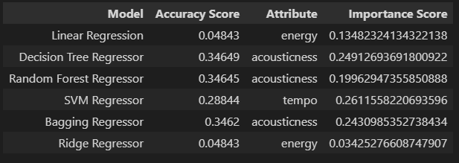
Model Selection
For every model listed, a dataframe of feature importance, bar graph, table entry is shown

Slide 10
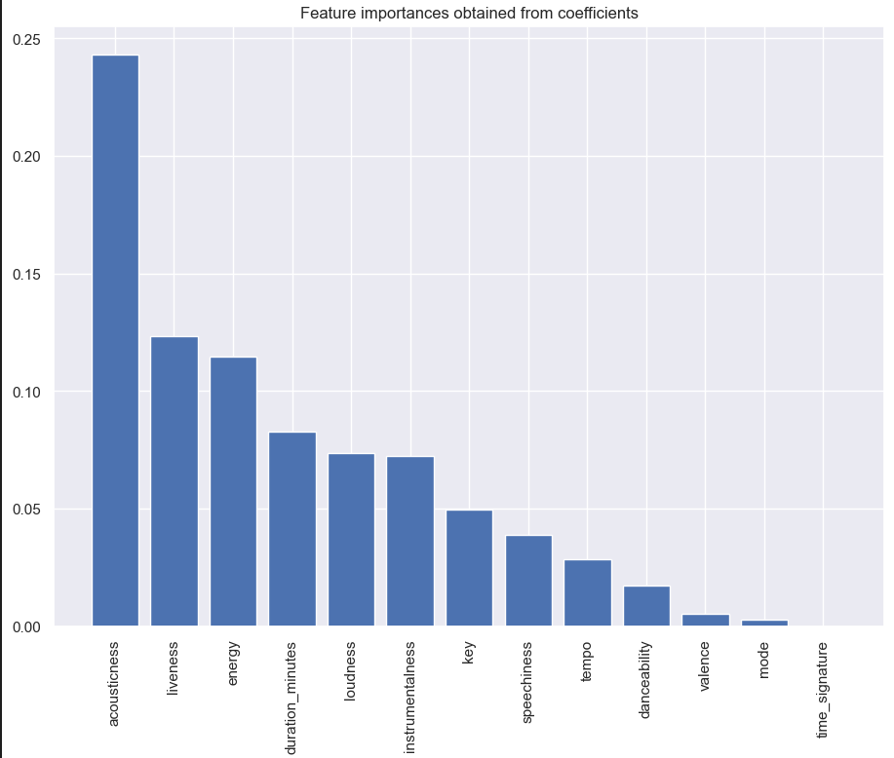
Model Selection Continued

Slide 11
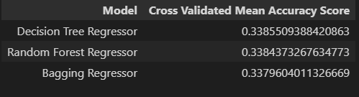
Model Evaluation
Cross Validated Mean Accuracy Score
Select the top three performing models via accuracy and
Run a cross validated mean accuracy score. The result is the same for all three models.

Slide 12
HyperParameter Tuning
I selected the top two models, Decision Tree Regressor and Random Forest Regressor model, ran GridSearchCV and found no performance gains when running the training set data with optimal parameter settings.

Slide 13
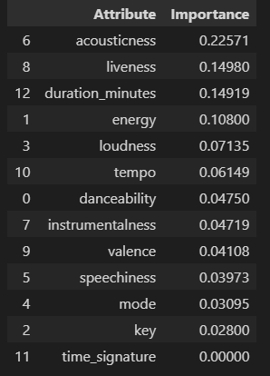
Final Prediction of Position Target
With running the test dataset. Acousticness was the top predictor in determining a songs popularity which also follows the outputs we got from the training data.

Slide 14
Conclusion
In conclusion with the results from the modeling we don’t have strong evidence to suggest that the features listed from a song play an important factor when a song is chosen for its popularity, we are no better than guessing and it’s mostly likely due to underfitting where we cannot capture the relationship properly between the inputs and outputs accurately. If we were to include the popularity field from Spotify as our target, the results would have been better. It was interesting to see what models predicted its own feature importance.

Slide 15
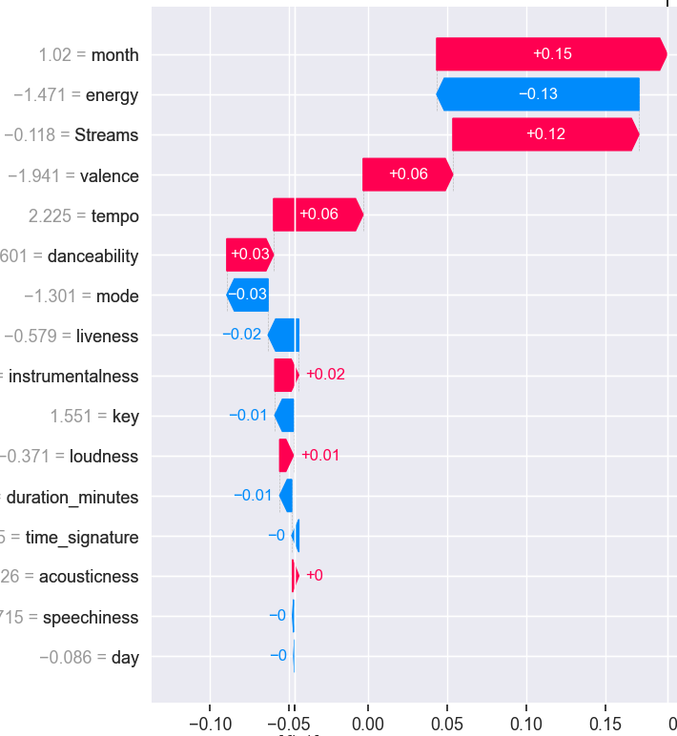
Explainable AI with shap package

Slide 16
Surprise! Explainable machine learning with explainerdashboard
See browser tab

Slide 17
Questions?
Thank You! 👍

