Slide 1
Heather Lemon
COMP 4449 – Midterm
Spotify

Slide 2

Understand which features about a song make it popular?

Slide 3
Data Description & Ingest
We are given 2 files. The first file is a features_df csv file that contains details about popular songs (speechiness, tempo, song name etc)
The second file contains a list of 2+ million songs collected over the year 2017. It also contains Position, number of streams, date, and region.
These files contain both numerical and categorical data.
For this project we only use region: USA and Year: 2017

Slide 4
Feature Engineering
Convert milliseconds into minutes/seconds
Convert key signature into original symbol (0,1,2 into C#, Ab)
Data Type checking
Null Checks
Drop columns that we don’t need such as URL

Slide 5
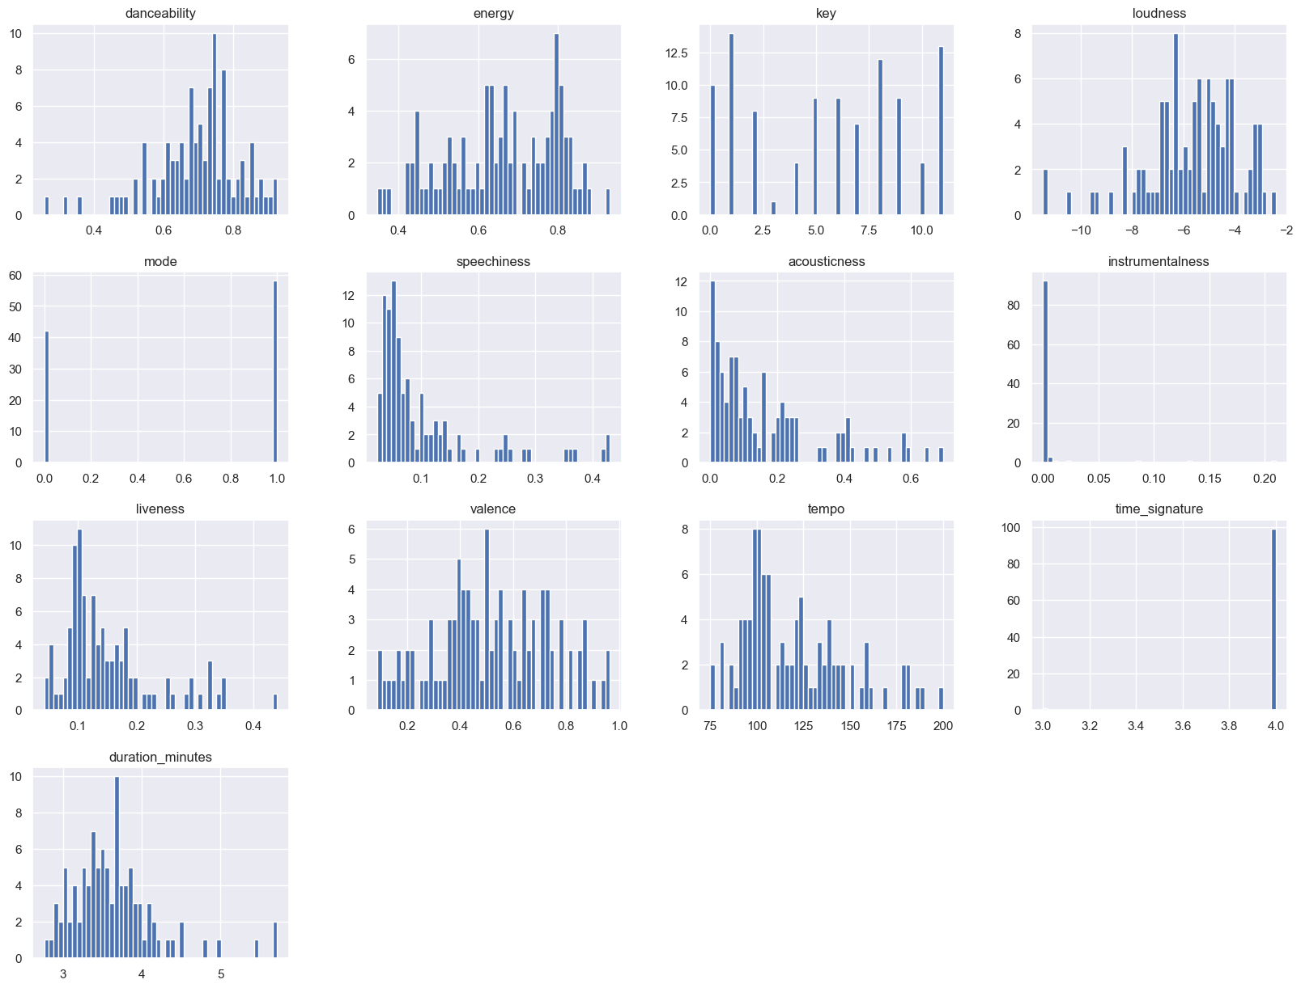
Exploratory Data Analysis
Feature Histogram Distribution Graphs

Slide 6
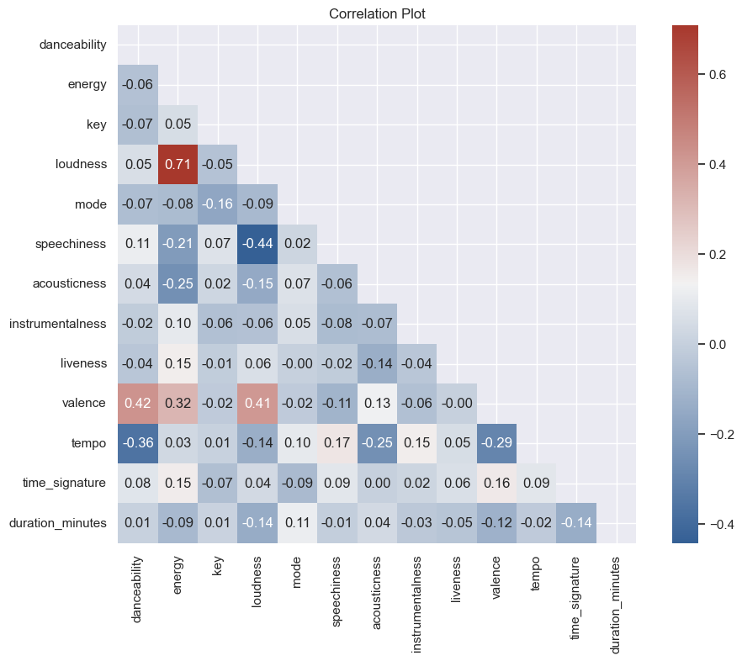
Correlation Plot

Slide 7
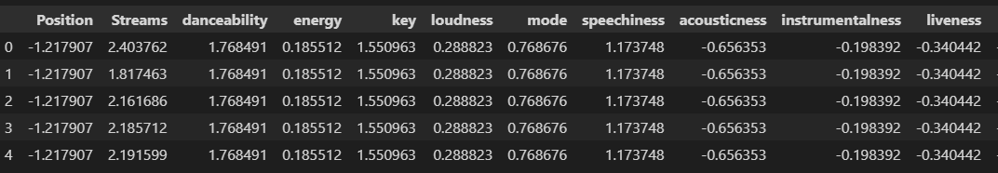
Data Scaling & Splitting
train_test_split(scaled_data, y, test_size=.20, random_state=0)

Slide 8
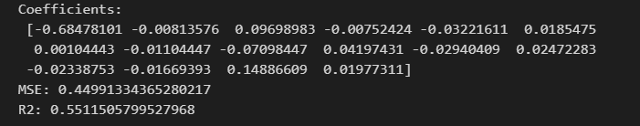
Model Selection
* Linear Regression
* Decision Tree Regressor
* Random Forest Regressor
* SVM-R
* Bagging Regressor
* Lasso Regressor
* Ridge Regressor

Slide 9
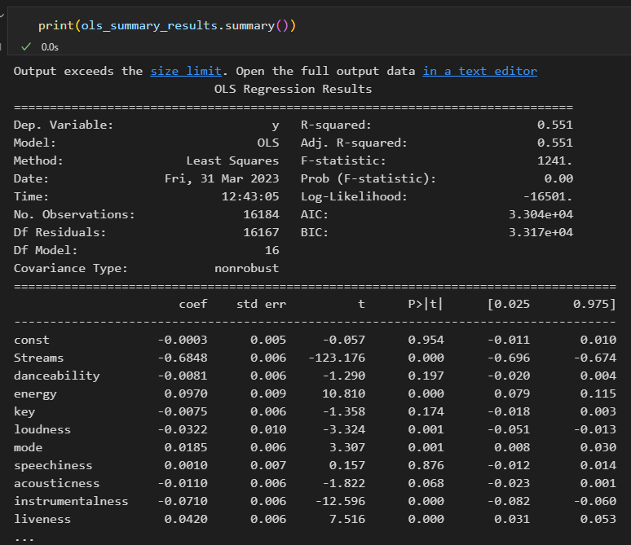
OLS Summary

Slide 10
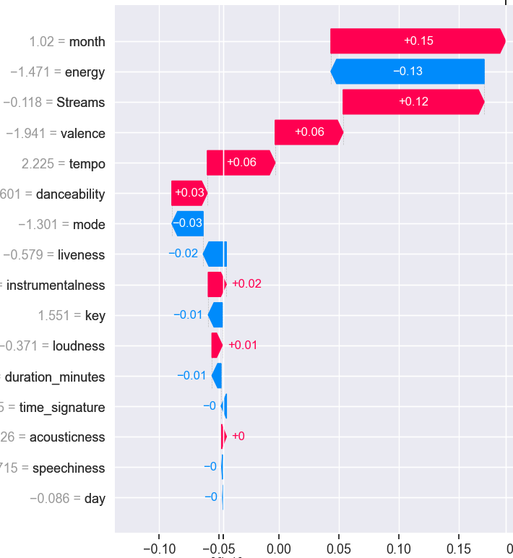
Explainable AI with shap package

Slide 11
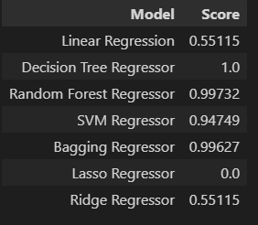
Model Selection

Slide 12
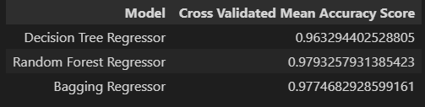
Model Evaluation
Cross Validated Mean Accuracy Score

Slide 13
Final Prediction of Position Target
Final Scores: R2 Score: 0.98 MSE: 0.02 RMSE: 0.13

Slide 14
Surprise! Explainable machine learning with explainerdashboard
See browser tab

Slide 15
Conclusion
In conclusion with the results from the model including what explainerdashboard provides the number of Streams is by far the most important factor in determining if a song is popular. The other important features include month the song came out and energy levels.

Slide 16
Questions?
Thank You! 👍

