Slide 1
Heather Lemon
COMP 4449 – Midterm
Spotify

Slide 2

Understand which features about a song make it popular?
Notes:
I chose the spotify dataset because I am currently learning how to play the cello and it would be interesting to learn more about the music space.

Slide 3
Data Description & Ingest
We are given 2 files. The first file is a features_df csv file that contains details about popular songs (speechiness, tempo, song name etc) (100 rows & 14 columns)
The second file contains a list of 2+ million songs collected over the year 2017 & 2018. It also contains Position, number of streams, date, and region. (72400 & 7 columns)
These files contain both numerical and categorical data.
For this project we only use region: USA and Year: 2017

Slide 4
Feature Engineering
Convert milliseconds into minutes/seconds
Convert key signature into original symbol (0,1,2 into C#, Ab)
Data Type checking
Null Checks
Drop columns that we don’t need such as URL

Slide 5
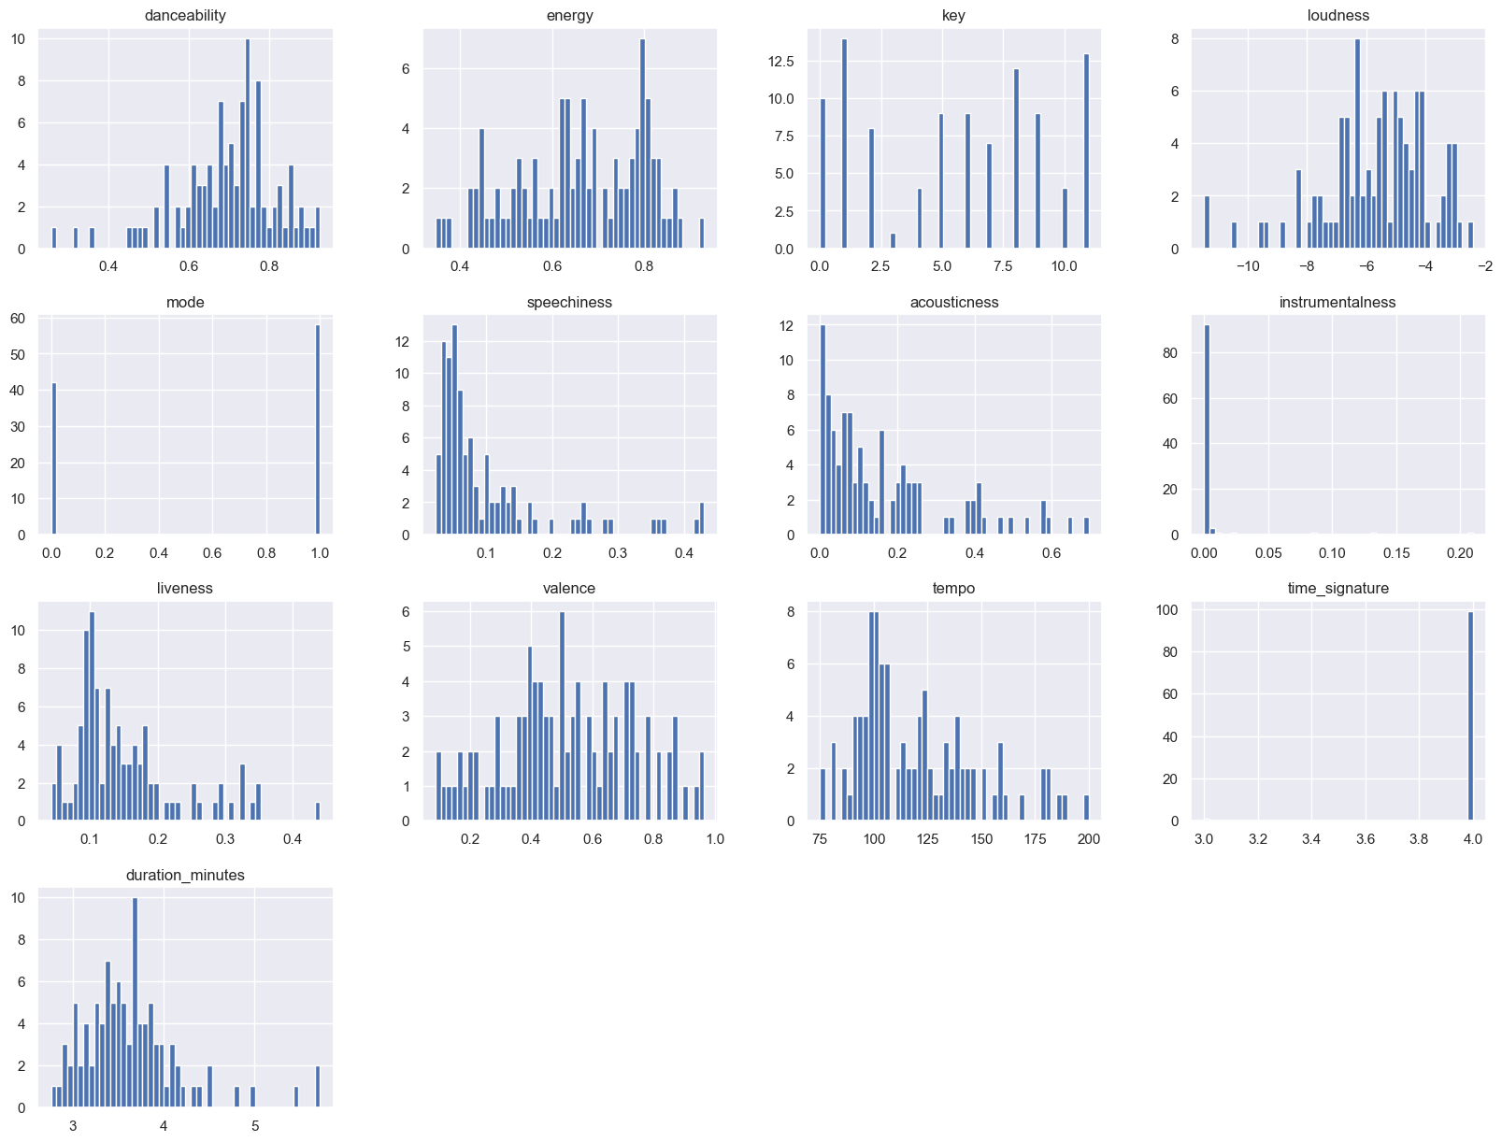
Exploratory Data Analysis
Feature Histogram Distribution Graphs
Notes:
I initially wanted to do a pair plot but with 14 features it was taking too long to generate so I did the histogram instead

Slide 6
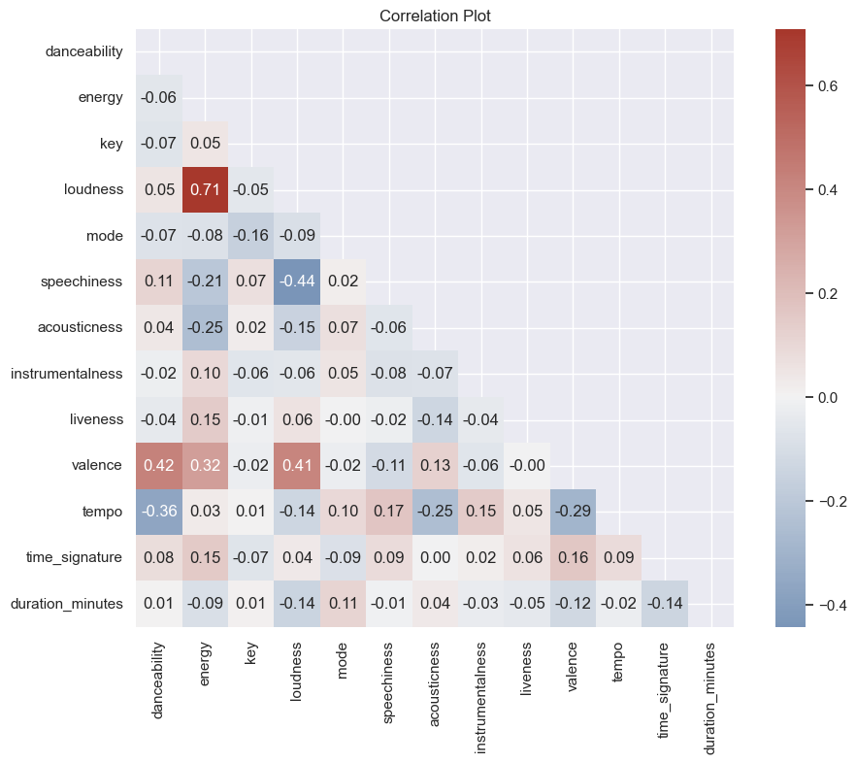
Correlation Plot
Notes:
We can see immediately that energy and loudness have a strong positive correlation.
Valance and danceability, energy and loudness all have a positive correlation.
Loudness and speechiness have a stronger negative correlation, which makes sense if a song is very loud you likely cannot hear the person singing in the background unless you're talking about death metal :) Surprising note - I expected danceability to have a stronger correlation with loudness, but there can be songs to be used to dance formally like a waltz or tango.
This was one of six EDAs graphs I did.

Slide 7
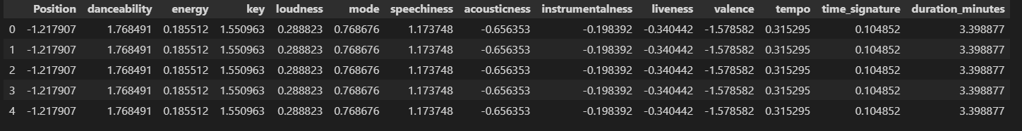
Data Scaling & Splitting
train_test_split(scaled_data, y, test_size=.20, random_state=0)
Break out time percentages for data cleaning and EDA was 50% and the other 50% was model building, evaluation, and results/conclusions.
Notes:
Generic 80/20 split with a standard scalar. We scale the data because the features all have different relational values ie. energy is not on the same scale as minutes.

Slide 8
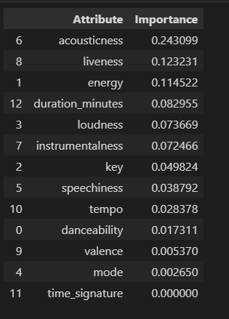
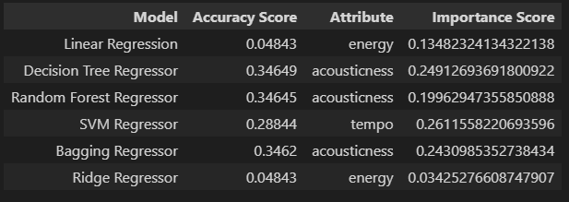
Model Selection
For every model listed, a dataframe of feature importance with a bar graph and table entry is shown
Sample model output
Final Results
Notes:
For every model there is an accuracy score, the song attribute it thought was most important and it’s importance score

Slide 9
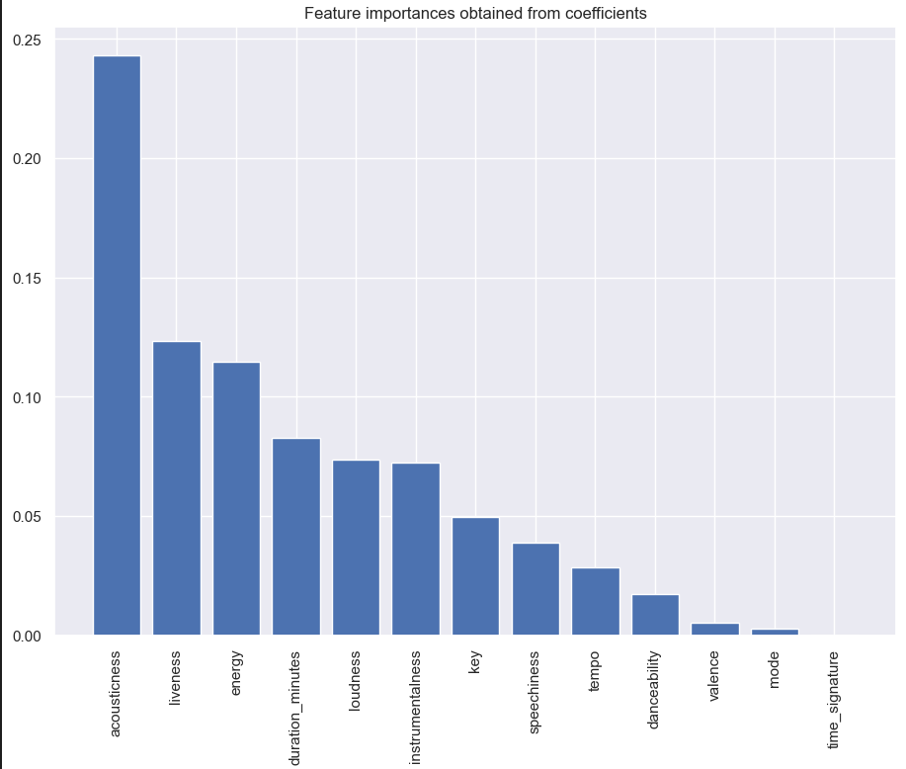
Model Selection Continued

Slide 10
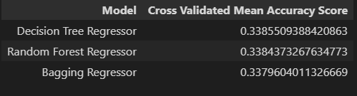
Model Evaluation
Cross Validated Mean Accuracy Score
Select the top three performing models via accuracy and
Run a cross validated mean accuracy score. The result is the same for all three models.

Slide 11
HyperParameter Tuning
I selected the top two models, Decision Tree Regressor and Random Forest Regressor model, ran GridSearchCV and found no performance gains when running the training set data with optimal parameter settings.

Slide 12
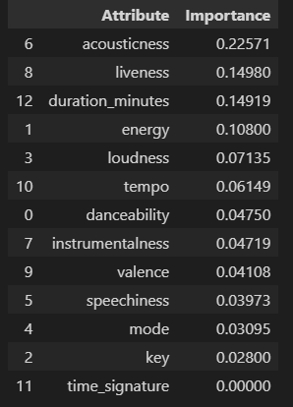
Final Prediction of Position Target
Acousticness was the top predictor in determining a songs popularity which also follows the outputs we got from the training data.

Slide 13
Conclusion
In conclusion with the results from the modeling we don’t have strong evidence to suggest that the features listed from a song play an important factor when a song is chosen for its popularity, we are no better than guessing and it’s mostly likely due to underfitting where we cannot capture the complex relationship properly between the inputs and outputs accurately. If we were to include the popularity field from Spotify as our target, the results would have been better. It was interesting to see what models predicted its own feature importance.
Notes:
There are 2 main reasons to see the results we saw.
1. I chose the target position from the list, i could have chosen streams as the target, both are strong indicators of what it means
to be a popular song. Spotify has a popuarity score feature that could be added and im sure the accuracies would improve
The accuracy scores should not be surprising - as the target definition was vauge. What does it mean to be popular, there could be a threshold that
can be added to say only the top 10 songs instead of 200.
we are no better at guessing than using the model if its less than 50%
To solve the underfitting problem, I initially used a sample size of 100 and saw 99% accuracy scores which means we are overfitting,
but the real problem is the target, its continuous and doesnt have a normal distribution which is a problem when using models like linear regression.

Slide 14
Questions?
Thank You! 👍
Notes:
Questions on the project

Slide 15
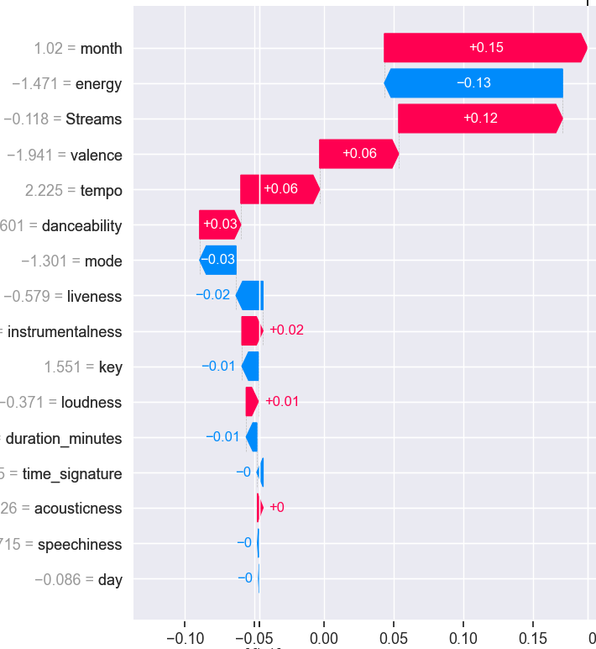
Explainable AI with shap package

Slide 16
Surprise! Explainable machine learning with explainerdashboard
See browser tab

