Slide 1
Heather Lemon Kronos Kidnapping Case
COMP 4449 Capstone
5/12/2023

Slide 2
Case Background:
In January 2014, the leaders of GASTech are celebrating their new-found fortune as a result of the IPO of their very successful company. In the midst of this celebration, several employees of GASTech go missing. An organization known as the Protectors of Kronos (POK) is suspected in the disappearance, but things may not be what they seem...

Slide 3
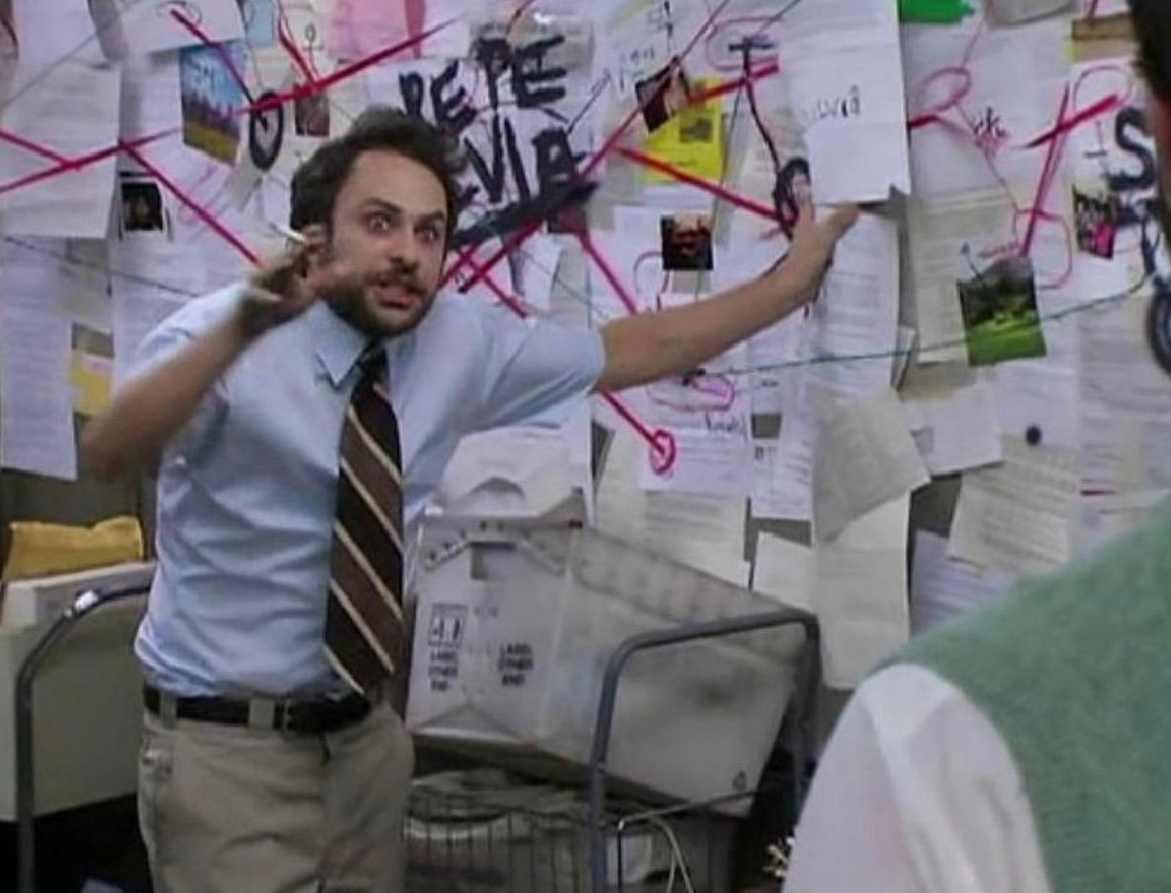
Notes:
So, we are going to play a game of Clue to figure out what exactly is happening in Kronos surrounding the POK members, GASTech and the government/citizens.

Slide 4
Questions to be answered
Provide a clear analysis of the structure of the Protectors of Kronos network, with supporting evidence.
Who are the leaders?
Who is part of the extended network?
How has the group structure and organization changed over time?
Where are the potential connections between the POK and GASTech?
2. Describe the events of January 20-21, 2014. What is the timeline of events?
3. Provide at least two possible explanations why the GASTech employees may be missing. What evidence do you have to support each of these explanations?

Slide 5
Dataset Description
A map of Kronos
A chart describing the local GAStech organization, in PDF format.
A spreadsheet of GAStech employee records
Email headers from two weeks of internal GAStech company email
Resumes and short biographies of many, but not all, of the GAStech employees, in Microsoft Word format
Historical reports and descriptions of the countries involved, in Microsoft Word format
Relevant current and historical news reports from multiple domestic and translated foreign sources, in text file format.
Notes:
We have been given a map, an org chart of GASTech, Employee records, email headers of 2 weeks prior to the kidnapping, a few employee resumes, factsheet of kronos and historical reports, and news articles.

Slide 6
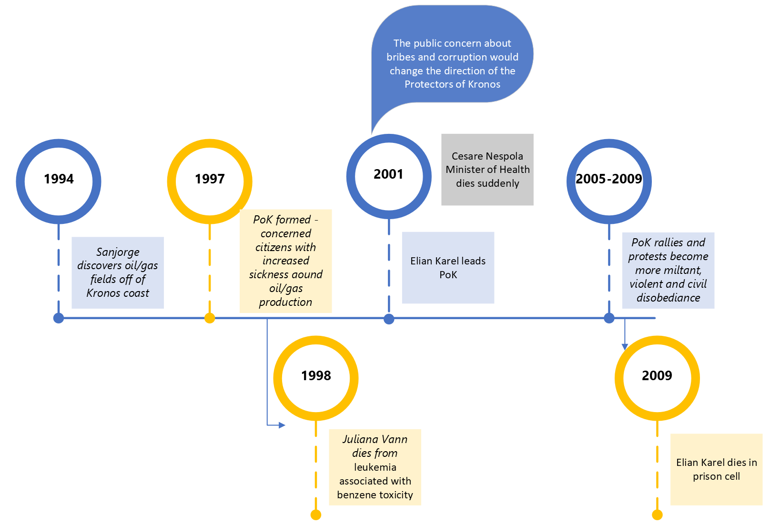
Historical Background of POK
Notes:
In 1994 the CEO discovers oil/gas fields off the Kronos coast. The POK formed in 1997 in response to the pollution of the local water supply and the resultant sickness and subsequent deaths of local residents.
1998 Juliana dies from benzene toxicity which spurs more people to join the POK.
2001, Mr. Karel leads the POK and Mr. Nespola dies suddenly. In addition to the environment and health concerns from the POK they added bribery and corruption to the agenda.
2005-2009 POK rallies are more militant, violent, and more civil disobedience and no laws have passed in more than 10 years. The POK have tried multiple times to get an audience with government officials and no one
wants to hear them, this includes the toxicity level reports from the river so they have data and statistics.
2009 June – Elian Karel dies in prison cell

Slide 7
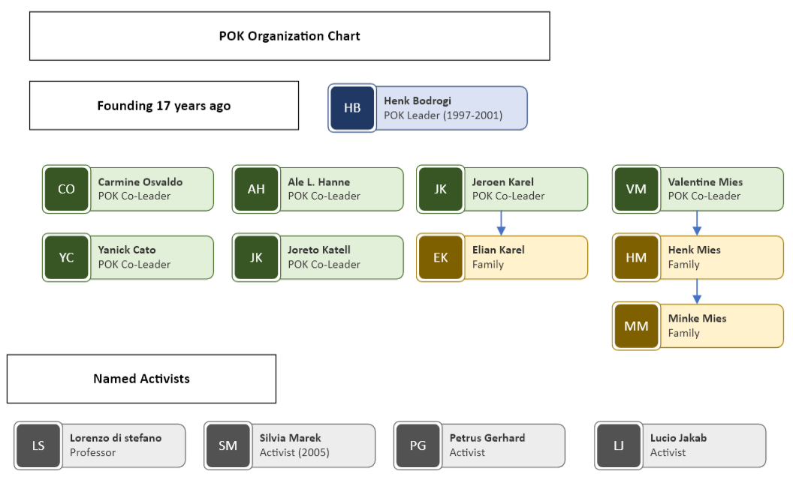
Founding Structure of POK Network
Notes:
Henk Bodrogi is the founder and leader with 6 other co-leaders and 4 named activists.

Slide 8
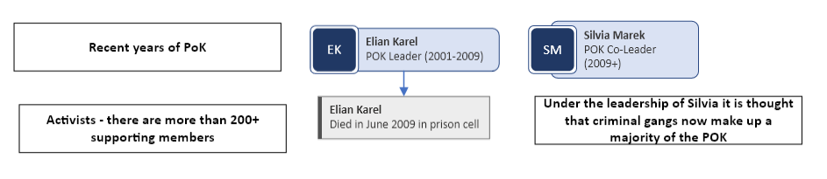
Recent Structure of POK Network
Notes:
Elian dies in a prison cell in 2009, Silvia takes over the POK for the past 5 years.

Slide 9
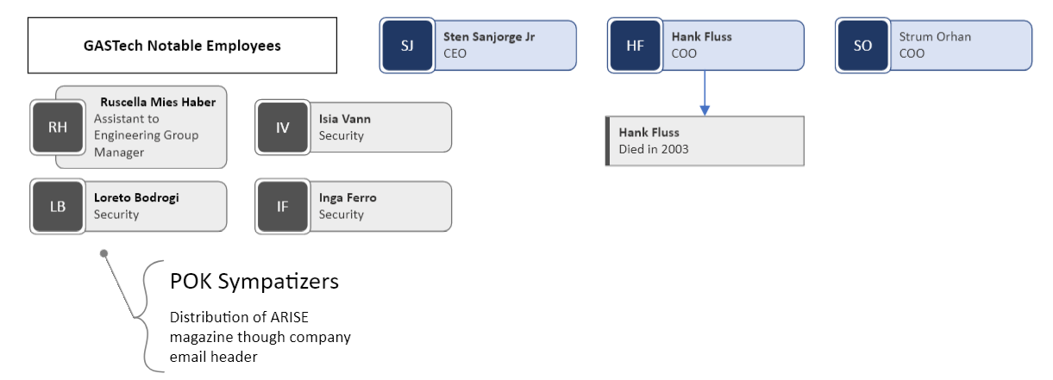
GASTech Notable Employees

Slide 10
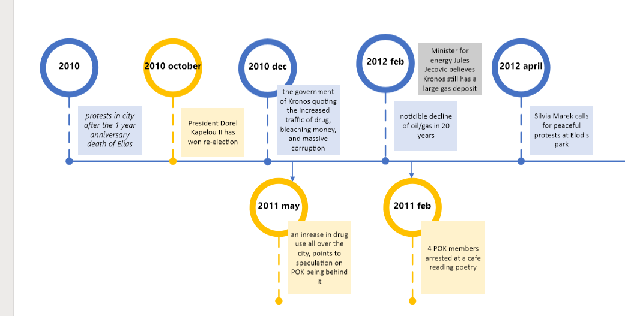
Timeline 2010-2012

Slide 11
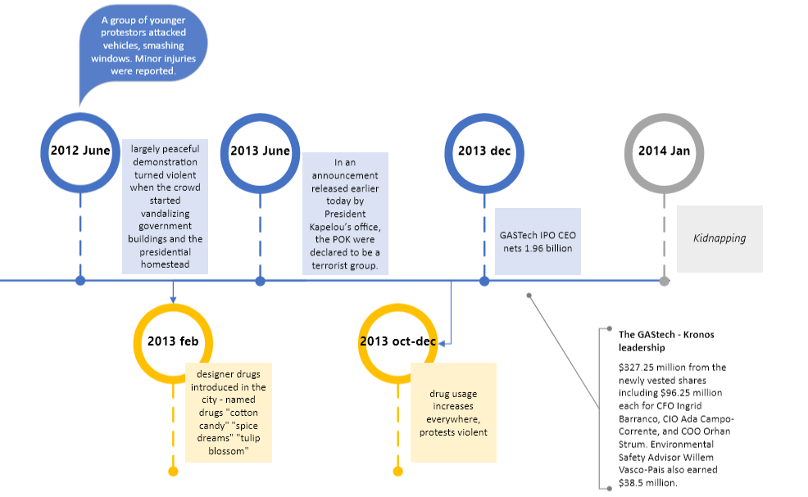
Timeline 2012-2014

Slide 12
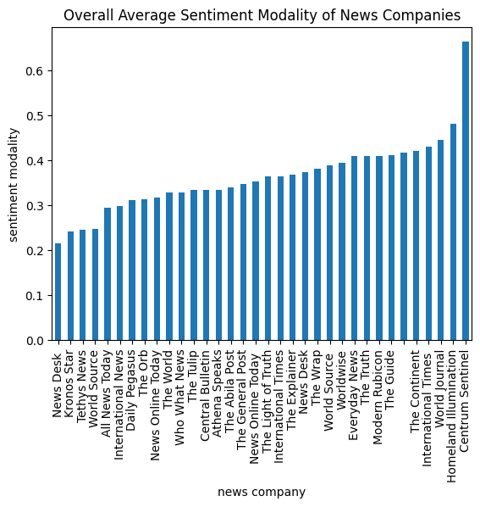
News Article Facts vs Opinions
Briefly wanted to point out the news articles of facts vs opinions. The Kronos Star has the least amount of bias when reporting their news articles. The timeline for the kidnapping will follow the Kronos Star reporting timeline.
Notes:
Sentiment analysis of news articles with the Pattern library, modality is a rating from 0 to 1 if something is more like a fact its closer to 0 and something that’s an opinion is closer to a 1.

Slide 13
Kidnapping Timeline Events January 20-21

Slide 18
Questions?
Thank You! 👏

