Slide 1

SMART INDIA HACKATHON 2026
TITLE PAGE
Problem Statement ID – SIH26188
Problem Statement Title - AI-Based Fake Identity & Document Screening System
Theme – Blockchain & Cybersecurity
PS Category - Software
Team ID -
Team Name - ZYNTRIX

Slide 2
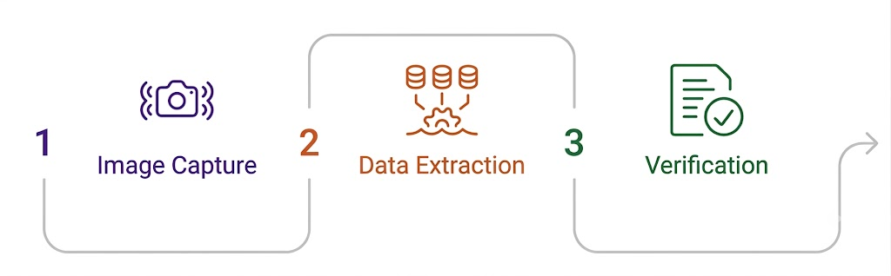

IDEA TITLE : SENTINELID
ZYNTRIX
AI-Based Fake Identity & Document Screening System
Problem:
Sophisticated document forgery poses critical security risks at land-border checkpoints that rely on manual verification.
Innovations/Uniqueness:
Explainable AI overlays:
Grad-CAM / Error Level Analysis heatmaps.
Two-factor forensic proof:
visual tampering detection layered with EXIF/metadata and noise analysis.
Offline-capable edge inference
for checkpoints with poor connectivity.
Fuzzy watchlist matching:
handles transliteration variants of names.
Hash-chained audit trail for
investigations, tying into the Blockchain & Cybersecurity theme.
Our Idea:
SentinelID is an AI-powered border document screening platform that validates documents instantly against official databases.
It replaces manual guesswork with multi-layered forensic analysis, identifying physical and digital tampering invisibly
Solution:
Our automated system streamlines identity verification by performing advanced sequence checks on every submitted document.
The platform scans the ID using high-accuracy OCR for database validation, followed by strict forensic tampering detection and AI-driven face verification against a live selfie.
Ultimately, all findings are consolidated to output a real-time Risk Score (0-100) complete with explainable evidence highlights that clearly flag any anomalies for manual reviewers.
DEMO: LINK

Slide 3
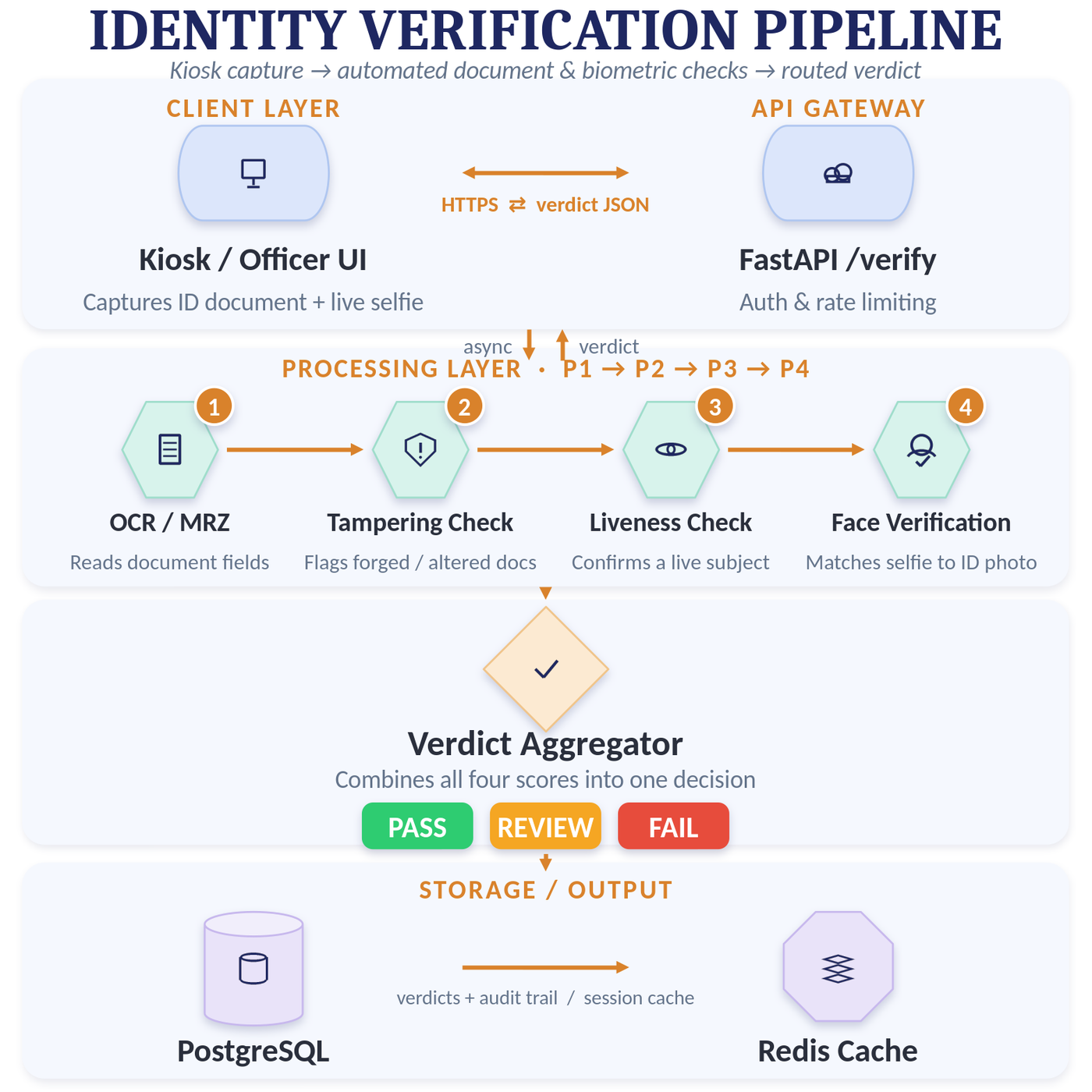
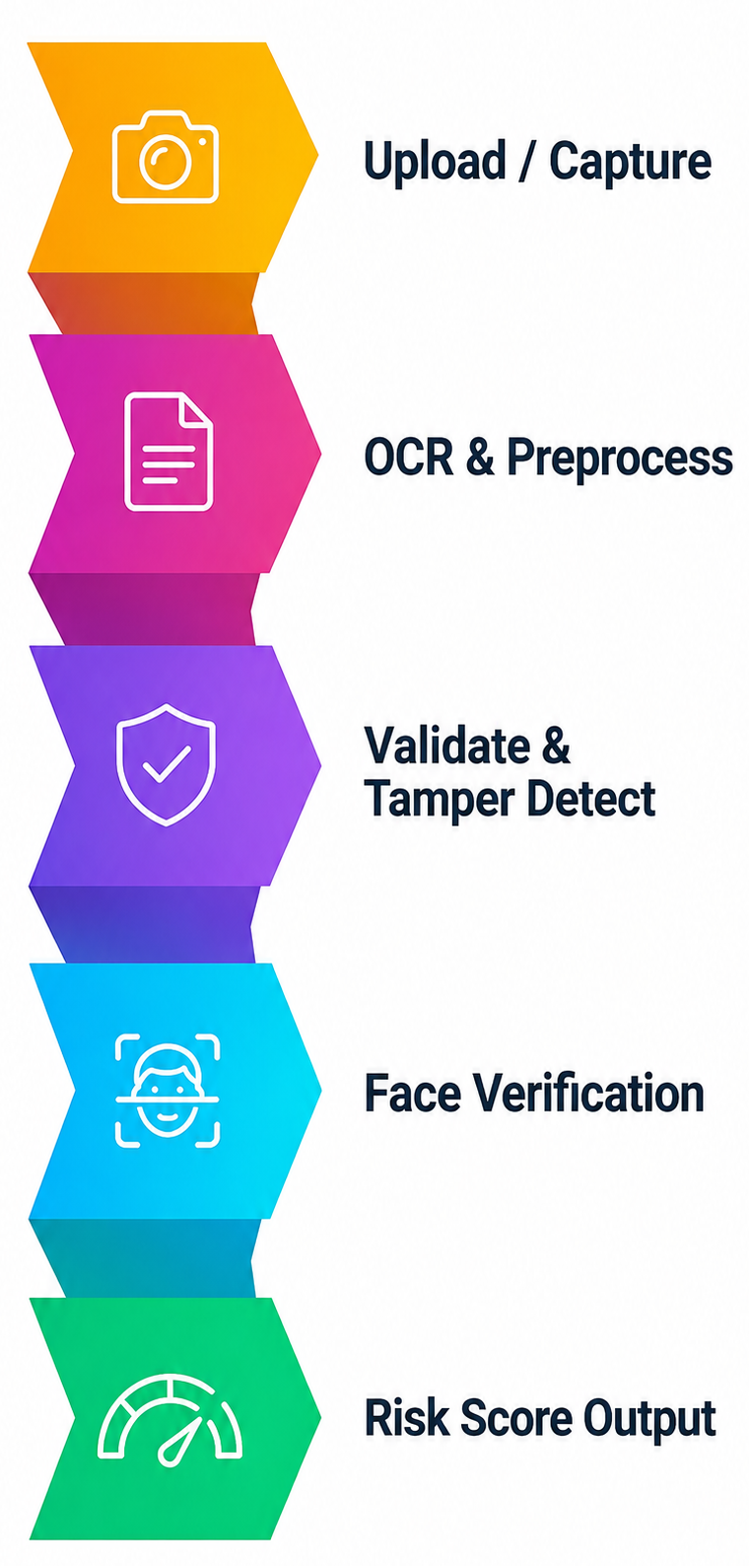
TECHNICAL APPROACH
ZYNTRIX
Technologies Used
React – Used for the production-level kiosk interface.
FastAPI – Backend framework for handling API requests and coordinating verification processes.
PassportEye – Extracts and parses passport MRZ information.
PyTesseract – Performs OCR to extract text from documents.
MobileNetV2 – Lightweight CNN used for image classification and tamper analysis.
Anti-Spoofing CNN – Performs face liveness detection to identify real users vs. presentation attacks.
DeepFace – Framework used for face analysis and verification.
ArcFace – Generates face embeddings and performs face matching.
PostgreSQL – Stores verification results and audit logs.
Redis – Provides fast session and result caching.
Document Scanner/Webcam – Captures identity documents and facial images.
NUC-class Edge Box – Runs OCR, tamper detection, and liveness processing locally when connectivity is limited.
WORKFLOW PIPELINE
`

Slide 4
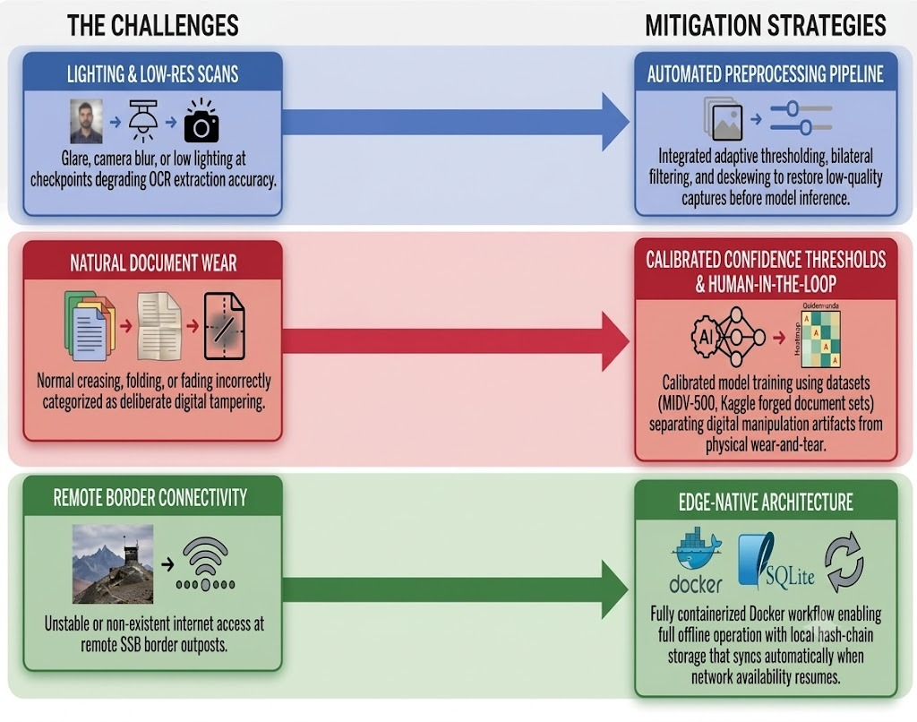
FEASIBILITY AND VIABILITY
ZYNTRIX
FEASIBILITY ANALYSIS
TECHNICAL
Uses open-source, CPU-friendly models with functional Colab prototypes (P1, P2, P4) ready; technical effort focuses only on integration and liveness selection.
FINANCIAL
Open-source stack eliminates recurring inference fees, restricting costs to pre-budgeted, one-time edge hardware purchases (CapEx).
MARKET
Tailor-made for border checkpoints to directly address SSB’s operational problem statement, eliminating market demand uncertainty.
OPERATIONAL
Runs offline at edge-first checkpoints to prevent downtime, needing only periodic model threshold updates using deployment data..

Slide 5
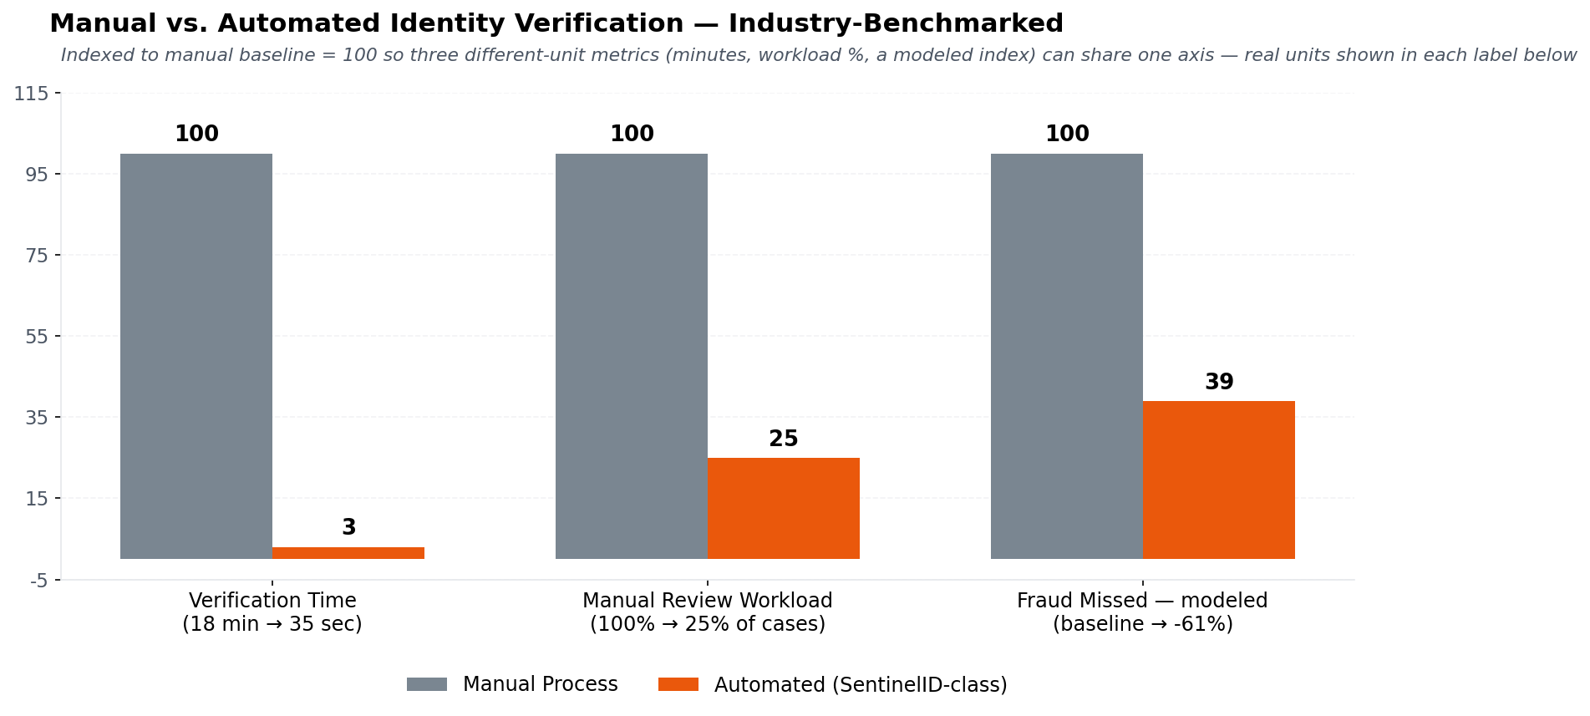
IMPACT AT A GLANCE
ZYNTRIX
Direct Impact on Target Users
Instant Decision Support: Collapses document verification time from minutes down to double-digit seconds, drastically cutting checkpoint processing delay.
Fatigue & Error Reduction: Replaces stressful manual text-reading and photo-eyeballing with concurrent AI processing, mitigating fatigue-induced mistakes.
Standardized Inspection: Delivers a structured PASS / REVIEW / FAIL risk score, eliminating subjective guesswork and variance across officers or shifts.
Zero-Spoof Protection: Enforces a mandatory "Liveness Gate" that halts verification if a live person is not present, protecting officers from printed-photo or screen-replay tricks.
Economic & Operational Benefits
Cost-Effective Scalability: Built on open-source AI frameworks to run locally on low-cost edge hardware, eliminating recurring per-scan API costs.
Throughput Optimization: Maximize checkpoint capacity during peak traffic hours without requiring extra personnel or physical infrastructure.
Cross-Domain Interoperability: Provides a flexible verification core easily expandable to broader national uses, including telecom onboarding and banking KYC checks.
Strategic Impact
Invisible Threat Detection: Uncovers subtle digital tampering—such as swapped photos, modified birth dates, or forged stamps—invisible to the naked eye.
Resilient Edge Deployment: Operates continuously at low-connectivity border posts without central network dependence, syncing audit logs automatically when connection restores.
Actionable Intelligence Pipeline: Converts routine, temporary border decisions into structured digital audit trails with sub-scores for downstream criminal investigations.

Slide 6
RESEARCH AND REFERENCES
ZYNTRIX
ICAO Standards (MRZ & Identity Architecture):
Reference: International Civil Aviation Organization. (2021). Doc 9303: Machine Readable Travel Documents (8th ed.). ICAO, Montreal, Canada.
LINK
Document Image Forensics & ELA:
Reference: Krawetz, N. (2007). A Picture's Worth. Digital Image Analysis and Forensics. Black Hat Briefings.
LINK
ArcFace (Biometric Embeddings):
Reference: Deng, J.,Guo, J., Xue, N., & Zafeiriou, S.(2019). ArcFace: Additive Angular MarginLoss for DeepFace Recognition. IEEE/CVF Conference on ComputerVision and PatternRecognition (CVPR), 4690–4699
LINK
DeepFace Framework Implementation:
Reference: Serengil, S. I., & Ozpinar, A. (2021). HyperExtended LightFace: A Facial Attribute Analysis Framework. International Conference on Engineering and Telecommunication (EnT), 1–4.
LINK
RetinaFace (Robust Face Detection):
Reference: Deng, J., Guo, J., Ververas, E., Kotsia, I., & Zafeiriou, S. (2020). RetinaFace: Single-Shot Multi-Level Face Localisation in the Wild. IEEE/CVF Conference on Computer Vision and Pattern Recognition (CVPR), 5203–5212. LINK
Smart Engines MIDV-500 Dataset:
Reference: Arlazarov, V. V., Bulatov, K., Chernov, T., & Arlazarov, V. L. (2019). MIDV-500: A Dataset for Identity Documents Analysis and Recognition on Mobile Devices in Video Stream. Computer Optics, 43(5), 818–824.
LINK

