Slide 1
Layered Architecture
Presentation Layer
Domain Layer (aka Business Logic Layer)
Data Access Layer

Slide 2
Layered Architecture
Presentation Layer
Domain Layer (aka Business Logic Layer)
Object-Relational Impedance
Data Access Layer

Slide 3
Object-Relational Impedance: Single Class
Object-Oriented
Relational
Class
Table

Slide 4
Object-Relational Impedance: One-to-Many
Object-Oriented
Relational
A
B
A
B
m
m
1
1

Slide 5
Object-Relational Impedance: One-to-Many
Object-Oriented
Relational
A
B
A
B
m
m
1
1
class A {
Guid Id { get; set; }
List<B> TheBs { get; set; }
} class B {
Guid Id { get; set; }
A MyA { get; set; }
}

Slide 6
Object-Relational Impedance: One-to-Many
Object-Oriented
Relational
A
B
A
B
m
m
1
1
class A {
Guid Id { get; set; }
List<B> TheBs { get; set; }
} class B {
Guid Id { get; set; }
A MyA { get; set; }
}
A
B
Id
Id
AId

Slide 7
Object-Relational Impedance: One-to-Many
Object-Oriented
Relational
A
B
A
B
m
m
1
1
class A {
Guid Id { get; set; }
List<B> TheBs { get; set; }
} class B {
Guid Id { get; set; }
A MyA { get; set; }
}
A
B
Id
Id
AId
How about foreign key?

Slide 8
Object-Relational Impedance: Many-to-Many
Object-Oriented
Relational
A
B
?
m
n

Slide 9
Object-Relational Impedance: Many-to-Many
Object-Oriented
Relational
A
B
A
B
m
1
1
n
AtoB
m
m

Slide 10
Object-Relational Impedance: Many-to-Many
Object-Oriented
Relational
A
B
A
B
m
1
1
n
AtoB
m
m
class A {
Guid Id { get; set; }
List<B> TheBs { get; set; }
} class B {
Guid Id { get; set; }
List<A> TheAs { get; set; }
}

Slide 11
Object-Relational Impedance: Many-to-Many
Object-Oriented
Relational
A
B
A
B
m
1
1
n
AtoB
m
m
class A {
Guid Id { get; set; }
List<B> TheBs { get; set; }
} class B {
Guid Id { get; set; }
List<A> TheAs { get; set; }
}
A
B
Id
Id
AtoB
AId
BId

Slide 12
NHibernate Concepts

Slide 13
NHibernate Concepts
Session
Transaction
SessionFactory
Map

Slide 14
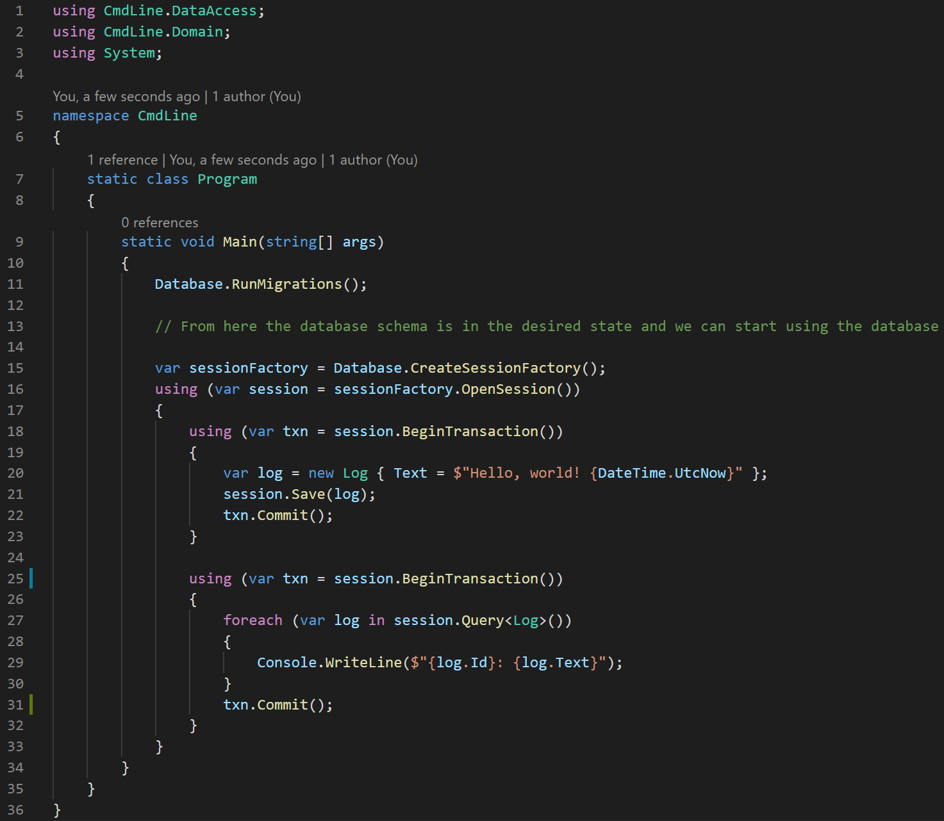
NHibernate Concepts
SessionFactory (1)
Session (2)
Txn
Transaction (3)
Session
Txn
Transaction (3)
Commit not strictly necessary for R/O transaction, but recommended for consistency

Slide 15
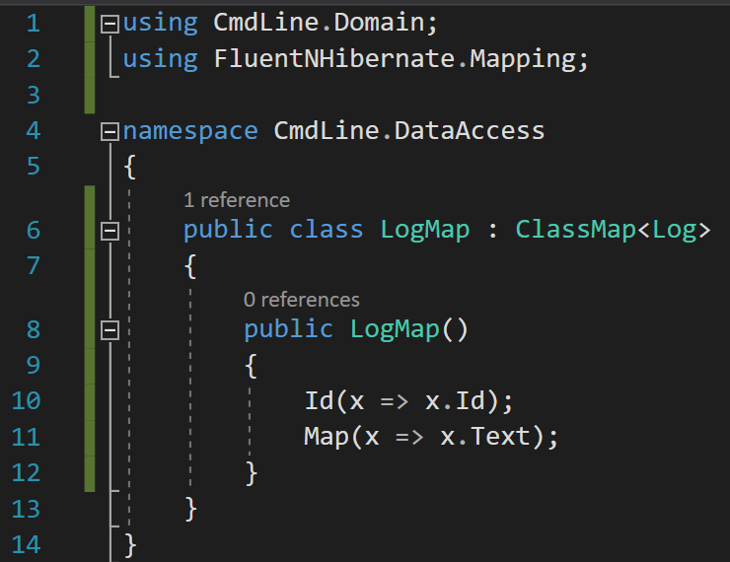
NHibernate Concepts
Generic Base Class
Map Id property
Map regular Property

