Slide 1
Easy Journey
Let us take you to the the destination.
Karen Soriano, Alejandro Aguilar Jr, Sean Huang

Slide 2
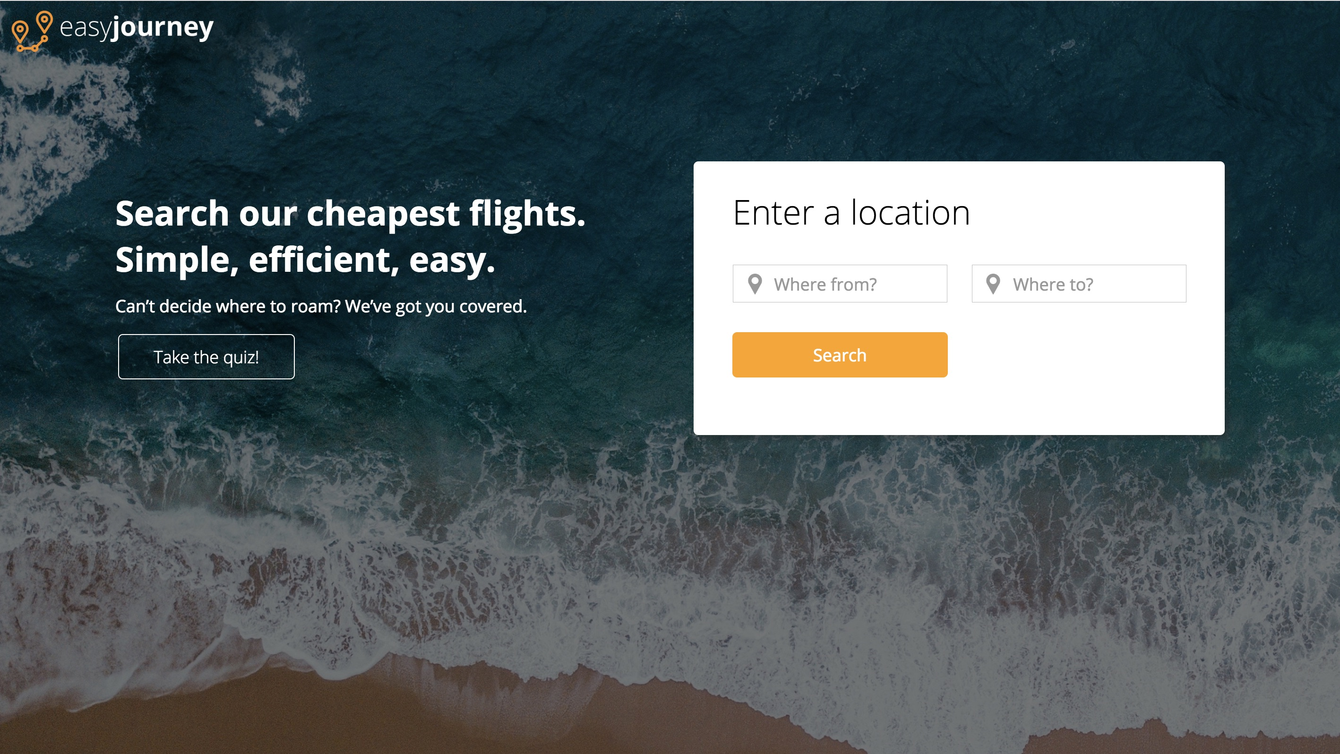
Pick the Destination
Any City in the World
AutoFill

Slide 3
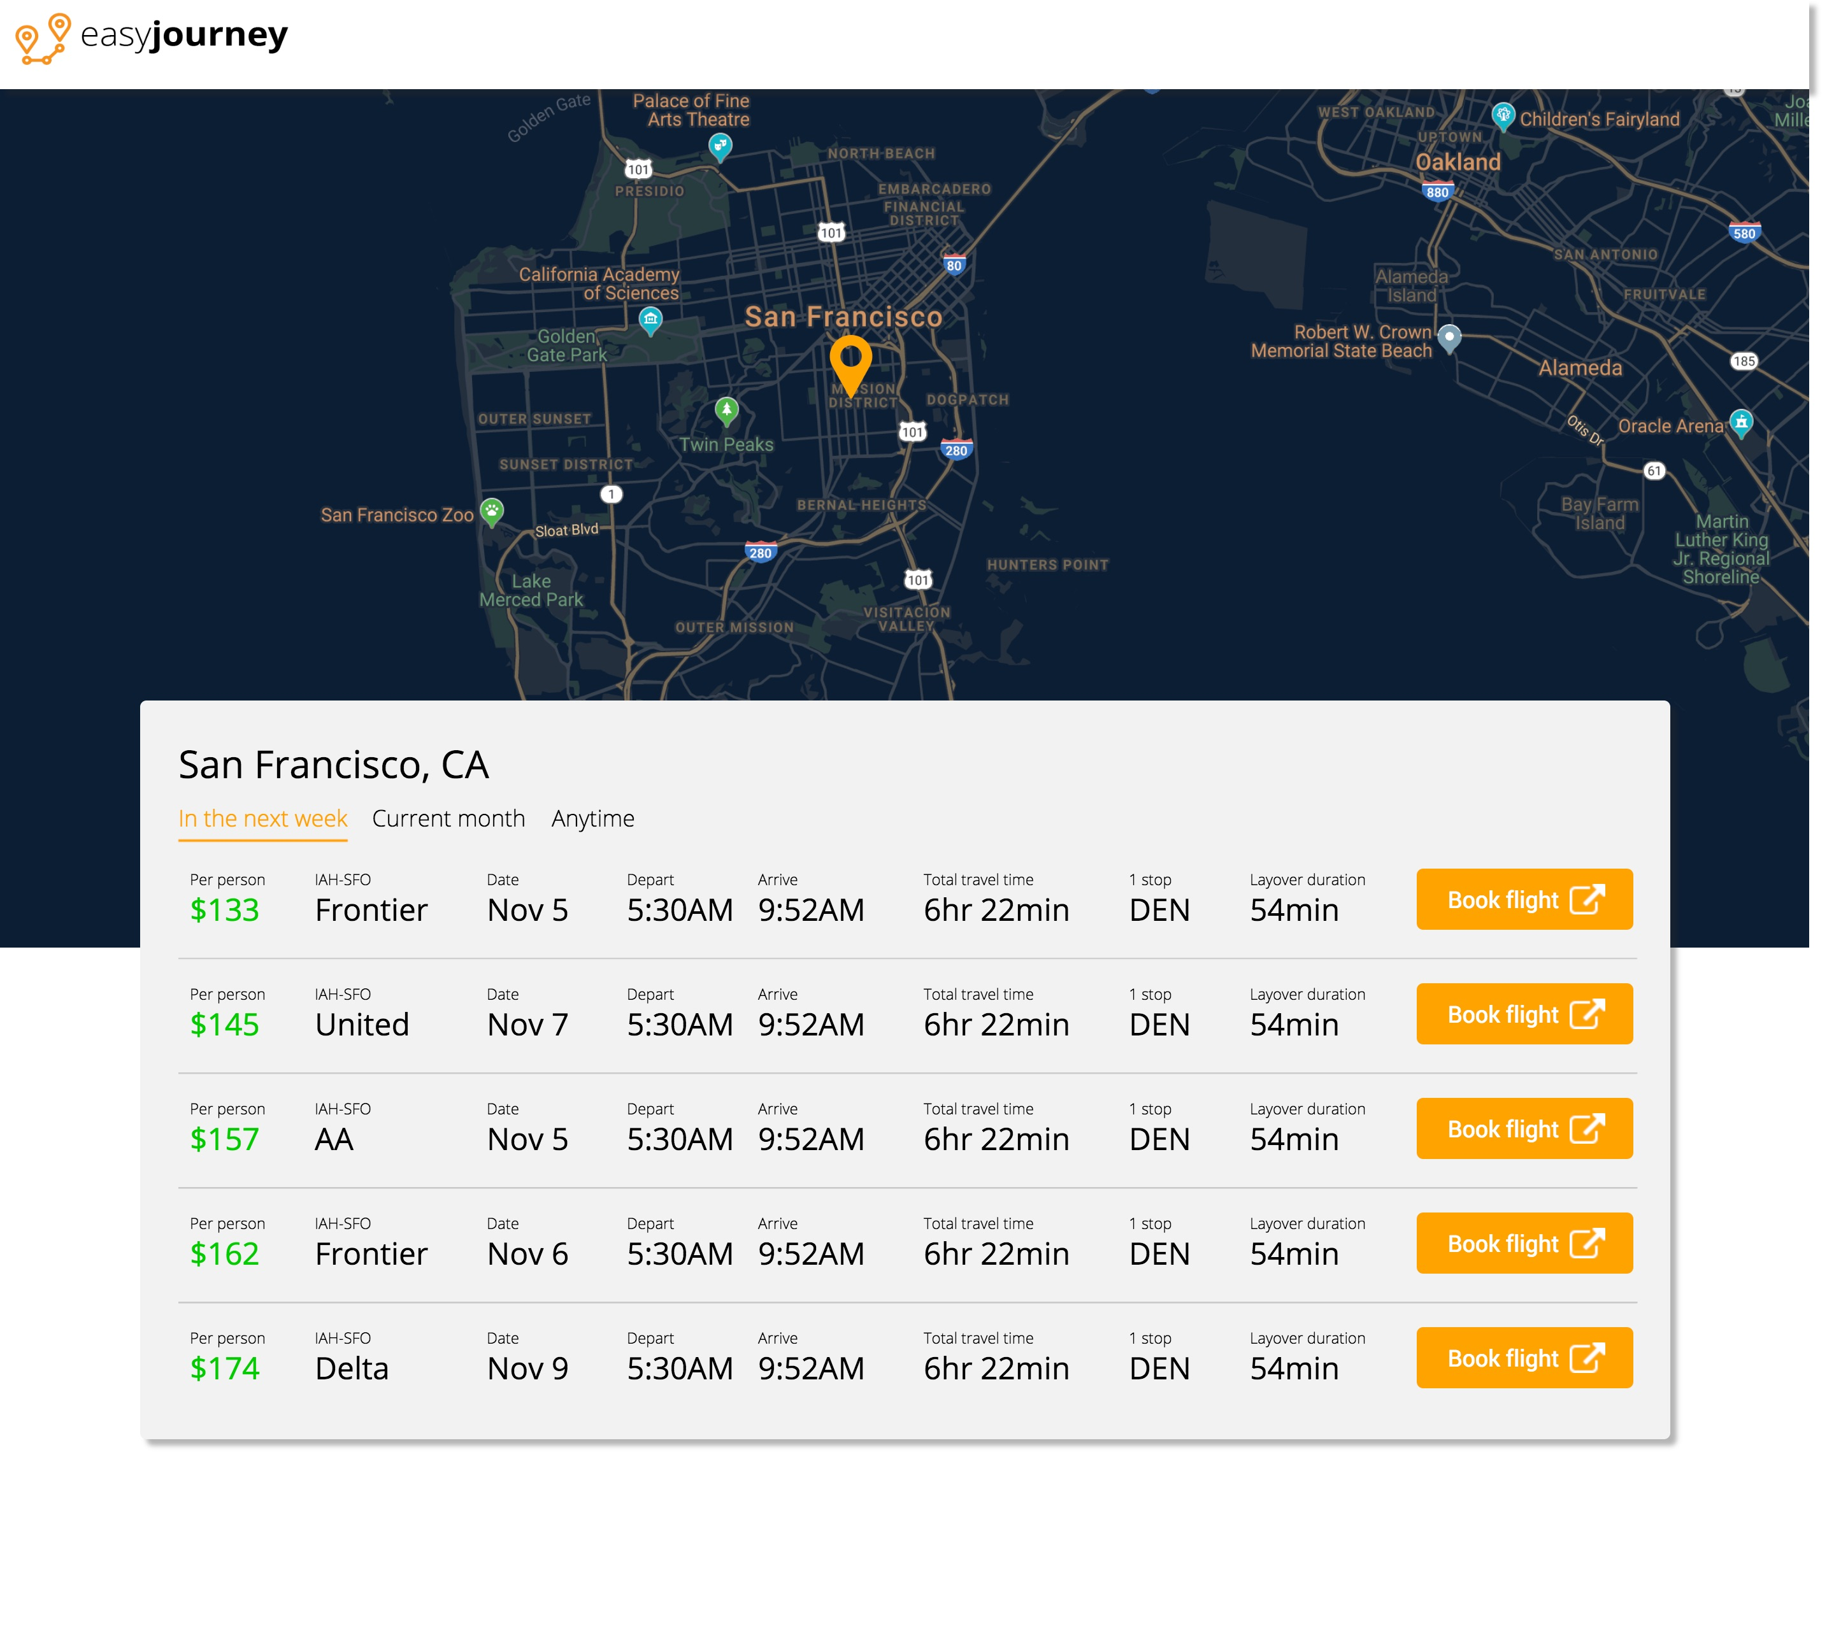
Up in the Air
Airlines, Prices, Dates
International & Domestic

Slide 4

Journey Matcher
Match Preferences

