Slide 1
NYC SHOOTINGS CLUSTER ANALYSIS

Slide 2
Overview & Goals
Cluster shooting incidents by time, location, demographics, jurisdiction
Provide actionable insights for targeted interventions and resource allocation
Deliverables: cleaned data, features, clustering model, visualizations, profiles, recommendations

Slide 3
Data Description
Source: Provided NYC shooting incidents dataset (confidential)
Key columns: occur_date, occur_time, borough, location, latitude, longitude, perp/victim demographics, precinct
Reminder: do NOT upload the dataset to public platforms (Kaggle/GitHub)

Slide 4
Preprocessing — Why & How
Why: clean messy fields, handle missing values, and normalize formats
How: normalize text, parse dates/times, convert age groups to numeric midpoints
Reduce rare categories to 'Other' to avoid noisy one-hot columns

Slide 5
Feature Engineering (selected)
Temporal: hour, day-of-week, month (+ cyclical sin/cos transforms)
Spatial: latitude & longitude for mapping and spatial clustering
Demographic: perp/victim ages (midpoints), sex, race (kept high-level/non-stigmatizing)

Slide 6
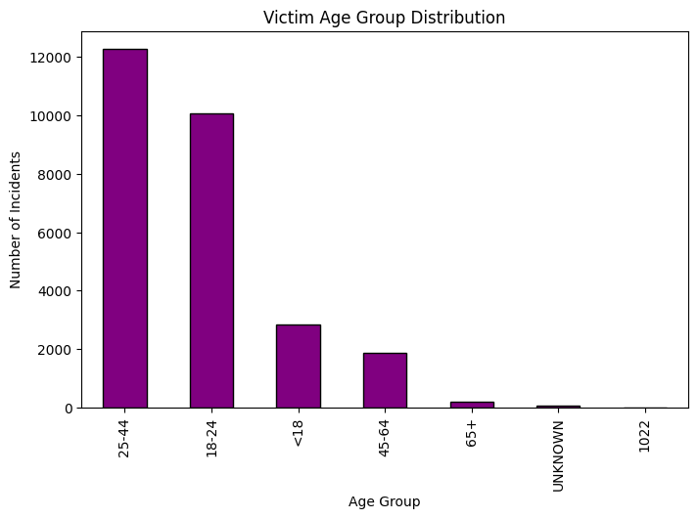
Victim Age Group Distribution
The bar chart shows the number of shooting incidents per victim age group.
The 25–44 age group has the highest number of victims, followed by 18–24.
Very few incidents involve victims aged 65+ or children under 10 (except "<18" has some cases).
This indicates that most shooting victims are young adults and middle-aged individuals.
Key Insight:
Interventions should focus on protecting individuals aged 18–44, as they represent the majority of victims.
Community programs, education, and targeted policing could focus on this demographic to reduce ris

Slide 7
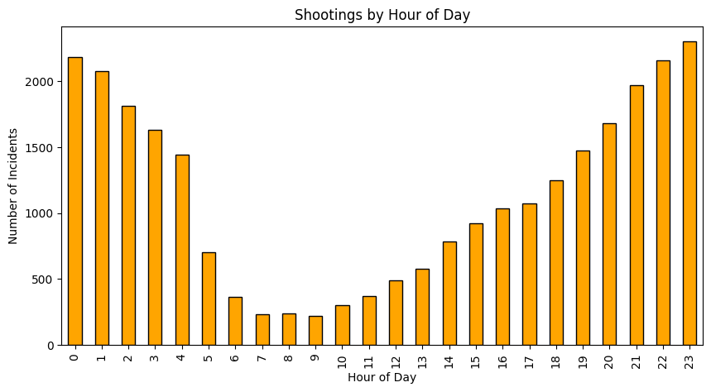
Shootings by Hour of Day
The bar chart shows number of incidents by hour (0–23).
Most shootings happen during late night and early morning hours — peaking around 11 PM – 1 AM.
Incidents drop sharply between 4 AM – 9 AM, the quietest period.
There is a gradual rise again from afternoon toward late evening.
Key Insight:
Late-night hours (8 PM – 2 AM) are the most critical for intervention.
Police departments can increase patrol presence and surveillance during these hours to reduce gun violence.
This is actionable insight for resource allocation and scheduling.

Slide 8
Modeling — Clustering Approach
Algorithm: KMeans (simple, interpretable) with silhouette-based k selection
Alternative: DBSCAN/HDBSCAN for density-based hotspots (recommended for hotspots)
Success criteria: meaningful, actionable clusters with reasonable silhouette score

Slide 9
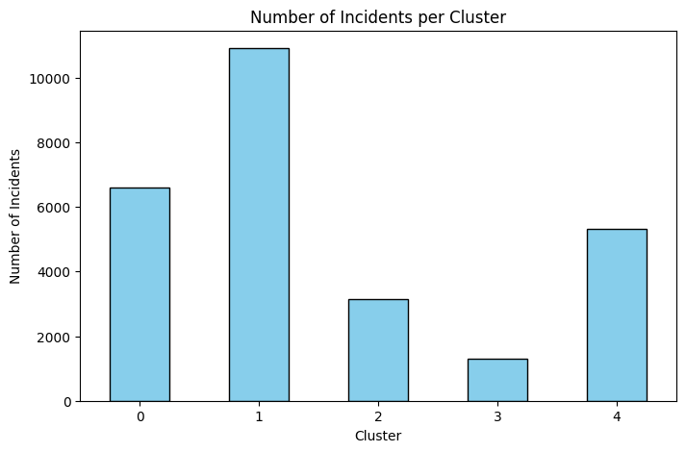
Number of Incidents per Cluster
This bar chart displays how many shooting incidents fall into each cluster (0–4).
Cluster 1 is the largest, with over 10,000 incidents — it likely represents the most common pattern of shootings.
Clusters 0 and 4 are medium-sized, while Clusters 2 and 3 represent fewer incidents.
This helps us understand the relative weight of each cluster and prioritize which ones to focus on first.
Key Insight:
Clusters with the largest counts (like Cluster 1) deserve deeper profiling and targeted action because they represent the biggest share of incidents.
Smaller clusters may represent unique edge cases or special conditions that require niche interventions

Slide 10
Cluster Profiling — What to compute
Cluster size (count of incidents) and top boroughs/precincts
Peak temporal windows (hour, day-of-week) per cluster
Outcome shares (statistical murder flag), demographic proportions (non-stigmatizing)

Slide 11
Actionable Recommendations (Draft)
1) Focused patrol & community engagement during peak hours in hotspot areas
2) Allocate resources to top precincts identified per cluster
3) Coordinate NYPD and non-NYPD jurisdiction responses where relevant
4) Monitor and evaluate interventions; avoid policies that stigmatize communities

Slide 12
Ethics, Bias & Limitations
Clusters reflect historical reporting/policing biases — not causal proof
Missing data, geocoding errors, and time lags can affect results
Always validate findings with community stakeholders and domain experts

