Slide 1
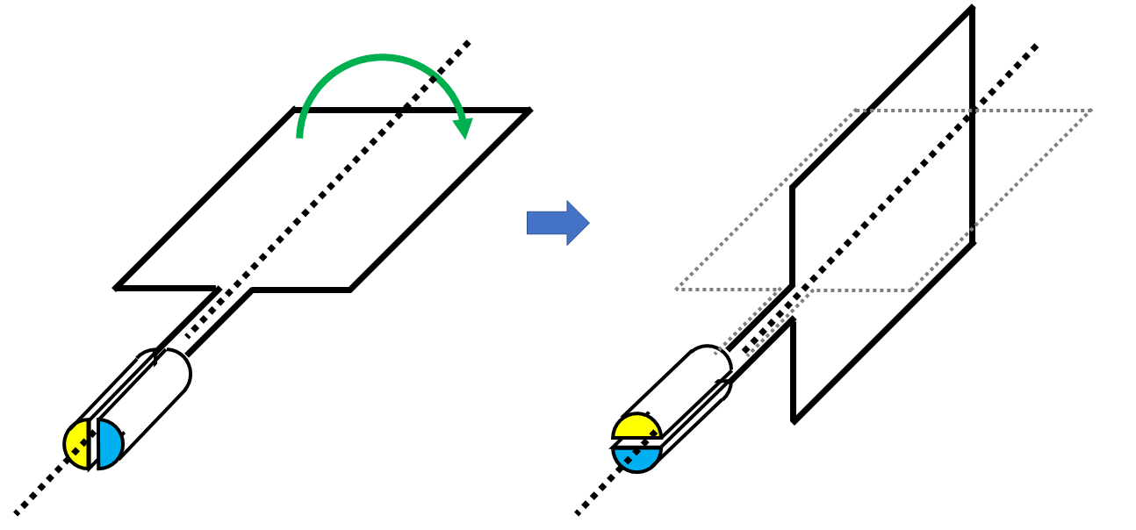









a
a
d
b
b
d
c
c
x = 90°
x = 0°

Slide 2
d
d
a
c
a
c
b
b
x = 270°
x = 180°

Slide 3


x
x = 0°
x = 90°
x = 270°
x = 180°
条件：反時計周り

