Slide 1
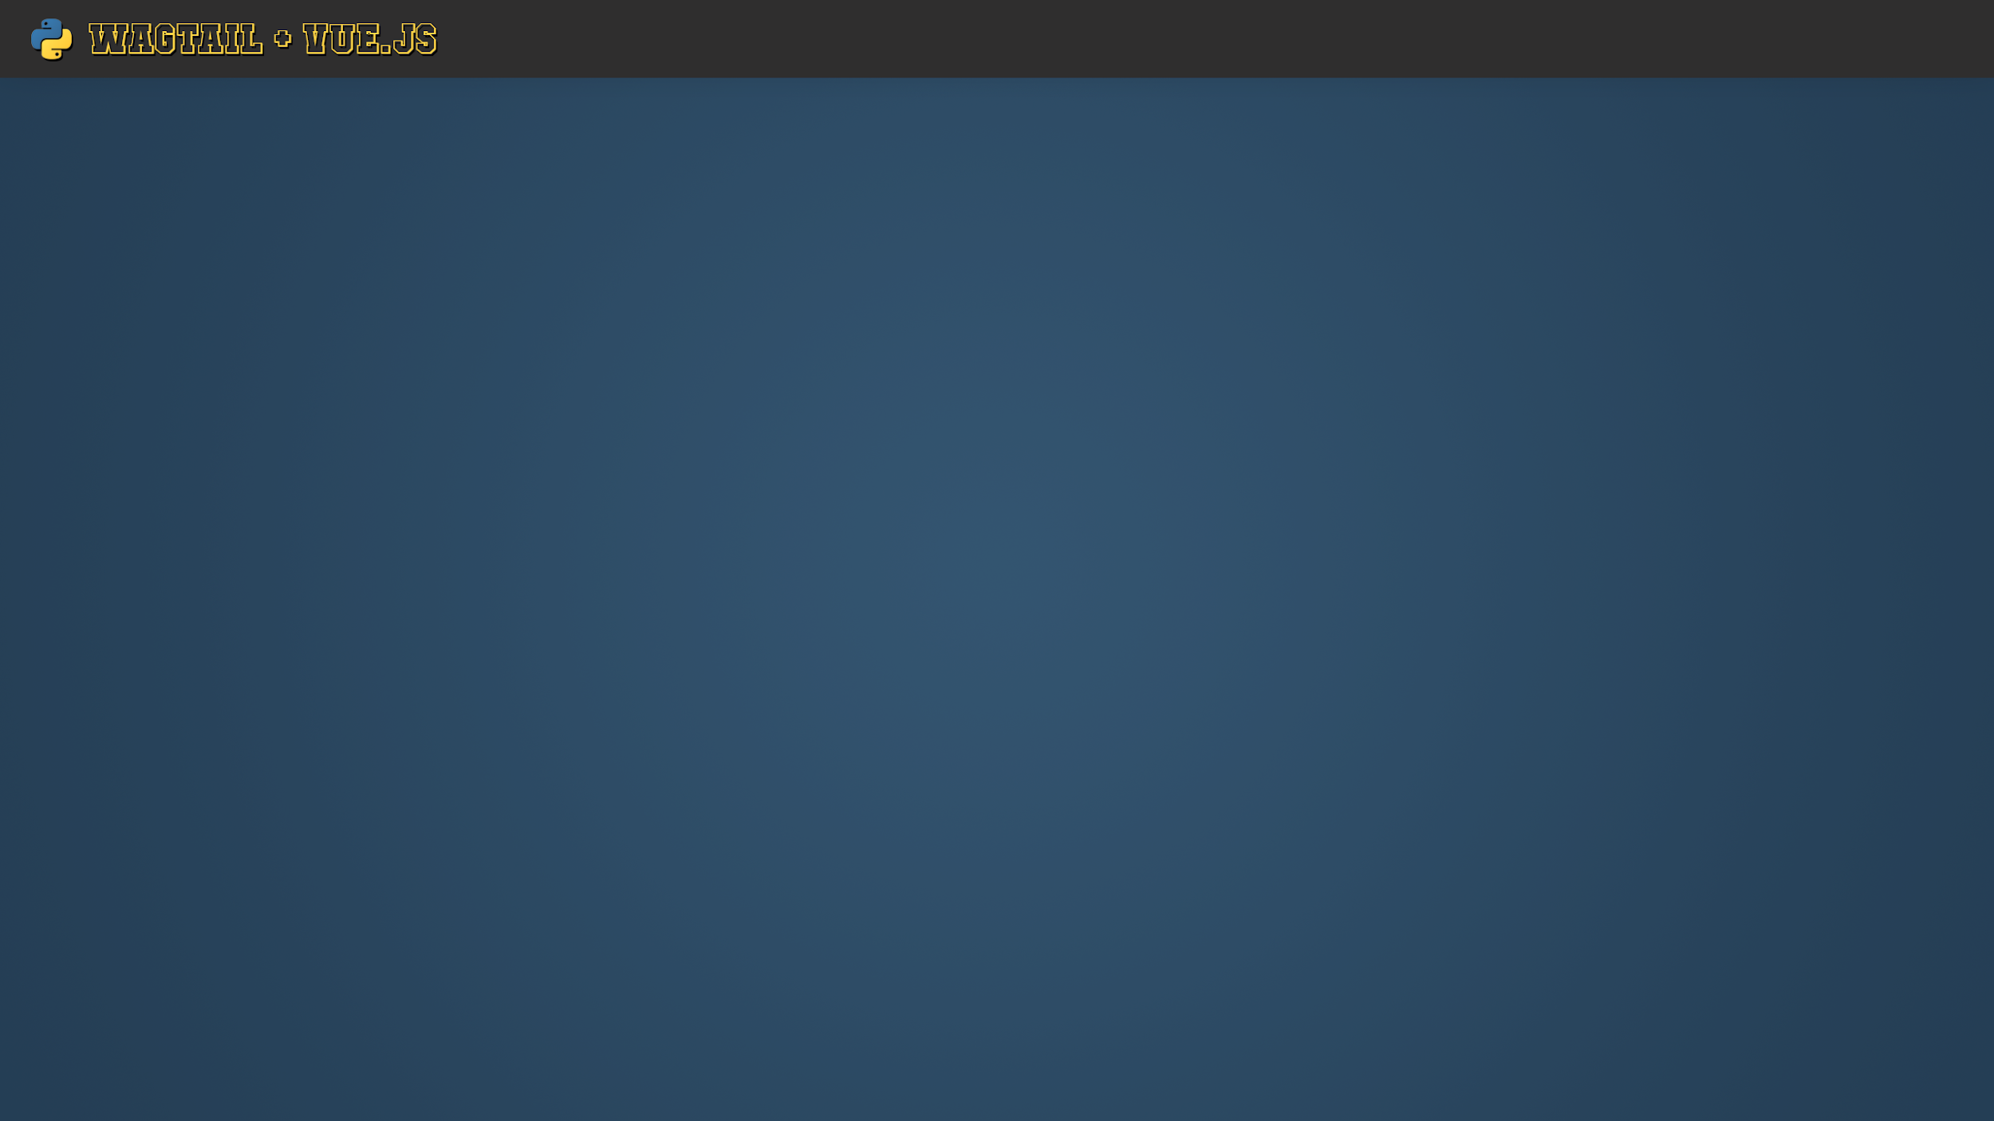


Setting up Wagtail as a Headless CMS

Slide 2
What’s in this talk?
Installing Wagtail from scratch
Installing Wagtail on top of an existing Django application
Creating your first Wagtail CMS Page
How to enable Wagtails Headless CMS
Exploring the Pages API
Testing the API response in JavaScript

Slide 3
Installing Wagtail
There are two ways to install Wagtail:
Fresh install (easiest)
On top of your existing Django application (harder, but it’s still easy)

Slide 4
Fresh Install with Docker
(5 mins)
Up and running in 5 simple steps:
pip install wagtail
wagtail start mysite
cd mysite
docker build -t mysite .
docker run -p 8000:8000 mysite
You’ll need a superuser to get into the admin. So enter the container with:
docker exec -it 3e2fdcbac6f7 /bin/bash
Get the docker container id from docker container ls
./manage.py createsuperuser
Go to localhost:8000/admin/

