Slide 1
University of York Update
December 2021

Slide 2
Environment Modelling
Countertops
Hob/Cooker
Sink
Bathroom
Bedroom (s)
Master bedroom

Slide 3
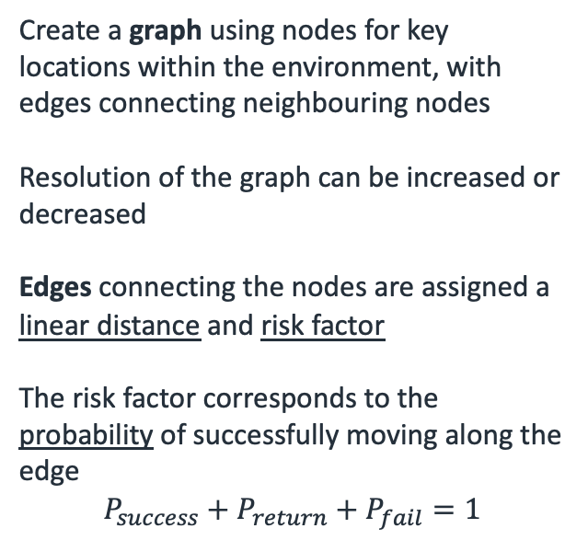
Environment Modelling
17
18
19
21
22
Create a graph using nodes for key locations within the environment, with edges connecting neighbouring nodes
Resolution of the graph can be increased or decreased
Edges connecting the nodes are assigned a linear distance and risk factor
The risk factor corresponds to the probability of successfully moving along the edge
$$P_{success}+P_{return}+P_{fail}=1$$
13
16
20
24
14
12
23
15
11
10
25
8
9
6
5
4
26
29
7
27
30
3
28
2
1

Slide 4
Environment Modelling
17
18
19
21
22
Each edge is weighted:
Green low risk
Orange medium risk
Red high risk
Back very high risk
Risk categories are assigned based on clutter and also whether they intersect one or more edge
Each risk category has three sub-categories (low, medium, high)
”low-low”
”medium-low”
“high-medium”, etc
13
16
20
24
14
12
23
15
11
10
25
8
9
6
5
4
26
29
7
27
30
3
28
2
1

Slide 5
Environment Modelling
17
18
19
21
22
Each edge is weighted:
Green low risk
Orange medium risk
Red high risk
Back very high risk
Risk categories are assigned based on clutter and also whether they intersect one or more edge
Each risk category has three sub-categories (low, medium, high)
”low-low”
”medium-low”
“high-medium”, etc
13
16
20
24
14
12
23
15
11
10
25
8
9
6
5
4
26
29
7
27
30
3
28
2
1

Slide 6
Path Finding
Dijkstra’s Algorithm
Shortest distance path in a graph
3
3
1
1.8
1
1.8
1
5
1
5
2
1.2
2
1.2
0.8
0.8
0.6
4
0.6
4
2
1.5
2
1.5
Shortest Distance Path:
1
3
5

Slide 7


Path Finding
Dijkstra’s Algorithm
Adjust the parameters of the algorithm to maximise a parameter, such as probability
Rather than a distance value, each edge has a probability of success ${(P}_{s})$ and failure $(1−P_{s})$
0.4
3
0.7
0.4
3
0.7
0.5
0.2
0.5
0.2
1
5
1
0.2
5
0.4
0.4
0.2
0.4
0.5
0.6
0.3
0.7
0.6
0.3
0.7
0.9
0.9
0.8
0.8
0.7
4
0.7
4
2
0.3
2
0.3
Highest Probability Path:
1
2
4
5
$0.7 × 0.7 × 0.9≈$ 44%
Shortest Distance Path:
1
3
5
$$0.5 × 0.2=10\%$$

Slide 8
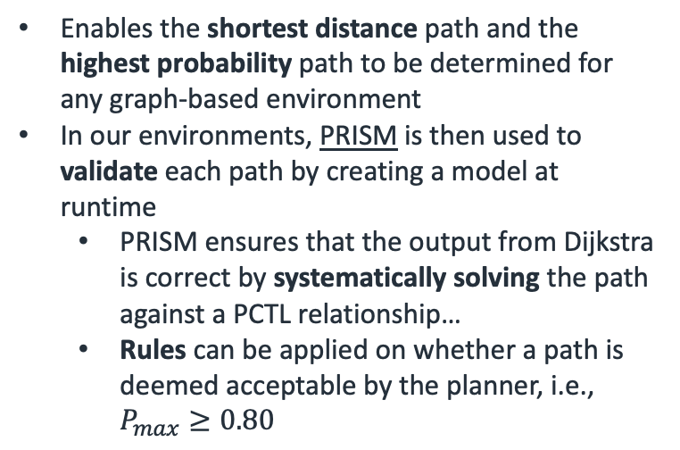
Path Finding
Dijkstra’s Algorithm
3
Enables the shortest distance path and the highest probability path to be determined for any graph-based environment
In our environments, PRISM is then used to validate each path by creating a model at runtime
PRISM ensures that the output from Dijkstra is correct by systematically solving the path against a PCTL relationship…
Rules can be applied on whether a path is deemed acceptable by the planner, i.e., $P_{max}≥0.80$
1
1.8
1
5
2
1.2
0.8
0.6
4
2
1.5
0.4
3
0.7
0.5
0.2
1
0.2
0.4
0.5
0.7
0.6
0.3
0.8
0.9
0.7
4
2
0.3

Slide 9
Path Finding Example (Agent)
17
18
19
21
22
Start Node
13
20
Final Node
16
14
24
12
23
If we take the previously defined environment, where the robot:
Starts at Node 25
Ends at Node 17
Dijkstra’s creates two solutions:
Path of least distance
Path of maximum probability of success
15
11
10
25
8
9
6
5
4
26
29
7
27
30
3
28
2
1

Slide 10
Path Finding Example (Agent)
17
18
19
21
22
Start Node
13
Final Node
16
20
24
14
12
23
If we take the previously defined environment, where the robot:
Starts at Node 25
Ends at Node 17
Dijkstra’s creates two solutions:
Path of least distance
Path of maximum probability of success
15
11
10
25
8
9
6
5
4
26
29
7
27
30
3
28
2
1

Slide 11
Path Finding Example (Agent)
17
18
19
21
22
Start Node
13
20
Final Node
16
14
24
12
23
Highest Probability Path (Robot)
15
11
10
25
Minimum Distance Path (Robot)
8
9
Mutual Path (Robot)
6
5
4
26
29
7
Minimum distance path is 2.9 m with 58% chance of success
Maximum probability path is 4.0 m with 92% chance of success
27
30
3
28
2
1

Slide 12
Path Finding Example (Agent)
17
18
19
21
22
Start Node
13
20
Final Node
16
14
24
12
23
Highest Probability Path (Robot)
15
11
10
25
Minimum Distance Path (Robot)
8
9
Mutual Path (Robot)
6
5
4
26
29
7
Minimum distance path is 2.9 m with 58% chance of success
Maximum probability path is 4.0 m with 92% chance of success
27
30
3
28
2
1

Slide 13
Path Finding Example (Human)
17
18
19
21
22
Start Node
13
Final Node
16
20
24
14
12
23
Introduce a human into the environment at Node 15
The human intends to navigate towards Node 6
Unlike the robot, it is assumed the human moves along the path of least distance.
15
11
10
25
8
9
6
5
4
26
29
7
27
30
3
28
2
1

Slide 14
Path Finding Example (Human)
17
18
19
21
22
Start Node
13
Final Node
16
20
24
14
Minimum Distance Path (Human)
12
23
15
11
10
25
This path causes a spatial conflict with the path of the agent
8
9
6
5
4
26
29
7
27
30
3
28
2
1

Slide 15
Path Finding Example (Co-Op)
17
18
19
21
22
Start Node
13
Final Node
16
20
24
14
Highest Probability Path (Robot)
12
23
15
11
10
Minimum Distance Path (Robot)
25
8
Mutual Path (Robot)
9
6
5
Spatially Conflicted Node
4
26
29
7
Artificially update the probability heat map for the agent based on the path of the human
Probability decreased from 92% to 23% chance of success
27
30
3
28
2
1

Slide 16
Path Finding Example (Co-Op)
17
18
19
21
22
Start Node
13
Final Node
16
20
24
14
Highest Probability Path (Robot)
12
23
15
11
10
Minimum Distance Path (Robot)
25
8
Mutual Path (Robot)
9
6
5
Spatially Conflicted Node
4
26
29
7
Artificially update the probability heat map for the agent based on the path of the human
Probability decreased from 92% to 23% chance of success
27
30
3
28
2
1

Slide 17
Path Finding Example (Co-Op)
17
18
19
21
22
Start Node
13
Final Node
16
20
24
14
12
23
Highest Probability Path (Robot)
15
11
10
Minimum Distance Path (Robot)
25
8
9
Mutual Path (Robot)
6
5
4
26
29
The agent now re-plans it’s path around the environment, increasing the probability of reaching the final node
Maximum probability path is 4.8 m with 81% chance of success
7
27
30
3
28
2
1

Slide 18
What does this mean?
Require knowledge of the human’s position and intentions
This could be a fair assumption if we were guiding the human to locations during a cooperative task…
Requires accurate predictions of the human’s behaviour
How they will navigate through the environment?
Assume the human takes the least distance path (Factor some creativity?)
Working on spatial deconfliction (not temporal & spatial deconfliction)
Future work for time-based simulations with kinematic movement analysis?
Purely predictive behaviour?
Adaptation at runtime?
These are all thing we need to consider in the final solution

Slide 19
Mission Management
Previously discussed how a mission can be comprised of multiple tasks, each with sub-tasks.
Food Preparation
Phase 1: Locating
Phase 2: Making
Locate Sauce
Guidance
Locate Pasta
Monitoring
Locate Utensil
Assistance
Must perform all tasks in Phase 1 before Phase 2 can start

Slide 20
Mission Management
Food Preparation
Perform Check (Tasks)
Phase 1: Locating
Phase 2: Making
Check Cupboard 1
Check Cupboard 2
Locate Sauce
Guidance
Locate Pasta
Monitoring
Begin retrieval (robot or human assisted)
Locate Utensil
Assistance
Each task in Phase 1 may be comprised of individual sub-tasks… all of which also need to be completed

Slide 21
Environment Modelling
17
18
19
21
22
13
16
20
24
14
12
23
15
11
10
25
8
9
6
5
4
26
29
7
27
30
3
28
2
1

Slide 22
Environment Modelling
17
19
22
15
11
4
26
2

Slide 23
17
19
11
15
22
4
2
26

Slide 24
17
19
Least distance path: [22, 19, 17, 15, 11, 2, 4, 26, 22]
Probability: 10.23% (Unvalidated)
11
15
22
4
2
26

Slide 25
17
19
Least distance path: [22, 26, 2, 4, 11, 15, 17, 19, 22]
Distance: 17.3 metres
11
15
22
4
2
26

Slide 26
Mission Management
Two room environment which has a kitchen and sitting area…
Graph consisting of 20 nodes is created, where edges represent a linear distance and risk factor (probability values)
Each task in a mission is performed at a specific node…
For example: check cupboard could occur at Node 1, 6 and 3
1
11
14
17
19
2
6
9
15
3
7
12
20
16
18
4
10
5
8
13

Slide 27
Defining a Mission
Consider the food preparation mission introduced before, with the following abstracted workflow:
Phase 1:
// Check Cupboard 1 → Check Cupboard 2 → Check Fridge → Check Table Clear → Hold/Wait…
All of the tasks in Phase 1 must be completed before Phase 2 can begin.
Phase 2:
// Begin instructions for making → Loop Phase…
In Phase 1, there are four tasks, which are not order dependant. This means that the tasks can be completed in any order, and only when all have been completed, can progression be made to the “Hold/Wait” task.
These tasks are denoted as “unordered tasks”

Slide 28
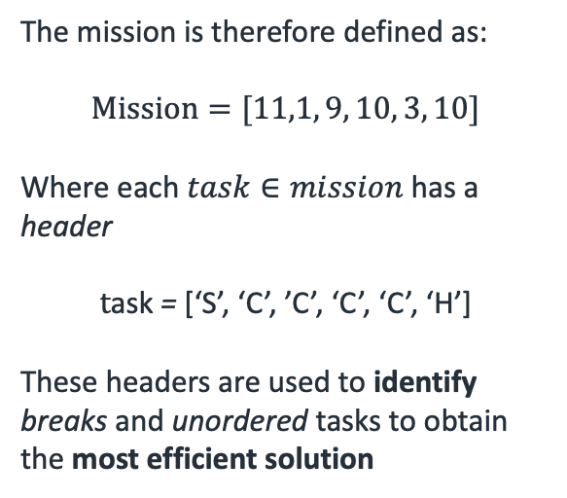
Defining a Mission
Based on Phase 1:
Start Node 11
unordered tasks at nodes : [1, 9, 10, 3]
Final Hold/Wait occurring at Node 10.
The mission is therefore defined as:
$$Mission=[11,1, 9, 10, 3, 10]$$
Where each $task∈mission$ has a header
$$t\text{ask}\text{ = }\text{[}\text{‘}\text{S}\text{’, ‘}\text{C}\text{’, ’}\text{C}\text{’, ‘}\text{C}\text{’, ‘}\text{C}\text{’, ‘}\text{H}\text{’]}$$
These headers are used to identify breaks and unordered tasks to obtain the most efficient solution
1
11
14
17
19
2
6
9
15
3
7
12
20
16
18
4
10
5
8
13

Slide 29
Defining a Mission
The nodes representing tasks in the set mission are used to create a fully connected subset graph
11
10
1
11
1
14
17
19
2
6
9
15
3
3
7
12
20
9
16
18
4
10
The edges of the subset map are unknow and determined by obtaining the solution between each node on the main map using Dijkstra
5
8
13

Slide 30



Subset Graph Solution
The edges connecting each node in the subset map are determined by solving Dijkstra’s algorithm for distance and probability on the main map
11
$$1$$
2
10
1
4
3
1
11
14
17
19
2
6
9
3
15
3
7
12
9
20
16
18
$${1=\{D}_{10→11, }P_{10→11}\}=11→9→7→10$$
4
10
$${2=\{D}_{1→11, }P_{1→11}\}=11→9→6→1$$
13
$${3=\{D}_{9→11, }P_{9→11}\}=11→9$$
5
8
$${4=\{D}_{3→11, }P_{3→11}\}=11→9→6→3$$

Slide 31
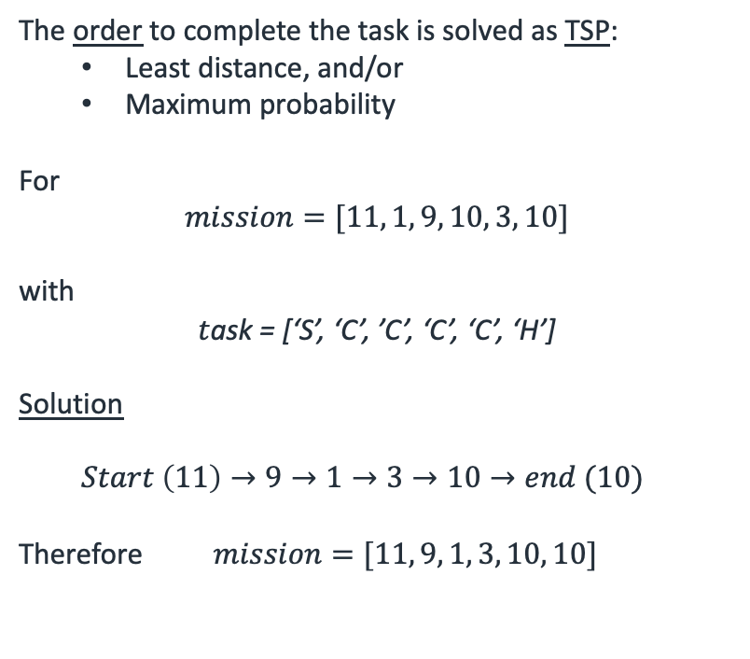
Subset Graph Solution
The order to complete the task is solved as TSP:
Least distance, and/or
Maximum probability
For
$$mission=[11, 1, 9, 10, 3, 10]$$
with
$$t\text{ask}\text{ = [‘}\text{S}\text{’, ‘}\text{C}\text{’, ’}\text{C}\text{’, ‘}\text{C}\text{’, ‘}\text{C}\text{’, ‘}\text{H}\text{’]}$$
Solution
$Start \left(11\right)→9→1→3→10→end (10)$
Therefore $mission=[11, 9, 1, 3, 10, 10]$
11
10
1
3
9

Slide 32
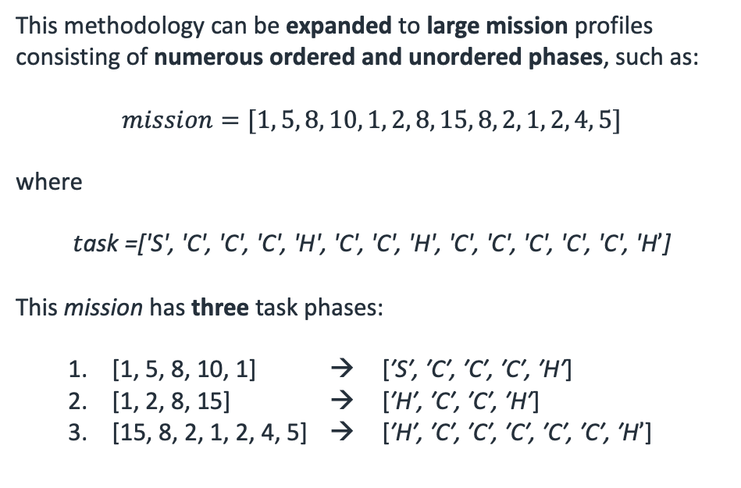
Multi-Unordered Solutions
This methodology can be expanded to large mission profiles consisting of numerous ordered and unordered phases, such as:
$$mission=[1, 5, 8, 10, 1, 2, 8, 15, 8, 2, 1, 2, 4, 5]$$
where
$$t\text{ask}\text{ =[′}\text{S}\text{′, ′}\text{C}\text{′, ′}\text{C}\text{′, ′}\text{C}\text{′, ′}\text{H}\text{′, ′}\text{C}\text{′, ′}\text{C}\text{′, ′}\text{H}\text{′, ′}\text{C}\text{′, ′}\text{C}\text{′, ′}\text{C}\text{′, ′}\text{C}\text{′, ′}\text{C}\text{′, ′}\text{H}’\text{]}$$
This mission has three task phases:
[1, 5, 8, 10, 1] → [$\text{′}\text{S}\text{′, ′}\text{C}\text{′, ′}\text{C}\text{′, ′}\text{C}\text{′, ′}\text{H}\text{′}$]
[1, 2, 8, 15] → [$\text{′}\text{H}\text{′, ′}\text{C}\text{′, ′}\text{C}\text{′, ′}\text{H}\text{′}$]
[15, 8, 2, 1, 2, 4, 5] → [$\text{′}\text{H}\text{′, ′}\text{C}\text{′, ′}\text{C}\text{′, ′}\text{C}\text{′, ′}\text{C}\text{′, ′}\text{C}\text{′, ′}\text{H}’$]
11
10
1
3
9

Slide 33
Multi-Unordered Solutions
Create an individual sub-graph for each phase of the mission, where all unordered tasks are fully connected. Each phase is connected using the header exit and entry point.
The edges are solved in the same manner as the previously demonstrated single unordered solution… by obtaining a local solution using Dijkstra on the main environment map.
1
8
2
1
15
2
5
10
15
5
8
4
8
1

Slide 34
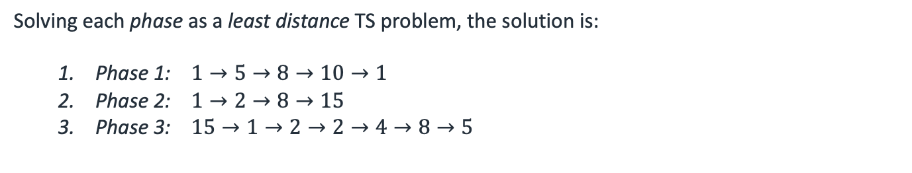
Multi-Unordered Solutions
Solving each phase as a least distance TS problem, the solution is:
Phase 1: $1→5→8→10→1$
Phase 2: $1→2→8→15$
Phase 3: $15→1→2→2→4→8→5$
1
8
2
1
15
2
5
10
15
5
8
4
8
1

Slide 35
Next Stages
Refine the mission management and mission allocation structure
Introduce human movement analysis into the mission management analysis
Temporal deconfliction analysis human and robot movement during path finding
Adding some level of ”creativity” or probabilistic planning for human pathing behaviour
Start looking into simulation and interface with ROS

